Slide 1
Signaling of Multi-TID Aggregation Limit
Date: 2016-05-16
Authors:
Name | Affiliation | Address | Phone | Email
Chittabrata Ghosh | Intel | 2200 Mission College Blvd., Santa Clara, CA 95054, USA | +1-415-244-8904 | chittabrata.ghosh@intel.com
Robert Stacey |  |  |  | robert.stacey@intel.com
Shahrnaz Azizi |  |  |  | shahrnaz.azizi@intel.com
Po-Kai Huang |  |  |  | po-kai.huang@intel.com
Qinghua Li |  |  |  | quinghua.li@intel.com
Laurent Cariou |  |  |  | laurent.cariou@intel.com
Xiaogang Chen |  |  |  | xiaogang.c.chen@intel.com
Rongzhen Yang |  |  |  | rongzhen.yang@intel.com
Yaron Alpert |  |  |  | yaron.alpert@intel.com
Avi Mansour |  |  |  | avi.mansour@intel.com
Chittabrata Ghosh, Intel

Slide 2
Authors (continued)
Name | Affiliation | Address | Phone | Email
Ron Porat | Broadcom |  |  | rporat@broadcom.com
Sriram Venkateswaran
Matthew Fischer |  |  |  | mfischer@broadcom.com
Zhou Lan
Leo Montreuil
Andrew Blanksby
Thomas Derham
Vinko Erceg
Mingyue Ji
Name | Affiliation | Address | Phone | Email
Jianhan Liu | Mediatek USA | 2860 Junction Ave, San Jose, CA 95134, USA | +1-408-526-1899 | jianhan.Liu@mediatek.com
Thomas Pare |  |  |  | thomas.pare@mediatek.com
ChaoChun Wang |  |  |  | chaochun.wang@mediatek.com
James Wang |  |  |  | james.wang@mediatek.com
Tianyu Wu |  |  |  | tianyu.wu@mediatek.com
Russell Huang |  |  |  | russell.huang@mediatek.com
James Yee | Mediatek | No. 1 Dusing 1st Road, Hsinchu, Taiwan | +886-3-567-0766 | james.yee@mediatek.com
Alan Jauh |  |  |  | alan.jauh@mediatek.com
Frank Hsu |  |  |  | frank.hsu@mediatek.com
Chittabrata Ghosh, Intel

Slide 3
Authors (continued)
Name | Affiliation | Address | Phone | Email
Hongyuan Zhang | Marvell | 5488 Marvell Lane, Santa Clara, CA, 95054 | 408-222-2500 | hongyuan@marvell.com
Lei Wang |  |  |  | Leileiw@marvell.com
Liwen Chu |  |  |  | liwenchu@marvell.com
Jinjing Jiang |  |  |  | jinjing@marvell.com
Yan Zhang |  |  |  | yzhang@marvell.com
Rui Cao |  |  |  | ruicao@marvell.com
Sudhir Srinivasa |  |  |  | sudhirs@marvell.com
Bo Yu |  |  |  | boyu@marvell.com
Saga Tamhane |  |  |  | sagar@marvell.com
Mao Yu |  |  |  | my@marvel..com
Xiayu Zheng |  |  |  | xzheng@marvell.com
Christian Berger |  |  |  | crberger@marvell.com
Niranjan Grandhe |  |  |  | ngrandhe@marvell.com
Hui-Ling Lou |  |  |  | hlou@marvell.com
Chittabrata Ghosh, Intel

Slide 4
Authors (continued)
Name | Affiliation | Address | Phone | Email
Alice Chen | Qualcomm | 5775 Morehouse Dr. San Diego, CA, USA |  | alicel@qti.qualcomm.com
Albert Van Zelst |  | Straatweg 66-S Breukelen, 3621 BR Netherlands |  | allert@qti.qualcomm.com
Alfred Asterjadhi |  | 5775 Morehouse Dr. San Diego, CA, USA |  | aasterja@qti.qualcomm.com
Bin Tian |  | 5775 Morehouse Dr. San Diego, CA, USA |  | btian@qti.qualcomm.com
Carlos Aldana |  | 1700 Technology Drive San Jose, CA 95110, USA |  | caldana@qca.qualcomm.com
George Cherian |  | 5775 Morehouse Dr. San Diego, CA, USA |  | gcherian@qti.qualcomm.com
Gwendolyn Barriac |  | 5775 Morehouse Dr. San Diego, CA, USA |  | gbarriac@qti.qualcomm.com
Hemanth Sampath |  | 5775 Morehouse Dr. San Diego, CA, USA |  | hsampath@qti.qualcomm.com
Lin Yang |  | 5775 Morehouse Dr. San Diego, CA, USA |  | linyang@qti.qualcomm.com
Menzo Wentink |  | Straatweg 66-S Breukelen, 3621 BR Netherlands |  | mwentink@qti.qualcomm.com
Naveen Kakani |  | 2100 Lakeside Boulevard Suite 475, Richardson TX 75082, USA |  | nkakani@qti.qualcomm.com
Raja Banerjea |  | 1060 Rincon Circle San Jose CA 95131, USA |  | rajab@qit.qualcomm.com
Richard Van Nee |  | Straatweg 66-S Breukelen, 3621 BR Netherlands |  | rvannee@qti.qualcomm.com
Chittabrata Ghosh, Intel

Slide 5
Authors (continued)
Name | Affiliation | Address | Phone | Email
Rolf De Vegt | Qualcomm | 1700 Technology Drive San Jose, CA 95110, USA |  | rolfv@qca.qualcomm.com
Sameer Vermani |  | 5775 Morehouse Dr. San Diego, CA, USA |  | svverman@qti.qualcomm.com
Simone Merlin |  | 5775 Morehouse Dr. San Diego, CA, USA |  | smerlin@qti.qualcomm.com
Tevfik Yucek |  | 1700 Technology Drive San Jose, CA 95110, USA |  | tyucek@qca.qualcomm.com
VK Jones |  | 1700 Technology Drive San Jose, CA 95110, USA |  | vkjones@qca.qualcomm.com
Youhan Kim |  | 1700 Technology Drive San Jose, CA 95110, USA |  | youhank@qca.qualcomm.com
Joonsuk Kim | Apple |  |  | joonsuk@apple.com
Aon Mujtaba |  |  |  | mujtaba@apple.com
Guoqing Li |  |  |  | guoqing_li@apple.com
Eric Wong |  |  |  | ericwong@apple.com
Chris Hartman |  |  |  | chartman@apple.com
Chittabrata Ghosh, Intel

Slide 6
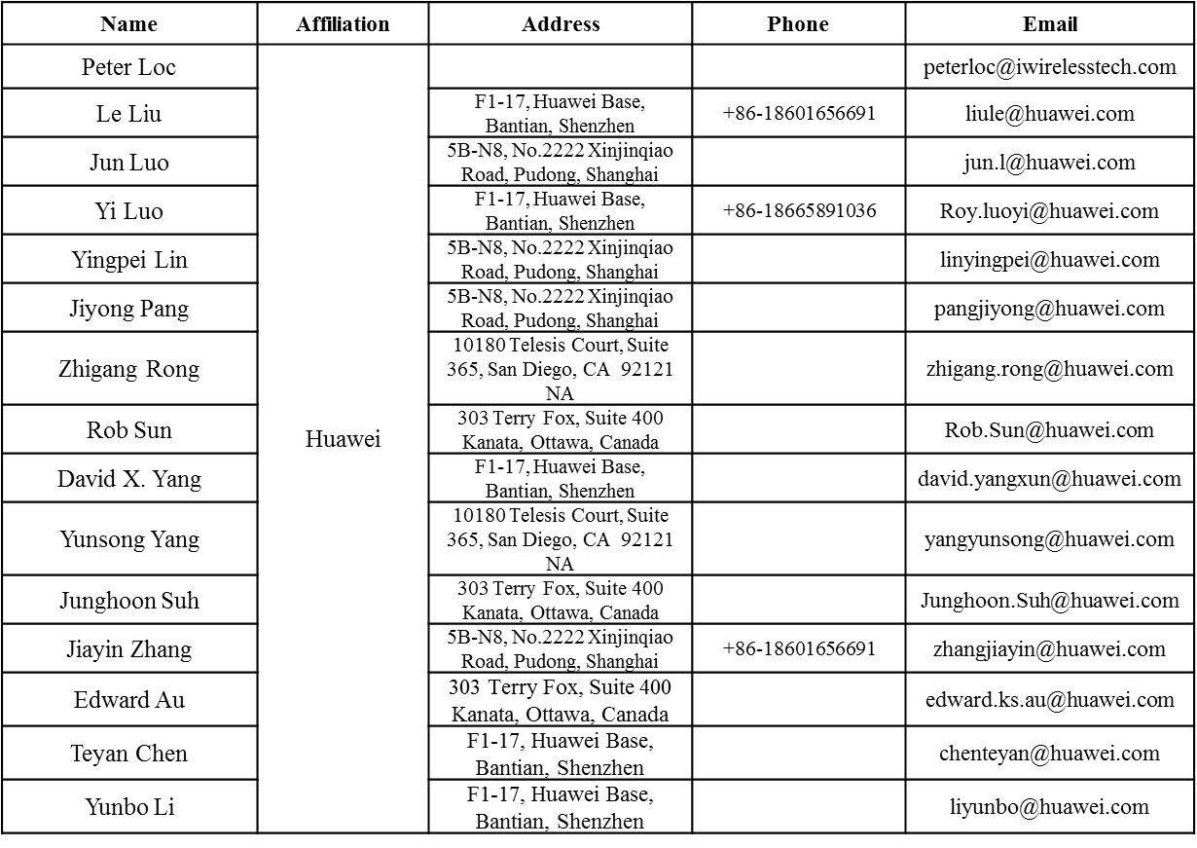
Authors (continued)
Chittabrata Ghosh, Intel

Slide 7
Authors (continued)
Name | Affiliation | Address | Phone | Email
Jinmin Kim | LG Electronics | 19, Yangjae-daero 11gil, Seocho-gu, Seoul 137-130, Korea |  | Jinmin1230.kim@lge.com
Kiseon Ryu |  |  |  | kiseon.ryu@lge.com
Jinyoung Chun |  |  |  | jiny.chun@lge.com
Jinsoo Choi |  |  |  | js.choi@lge.com
Jeongki Kim |  |  |  | jeongki.kim@lge.com
Dongguk Lim |  |  |  | dongguk.lim@lge.com
Suhwook Kim |  |  |  | suhwook.kim@lge.com
Eunsung Park |  |  |  | esung.park@lge.com
JayH Park |  |  |  | Hyunh.park@lge.com
HanGyu Cho |  |  |  | hg.cho@lge.com
Bo Sun | ZTE | #9 Wuxingduan, Xifeng Rd., Xi'an, China |  | sun.bo1@zte.com.cn
Kaiying Lv |  |  |  | lv.kaiying@zte.com.cn
Yonggang Fang |  |  |  | yfang@ztetx.com
Ke Yao |  |  |  | yao.ke5@zte.com.cn
Weimin Xing |  |  |  | xing.weimin@zte.com.cn
Brian Hart | Cisco Systems | 170 W Tasman Dr, San Jose, CA 95134 |  | brianh@cisco.com
Pooya Monajemi |  |  |  | pmonajem@cisco.com
Chittabrata Ghosh, Intel

Slide 8
Authors (continued)
Name | Affiliation | Address | Phone | Email
Fei Tong | Samsung | Innovation Park, Cambridge CB4 0DS (U.K.) | +44 1223 434633 | f.tong@samsung.com
Hyunjeong Kang |  | Maetan 3-dong; Yongtong-Gu Suwon; South Korea | +82-31-279-9028 | hyunjeong.kang@samsung.com
Kaushik Josiam |  | 1301, E. Lookout Dr, Richardson TX 75070 | (972) 761 7437 | k.josiam@samsung.com
Mark Rison |  | Innovation Park, Cambridge CB4 0DS (U.K.) | +44 1223 434600 | m.rison@samsung.com
Rakesh Taori |  | 1301, E. Lookout Dr, Richardson TX 75070 | (972) 761 7470 | rakesh.taori@samsung.com
Sanghyun Chang |  | Maetan 3-dong; Yongtong-Gu Suwon; South Korea | +82-10-8864-1751 | s29.chang@samsung.com
Yasushi Takatori | NTT | 1-1 Hikari-no-oka, Yokosuka, Kanagawa 239-0847 Japan | +81 46 859 3135 | takatori.yasushi@lab.ntt.co.jp
Yasuhiko Inoue |  |  | +81 46 859 5097 | inoue.yasuhiko@lab.ntt.co.jp
Shoko Shinohara |  |  | +81 46 859 5107 | Shinohara.shoko@lab.ntt.co.jp
Yusuke Asai |  |  | +81 46 859 3494 | asai.yusuke@lab.ntt.co.jp
Koichi Ishihara |  |  | +81 46 859 4233 | ishihara.koichi@lab.ntt.co.jp
Junichi Iwatani |  |  | +81 46 859 4222 | Iwatani.junichi@lab.ntt.co.jp
Akira Yamada | NTT DOCOMO | 3-6, Hikarinooka, Yokosuka-shi, Kanagawa, 239-8536, Japan | +81 46 840 3759 | yamadaakira@nttdocomo.com
Chittabrata Ghosh, Intel

Slide 9
Authors (continued)
May 2016
Name | Affiliation | Address | Phone | Email
Masahito Mori | Sony Corp. |  |  | Masahito.Mori@jp.sony.com
Yusuke Tanaka |  |  |  | YusukeC.Tanaka@jp.sony.com
Yuichi Morioka |  |  |  | Yuichi.Morioka@jp.sony.com
Kazuyuki Sakoda |  |  |  | Kazuyuki.Sakoda@am.sony.com
William Carney |  |  |  | William.Carney@am.sony.com
Narendar Madhavan | Toshiba |  |  | narendar.madhavan@toshiba.co.jp
Masahiro Sekiya
Toshihisa Nabetani
Tsuguhide Aoki
Tomoko Adachi
Kentaro Taniguchi
Daisuke Taki
Koji Horisaki
David Halls
Filippo Tosato
Zubeir Bocus
Chittabrata Ghosh, Intel

Slide 10
Authors (continued)
May 2016
Minho Cheong | Newracom, Inc. | 9008 Research Dr, Irvine, CA 92618 | +1-949-390-7146 | minho.cheong@newracom.com
Reza Hedayat |  |  |  | reza.hedayat@newracom.com
Young Hoon Kwon |  |  |  | younghoon.kwon@newracom.com
Yongho Seok |  |  |  | yongho.seok@newracom.com
Daewon Lee |  |  |  | daewon.lee@newracom.com
Yujin Noh |  |  |  | yujin.noh@newracom.com
Sigurd Schelstraete | Quantenna | 3450 W. Warren Ave, Fremont, CA 94538 |  | Sigurd@quantenna.com
Huizhao Wang |  |  |  | hwang@quanetnna.com
Chittabrata Ghosh, Intel

Slide 11
Abstract
IEEE SFD currently has the following text on the limitation of the number of TIDs at the originator:
  The recipient indicates the maximum number of TIDs of the MPDUs values that the originator can aggregate in a multi-TID A-MPDU in MU PPDU
In this contribution, we discuss about the signaling of multi-TID aggregation limit provided by the recipient (AP in this contribution)
We also discuss about the aggregation rule of MPDUs in multi-TID A-MPDUs within Trigger-based PPDU at the originator (STA in this contribution)
Chittabrata Ghosh, Intel

Slide 12
Proposal on Multi-TID Aggregation Limit Signaling
Signaling the number of TIDs from which MPDUs are aggregated can either be in Trigger frame or can be negotiated
Signaling the TID aggregation limit in Trigger frame
  Dynamic changes in the limit based on partial state operation of AP
    Adaptive based on network condition (for example, network congestion) or buffer status report from STAs
    AP in partial state [1] operation has flexibility of changing the limit indicated in current Trigger frame and change the limit over the following cascaded Trigger frames
Negotiation of the TID aggregation limit
  Currently D0.1 has 1 bit for multi-TID support in HE Capabilities IE
  HE Capabilities IE may also indicate the TID aggregation limit
In this contribution, we propose to indicate the TID aggregation limit in the basic variant Trigger frame
[1] C. Ghosh (Intel) et. al., 11-16/0362r1 Multi-TID Aggregation Limit

Slide 13
Proposal on Multi-TID Aggregation Limit in Per User Info Field of Basic Variant Trigger Frame
May 2016
User Identifier
RU Allocation
Coding Type
MCS
DCM
SS Allocation
Trigger Dependent
Per User Info
TID Aggregation Limit
TBD
Bits 3 TBD
Propose to indicate the aggregation limit of multiple TIDs in the Per User Info field of a basic variant Trigger frame
  The TID Aggregation Limit sub-field is in the Trigger-dependent Per User Info sub-field
Value in TID Aggregation Limit sub-field indicates the number of TIDs from which MPDUs are aggregated in a multi-TID A-MPDU carried in the responding Trigger-based PPDU
  The TID (=15) for Management frames is not included in the value of TID aggregation limit signaled by the AP
Chittabrata Ghosh, Intel

Slide 14
Multi-TID Aggregation by STA based on Signaling of TID Aggregation Limit
May 2016
If the multi-TID support bit in HE Capabilities IE is set to 1, a STA aggregates MPDUs from multiple TIDs in a multi-TID A-MPDU carried in the responding Trigger-based PPDU
The responding STA shall not aggregate MPDUs in the multi-TID A-MPDU with a number of TIDs that exceeds the value indicated in the TID Aggregation Limit sub-field intended to it
Chittabrata Ghosh, Intel

Slide 15
Conclusions
We have proposed the signaling of the limit on the number of TIDs from which MPDUs are aggregated by a STA in a Trigger-based PPDU
We have also proposed the multi-TID aggregation rule for the STA in a multi-TID A-MPDU carried in the responding Trigger-based PPDU
Chittabrata Ghosh, Intel

Slide 16
Straw poll
Do you support that the basic variant Trigger frame shall contain the TID Aggregation Limit subfield in the Trigger Dependent Per User Info field that indicates the limit of the number of TIDs that can be aggregated by a STA in a multi-TID A-MPDU carried in the responding Trigger-based PPDU?
      The responding STA shall not aggregate QoS Data frames in the multi-TID A-MPDU with a number of TIDs that exceeds the value indicated in the TID Aggregation Limit sub-field intended to it
Chittabrata Ghosh, Intel

