Slide 1
On 1024QAM Modulation
Date: 2016-05-11
Authors:
Name | Affiliation | Address | Phone | Email
Shengquan Hu | Mediatek | 2860 Junction Ave, San Jose, CA 95134, USA | +1-408-526-1899 | Shengquan.hu@mediatek.com
Jianhan Liu |  | 2860 Junction Ave, San Jose, CA 95134, USA | +1-408-526-1899 | jianhan.Liu@mediatek.com
Thomas Pare |  |  |  | thomas.pare@mediatek.com
ChaoChun Wang |  |  |  | chaochun.wang@mediatek.com
James Wang |  |  |  | james.wang@mediatek.com
Tianyu Wu |  |  |  | tianyu.wu@mediatek.com
Russell Huang |  |  |  | russell.huang@mediatek.com
James Yee |  | No. 1 Dusing 1st Road, Hsinchu, Taiwan | +886-3-567-0766 | james.yee@mediatek.com
Frank Hsu |  |  |  | frank.hsu@mediatek.com

Slide 2
Authors (continued)
Name | Affiliation | Address | Phone | Email
David X. Yang | Huawei | F1-17, Huawei Base, Bantian, Shenzhen |  | david.yangxun@huawei.com
Jiayin Zhang |  | 5B-N8, No.2222 Xinjinqiao Road, Pudong, Shanghai | +86-18601656691 | zhangjiayin@huawei.com
Jun Luo |  | 5B-N8, No.2222 Xinjinqiao Road, Pudong, Shanghai |  | jun.l@huawei.com
Yi Luo |  | F1-17, Huawei Base, Bantian, Shenzhen | +86-18665891036 | Roy.luoyi@huawei.com
Yingpei Lin |  | 5B-N8, No.2222 Xinjinqiao Road, Pudong, Shanghai |  | linyingpei@huawei.com
Jiyong Pang |  | 5B-N8, No.2222 Xinjinqiao Road, Pudong, Shanghai |  | pangjiyong@huawei.com
Zhigang Rong |  | 10180 Telesis Court, Suite 365, San Diego, CA 92121 NA |  | zhigang.rong@huawei.com
Jian Yu |  | F1-17, Huawei Base, Bantian, Shenzhen |  | ross.yujian@huawei.com
Ming Gan |  | F1-17, Huawei Base, Bantian, Shenzhen |  | ming.gan@huawei.com
Yuchen Guo |  | F1-17, Huawei Base, Bantian, Shenzhen |  | guoyuchen@huawei.com
Yunsong Yang |  | 10180 Telesis Court, Suite 365, San Diego, CA 92121 NA |  | yangyunsong@huawei.com
Junghoon Suh |  | 303 Terry Fox, Suite 400 Kanata, Ottawa, Canada |  | Junghoon.Suh@huawei.com
Peter Loc |  |  |  | peterloc@iwirelesstech.com
Edward Au |  | 303 Terry Fox, Suite 400 Kanata, Ottawa, Canada |  | edward.ks.au@huawei.com
Teyan Chen |  | F1-17, Huawei Base, Bantian, Shenzhen |  | chenteyan@huawei.com
Yunbo Li |  | F1-17, Huawei Base, Bantian, Shenzhen |  | liyunbo@huawei.com

Slide 3
Authors (continued)
Name | Affiliation | Address | Phone | Email
Alice Chen | Qualcomm | 5775 Morehouse Dr. San Diego, CA, USA |  | alicel@qti.qualcomm.com
Albert Van Zelst |  | Straatweg 66-S Breukelen, 3621 BR Netherlands |  | allert@qti.qualcomm.com
Alfred Asterjadhi |  | 5775 Morehouse Dr. San Diego, CA, USA |  | aasterja@qti.qualcomm.com
Bin Tian |  | 5775 Morehouse Dr. San Diego, CA, USA |  | btian@qti.qualcomm.com
Carlos Aldana |  | 1700 Technology Drive San Jose, CA 95110, USA |  | caldana@qca.qualcomm.com
George Cherian |  | 5775 Morehouse Dr. San Diego, CA, USA |  | gcherian@qti.qualcomm.com
Gwendolyn Barriac |  | 5775 Morehouse Dr. San Diego, CA, USA |  | gbarriac@qti.qualcomm.com
Hemanth Sampath |  | 5775 Morehouse Dr. San Diego, CA, USA |  | hsampath@qti.qualcomm.com
Lin Yang |  | 5775 Morehouse Dr. San Diego, CA, USA |  | linyang@qti.qualcomm.com
Lochan Verma |  | 5775 Morehouse Dr. San Diego, CA USA |  | lverma@qti.qualcomm.com
Menzo Wentink |  | Straatweg 66-S Breukelen, 3621 BR Netherlands |  | mwentink@qti.qualcomm.com
Naveen Kakani |  | 2100 Lakeside Boulevard Suite 475, Richardson TX 75082, USA |  | nkakani@qti.qualcomm.com
Raja Banerjea |  | 1060 Rincon Circle San Jose CA 95131, USA |  | rajab@qit.qualcomm.com
Richard Van Nee |  | Straatweg 66-S Breukelen, 3621 BR Netherlands |  | rvannee@qti.qualcomm.com

Slide 4
Authors (continued)
Name | Affiliation | Address | Phone | Email
Rolf De Vegt | Qualcomm | 1700 Technology Drive San Jose, CA 95110, USA |  | rolfv@qca.qualcomm.com
Sameer Vermani |  | 5775 Morehouse Dr. San Diego, CA, USA |  | svverman@qti.qualcomm.com
Simone Merlin |  | 5775 Morehouse Dr. San Diego, CA, USA |  | smerlin@qti.qualcomm.com
Tevfik Yucek |  | 1700 Technology Drive San Jose, CA 95110, USA |  | tyucek@qca.qualcomm.com
VK Jones |  | 1700 Technology Drive San Jose, CA 95110, USA |  | vkjones@qca.qualcomm.com
Youhan Kim |  | 1700 Technology Drive San Jose, CA 95110, USA |  | youhank@qca.qualcomm.com
Joonsuk Kim | Apple |  |  | joonsuk@apple.com
Aon Mujtaba |  |  |  | mujtaba@apple.com
Guoqing Li |  |  |  | guoqing_li@apple.com
Eric Wong |  |  |  | ericwong@apple.com
Chris Hartman |  |  |  | chartman@apple.com
Jarkko Kneckt |  |  |  | jkneckt@apple.com

Slide 5
Authors (continued)
Robert Stacey | Intel | 2111 NE 25th Ave, Hillsboro OR 97124, USA | +1-503-724-893 | robert.stacey@intel.com
Shahrnaz Azizi |  |  |  | shahrnaz.azizi@intel.com
Po-Kai Huang |  |  |  | po-kai.huang@intel.com
Qinghua Li |  |  |  | quinghua.li@intel.com
Xiaogang Chen |  |  |  | xiaogang.c.chen@intel.com
Chitto Ghosh |  |  |  | chittabrata.ghosh@intel.com
Laurent Cariou |  |  |  | laurent.cariou@intel.com
Yaron Alpert |  |  |  | yaron.alpert@intel.com
Assaf Gurevitz |  |  |  | assaf.gurevitz@intel.com
Ilan Sutskover |  |  |  | ilan.sutskover@intel.com
Ron Porat | Broadcom |  |  | rporat@broadcom.com
Sriram Venkateswaran
Matthew Fischer |  |  |  | mfischer@broadcom.com
Zhou Lan
Leo Montreuil
Andrew Blanksby
Vinko Erceg
Thomas Derham
Mingyue Ji

Slide 6
Authors (continued):
Name | Affiliation | Address | Phone | Email
Hongyuan Zhang | Marvell | 5488 Marvell Lane, Santa Clara, CA, 95054 | 408-222-2500 | hongyuan@marvell.com
Lei Wang |  |  |  | Leileiw@marvell.com
Liwen Chu |  |  |  | liwenchu@marvell.com
Jinjing Jiang |  |  |  | jinjing@marvell.com
Yan Zhang |  |  |  | yzhang@marvell.com
Rui Cao |  |  |  | ruicao@marvell.com
Sudhir Srinivasa |  |  |  | sudhirs@marvell.com
Bo Yu |  |  |  | boyu@marvell.com
Saga Tamhane |  |  |  | sagar@marvell.com
Mao Yu |  |  |  | my@marvel..com
Xiayu Zheng |  |  |  | xzheng@marvell.com
Christian Berger |  |  |  | crberger@marvell.com
Niranjan Grandhe |  |  |  | ngrandhe@marvell.com
Hui-Ling Lou |  |  |  | hlou@marvell.com

Slide 7
Authors (continued)
Name | Affiliation | Address | Phone | Email
Hyeyoung Choi | LG Electronics | 19, Yangjae-daero 11gil, Seocho-gu, Seoul 137-130, Korea |  | hy0117.choi@lge.com
Kiseon Ryu |  |  |  | kiseon.ryu@lge.com
Jinyoung Chun |  |  |  | jiny.chun@lge.com
Jinsoo Choi |  |  |  | js.choi@lge.com
Jeongki Kim |  |  |  | jeongki.kim@lge.com
Giwon Park |  |  |  | giwon.park@lge.com
Dongguk Lim |  |  |  | dongguk.lim@lge.com
Suhwook Kim |  |  |  | suhwook.kim@lge.com
Eunsung Park |  |  |  | esung.park@lge.com
HanGyu Cho |  |  |  | hg.cho@lge.com
Thomas Derham | Orange |  |  | thomas.derham@orange.com
Bo Sun | ZTE | #9 Wuxingduan, Xifeng Rd., Xi'an, China |  | sun.bo1@zte.com.cn
Kaiying Lv |  |  |  | lv.kaiying@zte.com.cn
Yonggang Fang |  |  |  | yfang@ztetx.com
Ke Yao |  |  |  | yao.ke5@zte.com.cn
Weimin Xing |  |  |  | xing.weimin@zte.com.cn
Brian Hart | Cisco Systems | 170 W Tasman Dr, San Jose, CA 95134 |  | brianh@cisco.com
Pooya Monajemi |  |  |  | pmonajem@cisco.com

Slide 8
Authors (continued)
Name | Affiliation | Address | Phone | Email
Fei Tong | Samsung | Innovation Park, Cambridge CB4 0DS (U.K.) | +44 1223 434633 | f.tong@samsung.com
Hyunjeong Kang |  | Maetan 3-dong; Yongtong-Gu Suwon; South Korea | +82-31-279-9028 | hyunjeong.kang@samsung.com
Kaushik Josiam |  | 1301, E. Lookout Dr, Richardson TX 75070 | (972) 761 7437 | k.josiam@samsung.com
Mark Rison |  | Innovation Park, Cambridge CB4 0DS (U.K.) | +44 1223 434600 | m.rison@samsung.com
Rakesh Taori |  | 1301, E. Lookout Dr, Richardson TX 75070 | (972) 761 7470 | rakesh.taori@samsung.com
Sanghyun Chang |  | Maetan 3-dong; Yongtong-Gu Suwon; South Korea | +82-10-8864-1751 | s29.chang@samsung.com
Yasushi Takatori | NTT | 1-1 Hikari-no-oka, Yokosuka, Kanagawa 239-0847 Japan | +81 46 859 3135 | takatori.yasushi@lab.ntt.co.jp
Yasuhiko Inoue |  |  | +81 46 859 5097 | inoue.yasuhiko@lab.ntt.co.jp
Shoko Shinohara |  |  | +81 46 859 5107 | Shinohara.shoko@lab.ntt.co.jp
Yusuke Asai |  |  | +81 46 859 3494 | asai.yusuke@lab.ntt.co.jp
Koichi Ishihara |  |  | +81 46 859 4233 | ishihara.koichi@lab.ntt.co.jp
Junichi Iwatani |  |  | +81 46 859 4222 | Iwatani.junichi@lab.ntt.co.jp
Akira Yamada | NTT DOCOMO | 3-6, Hikarinooka, Yokosuka-shi, Kanagawa, 239-8536, Japan | +81 46 840 3759 | yamadaakira@nttdocomo.com

Slide 9
Authors (continued)
Authors (continued)
Name | Affiliation | Address | Phone | Email
Masahito Mori | Sony Corp. |  |  | Masahito.Mori@jp.sony.com
Yusuke Tanaka |  |  |  | YusukeC.Tanaka@jp.sony.com
Yuichi Morioka |  |  |  | Yuichi.Morioka@jp.sony.com
Kazuyuki Sakoda |  |  |  | Kazuyuki.Sakoda@am.sony.com
William Carney |  |  |  | William.Carney@am.sony.com
Authors (continued)
Sigurd Schelstraete | Quantenna |  |  | Sigurd@quantenna.com
Huizhao Wang |  |  |  | hwang@quantenna.com
Minho Cheong | Newracom | 9008 Research Dr. Irvine, CA 92618 |  | minho.cheong@newracom.com
Reza Hedayat |  |  |  | reza.hedayat@newracom.com
Young Hoon Kwon |  |  |  | younghoon.kwon@newracom.com
Yongho Seok |  |  |  | yongho.seok@newracom.com
Daewon Lee |  |  |  | daewon.lee@newracom.com
Yujin Noh |  |  |  | yujin.noh@newracom.com

Slide 10
Authors (continued)

Slide 11
Introduction
1024QAM has been accepted as an optional modulation scheme in 11ax for MCS10 and MCS11
Non-uniform 1024QAM constellation scheme was proposed in [1] with claiming about 0.3dB performance gain comparing to uniform mapping
We compared the Uniform 1024QAM and Non-Uniform Modulations on performance and complexity and propose a Gray mapping based Uniform 1024QAM constellation mapping.

Slide 12
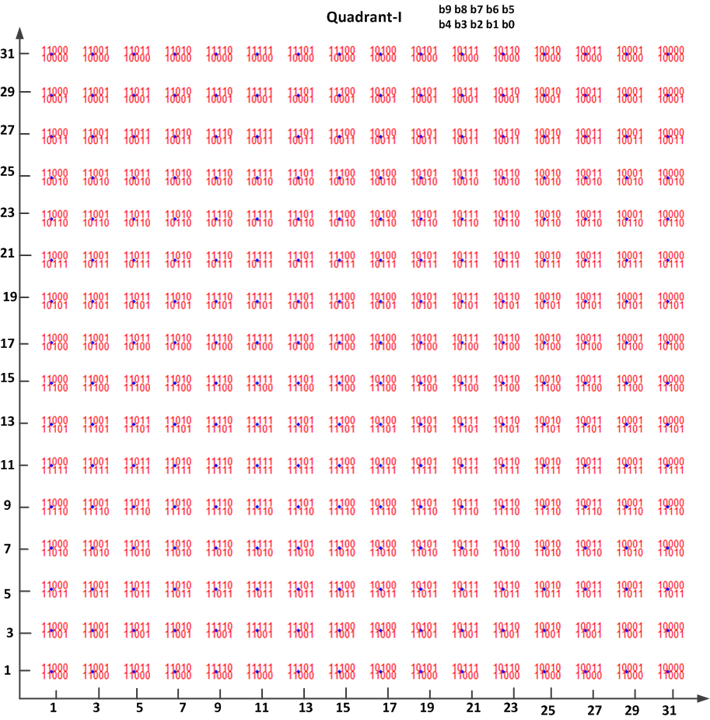
1024QAM Constellation Mapping Proposal: Quadrant-I

Slide 13
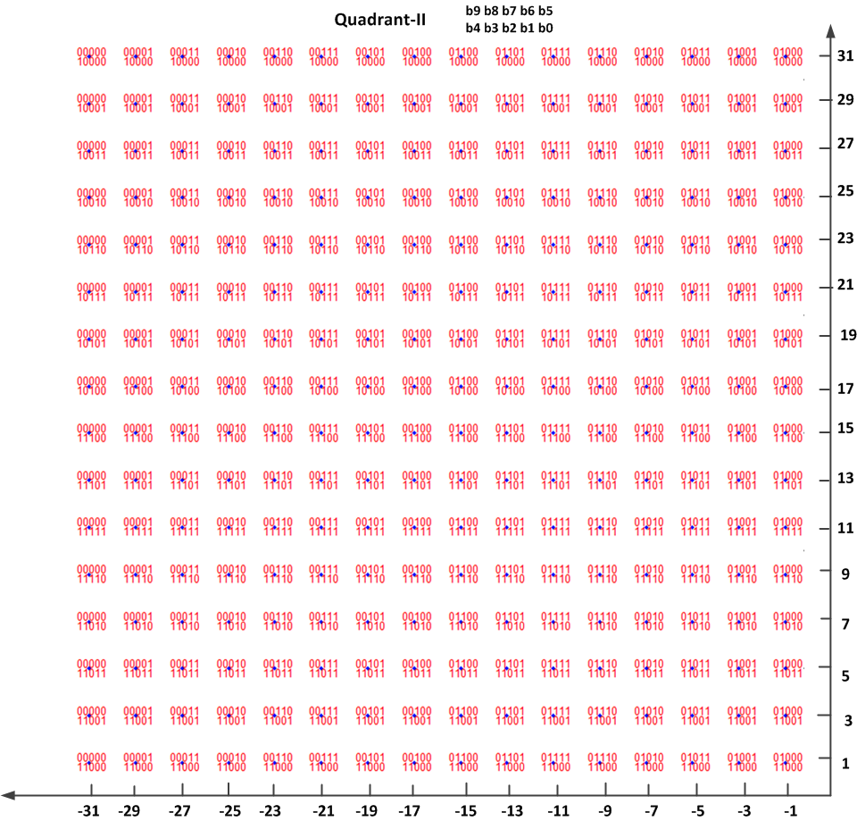
1024QAM Constellation Mapping Proposal: Quadrant-II

Slide 14
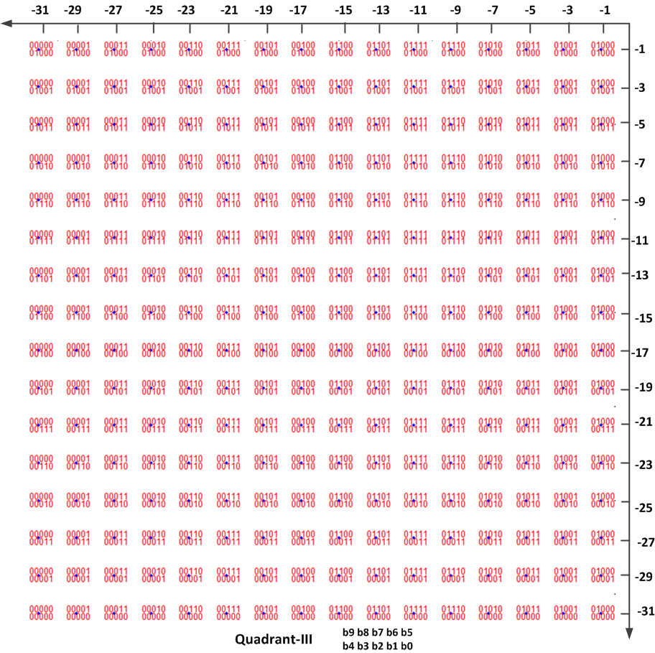
1024QAM Constellation Mapping Proposal: Quadrant-III

Slide 15
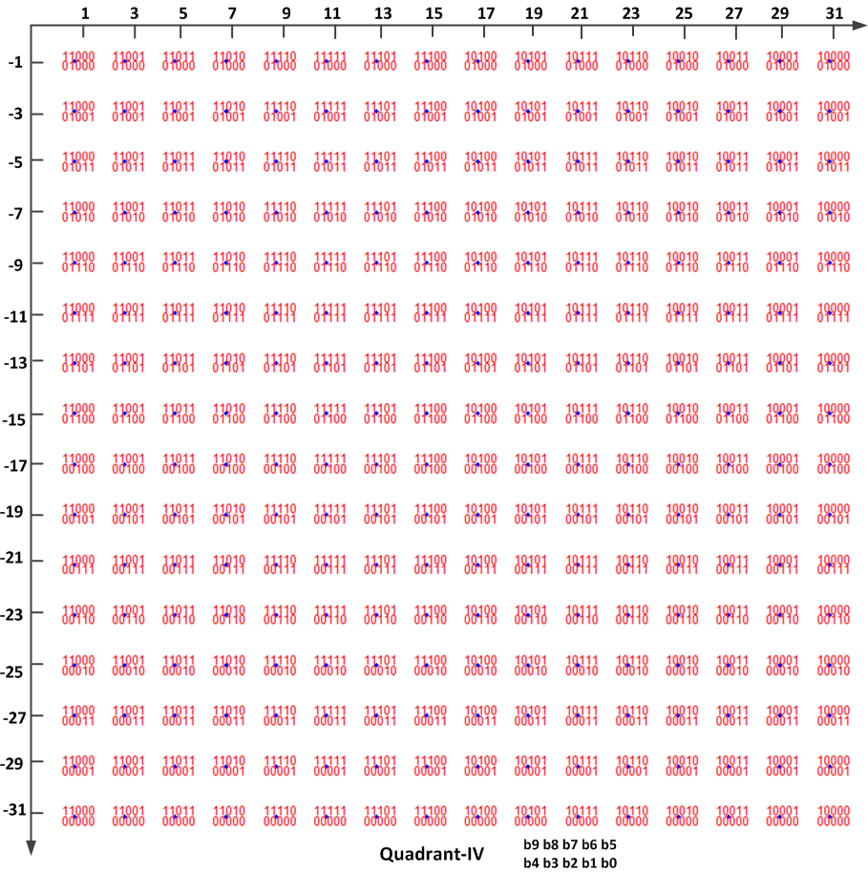
1024QAM Constellation Mapping Proposal: Quadrant-IV

Slide 16
Uniform V.S. Non-Uniform
IEEE 802.11a/n/ac use Uniform constellations for QPSK, 16QAM, 64QAM and 256QAM
  Some hardware can be re-used for Uniform 1024QAM
Uniform 1024QAM constellations have been adopted in Digital Subscriber Line (DSL) and Passive Optical Network (PON) standards.
Less complexity for uniform 1024QAM constellation.
The gain provided by Non-uniform constellation is not significant
  0.3dB gain is claimed in [1]
Uniform 1024QAM constellation is more suitable for ML demodulation using sphere decoder.

Slide 17
Normalization factor for 1024QAM
The normalization factor for 1024QAM is:
Reference codes for 1024QAM modulation:
SymShape = reshape(Data,BitsPerSC,Ndsc,NumSyms);
Kmod=1/sqrt(682);
table = [-31 -29 -25 -27 -17 -19 -23 -21 -1 -3 -7 -5 -15 -13 -9 -11 31 29 25 27 17 19 23 21 1 3 7 5 15 13 9 11]; % gray encoding
DataReal = squeeze(SymShape(1,:,:)*16 + SymShape(2,:,:)*8 + SymShape(3,:,:)*4+SymShape(4,:,:)*2+SymShape(5,:,:)) + 1;
DataImag = squeeze(SymShape(6,:,:)*16 + SymShape(7,:,:)*8 + SymShape(8,:,:)*4+SymShape(9,:,:)*2+SymShape(10,:,:)) + 1;
FDreal = table(DataReal);
FDimag = table(DataImag);
if NumSyms>1
FDdata = Kmod*(FDreal + j*FDimag).';
else
FDdata = Kmod*(FDreal + j*FDimag);
end

Slide 18
Simulation
2x2 MIMO
MCS-10 & MCS-11
BCC & LDPC
AWGN, D-NLOS, B-NLOS
Ideal CE
Packet length = 1000B; 500 runs

Slide 19
Uniform 1024QAM: ZF vs. MLD
MLD achieves more than 11dB gain than ZF for Uniform 1024QAM at 10%PER

Slide 20
Uniform vs. Non-Uniform
Simulation Condition |  |  |  | Performance Gain (dB) of NUC over UC
MCS | Channel | Nss | Phase-Noise (PN) | 10% PER
MCS10 | AWGN | 1 | off | 0.5
MCS10 | AWGN | 1 | on | 0.53
MCS10 | D-NLOS | 1 | off | 0.49
MCS10 | D-NLOS | 1 | on | 0.51
Simulation Condition |  |  |  | Performance Gain (dB) of NUC over UC
MCS | Channel | Nss | Phase-Noise (PN) | 10% PER
MCS10 | AWGN | 2 | off | 0.2
MCS10 | D-NLOS | 2 | off | 0.34
The gain provided by Non-uniform modulation is about 0.3dB in 2 spatial steams.
Without efficient MLD for non-uniform 1024QAM modulation, Non-Uniform 1024QAM
performs worse than Uniform 1024QAM with MLD.

Slide 21
Conclusion
We compared the performance of Non-Uniform and Uniform 1024QAM constellation.
We propose a Gray encoding based Uniform 1024QAM constellation mapping
  Uniform 1024QAM constellation is consistent with other QAM mapping used in 11n/ac/ax;
  Uniform 1024QAM constellation is well structured suitable for efficient implementation, especially for MLD;
  More Hardware reuse for Uniform 1024QAM constellation .

Slide 22
Straw Poll #1
Do you agree to add 11ax SFD that 1024QAM uses uniform constellation with Gray mapping?

Slide 23
Reference
[1] IEEE 802.11-15/1289r1, “Non-Uniform Constellations for 1024QAM”, Dana Ciochina, Sony.

