Slide 1
Regarding HE fragmentation
Date: 2016-05-17
Authors:

Slide 2
Abstract
In this contribution, we discuss the inefficiency of HE fragmentation rule in D0.1 spec
In order to reduce the redundancy of BA bitmap in acknowledging A-MPDUs containing fragmented MSDUs, we propose to define more specific indication mechanism for the fragmentation level of A-MPDU

Slide 3
Recap - D0.1 HE Fragmentation
25.3.3 Procedure at the receiver
Upon reception of a PSDU that carries one or more dynamic fragments, the receiver STA responds with:
A BlockAck frame when the received fragments, one or more fragments for each MSDU, are contained in an A-MPDU that solicits the immediate response and is sent by an HE STA whose HE Fragmentation Support subfield in its HE Capabilities element is 3
  The receiver STA shall follow the rules in 10.24.7.5 (Generation and transmission of BlockAck frames by an HT STA or DMG STA) for generating the BlockAck frame, except that the STA shall:
    Set to 1 the Fragment Number subfield in the Block Ack Starting Sequence Control subfield of the BlockAck frame

Slide 4
Inefficiency in D0.1 HE Fragmentation
Level 3 receiver shall respond with fragment-scaled BA bitmap if there’s a possibility that the received A-MPDU is a fragmentation level 3 A-MPDU
  Multiple fragments per MSDU in an A-MPDU
Any HE STAs are possible to transmit a level 3 A-MPDU as long as the receiver supports it
  The fragmentation support level is proposed to define the receiving capability of HE STAs
  The current spec regarding the fragmentation support level does not restrict the STAs’ behavior as an originator
The current spec may reads level 3 receiver has no option but to respond with fragment-scaled BA bitmap
  The receiver cannot make a decision of the fragmentation level of received A-MPDU always

Slide 5
Expected use case of dynamic fragmentation
Trigger
M-BA
…
Trigger
M-BA
HE TRIG
HE TRIG
STA1
MPDU
MPDU
…
F-MPDU
F-MPDU
MPDU
…
F-MPDU
SN = 1
FN = 0
MF = 0
SN = 2
FN = 0
MF = 0
SN = 5
FN = 0
MF = 1
SN = 5
FN = 1
MF = 0
SN = 6
FN = 0
MF = 0
SN = 10
FN = 0
MF = 1
Dynamic fragmentation is proposed to reduce the amount of padding upon constructing A-MPDU in UL MU [1]
  When the remaining size of allowed PPDU is smaller than the size of the next MSDU, the originator may transmit a fragmented MSDU at the end of the A-MPDU (SN = x, FN = 0, MF = 1) → (x, 0, 1)
  In the next TXOP, the remaining fragmented MSDU (x, 1, 0) will be transmitted with the succeeding MSDUs
  If such situation continues, a number of A-MPDUs may consist of a number of un-fragmented MSDUs and one or two fragmented MSDUs with FN = 1
  In many cases, it is expected that the transmitting A-MPDU is a fragmentation level 2 A-MPDU
    The A-MPDU does not carry more than one MPDU for each MSDU
    The receiver is allowed to respond with sequence-scaled BA bitmap

Slide 6
Expected use case of dynamic fragmentation
Sequence-scaled
BA bitmap
…
F-MPDU
…
MPDU
…
MPDU
…
F-MPDU
(5,0,1)
(6,0,0)
(10,0,1)
Fragment-scaled
BA bitmap
(5,1,1)?
(5,1,0)?
(5,1,1), (5,2,0)
Other TID?
…
: essential bits in BA bitmap
In order for the receiver to respond with sequence-scaled BA bitmap, the receiver must be sure of the fragmentation level of the received A-MPDU
However, in case some MPDUs are lost, it is difficult for AP to decide the fragmentation level of the received A-MPDU
  There is no strict rules on SN upon constructing A-MPDU
  Multi TID A-MPDU is allowed
    It is possible the order of MPDUs with different TID can be mixed
It is redundant to respond with fragment-scaled BA bitmaps for fragmentation level 2 A-MPDUs
  75% of the bitmaps is wasted
  Increasing the duration of M-BA
Reducing the duration of M-BA is important
  M-BA duration may exceed EIFS
  Hard to estimate TXOP duration as the variance of M-BA duration increases

Slide 7
Computation of the redundancy of M-BA duration
How much of the duration of M-BA is wasted due to the redundancy of BA bitmaps?
Assumptions:
  (9, 18) STAs, 2 TIDs, MCS1
  (33, 66)% of the A-MPDUs are fragmentation level 2 A-MPDU responded with fragment-scaled BA bitmap
  (32, 64) MPDUs per A-MPDU

Slide 8
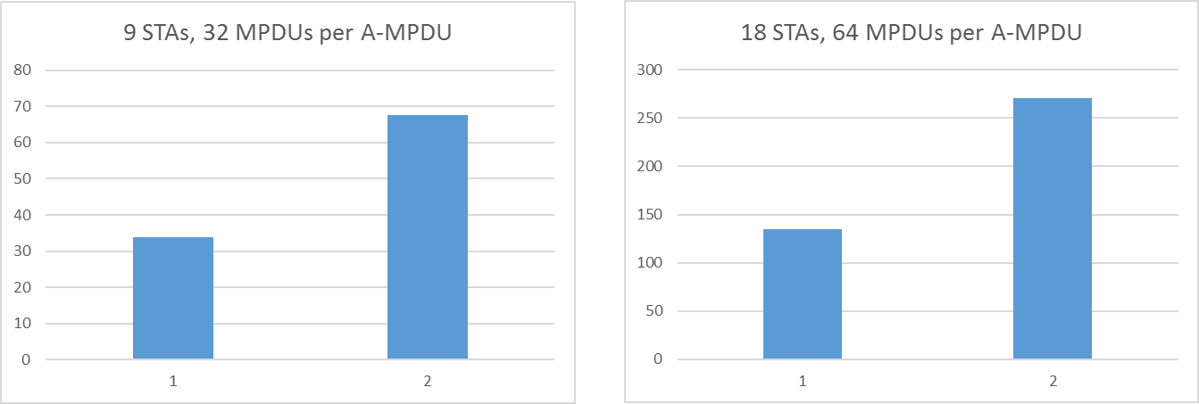
Computation of the redundancy of M-BA duration
68 (us)
270 (us)
34 (us)
135 (us)
(us)
33%
66%
(us)
33%
66%
Max. M-BA duration ≈ 181 (us)
590 (us)
34~68us (9 STAs, 32 MPDUs), 135~270us (18 STAs, 64 MPDUs) of M-BA duration can be wasted by the redundancy of BA bitmap
  X-axis shows the number of STAs having A-MPDU in an HE TRIG PPDU with ambiguous level
  Considering the max. M-BA duration, it may have a non-negligible overhead
In order to reduce the M-BA duration, it is necessary for receiver to be aware of the fragmentation level of the received A-MPDU
  Up to 16 MPDUs, 50% of BA bitmap size can be reduced (8 → 4 octets)
  From 17 to 64 MPDUs, 75% of BA bitmap size can be reduced [2]
  (16 → 4, 32 → 8 octets)

Slide 9
Possible approaches
The definite method is that the originator informs the fragmentation level of transmitting A-MPDU to the receiver
  The essential information is whether the A-MPDU contains multiple fragments of an MSDU or not
The receiver may limit the fragmentation level of receiving A-MPDUs
More specific indication methods on the fragmentation level of transmitting/receiving A-MPDUs is necessary

Slide 10
Conclusions
We have discussed the inefficiency of HE fragmentation in the current D0.1 spec.
The numerical results have shown that a non-negligible overhead might take place when acknowledging A-MPDUs with multiple fragments
More specific indication mechanism on the fragmentation level of A-MPDU is necessary in order to enhance the efficiency of HE fragmentation

Slide 11
Strawpoll
Do you support to add the following to the 11ax SFD:
  25.3.1 General
    The spec shall provide a mechanism that indicates the fragmentation level of A-MPDU

Slide 12
Reference
[1] 11-15-1102-00-00ax-fragmentation-with-mu-operation
[2] 11-16-0616-00-00ax-blockack-generation-and-selection-rules

