Slide 1
Left over Issues in RA Signaling for HE-SIGB
Date: 2016-05-16
Authors:
Name | Affiliation | Address | Phone | Email
Yan Zhang | Marvell | 5488 Marvell Lane, Santa Clara, CA, 95054 | 408-222-2500 | yzhang@marvell.com
Hongyuan Zhang |  |  |  | hongyuan@marvell.com
Lei Wang |  |  |  | Leileiw@marvell.com
Liwen Chu |  |  |  | liwenchu@marvell.com
Jinjing Jiang |  |  |  | jinjing@marvell.com
Rui Cao |  |  |  | ruicao@marvell.com
Sudhir Srinivasa |  |  |  | sudhirs@marvell.com
Bo Yu |  |  |  | boyu@marvell.com
Saga Tamhane |  |  |  | sagar@marvell.com
Mao Yu |  |  |  | my@marvel..com
Xiayu Zheng |  |  |  | xzheng@marvell.com
Christian Berger |  |  |  | crberger@marvell.com
Niranjan Grandhe |  |  |  | ngrandhe@marvell.com
Hui-Ling Lou |  |  |  | hlou@marvell.com

Slide 2
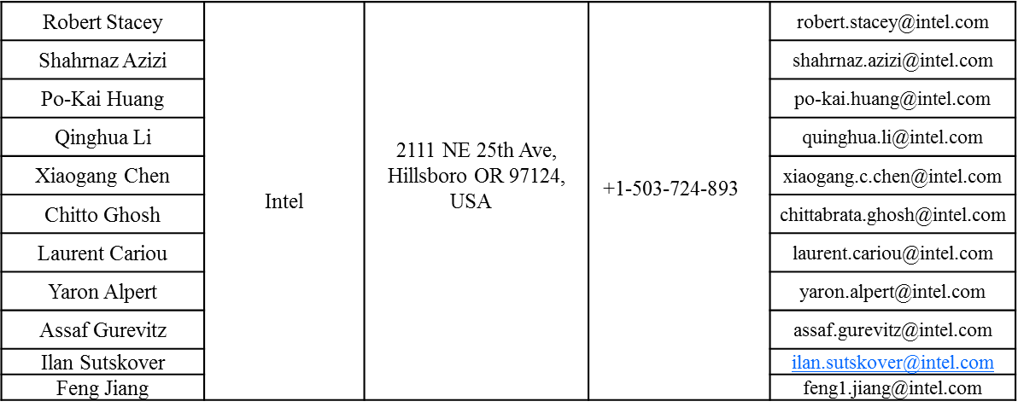
Authors (continued)
Name | Affiliation | Address | Phone | Email
Ron Porat | Broadcom |  |  | rporat@broadcom.com
Sriram Venkateswaran |  |  |  | mfischer@broadcom.com
Matthew Fischer
Zhou Lan
Leo Montreuil
Andrew Blanksby
Vinko Erceg

Slide 3
Authors (continued)
Name | Affiliation | Address | Phone | Email
Alice Chen | Qualcomm | 5775 Morehouse Dr. San Diego, CA, USA |  | alicel@qti.qualcomm.com
Albert Van Zelst |  | Straatweg 66-S Breukelen, 3621 BR Netherlands |  | allert@qti.qualcomm.com
Alfred Asterjadhi |  | 5775 Morehouse Dr. San Diego, CA, USA |  | aasterja@qti.qualcomm.com
Arjun Bharadwaj |  | 5775 Morehouse Dr. San Diego, CA, USA |  | arjunb@qti.qualcomm.com
Bin Tian |  | 5775 Morehouse Dr. San Diego, CA, USA |  | btian@qti.qualcomm.com
Carlos Aldana |  | 1700 Technology Drive San Jose, CA 95110, USA |  | caldana@qca.qualcomm.com
George Cherian |  | 5775 Morehouse Dr. San Diego, CA, USA |  | gcherian@qti.qualcomm.com
Gwendolyn Barriac |  | 5775 Morehouse Dr. San Diego, CA, USA |  | gbarriac@qti.qualcomm.com
Hemanth Sampath |  | 5775 Morehouse Dr. San Diego, CA, USA |  | hsampath@qti.qualcomm.com
Lin Yang |  | 5775 Morehouse Dr. San Diego, CA, USA |  | linyang@qti.qualcomm.com
Menzo Wentink |  | Straatweg 66-S Breukelen, 3621 BR Netherlands |  | mwentink@qti.qualcomm.com
Naveen Kakani |  | 2100 Lakeside Boulevard Suite 475, Richardson TX 75082, USA |  | nkakani@qti.qualcomm.com
Raja Banerjea |  | 1060 Rincon Circle San Jose CA 95131, USA |  | rajab@qit.qualcomm.com
Richard Van Nee |  | Straatweg 66-S Breukelen, 3621 BR Netherlands |  | rvannee@qti.qualcomm.com

Slide 4
Authors (continued)
Name | Affiliation | Address | Phone | Email
Rolf De Vegt | Qualcomm | 1700 Technology Drive San Jose, CA 95110, USA |  | rolfv@qca.qualcomm.com
Sameer Vermani |  | 5775 Morehouse Dr. San Diego, CA, USA |  | svverman@qti.qualcomm.com
Simone Merlin |  | 5775 Morehouse Dr. San Diego, CA, USA |  | smerlin@qti.qualcomm.com
Tao Tian |  | 5775 Morehouse Dr. San Diego, CA, USA |  | ttian@qti.qualcomm.com
Tevfik Yucek |  | 1700 Technology Drive San Jose, CA 95110, USA |  | tyucek@qca.qualcomm.com
VK Jones |  | 1700 Technology Drive San Jose, CA 95110, USA |  | vkjones@qca.qualcomm.com
Youhan Kim |  | 1700 Technology Drive San Jose, CA 95110, USA |  | youhank@qca.qualcomm.com

Slide 5
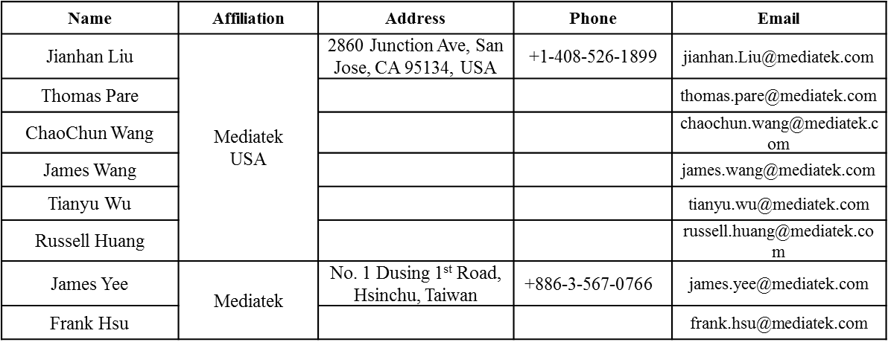
Authors (continued)

Slide 6
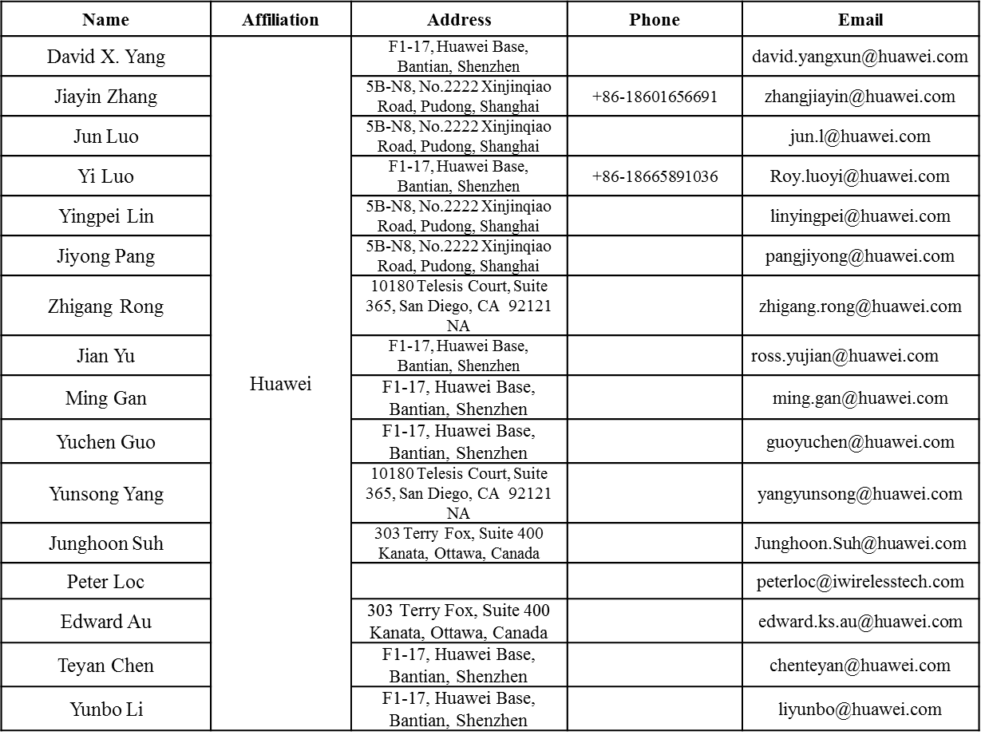
Authors (continued)

Slide 7
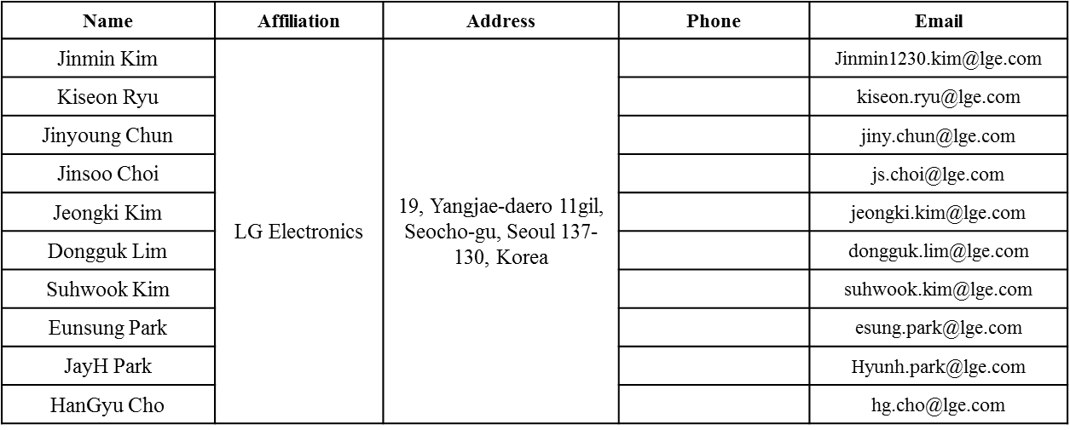
Authors (continued)
Bo Sun | ZTE | #9 Wuxingduan, Xifeng Rd., Xi'an, China |  | sun.bo1@zte.com.cn
Kaiying Lv |  |  |  | lv.kaiying@zte.com.cn
Yonggang Fang |  |  |  | yfang@ztetx.com
Ke Yao |  |  |  | yao.ke5@zte.com.cn
Weimin Xing |  |  |  | xing.weimin@zte.com.cn
Brian Hart | Cisco Systems | 170 W Tasman Dr, San Jose, CA 95134 |  | brianh@cisco.com
Pooya Monajemi |  |  |  | pmonajem@cisco.com

Slide 8
Authors (continued)
Name | Affiliation | Address | Phone | Email
Fei Tong | Samsung | Innovation Park, Cambridge CB4 0DS (U.K.) | +44 1223 434633 | f.tong@samsung.com
Hyunjeong Kang |  | Maetan 3-dong; Yongtong-Gu Suwon; South Korea | +82-31-279-9028 | hyunjeong.kang@samsung.com
Kaushik Josiam |  | 1301, E. Lookout Dr, Richardson TX 75070 | (972) 761 7437 | k.josiam@samsung.com
Mark Rison |  | Innovation Park, Cambridge CB4 0DS (U.K.) | +44 1223 434600 | m.rison@samsung.com
Rakesh Taori |  | 1301, E. Lookout Dr, Richardson TX 75070 | (972) 761 7470 | rakesh.taori@samsung.com
Sanghyun Chang |  | Maetan 3-dong; Yongtong-Gu Suwon; South Korea | +82-10-8864-1751 | s29.chang@samsung.com
Yasushi Takatori | NTT | 1-1 Hikari-no-oka, Yokosuka, Kanagawa 239-0847 Japan | +81 46 859 3135 | takatori.yasushi@lab.ntt.co.jp
Yasuhiko Inoue |  |  | +81 46 859 5097 | inoue.yasuhiko@lab.ntt.co.jp
Shoko Shinohara |  |  | +81 46 859 5107 | Shinohara.shoko@lab.ntt.co.jp
Yusuke Asai |  |  | +81 46 859 3494 | asai.yusuke@lab.ntt.co.jp
Koichi Ishihara |  |  | +81 46 859 4233 | ishihara.koichi@lab.ntt.co.jp
Junichi Iwatani |  |  | +81 46 859 4222 | Iwatani.junichi@lab.ntt.co.jp
Akira Yamada | NTT DOCOMO | 3-6, Hikarinooka, Yokosuka-shi, Kanagawa, 239-8536, Japan | +81 46 840 3759 | yamadaakira@nttdocomo.com

Slide 9
Authors (continued)
Name | Affiliation | Address | Phone | Email
Masahito Mori | Sony Corp. |  |  | Masahito.Mori@jp.sony.com
Yusuke Tanaka |  |  |  | YusukeC.Tanaka@jp.sony.com
Yuichi Morioka |  |  |  | Yuichi.Morioka@jp.sony.com
Kazuyuki Sakoda |  |  |  | Kazuyuki.Sakoda@am.sony.com
William Carney |  |  |  | William.Carney@am.sony.com
Sigurd Schelstraete | Quantenna |  |  | Sigurd@quantenna.com
Huizhao Wang |  |  |  | hwang@quantenna.com
Minho Cheong | Newracom | 9008 Research Dr. Irvine, CA 92618 |  | minho.cheong@newracom.com
Reza Hedayat |  |  |  | reza.hedayat@newracom.com
Young Hoon Kwon |  |  |  | younghoon.kwon@newracom.com
Yongho Seok |  |  |  | yongho.seok@newracom.com
Daewon Lee |  |  |  | daewon.lee@newracom.com
Yujin Noh |  |  |  | yujin.noh@newracom.com

Slide 11
Overview
Table 4 - Arrangement and number of MU-MIMO allocations
8 bits indices | #1 | #2 | #3 | #4 | #5 | #6 | #7 | #8 | #9 | Num of entries
000 00000 | 26 | 26 | 26 | 26 | 26 | 26 | 26 | 26 | 26 | 1
000 00001 | 26 | 26 | 26 | 26 | 26 | 26 | 26 | 52 |  | 1
000 00010 | 26 | 26 | 26 | 26 | 26 | 52 |  | 26 | 26 | 1
000 00011 | 26 | 26 | 26 | 26 | 26 | 52 |  | 52 |  | 1
000 00100 | 26 | 26 | 52 |  | 26 | 26 | 26 | 26 | 26 | 1
000 00101 | 26 | 26 | 52 |  | 26 | 26 | 26 | 52 |  | 1
000 00110 | 26 | 26 | 52 |  | 26 | 52 |  | 26 | 26 | 1
000 00111 | 26 | 26 | 52 |  | 26 | 52 |  | 52 |  | 1
000 01000 | 52 |  | 26 | 26 | 26 | 26 | 26 | 26 | 26 | 1
000 01001 | 52 |  | 26 | 26 | 26 | 26 | 26 | 52 |  | 1
000 01010 | 52 |  | 26 | 26 | 26 | 52 |  | 26 | 26 | 1
000 01011 | 52 |  | 26 | 26 | 26 | 52 |  | 52 |  | 1
000 01100 | 52 |  | 52 |  | 26 | 26 | 26 | 26 | 26 | 1
000 01101 | 52 |  | 52 |  | 26 | 26 | 26 | 52 |  | 1
000 01110 | 52 |  | 52 |  | 26 | 52 |  | 26 | 26 | 1
000 01111 | 52 |  | 52 |  | 26 | 52 |  | 52 |  | 1
000 1xxxx | Definition TBD |  |  |  |  |  |  |  |  | 16
001 00yyy | 26 | 26 | 26 | 26 | 26 | 106 |  |  |  | 8
001 01yyy | 26 | 26 | 52 |  | 26 | 106 |  |  |  | 8
001 10yyy | 52 |  | 26 | 26 | 26 | 106 |  |  |  | 8
001 11yyy | 52 |  | 52 |  | 26 | 106 |  |  |  | 8
010 00yyy | 106 |  |  |  | 26 | 26 | 26 | 26 | 26 | 8
010 01yyy | 106 |  |  |  | 26 | 26 | 26 | 52 |  | 8
010 10yyy | 106 |  |  |  | 26 | 52 |  | 26 | 26 | 8
010 11yyy | 106 |  |  |  | 26 | 52 |  | 52 |  | 8
011 xxxxx | Definition TBD |  |  |  |  |  |  |  |  | 32
10 yyy yyy | 106 |  |  |  | 26 | 106 |  |  |  | 64
11 0 00yyy | 242 |  |  |  |  |  |  |  |  | 8
11 0 01yyy | 484 |  |  |  |  |  |  |  |  | 8
11 0 10yyy | 996 |  |  |  |  |  |  |  |  | 8
11 0 11yyy | 2*996 |  |  |  |  |  |  |  |  | 8
11 1xxxxx | Definition TBD |  |  |  |  |  |  |  |  | 32
The RA signaling table has been agreed in [1] to cover all full allocations.
There are 16+32+32 = 80 “Definition TBD” entries in the table.
Those entries can represent some most frequently used partial bandwidth allocations.
Additionally, center 26-tone RU for 80/160MHz BW is not included in the 8-bit table.
Center 26-tone RU for each 80MHz is not included in any 242-tone RU.
Need to signal whether the center 26-tone RU has been allocated or not.

Slide 12
Partial Bandwidth Allocation
Partial bandwidth allocation includes both empty allocation (no user is scheduled for a 242-tone RU), or partially allocated BW per 20MHz channel.
It is impossible to cover all partial allocated RU combinations by 8bit table (need at least 11bit table).
Focus on only 1 unallocated RU in the discussion.
If there are more than 1 unallocated RUs, we can always use “dummy STA ID” for user info signaling in HESIGB user fields.

Slide 13
Case 1: Empty Allocation
Non-contiguous channel bonding,
There is no user to signal in a punctured 242-tone RU.
It is essential to add an entry corresponding to zero users in this 242-tone RU, instead of using a “dummy STA ID” in user field to save some overhead.

Slide 14
Case 2: Partial Allocations with Only Large RUs Allocated
There is no 26-tone RU allocated within each 20MHz channel
Most frequent partial allocations cases are the ones where center 26-tone RU is not allocated.
There are total “1 (52+52) + 64 (106+106) + 8 (52+52+106) + 8 (106+52+52) = 81” combinations.
Given the number of available entries in the table, we can limit the number of spatially multiplexed users to 4 in each 106-tone RU for the 106+106 case.
Still some entries are left for other purposes.
52
52
52
52
106
106
52
52
106
106
52
52

Slide 15
Center 26-tone RU for 80/160MHz
Use 1 bit to indicate if the center 26-tone RU is allocated for each 80MHz. (2 bits if 160MHz or 80+80MHz).
Negligible overhead added, save “dummy STA” user info overhead in user fields
For full BW 80MHz, add 1 bit indication of the same value in the common block fields of both SIGB content channels.
For full BW160MHz, add 1 bit indication, corresponding to one individual 80MHz, in common block fields of both SIGB content channels.

Slide 16
Proposed Changes to RA Signaling
Table 4 - Arrangement and number of MU-MIMO allocations
Propose to replace 36 “Definition TBD” entries with the highlighted entries highlighted in Table 4 in 11ax SFD 3.2.5 HE-SIG-B sub-clause to indicate most frequently used partial bandwidth allocations.
‘zz’ = 00~11 indicates number of spatially multiplexed STAs for 106-tone RU in partial bandwidth allocations.
8 bits indices | #1 | #2 | #3 | #4 | #5 | #6 | #7 | #8 | #9 | Num of entries
000 0 0000 | 26 | 26 | 26 | 26 | 26 | 26 | 26 | 26 | 26 | 1
000 0 0001 | 26 | 26 | 26 | 26 | 26 | 26 | 26 | 52 |  | 1
000 0 0010 | 26 | 26 | 26 | 26 | 26 | 52 |  | 26 | 26 | 1
000 0 0011 | 26 | 26 | 26 | 26 | 26 | 52 |  | 52 |  | 1
000 0 0100 | 26 | 26 | 52 |  | 26 | 26 | 26 | 26 | 26 | 1
000 0 0101 | 26 | 26 | 52 |  | 26 | 26 | 26 | 52 |  | 1
000 0 0110 | 26 | 26 | 52 |  | 26 | 52 |  | 26 | 26 | 1
000 0 0111 | 26 | 26 | 52 |  | 26 | 52 |  | 52 |  | 1
000 0 1000 | 52 |  | 26 | 26 | 26 | 26 | 26 | 26 | 26 | 1
000 0 1001 | 52 |  | 26 | 26 | 26 | 26 | 26 | 52 |  | 1
000 0 1010 | 52 |  | 26 | 26 | 26 | 52 |  | 26 | 26 | 1
000 0 1011 | 52 |  | 26 | 26 | 26 | 52 |  | 52 |  | 1
000 0 1100 | 52 |  | 52 |  | 26 | 26 | 26 | 26 | 26 | 1
000 0 1101 | 52 |  | 52 |  | 26 | 26 | 26 | 52 |  | 1
000 0 1110 | 52 |  | 52 |  | 26 | 52 |  | 26 | 26 | 1
000 0 1111 | 52 |  | 52 |  | 26 | 52 |  | 52 |  | 1
000 1 0yyy | 52 |  | 52 |  | - | 106 |  |  |  | 8
0001 1yyy | 106 |  |  |  | - | 52 |  | 52 |  | 8
00100 yyy | 26 | 26 | 26 | 26 | 26 | 106 |  |  |  | 8
00101 yyy | 26 | 26 | 52 |  | 26 | 106 |  |  |  | 8
00110 yyy | 52 |  | 26 | 26 | 26 | 106 |  |  |  | 8
00111 yyy | 52 |  | 52 |  | 26 | 106 |  |  |  | 8
01000 yyy | 106 |  |  |  | 26 | 26 | 26 | 26 | 26 | 8
01001 yyy | 106 |  |  |  | 26 | 26 | 26 | 52 |  | 8
01010 yyy | 106 |  |  |  | 26 | 52 |  | 26 | 26 | 8
01011 yyy | 106 |  |  |  | 26 | 52 |  | 52 |  | 8
0110 zzzz | 106 |  |  |  | - | 106 |  |  |  | 16
0111 0000 | 52 |  | 52 |  | - | 52 |  | 52 |  | 1
0111 0001 | 242-tone RU empty |  |  |  |  |  |  |  |  | 1
0111 0010 | 484-tone RU empty |  |  |  |  |  |  |  |  | 1
0111 0011 | 996-tone RU empty |  |  |  |  |  |  |  |  | 1
0111 01xx | Definition TBD |  |  |  |  |  |  |  |  | 4
0111 1xxx | Definition TBD |  |  |  |  |  |  |  |  | 8
10 yyy yyy | 106 |  |  |  | 26 | 106 |  |  |  | 64
11 0 00yyy | 242 |  |  |  |  |  |  |  |  | 8
11 0 01yyy | 484 |  |  |  |  |  |  |  |  | 8
11 0 10yyy | 996 |  |  |  |  |  |  |  |  | 8
11 0 11yyy | 2*996 |  |  |  |  |  |  |  |  | 8
11 1 xxxxx | Definition TBD |  |  |  |  |  |  |  |  | 32

Slide 17
Reference
[1] IEEE 802.11-15/1335r0 HE-SIG-B Contents

Slide 18
SP1
Do you support to add the following to the current SFD:
For full BW 80MHz, add 1 bit to indicate if center 26-tone RU is allocated in the common block fields of both SIGB content channels with same value.
For full BW160MHz, add 1 bit to indicate if center 26-tone RU is allocated for one individual 80MHz in common block fields of both SIGB content channels.

Slide 19
SP2
Do you support to use 36 “Definition TBD” entries in Table 4 in the current SFD 3.2.5 HE-SIG-B sub-clause to indicate most frequently used partial bandwidth allocations, as shown in slide 15?

