Slide 1
Performance Analysis of Robust Transmission Modes for MIMO in 11ay
Date: 2016-16-05
Authors:

Slide 2
Introduction
This presentation describes the results of performance analysis for MIMO robust transmission modes using MRC 1x2, Alamouti 2x1 and Alamouti 2x2 schemes.
OFDM and SC signal structure is proposed to support Alamouti signal processing, [1], [2].
The performance of OFDM and SC PHY is evaluated in frequency flat and frequency selective Rayleigh channel.
In case of OFDM PHY the performance of dual carrier SQPSK and QPSK modulations and regular BPSK and QPSK modulations providing the same data rate is compared.

Slide 3
Considered System Configurations
Configurations:
  MRC 1x2: 1 TX and 2 RX antennas;
  Alamouti 2x1: 2 TX and 1 RX antenna;
  Alamouti 2x2: 2 TX and 2 RX antennas;
Usage cases:
  STA -> AP MRC 1x2, AP -> STA Alamouti 2x1;
  STA -> AP, AP -> STA, Alamouti 2x2;

Slide 4
OFDM Subcarriers Mapping
For the regular modulation, the input pair of symbols (X_{k}, Y_{k}) is mapped to the k-th subcarrier for OFDM symbol #1 for spatial streams 1 and 2 (TX antennas #0 and #1).
The input pair is repeated with complex conjugation and sign inversion for Y_{k} as (-Y_{k}*, X_{k}*) and mapped to the k-th subcarrier for OFDM symbol #2 for spatial streams 1 and 2 (TX antennas #0 and #1).
Antenna #0
Antenna #1

Slide 5
OFDM Subcarriers Mapping for DCM
In case of the DCM SQPSK and QPSK modulations the subcarriers mapping is shown below.
(X₀,X₁) and (Y₀,Y₁) represent the pairs of DCM symbols. In the simulations STP mapping was used only.
Antenna #0
Antenna #1

Slide 6
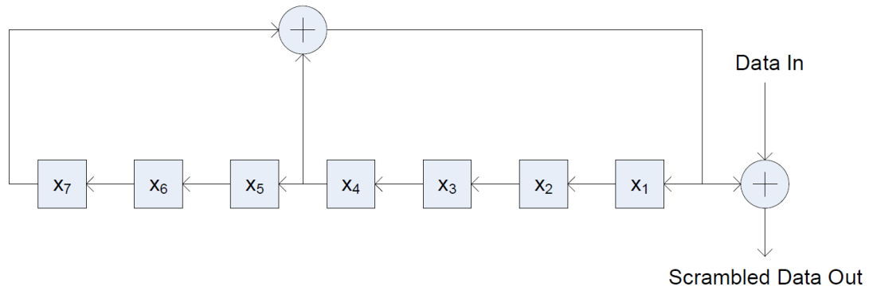
OFDM Pilots Structure for Alamouti Scheme
Similar to the legacy OFDM 11ad PHY pilots are transmitted in each OFDM symbol.
Pilots are regularly spaced in frequency domain:
  16 pilots per OFDM symbol;
  Pilot sequence: P = [-1, 1, -1, 1, 1, -1, -1, -1, -1, -1, 1, 1, 1, -1, 1, 1];
  Pilot indexes: +/-10, +/-30, +/-50, +/-70, +/-90, +/-110, +/-130, +/-150;
Pilots sequence modulation:
  At OFDM symbol n the pilot sequence is multiplied by the value 2×p_{n}-1, where p_{n} is the value generated by the shift register;
  x₁, x₂,…,x₇ are all set to 1 at the first OFDM symbol;

Slide 7
OFDM Pilots Structure for Alamouti Scheme (Cont’d)
The difference in pilots mapping comparing to the legacy 11ad:
  First pilots sequence P₁ is mapped to the 1st stream (antenna #0) and 1st OFDM symbol;
  Second pilots sequence P₂ is mapped to the 2nd stream (antenna #1) and 1st OFDM symbol;
  Sequence P₁ is repeated in the 2nd stream (antenna #1) and 2nd OFDM symbol;
  Sequence P₂ is repeated with sign inversion in the 1st stream (antenna #0) and 2nd OFDM symbol;
  The described procedure is repeated for the next pair of OFDM symbols in time;
Antenna #0
Antenna #1

Slide 8
SC Frame Format Definitions
Definitions:
Guard Interval (GI) sequences:
  GI sequence: GI_{M}(n) = [a₁, a₂, …, a_{M-1}, a_{M}];
  GI sequence with time inversion and complex conjugation: GI_{M}*(-n) = [a_{M}*, a_{M-1}*, …, a₂*, a₁*];
  GI sequence with time inversion, complex conjugation and sign inversion: -GI_{M}*(-n) = [-a_{M}*, -a_{M-1}*, …, -a₂*, -a₁*];
Data sequence for SC symbol:
  s_{N}(n) = [s₁, s₂, …, s_{N-1}, s_{N}];
Time inversion and complex conjugation of the SC symbol:
  s_{N}*(-n) = [s_{N}*, s_{N-1}*, …, s₂*, s₁*];

Slide 9
SC Frame Format (Cont’d)

Slide 10
SC Frame Format (Cont’d)
GI property:
  GI is not changed after application of time inversion and complex conjugation operation.
  In simulations GI size M = 32, DFT size N = 512, data part size N-2*M = 448.
  The GI size can be increased, there is a trade-off between data size and GI size.

Slide 11
Simulated Channel Models
LOS channel model:
  MRC 1x2, Alamouti 2x1 only;
  H₀ and H₁ have unit power, uniformly distributed random phase;
NLOS Rayleigh channel model:
  MRC 1x2, Alamouti 2x1, Alamouti 2x2;
  H₀, H₁, H₂, H₃ are independent channels, have exponential delay profile in time domain, 3 ns RMS delay spread, amplitudes are Rayleigh distributed variables;

Slide 12
Simulation Assumptions
PPDU length 8192 bytes;
LDPC uses LBP with “min-sum” approximation, maximum number of iterations per CW is 20;
Number of simulated frames per SNR point is 10⁵;
Ideal channel knowledge, ideal acquisition, no RF imperfections;
OFDM: SISO ZF receiver;
SC: SISO LMMSE receiver;

Slide 13
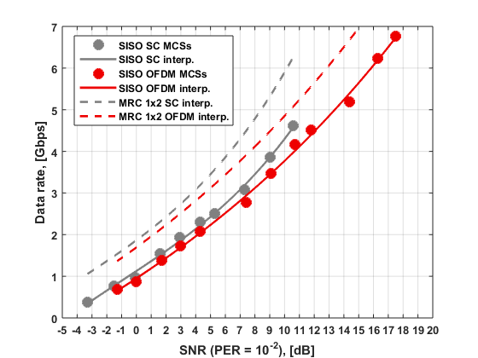
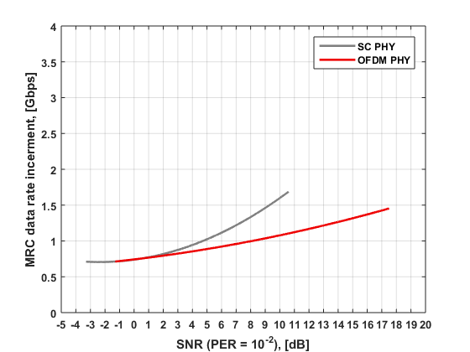
LOS Simulation Results
MRC 1x2 in LOS channel provides 3.0 dB SNR enhancement;
Corresponding data rate increment due to application of MRC depends on SNR and can be 0.7 – 1.7 Gbps;
MRC 1x2 vs. SISO

Slide 14
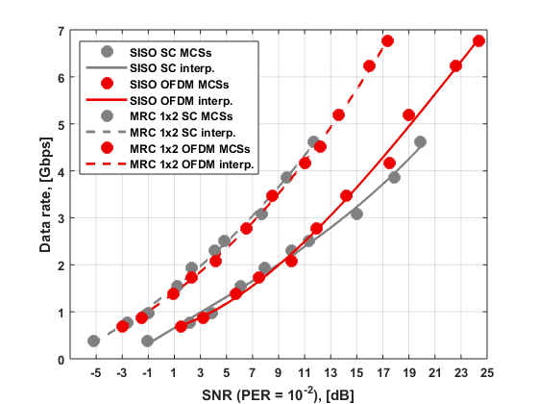
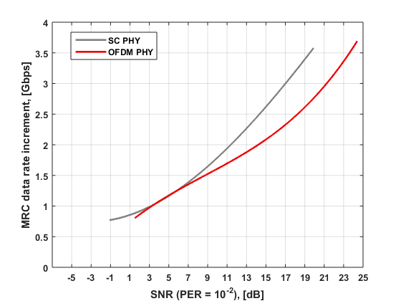
NLOS Simulation Results
MRC 1x2 in NLOS independent Rayleigh channel provides 4.1 – 8.3 dB SNR enhancement;
Corresponding data rate increment due to application of MRC depends on SNR and can be 0.8 – 3.7 Gbps;
MRC 1x2 vs. SISO

Slide 15
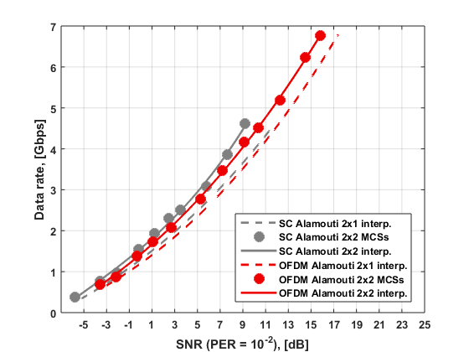
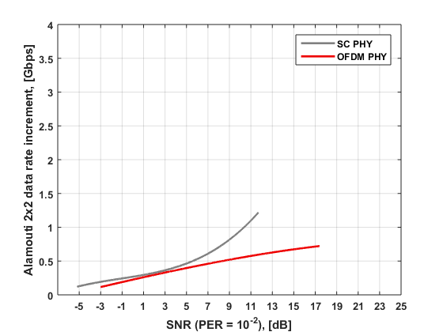
NLOS Simulation Results (Cont’d)
Alamouti 2x1 scheme exhibits the same gain as MRC 1x2 if it has the same transmit power per antenna.
Alamouti 2x2 scheme provides further enhancement in SNR of 0.6 – 2.5 dB or data rate enhancement of 0.1 – 1.2 Gbps.
Alamouti 2x2 vs. Alamouti 2x1

Slide 16
NLOS Simulation Results (Cont’d)
DCM SQPSK/QPSK modulations additional gain in SNR for PER = 10⁻² over the regular BPSK/QPSK modulations in NLOS Rayleigh channel:
MCS | SISO | MRC 1x2 (Alamouti 2x1) | Alamouti 2x2
13 | 1.8 dB | 0.9 dB | 0.3 dB
14 | 2.3 dB | 1.0 dB | 0.5 dB
15 | 0.7 dB | 0.1 dB | 0.1 dB
16 | 1.3 dB | 0.4 dB | 0.1 dB
17 | 2.0 dB | 0.8 dB | 0.3 dB

Slide 17
Conclusions
This presentation describes performance analysis of the robust MIMO transmission modes including MRC 1x2, Alamouti 2x1 and Alamouti 2x2 schemes.
It was demonstrated that in frequency flat LOS channel one can achieve 3.0 dB SNR gain applying MRC 1x2 or Alamouti 2x1 schemes.
In NLOS frequency selective channels the SNR gain can be very significant of 4.1 – 8.3 dB for MRC 1x2 and Alamouti 2x1 schemes. Further SNR enhancement is possible applying Alamouti 2x2 scheme by 0.6 – 2.5 dB.
OFDM and SC modulations with diversity schemes exhibit similar performance in frequency flat and selective channels.
In case of OFDM application of DCM modulations in combination with Alamouti technique provides additional SNR gain of 1.0 dB.
The considered diversity schemes are proposed to be used in the 11ay standard for robust data transmission modes.

Slide 18
Straw Poll
Would you agree to insert the following in section 7 of the SFD:”
  The 11ay specification shall enable transmit diversity schemes including Alamouti scheme for both SC and OFDM modulations for MIMO data transmission.
  “

Slide 19
References
Siavash M. Alamouti, “A Simple Transmit Diversity Technique for Wireless Communications,” IEEE Journal on Selected Areas in Communications, vol. 16, no. 8, October 1998.
“2016-TECH-Intel-0006-00 Transmit Diversity Scheme for SC and OFDM MIMO in 11ay,” January 2016.

