Slide 1
Performance Comparison of Dual Carrier and Regular Modulations for SU-MIMO in 11ay
Date: 2016-16-05
Authors:

Slide 2
Introduction
This work presents comparison analysis of Dual Carrier Modulations (DCMs) defined for the legacy 11ad OFDM PHY and regular BPSK and QPSK modulations providing the same data rate in application to the open loop 2 x 2 SU-MIMO scheme.
The performance of the SQPSK and QPSK modulations transmitted using two subcarriers in the OFDM signal spectrum is compared to their regular BPSK and QPSK counterparts in frequency selective channel.
Additionally implementation complexity of 2 x 2 SU-MIMO with DCM and regular types of modulations is compared.
Based on the completed analysis a space-frequency diversity scheme is proposed for DCM modulation.

Slide 3
System Configuration
SISO system:
  DCM SQPSK and QPSK modulations, Static Tone Pairing (STP) subcarriers mapping;
  Regular BPSK and QPSK modulations, mapped to subcarriers without STP and any other interleaver type;
2 x 2 SU-MIMO system:
  Horizontal mapping: entire OFDM symbol is mapped to the 1-st or 2-nd stream;
  Modulation type is the same for both spatial streams;

Slide 4
Channel Model
In case of 2 x 2 SU-MIMO NLOS channel model is defined by 3D channel matrix as follows:
where N_{RX} = 2 is the number of receiver antennas, N_{TX} = 2 is the number of transmit antennas, and N_{taps} is the maximum number of taps in the channel impulse response realization.
Each H_{ij} has exponential decay envelope in time domain with t_{RMS} = 3 ns and independent distributed taps. The amplitudes of the taps are Rayleigh distributed and taps are taken at the sampling rate 2.64 Gsps.
The total power of each H_{ij} channel realization in time domain is normalized to unit power on instantaneous basis. The cross links are independent of the main links and have the same power as the main links.
In case of SISO NLOS channel model includes H₁₁ component only.

Slide 5
Simulation Assumptions
PPDU length 8192 bytes;
LDPC uses LBP with “min-sum” approximation, maximum number of iterations per CW is 20;
Number of simulated frames per SNR point is 10⁵;
Ideal channel knowledge, ideal acquisition, no RF imperfections;
SISO: ML receiver;
MIMO: ML or LMMSE receiver;

Slide 6
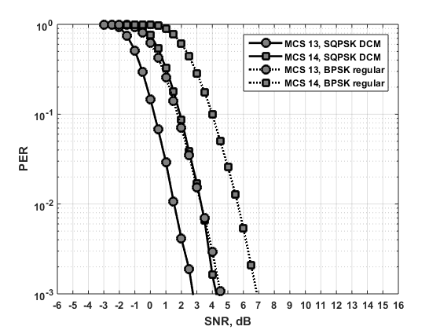
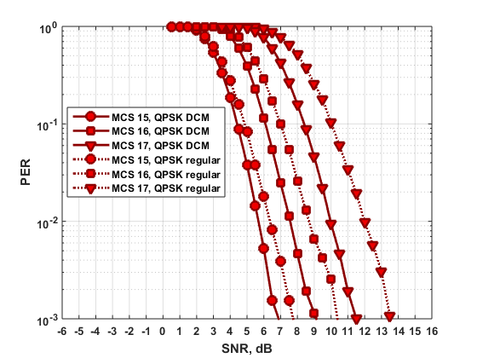
SISO Performance Results
ML receiver
Solid line – DCM, dashed line – regular modulations;
DCM SNR gain is defined for PER = 10⁻² level, gain is larger for higher encoding rates;
DCM SNR gain for SQPSK: MCS 13 – 1.8 dB, MCS 14 – 2.3 dB;
DCM SNR gain for QPSK: MCS 15 – 0.7 dB, MCS 16 – 1.3 dB, MCS 17 – 2.0 dB;

Slide 7
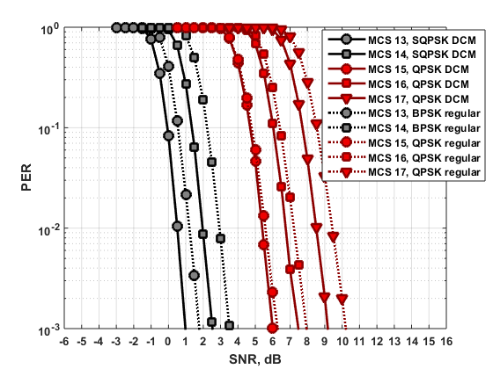
SU-MIMO Performance Results
ML receiver
Solid line – DCM, dashed line – regular modulations;
DCM SNR gain is defined for PER = 10⁻² level, gain is larger for higher encoding rates;
DCM SNR gain for SQPSK: MCS 13 – 0.7 dB, MCS 14 – 0.9 dB;
DCM SNR gain for QPSK: MCS 15 – 0.2 dB, MCS 16 – 0.5 dB, MCS – 0.9 dB;

Slide 8
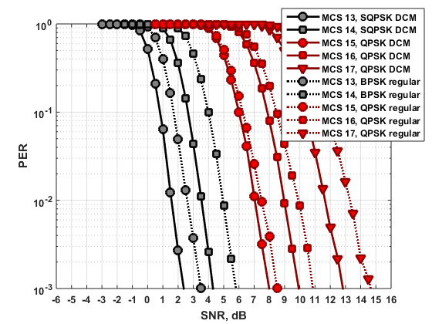
SU-MIMO Performance Results (Cont’d)
LMMSE receiver
Solid line – DCM, dashed line – regular modulations;
DCM SNR gain is defined for PER = 10⁻² level, gain is larger for higher encoding rates;
DCM SNR gain for SQPSK: MCS 13 – 1.0 dB, MCS 14 – 1.4 dB;
DCM SNR gain for QPSK: MCS 15 – 0.5 dB, MCS 16 – 0.9 dB, MCS – 1.6 dB;

Slide 9
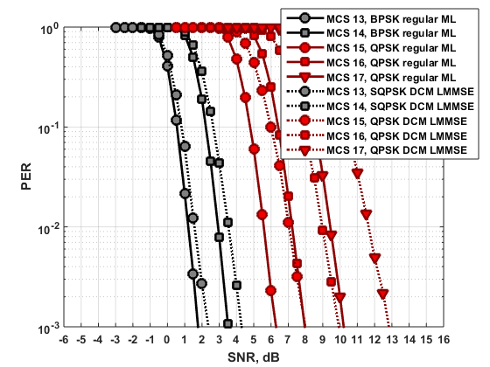
SU-MIMO Performance Results (Cont’d)
Regular modulation ML vs. DCM LMMSE
Solid line – regular modulation with ML, dashed line – DCM modulation with LMMSE;
SNR gain is defined for PER = 10⁻² level, gain is larger for higher encoding rates;
SNR gain for regular BPSK: MCS 13 – 0.4 dB, MCS 14 – 0.6 dB;
SNR gain for regular QPSK: MCS 15 – 1.4 dB, MCS 16 – 1.8 dB, MCS – 2.3 dB;

Slide 10
Performance Summary
Table 1: SNR gain in dB for dual carrier modulations over the regular counterparts for SISO and MIMO systems.
MCS | SISO | MIMO
 | ML | ML | LMMSE
13 | 1.8 dB | 0.7 dB | 1.0 dB
14 | 2.3 dB | 0.9 dB | 1.4 dB
15 | 0.7 dB | 0.2 dB | 0.5 dB
16 | 1.3 dB | 0.5 dB | 0.9 dB
17 | 2.0 dB | 0.9 dB | 1.6 dB

Slide 11
Implementation Complexity
SQPSK DCM MIMO:
  Effective 4 x 2 channel matrix, considered for k-th and q-th subcarriers:
  S₁, S₂ – QPSK symbols;
ML receiver:
  MIMO system with N_{TX} = 2 antennas can be effectively implemented using approach in [1];
  ML receiver makes search over 2 * M hypotheses, for QPSK M = 4, total number is 8, so it has moderate complexity;
  Regular BPSK has smaller complexity, it requires 2 * 2 = 4 hypotheses;
LMMSE receiver:
  LMMSE solution requires channel matrix inversion (H^{H}H + σ²I)⁻¹, H^{H}H is a 2 x 2 matrix, implementation complexity is similar to the MIMO with regular BPSK modulation;

Slide 12
Implementation Complexity (Cont’d)
QPSK DCM MIMO:
  Effective 4 x 4 channel matrix, considered for k-th and q-th subcarriers:
  S₁, S₂, S₃, S₄ – QPSK symbols;
ML receiver:
  MIMO system with N_{TX} = 4 antennas;
  ML receiver makes search over 2 * M^{(NTX-1)} = 2 * 4³ = 128 hypotheses;
  Regular QPSK has smaller complexity, it requires 2 * 4 = 8 hypotheses;
LMMSE receiver:
  LMMSE solution requires channel matrix inversion (H^{H}H + σ²I)⁻¹ per subcarrier, H^{H}H is a 4 x 4 matrix;
  Regular QPSK requires 2 x 2 matrix inversion;

Slide 13
Complexity Summary
Table 2: Dual carrier and regular modulations implementation complexity for MIMO
Modulation type | Receiver operations |  | Receiver complexity
 | ML | LMMSE | ML | LMMSE
SQPSK DCM | 8* | 2x2** | Moderate | Low
QPSK DCM | 128 | 4x4 | High | High
BPSK regular | 4 | 2x2 | Low | Low
QPSK regular | 8 | 2x2 | Moderate | Low
  * - number of hypotheses in the ML exhaustive search
  ** - H^{H}H matrix size for inversion in LMMSE solution

Slide 14
Space-Frequency Diversity Scheme
For SQPSK with 2x2 MIMO transmission it is proposed to use a space-frequency diversity scheme with mapping shown below.
The 1st SPQSK symbol S₀ is mapped to the 1st half of the spectrum to the 1st stream. Its conjugated repetition S₀* is mapped to the 2nd half of the spectrum in the 2nd spatial stream.
The proposed scheme extracts both space and frequency diversity gains.

Slide 15
Conclusions
MIMO with SQPSK DCM modulation exhibits performance gain of 0.7 – 0.9 dB for ML receiver and 1.0 – 1.4 dB for LMMSE receiver comparing to the regular BPSK modulation.
MIMO SQPSK has reasonable implementation complexity comparable to the BPSK modulation. It is recommended to be used for MIMO transmission in frequency selective channels.
MIMO QPSK DCM modulation exhibits performance gain of 0.2 – 0.9 dB for ML receiver and 0.5 – 1.6 dB for LMMSE receiver comparing to the regular QPSK modulation.
However QPSK DCM has much higher implementation complexity comparing to the regular QPSK. It is not recommended for MIMO transmission.

Slide 16
Straw Poll
Would you agree to insert the following in section 7 of the SFD:”
  The 11ay specification shall enable space-frequency diversity scheme for OFDM MIMO transmission using SQPSK DCM modulation with subcarriers mapping shown on slide 14.
  “

Slide 17
References
Y. Lomnitz, D. Andelman, “Efficient Maximum Likelihood Detector for MIMO Systems with Small Number of Streams,” Electronic Letters, October 25, 2007.

