Slide 1
BCC Interleaver Parameters for DCM
Date: 2016-05-16
Authors:
Name | Affiliation | Address | Phone | Email
Tianyu Wu | Mediatek USA | 2860 Junction Ave, San Jose, CA 95134, USA | +1-408-526-1899 | jianhan.Liu@mediatek.com
Jianhan Liu |  |  |  | thomas.pare@mediatek.com
Thomas Pare |  |  |  | chaochun.wang@mediatek.com
ChaoChun Wang |  |  |  | james.wang@mediatek.com
James Wang |  |  |  | tianyu.wu@mediatek.com
Russell Huang |  |  |  | russell.huang@mediatek.com
James Yee | Mediatek | No. 1 Dusing 1st Road, Hsinchu, Taiwan | +886-3-567-0766 | james.yee@mediatek.com
Frank Hsu |  |  |  | frank.hsu@mediatek.com

Slide 2
Authors (continued)
Name | Affiliation | Address | Phone | Email
Ron Porat | Broadcom |  |  | rporat@broadcom.com
Sriram Venkateswaran
Matthew Fischer |  |  |  | mfischer@broadcom.com
Zhou Lan
Leo Montreuil
Andrew Blanksby
Vinko Erceg
Thomas Derham
Mingyue Ji
Robert Stacey | Intel | 2111 NE 25th Ave, Hillsboro OR 97124, USA | +1-503-724-893 | robert.stacey@intel.com
Shahrnaz Azizi |  |  |  | shahrnaz.azizi@intel.com
Po-Kai Huang |  |  |  | po-kai.huang@intel.com
Qinghua Li |  |  |  | quinghua.li@intel.com
Xiaogang Chen |  |  |  | xiaogang.c.chen@intel.com
Chitto Ghosh |  |  |  | chittabrata.ghosh@intel.com
Laurent Cariou |  |  |  | laurent.cariou@intel.com
Yaron Alpert |  |  |  | yaron.alpert@intel.com
Assaf Gurevitz |  |  |  | assaf.gurevitz@intel.com
Ilan Sutskover |  |  |  | ilan.sutskover@intel.com
Feng Jiang |  |  |  | feng1.jiang@intel.com

Slide 3
Authors (continued)
Name | Affiliation | Address | Phone | Email
Hongyuan Zhang | Marvell | 5488 Marvell Lane, Santa Clara, CA, 95054 | 408-222-2500 | hongyuan@marvell.com
Lei Wang |  |  |  | Leileiw@marvell.com
Liwen Chu |  |  |  | liwenchu@marvell.com
Jinjing Jiang |  |  |  | jinjing@marvell.com
Yan Zhang |  |  |  | yzhang@marvell.com
Rui Cao |  |  |  | ruicao@marvell.com
Sudhir Srinivasa |  |  |  | sudhirs@marvell.com
Bo Yu |  |  |  | boyu@marvell.com
Saga Tamhane |  |  |  | sagar@marvell.com
Mao Yu |  |  |  | my@marvel..com
Xiayu Zheng |  |  |  | xzheng@marvell.com
Christian Berger |  |  |  | crberger@marvell.com
Niranjan Grandhe |  |  |  | ngrandhe@marvell.com
Hui-Ling Lou |  |  |  | hlou@marvell.com

Slide 4
Authors (continued)
Name | Affiliation | Address | Phone | Email
Alice Chen | Qualcomm | 5775 Morehouse Dr. San Diego, CA, USA |  | alicel@qti.qualcomm.com
Albert Van Zelst |  | Straatweg 66-S Breukelen, 3621 BR Netherlands |  | allert@qti.qualcomm.com
Alfred Asterjadhi |  | 5775 Morehouse Dr. San Diego, CA, USA |  | aasterja@qti.qualcomm.com
Bin Tian |  | 5775 Morehouse Dr. San Diego, CA, USA |  | btian@qti.qualcomm.com
Carlos Aldana |  | 1700 Technology Drive San Jose, CA 95110, USA |  | caldana@qca.qualcomm.com
George Cherian |  | 5775 Morehouse Dr. San Diego, CA, USA |  | gcherian@qti.qualcomm.com
Gwendolyn Barriac |  | 5775 Morehouse Dr. San Diego, CA, USA |  | gbarriac@qti.qualcomm.com
Hemanth Sampath |  | 5775 Morehouse Dr. San Diego, CA, USA |  | hsampath@qti.qualcomm.com
Lin Yang |  | 5775 Morehouse Dr. San Diego, CA, USA |  | linyang@qti.qualcomm.com
Lochan Verma |  | 5775 Morehouse Dr. San Diego, CA USA |  | lverma@qti.qualcomm.com
Menzo Wentink |  | Straatweg 66-S Breukelen, 3621 BR Netherlands |  | mwentink@qti.qualcomm.com
Naveen Kakani |  | 2100 Lakeside Boulevard Suite 475, Richardson TX 75082, USA |  | nkakani@qti.qualcomm.com
Raja Banerjea |  | 1060 Rincon Circle San Jose CA 95131, USA |  | rajab@qit.qualcomm.com
Richard Van Nee |  | Straatweg 66-S Breukelen, 3621 BR Netherlands |  | rvannee@qti.qualcomm.com

Slide 5
Authors (continued)
Name | Affiliation | Address | Phone | Email
Rolf De Vegt | Qualcomm | 1700 Technology Drive San Jose, CA 95110, USA |  | rolfv@qca.qualcomm.com
Sameer Vermani |  | 5775 Morehouse Dr. San Diego, CA, USA |  | svverman@qti.qualcomm.com
Simone Merlin |  | 5775 Morehouse Dr. San Diego, CA, USA |  | smerlin@qti.qualcomm.com
Tevfik Yucek |  | 1700 Technology Drive San Jose, CA 95110, USA |  | tyucek@qca.qualcomm.com
VK Jones |  | 1700 Technology Drive San Jose, CA 95110, USA |  | vkjones@qca.qualcomm.com
Youhan Kim |  | 1700 Technology Drive San Jose, CA 95110, USA |  | youhank@qca.qualcomm.com
Joonsuk Kim | Apple |  |  | joonsuk@apple.com
Aon Mujtaba |  |  |  | mujtaba@apple.com
Guoqing Li |  |  |  | guoqing_li@apple.com
Eric Wong |  |  |  | ericwong@apple.com
Chris Hartman |  |  |  | chartman@apple.com
Jarkko Kneckt |  |  |  | jkneckt@apple.com

Slide 6
Authors (continued)
Name | Affiliation | Address | Phone | Email
David X. Yang | Huawei | F1-17, Huawei Base, Bantian, Shenzhen |  | david.yangxun@huawei.com
Jiayin Zhang |  | 5B-N8, No.2222 Xinjinqiao Road, Pudong, Shanghai | +86-18601656691 | zhangjiayin@huawei.com
Jun Luo |  | 5B-N8, No.2222 Xinjinqiao Road, Pudong, Shanghai |  | jun.l@huawei.com
Yi Luo |  | F1-17, Huawei Base, Bantian, Shenzhen | +86-18665891036 | Roy.luoyi@huawei.com
Yingpei Lin |  | 5B-N8, No.2222 Xinjinqiao Road, Pudong, Shanghai |  | linyingpei@huawei.com
Jiyong Pang |  | 5B-N8, No.2222 Xinjinqiao Road, Pudong, Shanghai |  | pangjiyong@huawei.com
Zhigang Rong |  | 10180 Telesis Court, Suite 365, San Diego, CA 92121 NA |  | zhigang.rong@huawei.com
Jian Yu |  | F1-17, Huawei Base, Bantian, Shenzhen |  | ross.yujian@huawei.com
Ming Gan |  | F1-17, Huawei Base, Bantian, Shenzhen |  | ming.gan@huawei.com
Yuchen Guo |  | F1-17, Huawei Base, Bantian, Shenzhen |  | guoyuchen@huawei.com
Yunsong Yang |  | 10180 Telesis Court, Suite 365, San Diego, CA 92121 NA |  | yangyunsong@huawei.com
Junghoon Suh |  | 303 Terry Fox, Suite 400 Kanata, Ottawa, Canada |  | Junghoon.Suh@huawei.com
Peter Loc |  |  |  | peterloc@iwirelesstech.com
Edward Au |  | 303 Terry Fox, Suite 400 Kanata, Ottawa, Canada |  | edward.ks.au@huawei.com
Teyan Chen |  | F1-17, Huawei Base, Bantian, Shenzhen |  | chenteyan@huawei.com
Yunbo Li |  | F1-17, Huawei Base, Bantian, Shenzhen |  | liyunbo@huawei.com

Slide 7
Authors (continued)
Name | Affiliation | Address | Phone | Email
Jinmin Kim | LG Electronics | 19, Yangjae-daero 11gil, Seocho-gu, Seoul 137-130, Korea |  | Jinmin1230.kim@lge.com
Kiseon Ryu |  |  |  | kiseon.ryu@lge.com
Jinyoung Chun |  |  |  | jiny.chun@lge.com
Jinsoo Choi |  |  |  | js.choi@lge.com
Jeongki Kim |  |  |  | jeongki.kim@lge.com
Dongguk Lim |  |  |  | dongguk.lim@lge.com
Suhwook Kim |  |  |  | suhwook.kim@lge.com
Eunsung Park |  |  |  | esung.park@lge.com
Jayh hyunhee Park |  |  |  | hyunh.park@lge.com
HanGyu Cho |  |  |  | hg.cho@lge.com
Bo Sun | ZTE | #9 Wuxingduan, Xifeng Rd., Xi'an, China |  | sun.bo1@zte.com.cn
Kaiying Lv |  |  |  | lv.kaiying@zte.com.cn
Yonggang Fang |  |  |  | yfang@ztetx.com
Ke Yao |  |  |  | yao.ke5@zte.com.cn
Weimin Xing |  |  |  | xing.weimin@zte.com.cn
Brian Hart | Cisco Systems | 170 W Tasman Dr, San Jose, CA 95134 |  | brianh@cisco.com
Pooya Monajemi |  |  |  | pmonajem@cisco.com

Slide 8
Authors (continued)
Name | Affiliation | Address | Phone | Email
Fei Tong | Samsung | Innovation Park, Cambridge CB4 0DS (U.K.) | +44 1223 434633 | f.tong@samsung.com
Hyunjeong Kang |  | Maetan 3-dong; Yongtong-Gu Suwon; South Korea | +82-31-279-9028 | hyunjeong.kang@samsung.com
Kaushik Josiam |  | 1301, E. Lookout Dr, Richardson TX 75070 | (972) 761 7437 | k.josiam@samsung.com
Mark Rison |  | Innovation Park, Cambridge CB4 0DS (U.K.) | +44 1223 434600 | m.rison@samsung.com
Rakesh Taori |  | 1301, E. Lookout Dr, Richardson TX 75070 | (972) 761 7470 | rakesh.taori@samsung.com
Sanghyun Chang |  | Maetan 3-dong; Yongtong-Gu Suwon; South Korea | +82-10-8864-1751 | s29.chang@samsung.com
Yasushi Takatori | NTT | 1-1 Hikari-no-oka, Yokosuka, Kanagawa 239-0847 Japan | +81 46 859 3135 | takatori.yasushi@lab.ntt.co.jp
Yasuhiko Inoue |  |  | +81 46 859 5097 | inoue.yasuhiko@lab.ntt.co.jp
Shoko Shinohara |  |  | +81 46 859 5107 | Shinohara.shoko@lab.ntt.co.jp
Yusuke Asai |  |  | +81 46 859 3494 | asai.yusuke@lab.ntt.co.jp
Koichi Ishihara |  |  | +81 46 859 4233 | ishihara.koichi@lab.ntt.co.jp
Junichi Iwatani |  |  | +81 46 859 4222 | Iwatani.junichi@lab.ntt.co.jp
Akira Yamada | NTT DOCOMO | 3-6, Hikarinooka, Yokosuka-shi, Kanagawa, 239-8536, Japan | +81 46 840 3759 | yamadaakira@nttdocomo.com

Slide 9
Authors (continued)
Name | Affiliation | Address | Phone | Email
Masahito Mori | Sony Corp. |  |  | Masahito.Mori@jp.sony.com
Yusuke Tanaka |  |  |  | YusukeC.Tanaka@jp.sony.com
Yuichi Morioka |  |  |  | Yuichi.Morioka@jp.sony.com
Kazuyuki Sakoda |  |  |  | Kazuyuki.Sakoda@am.sony.com
William Carney |  |  |  | William.Carney@am.sony.com
Sigurd Schelstraete | Quantenna |  |  | Sigurd@quantenna.com
Huizhao Wang |  |  |  | hwang@quantenna.com
Minho Cheong | Newracom | 9008 Research Dr. Irvine, CA 92618 |  | minho.cheong@newracom.com
Reza Hedayat |  |  |  | reza.hedayat@newracom.com
Young Hoon Kwon |  |  |  | younghoon.kwon@newracom.com
Yongho Seok |  |  |  | yongho.seok@newracom.com
Daewon Lee |  |  |  | daewon.lee@newracom.com
Yujin Noh |  |  |  | yujin.noh@newracom.com

Slide 10
Authors (continued)

Slide 11
Introduction
In the spec draft, there is some TBDs related to DCM + MCS0
We propose DCM + MCS0 sharing same transmission flow as all other DCM MCSs.
DCM =1, MCS = 0 shall not indicate MCS0 Rep2(MCS10 in 11ah)
MCS0 Rep2 is not a DCM mode.
MCS0 Rep2 has bad performance on 106 tone RU.
In the spec draft, BCC interleaver parameters for DCM are not clear
For DCM, interleaved bits are mapped to each half of the RU.
Directly reuse the interleaver parameters for entire RU do not work for DCM+MCS0
We propose a set of DCM interleaver parameters optimized for half RU size.
MCS K with DCM
MCS K
RU
MCS K
MCS K for dup bits
Interleaver for entire RU
Interleaver for 1st half
Interleaver for 2nd half
Tianyu Wu, Mediatek, et. al.

Slide 12
DCM + MCS0 or MCS0 Rep2?
DCM + MCS0
MCS0 Rep2
MCS0 Rep2 is not a DCM mode
The transmission flow is different.
Constellation mapping to 1st half band
Info bits
Coded bits
Encoder
Interleaver
IDFT
Constellation mapping to 2nd half band
Duplicate copy
Info bits
Coded bits
Encoder
Bits Rep 2
Interleaver
Constellation mapper
IDFT
Tianyu Wu, Mediatek, et. al.

Slide 13
Problem of MCS0 rep2
In 802.11ax, interleaver parameters
for MCS0 is defined as:
Interleaver for MCS0 Rep2
A natural method for MCS0 Rep2 is reuse the interleaver parameters for MCS0
However, the interleaver performance will drop dramatically when parameter N_{row} is an even number. Because the repeated bits have a fixed distance of N_{row}/2.
For 106 tone RU, the repeated bits has a fixed 3 bit distance from original bits. This small distance lead to a bad performance.
RU size (tones) | BCC interleaver parameters
 | N_{col} | N_{row} | N_{rot}
26 | 8 | 3 | 2
52 | 16 | 3 | 11
106 | 17 | 6 | 29
242 | 26 | 9 | 58
Bit 1 | Bit 2 | …… | Bit 17
Bit 18 | Bit 19 | …… | Bit 34
Bit 35 | Bit 36 | …… | Bit 51
Rep bit 1 | Rep bit 2 | …… | Rep bit 17
Rep bit 18 | Rep bit 19 | …… | Rep bit 34
Rep bit 35 | Rep bit 36 | …… | Rep bit 51
Interleaved bits:
Bit 1, Bit 18, Bit 35, Rep bit 1, Rep bit 18, Rep bit 35,
Bit 2, Bit 19, Bit 36, Rep bit 2, Rep bit 19, Rep bit 36,
……
Bit 17, Bit 34, Bit 51, Rep bit 17, Rep bit 34, Rep bit 51
Tianyu Wu, Mediatek, et. al.

Slide 14
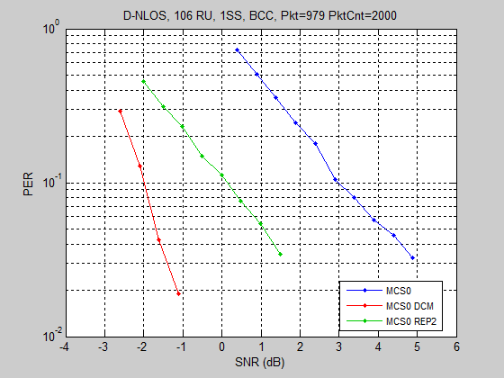
Simulation results
Comparison of BPSK, DCM MCS0, MCS0 Rep2 performance
MCS0 Rep2 has 2.1 dB performance loss comparing to DCM MCS0.
MCS0 Rep2 duplicated bits are only 3 subcarriers apart after interleaver.
Tianyu Wu, Mediatek, et. al.

Slide 15
Interleaver design for DCM modulations
Problem of reusing the interleaver for entire RU
Directly reuse interleaver for the whole RU but replace N_{BPSCS} by N_{BPSCS}/2
Define N_{BPSCS} for DCM modulations same as N_{BPSCS} for non DCM modulation of the same modulation level.
For DCM + MCS0, N_{BPSCS} is 1 and N_{row} will be non-integer number for 26, 52 and 242 tone RUs. In these cases, new interleaver parameters need to be defined.
Proposed interleaver design for DCM
For each RU, design interleaver for half RU size
Select the interleaver parameters optimized for half RU size.
 | DCM + BPSK | DCM + QPSK | DCM + 16QAM
N_{BPSCS} | 1 | 2 | 4
Tianyu Wu, Mediatek, et. al.

Slide 16
Interleaver Parameters
In 11ax, BCC will be applied on 26, 52, 106 and 242 tone RUs.
26 tone RU: 24 data tones; 12 data tones for half RU.
52 tone RU: 48 data tones; 24 data tones for half RU.
106 tone RU: 102 data tones; 51 data tones for half RU.
242 tone RU: 234 data tones; 117 data tones for half RU.
For DCM, optimal interleaver parameters for half RU are:
Parameter for DCM | RU Size (tones)
 | 26 | 52 | 106 | 242
N_{COL} | 4 | 8 | 17 | 13
N_{ROW} | 3×N_{BPSCS} | 3×N_{BPSCS} | 3×N_{BPSCS} | 9×N_{BPSCS}
N_{ROT} | 2 | 2 | 11 | 29
Tianyu Wu, Mediatek, et. al.

Slide 17
Interleaver parameters for HE SIG B
HE SIG B has 52 data tones.
For DCM case, 26 data tones for half BW.
We propose interleaver for HE SIG B with DCM modulations as follows:
Parameter | HE SIG B (tones)
 | 56
N_{COL} | 13
N_{ROW} | 2×N_{BPSCS}
Tianyu Wu, Mediatek, et. al.

Slide 18
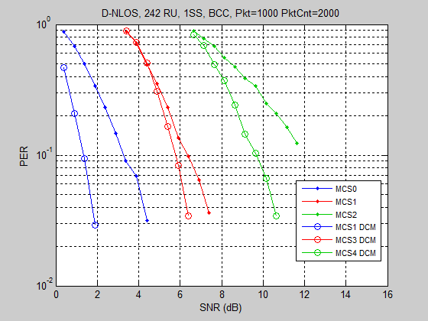
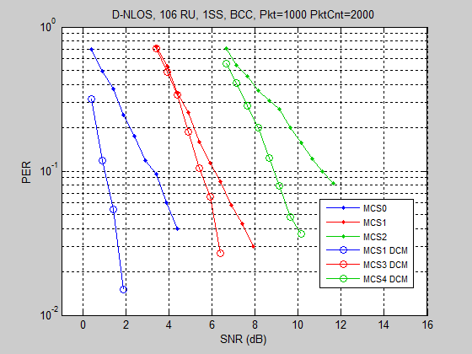
Simulation results
Performance of DCM with proposed interleaver.
The data rate is the same for PER results with same color.
Tianyu Wu, Mediatek, et. al.

Slide 19
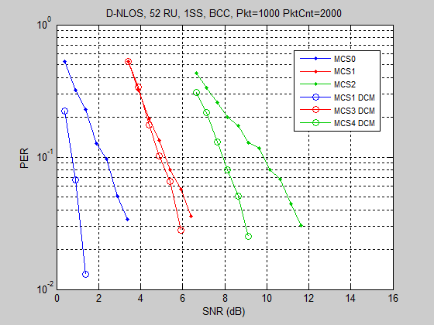
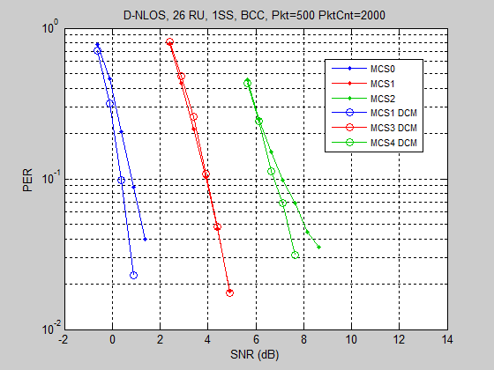
Simulation results – cont’d
Tianyu Wu, Mediatek, et. al.

Slide 20
Conclusion
We propose a simple interleaver for DCM MCSs
Low complexity, no change on encoder and decoder design
Unified design for all DCM MCSs
Tianyu Wu, Mediatek, et. al.

Slide 21
Straw Poll 1
Do you agree to add the following text to the 11ax SFD?
DCM+MCS0 has same transmission flow as other DCM MCSs.
Tianyu Wu, Mediatek, et. al.

Slide 22
Straw Poll 2
Do you agree to add the following text to 11ax SFD?
The interleaver parameters for DCM are given in the following table:
Parameter for DCM | RU Size (tones)
 | 26 | 52 | 106 | 242
N_{COL} | 4 | 8 | 17 | 13
N_{ROW} | 3×N_{BPSCS} | 3×N_{BPSCS} | 3×N_{BPSCS} | 9×N_{BPSCS}
N_{ROT} | 2 | 2 | 11 | 29
Value of N_{BPSCS} for DCM modulations equals to N_{BPSCS} of non DCM
modulations with same constellation size.
Tianyu Wu, Mediatek, et. al.

Slide 23
Straw Poll 3
Do you agree to add the following text to 11ax SFD?
The interleaver parameters for HE SIG B with DCM are given in the following table:
Parameter | HE SIG B (tones)
 | 56
N_{COL} | 13
N_{ROW} | 2×N_{BPSCS}
Tianyu Wu, Mediatek, et. al.

