Slide 1
Remaining Topics in Power Control
Date: 2016-05-16
Authors:
Name | Affiliation | Address | Phone | Email
Bin Tian | Qualcomm | 5775 Morehouse Dr. San Diego, CA, USA |  | btian@qti.qualcomm.com
Arjun Bharadwaj |  | 5775 Morehouse Dr. San Diego, CA, USA |  | arjunb@qti.qualcomm.com
Rahul Tandra |  | 5775 Morehouse Dr. San Diego, CA, USA |  | rtandra@qti.qualcomm.com
Sameer Vermani |  | 5775 Morehouse Dr. San Diego, CA, USA |  | svverman@qti.qualcomm.com
Youhan Kim |  | 1700 Technology Drive San Jose, CA 95110, USA |  | youhank@qca.qualcomm.com

Slide 2
Authors (continued)
Name | Affiliation | Address | Phone | Email
Alice Chen | Qualcomm | 5775 Morehouse Dr. San Diego, CA, USA |  | alicel@qti.qualcomm.com
Albert Van Zelst |  | Straatweg 66-S Breukelen, 3621 BR Netherlands |  | allert@qti.qualcomm.com
Alfred Asterjadhi |  | 5775 Morehouse Dr. San Diego, CA, USA |  | aasterja@qti.qualcomm.com
Lin Yang |  | 5775 Morehouse Dr. San Diego, CA, USA |  | arjunb@qti.qualcomm.com
Carlos Aldana |  | 1700 Technology Drive San Jose, CA 95110, USA |  | caldana@qca.qualcomm.com
George Cherian |  | 5775 Morehouse Dr. San Diego, CA, USA |  | gcherian@qti.qualcomm.com
Gwendolyn Barriac |  | 5775 Morehouse Dr. San Diego, CA, USA |  | gbarriac@qti.qualcomm.com
Hemanth Sampath |  | 5775 Morehouse Dr. San Diego, CA, USA |  | hsampath@qti.qualcomm.com
Menzo Wentink |  | Straatweg 66-S Breukelen, 3621 BR Netherlands |  | mwentink@qti.qualcomm.com
Naveen Kakani |  | 2100 Lakeside Boulevard Suite 475, Richardson TX 75082, USA |  | nkakani@qti.qualcomm.com
Raja Banerjea |  | 1060 Rincon Circle San Jose CA 95131, USA |  | rajab@qit.qualcomm.com
Richard Van Nee |  | Straatweg 66-S Breukelen, 3621 BR Netherlands |  | rvannee@qti.qualcomm.com
Rolf De Vegt |  | 1700 Technology Drive San Jose, CA 95110, USA |  | rolfv@qca.qualcomm.com
Simone Merlin |  | 5775 Morehouse Dr. San Diego, CA, USA |  | smerlin@qti.qualcomm.com
Tevfik Yucek |  | 1700 Technology Drive San Jose, CA 95110, USA |  | tyucek@qca.qualcomm.com
VK Jones |  | 1700 Technology Drive San Jose, CA 95110, USA |  | vkjones@qca.qualcomm.com

Slide 3
Authors (continued)
Name | Affiliation | Address | Phone | Email
Ron Porat | Broadcom |  |  | rporat@broadcom.com
Sriram Venkateswaran
Matthew Fischer |  |  |  | mfischer@broadcom.com
Zhou Lan
Leo Montreuil
Andrew Blanksby
Vinko Erceg
Thomas Derham
Mingyue Ji
Robert Stacey | Intel | 2111 NE 25th Ave, Hillsboro OR 97124, USA | +1-503-724-893 | robert.stacey@intel.com
Shahrnaz Azizi |  |  |  | shahrnaz.azizi@intel.com
Po-Kai Huang |  |  |  | po-kai.huang@intel.com
Qinghua Li |  |  |  | quinghua.li@intel.com
Xiaogang Chen |  |  |  | xiaogang.c.chen@intel.com
Chitto Ghosh |  |  |  | chittabrata.ghosh@intel.com
Laurent Cariou |  |  |  | laurent.cariou@intel.com
Yaron Alpert |  |  |  | yaron.alpert@intel.com
Assaf Gurevitz |  |  |  | assaf.gurevitz@intel.com
Ilan Sutskover |  |  |  | ilan.sutskover@intel.com
Feng Jiang |  |  |  | feng1.jiang@intel.com

Slide 4
Authors (continued)
Name | Affiliation | Address | Phone | Email
Hongyuan Zhang | Marvell | 5488 Marvell Lane, Santa Clara, CA, 95054 | 408-222-2500 | hongyuan@marvell.com
Lei Wang |  |  |  | Leileiw@marvell.com
Liwen Chu |  |  |  | liwenchu@marvell.com
Jinjing Jiang |  |  |  | jinjing@marvell.com
Yan Zhang |  |  |  | yzhang@marvell.com
Rui Cao |  |  |  | ruicao@marvell.com
Sudhir Srinivasa |  |  |  | sudhirs@marvell.com
Bo Yu |  |  |  | boyu@marvell.com
Saga Tamhane |  |  |  | sagar@marvell.com
Mao Yu |  |  |  | my@marvel..com
Xiayu Zheng |  |  |  | xzheng@marvell.com
Christian Berger |  |  |  | crberger@marvell.com
Niranjan Grandhe |  |  |  | ngrandhe@marvell.com
Hui-Ling Lou |  |  |  | hlou@marvell.com

Slide 5
Authors (continued)
Name | Affiliation | Address | Phone | Email
Jianhan Liu | Mediatek USA | 2860 Junction Ave, San Jose, CA 95134, USA | +1-408-526-1899 | jianhan.Liu@mediatek.com
Thomas Pare |  |  |  | thomas.pare@mediatek.com
ChaoChun Wang |  |  |  | chaochun.wang@mediatek.com
James Wang |  |  |  | james.wang@mediatek.com
Tianyu Wu |  |  |  | tianyu.wu@mediatek.com
Russell Huang |  |  |  | russell.huang@mediatek.com
James Yee | Mediatek | No. 1 Dusing 1st Road, Hsinchu, Taiwan | +886-3-567-0766 | james.yee@mediatek.com
Frank Hsu |  |  |  | frank.hsu@mediatek.com
Joonsuk Kim | Apple |  |  | joonsuk@apple.com
Aon Mujtaba |  |  |  | mujtaba@apple.com
Guoqing Li |  |  |  | guoqing_li@apple.com
Eric Wong |  |  |  | ericwong@apple.com
Chris Hartman |  |  |  | chartman@apple.com
Jarkko Kneckt |  |  |  | jkneckt@apple.com

Slide 6
Authors(continued)
Name | Affiliation | Address | Phone | Email
David X. Yang | Huawei | F1-17, Huawei Base, Bantian, Shenzhen |  | david.yangxun@huawei.com
Jiayin Zhang |  | 5B-N8, No.2222 Xinjinqiao Road, Pudong, Shanghai | +86-18601656691 | zhangjiayin@huawei.com
Jun Luo |  | 5B-N8, No.2222 Xinjinqiao Road, Pudong, Shanghai |  | jun.l@huawei.com
Yi Luo |  | F1-17, Huawei Base, Bantian, Shenzhen | +86-18665891036 | Roy.luoyi@huawei.com
Yingpei Lin |  | 5B-N8, No.2222 Xinjinqiao Road, Pudong, Shanghai |  | linyingpei@huawei.com
Jiyong Pang |  | 5B-N8, No.2222 Xinjinqiao Road, Pudong, Shanghai |  | pangjiyong@huawei.com
Zhigang Rong |  | 10180 Telesis Court, Suite 365, San Diego, CA 92121 NA |  | zhigang.rong@huawei.com
Jian Yu |  | F1-17, Huawei Base, Bantian, Shenzhen |  | ross.yujian@huawei.com
Ming Gan |  | F1-17, Huawei Base, Bantian, Shenzhen |  | ming.gan@huawei.com
Yuchen Guo |  | F1-17, Huawei Base, Bantian, Shenzhen |  | guoyuchen@huawei.com
Yunsong Yang |  | 10180 Telesis Court, Suite 365, San Diego, CA 92121 NA |  | yangyunsong@huawei.com
Junghoon Suh |  | 303 Terry Fox, Suite 400 Kanata, Ottawa, Canada |  | Junghoon.Suh@huawei.com
Peter Loc |  |  |  | peterloc@iwirelesstech.com
Edward Au |  | 303 Terry Fox, Suite 400 Kanata, Ottawa, Canada |  | edward.ks.au@huawei.com
Teyan Chen |  | F1-17, Huawei Base, Bantian, Shenzhen |  | chenteyan@huawei.com
Yunbo Li |  | F1-17, Huawei Base, Bantian, Shenzhen |  | liyunbo@huawei.com

Slide 7
Authors (continued)
Name | Affiliation | Address | Phone | Email
Jinmin Kim | LG Electronics | 19, Yangjae-daero 11gil, Seocho-gu, Seoul 137-130, Korea |  | Jinmin1230.kim@lge.com
Kiseon Ryu |  |  |  | kiseon.ryu@lge.com
Jinyoung Chun |  |  |  | jiny.chun@lge.com
Jinsoo Choi |  |  |  | js.choi@lge.com
Jeongki Kim |  |  |  | jeongki.kim@lge.com
Dongguk Lim |  |  |  | dongguk.lim@lge.com
Suhwook Kim |  |  |  | suhwook.kim@lge.com
Eunsung Park |  |  |  | esung.park@lge.com
Jayh hyunhee Park |  |  |  | hyunh.park@lge.com
HanGyu Cho |  |  |  | hg.cho@lge.com
Bo Sun | ZTE | #9 Wuxingduan, Xifeng Rd., Xi'an, China |  | sun.bo1@zte.com.cn
Kaiying Lv |  |  |  | lv.kaiying@zte.com.cn
Yonggang Fang |  |  |  | yfang@ztetx.com
Ke Yao |  |  |  | yao.ke5@zte.com.cn
Weimin Xing |  |  |  | xing.weimin@zte.com.cn
Brian Hart | Cisco Systems | 170 W Tasman Dr, San Jose, CA 95134 |  | brianh@cisco.com
Pooya Monajemi |  |  |  | pmonajem@cisco.com

Slide 8
Authors (continued)
Name | Affiliation | Address | Phone | Email
Fei Tong | Samsung | Innovation Park, Cambridge CB4 0DS (U.K.) | +44 1223 434633 | f.tong@samsung.com
Hyunjeong Kang |  | Maetan 3-dong; Yongtong-Gu Suwon; South Korea | +82-31-279-9028 | hyunjeong.kang@samsung.com
Kaushik Josiam |  | 1301, E. Lookout Dr, Richardson TX 75070 | (972) 761 7437 | k.josiam@samsung.com
Mark Rison |  | Innovation Park, Cambridge CB4 0DS (U.K.) | +44 1223 434600 | m.rison@samsung.com
Rakesh Taori |  | 1301, E. Lookout Dr, Richardson TX 75070 | (972) 761 7470 | rakesh.taori@samsung.com
Sanghyun Chang |  | Maetan 3-dong; Yongtong-Gu Suwon; South Korea | +82-10-8864-1751 | s29.chang@samsung.com
Yasushi Takatori | NTT | 1-1 Hikari-no-oka, Yokosuka, Kanagawa 239-0847 Japan | +81 46 859 3135 | takatori.yasushi@lab.ntt.co.jp
Yasuhiko Inoue |  |  | +81 46 859 5097 | inoue.yasuhiko@lab.ntt.co.jp
Shoko Shinohara |  |  | +81 46 859 5107 | Shinohara.shoko@lab.ntt.co.jp
Yusuke Asai |  |  | +81 46 859 3494 | asai.yusuke@lab.ntt.co.jp
Koichi Ishihara |  |  | +81 46 859 4233 | ishihara.koichi@lab.ntt.co.jp
Junichi Iwatani |  |  | +81 46 859 4222 | Iwatani.junichi@lab.ntt.co.jp
Akira Yamada | NTT DOCOMO | 3-6, Hikarinooka, Yokosuka-shi, Kanagawa, 239-8536, Japan | +81 46 840 3759 | yamadaakira@nttdocomo.com

Slide 9
Authors (continued)
Name | Affiliation | Address | Phone | Email
Masahito Mori | Sony Corp. |  |  | Masahito.Mori@jp.sony.com
Yusuke Tanaka |  |  |  | YusukeC.Tanaka@jp.sony.com
Yuichi Morioka |  |  |  | Yuichi.Morioka@jp.sony.com
Kazuyuki Sakoda |  |  |  | Kazuyuki.Sakoda@am.sony.com
William Carney |  |  |  | William.Carney@am.sony.com
Sigurd Schelstraete | Quantenna |  |  | Sigurd@quantenna.com
Huizhao Wang |  |  |  | hwang@quantenna.com
Minho Cheong | Newracom | 9008 Research Dr. Irvine, CA 92618 |  | minho.cheong@newracom.com
Reza Hedayat |  |  |  | reza.hedayat@newracom.com
Young Hoon Kwon |  |  |  | younghoon.kwon@newracom.com
Yongho Seok |  |  |  | yongho.seok@newracom.com
Daewon Lee |  |  |  | daewon.lee@newracom.com
Yujin Noh |  |  |  | yujin.noh@newracom.com

Slide 10
Authors (continued)

Slide 11
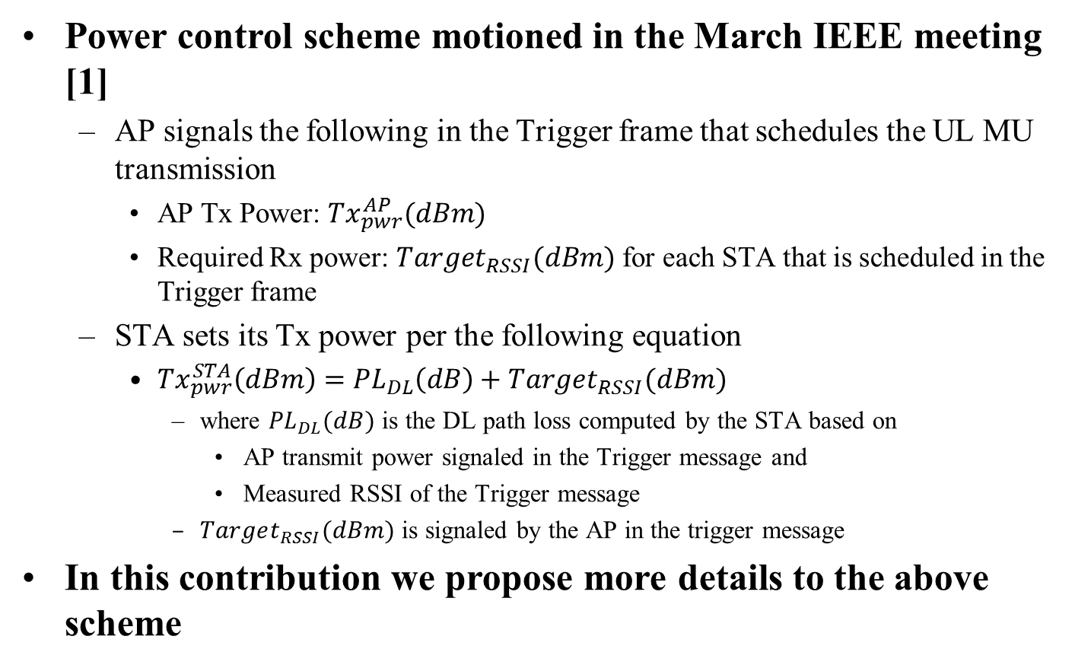
Overview
Power control scheme motioned in the March IEEE meeting [1]
  AP signals the following in the Trigger frame that schedules the UL MU transmission
    AP Tx Power: ${Tx}_{pwr}^{AP}(dBm)$
    Required Rx power: $Target_{RSSI}(dBm)$ for each STA that is scheduled in the Trigger frame
  STA sets its Tx power per the following equation
    ${Tx}_{pwr}^{STA}\left(dBm\right)={PL}_{DL}\left(dB\right)+Target_{RSSI}(dBm)$
      where ${PL}_{DL}(dB)$ is the DL path loss computed by the STA based on
        AP transmit power signaled in the Trigger message and
        Measured RSSI of the Trigger message
      $Target_{RSSI}(dBm)$ is signaled by the AP in the trigger message
In this contribution we propose more details to the above scheme

Slide 12
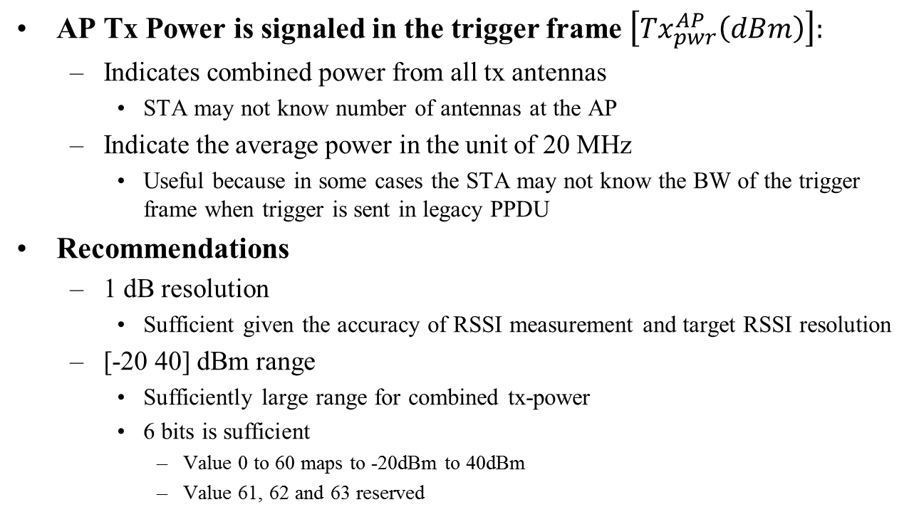
AP Tx power
AP Tx Power is signaled in the trigger frame $\left[{Tx}_{pwr}^{AP}\left(dBm\right)\right]:$
  Indicates combined power from all tx antennas
    STA may not know number of antennas at the AP
  Indicate the average power in the unit of 20 MHz
    Useful because in some cases the STA may not know the BW of the trigger frame when trigger is sent in legacy PPDU
Recommendations
  1 dB resolution
    Sufficient given the accuracy of RSSI measurement and target RSSI resolution
  [-20 40] dBm range
    Sufficiently large range for combined tx-power
    6 bits is sufficient
      Value 0 to 60 maps to -20dBm to 40dBm
      Value 61, 62 and 63 reserved

Slide 13
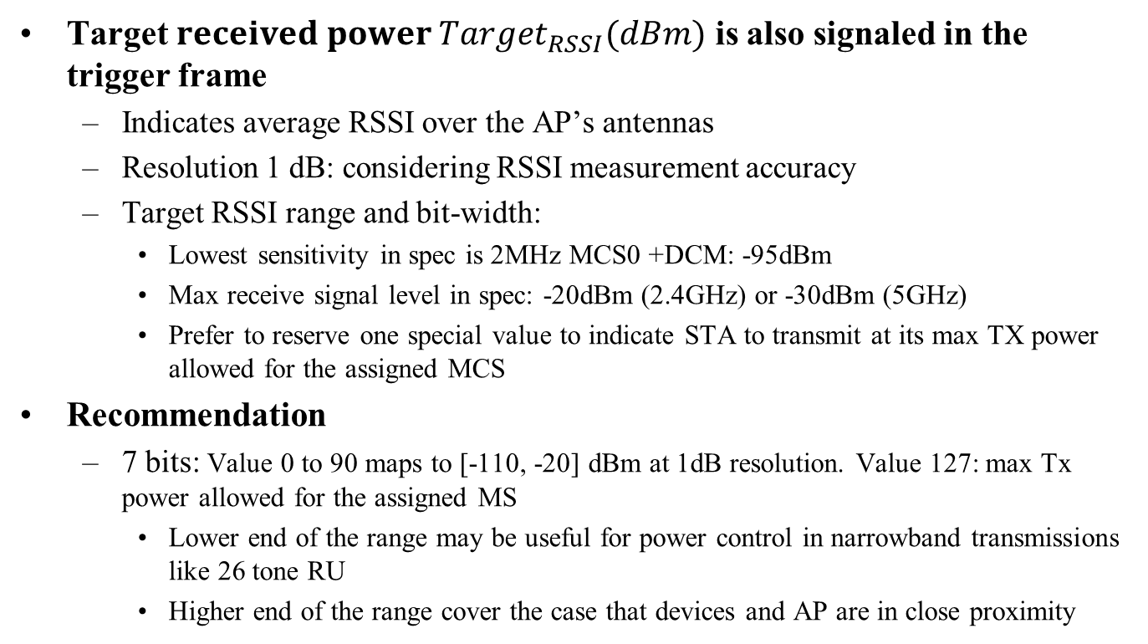
Target RSSI (per STA)
Target $received power Target_{RSSI}(dBm)$ is also signaled in the trigger frame
  Indicates average RSSI over the AP’s antennas
  Resolution 1 dB: considering RSSI measurement accuracy
  Target RSSI range and bit-width:
    Lowest sensitivity in spec is 2MHz MCS0 +DCM: -95dBm
    Max receive signal level in spec: -20dBm (2.4GHz) or -30dBm (5GHz)
    Prefer to reserve one special value to indicate STA to transmit at its max TX power allowed for the assigned MCS
Recommendation
  7 bits: Value 0 to 90 maps to [-110, -20] dBm at 1dB resolution. Value 127: max Tx power allowed for the assigned MS
    Lower end of the range may be useful for power control in narrowband transmissions like 26 tone RU
    Higher end of the range cover the case that devices and AP are in close proximity

Slide 14
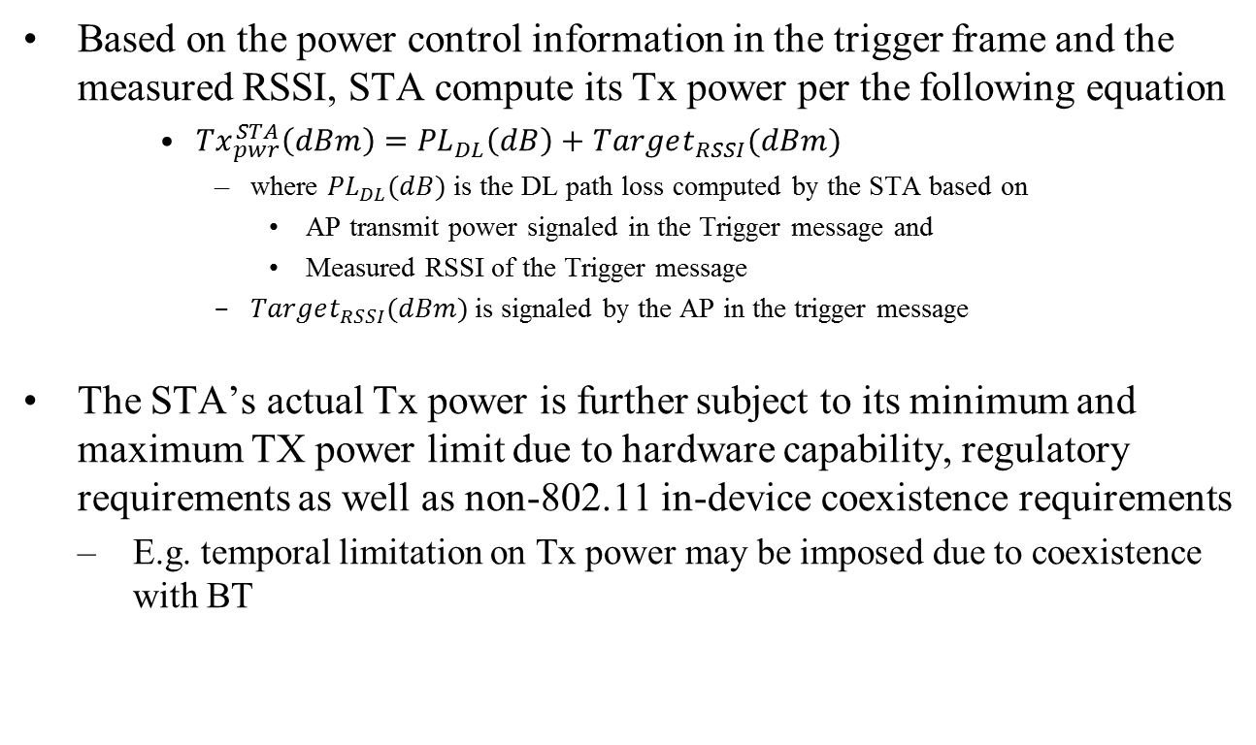
STA Tx Power
Based on the power control information in the trigger frame and the measured RSSI, STA compute its Tx power per the following equation
    ${Tx}_{pwr}^{STA}\left(dBm\right)={PL}_{DL}\left(dB\right)+Target_{RSSI}(dBm)$
      where ${PL}_{DL}(dB)$ is the DL path loss computed by the STA based on
        AP transmit power signaled in the Trigger message and
        Measured RSSI of the Trigger message
      $Target_{RSSI}(dBm)$ is signaled by the AP in the trigger message
    The STA’s actual Tx power is further subject to its minimum and maximum TX power limit due to hardware capability, regulatory requirements as well as non-802.11 in-device coexistence requirements
      E.g. temporal limitation on Tx power may be imposed due to coexistence with BT

Slide 15
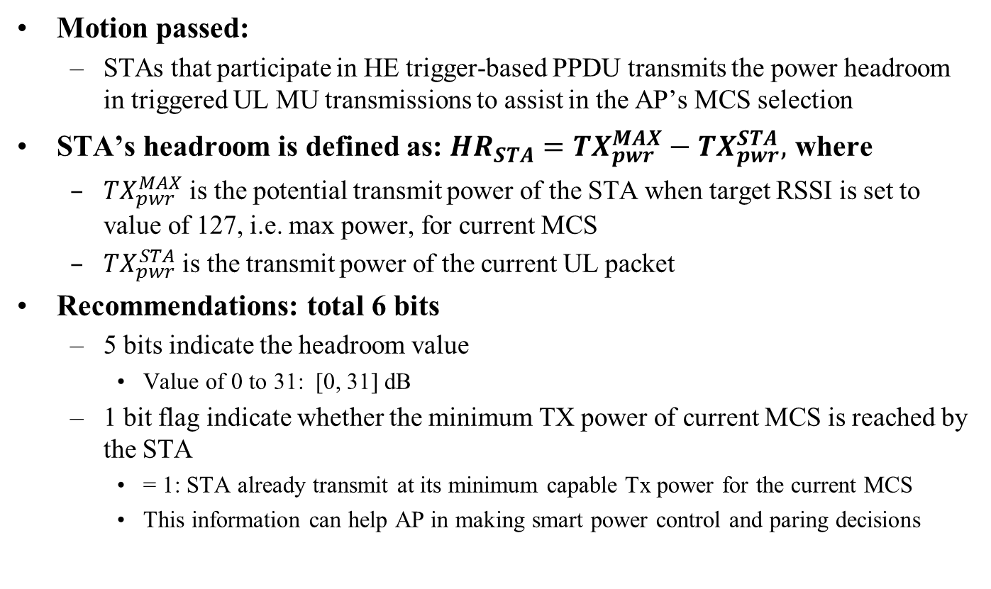
STA Headroom Indication
Motion passed:
  STAs that participate in HE trigger-based PPDU transmits the power headroom in triggered UL MU transmissions to assist in the AP’s MCS selection
STA’s headroom is defined as: $HR_{STA}={TX}_{pwr}^{MAX}−{TX}_{pwr}^{STA},$ where
  ${TX}_{pwr}^{MAX}$ is the potential transmit power of the STA when target RSSI is set to value of 127, i.e. max power, for current MCS
  ${TX}_{pwr}^{STA}$ is the transmit power of the current UL packet
Recommendations: total 6 bits
  5 bits indicate the headroom value
    Value of 0 to 31: [0, 31] dB
  1 bit flag indicate whether the minimum TX power of current MCS is reached by the STA
    = 1: STA already transmit at its minimum capable Tx power for the current MCS
    This information can help AP in making smart power control and paring decisions

Slide 16
RSSI Accuracy Requirement
Specifying RSSI measurement accuracy at STA can be useful, although most of the control relies on relative accuracy
  Useful for power controlling first multi-user UL transmission from a STA
  RSSI estimation accuracy also has an impact on random access
  Some spatial reuse proposals also depends on RSSI measurement accuracy
Motion passed on RSSI measurement accuracy
  Class A: +/-2dB
  Class B: +/-5dB
Some feedbacks that the above RSSI accuracy requirement for class A may be tight, considering
  RSSI measurement variations over different temperature and frequency channels,
  Platform-level inaccuracy matters as well (front-end insertion loss variation),
  Potential error in test equipment

Slide 17
RSSI Accuracy Requirements
Recommendations
  Relax the RSSI requirement of class A STA to +/-3 dB
  Notes on RSSI measurement
    RSSI is measured over legacy preamble
    RSSI accuracy requirements shall be applied to receive signal level range from -82dBm to -20dBm (2.4GHz) or -30dBm (5GHz)
    The requirements are stated for nominal (room) temperature conditions

Slide 18
Summary
In this contribution we present recommendations on following details of power control scheme
  AP Tx power indication
  Target RSSI indication
  STA Tx power
  STA headroom indication
  RSSI accuracy requirement

Slide 19
Straw Poll 1
Do you agree to add the following text to 11ax SFD
  The AP Tx power is signaled in trigger frame using 6 bits.
  Value 0 to 60 maps to -20dBm to 40dBm with 1dB resolution. Value 61, 62 and 63 are reserved.
  AP Tx power is defined as the averaged power in 20MHz unit and is the combined power over all Tx antennas.

Slide 20
Straw Poll 2
Do you agree to add the following text to 11ax SFD
  The target received power (RSSI) in trigger frame is signaled using 7 bits.
  Value 0 to 90 maps to -110 to -20dBm target received signal level with 1dB resolution.
  Value 127 indicates STA to transmit at its max power allowed for the assigned MCS
  Other values are reserved.

Slide 21
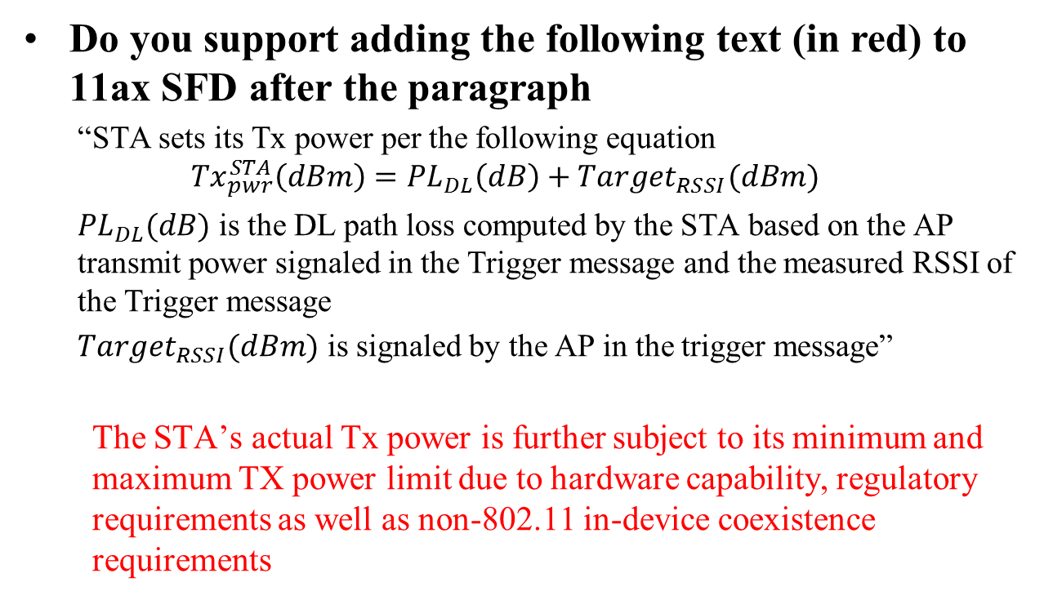
Straw Poll 3
Do you support adding the following text (in red) to 11ax SFD after the paragraph
  “STA sets its Tx power per the following equation
  $${Tx}_{pwr}^{STA}\left(dBm\right)={PL}_{DL}\left(dB\right)+Target_{RSSI}(dBm)$$
  ${PL}_{DL}(dB)$ is the DL path loss computed by the STA based on the AP transmit power signaled in the Trigger message and the measured RSSI of the Trigger message
  $Target_{RSSI}(dBm)$ is signaled by the AP in the trigger message”
  The STA’s actual Tx power is further subject to its minimum and maximum TX power limit due to hardware capability, regulatory requirements as well as non-802.11 in-device coexistence requirements

Slide 22

Straw Poll 4
Do you agree to add the following text to 11ax SFD
  STA’s power headroom is signaled using 6bits
  5 bits indicate the headroom value of [0 31]dB with resolution of 1dB
  1 bit flag indicates whether the minimum TX power of the current MCS is reached by the STA (=1: transmit at its minimum capable Tx power for current MCS)
  where a STA’s headroom is defined as: $HR_{STA}={TX}_{pwr}^{MAX}−{TX}_{pwr}^{STA},$ where
  ${TX}_{pwr}^{MAX}$ is the potential transmit power of the STA when target RSSI is set to value of 127, i.e. max power, for current MCS and current UL packet
  ${TX}_{pwr}^{STA}$ is the transmit power of the current UL packet

Slide 23
Straw Poll 5
Do you agree to make the following changes (highlighted in red) to 11ax SFD
  STAs that participate in HE trigger-based PPDU shall support the following absolute Tx power requirements and the RSSI measurement accuracy requirements for the two device classes:
  Class A:
    Tx power accuracy: +/-3dB
    RSSI measurement accuracy: +/-2dB +/- 3dB
  Class B:
    Tx power accuracy: +/-9dB
    RSSI accuracy: +/-5dB
  The RSSI accuracy requirements shall be applied to receive signal level range from -82dBm to -20dBm (2.4GHz) or -30dBm (5GHz). The requirement is stated for nominal (room) temperature conditions. RSSI is measured over legacy preamble

Slide 24
References
[1] IEEE 802.11-16/0413r0 Power Control for UL MU

