Slide 1
Simulation-based evaluation of DSC in enterprise scenario
Date: 2016-May
Authors:

Slide 2
1. Context
May 2016
Spatial reuse in the SFD
The amendment shall include one or more mechanisms to improve spatial reuse by allowing adjustments to one or more of the CCA-ED, 802.11 Signal Detect CCA, OBSS_PD or TXPWR threshold values. The constraints on selecting threshold values are TBD”
DSC could be used to select these threshold values
DSC: Dynamic Sensitivity Control
DSC widely studied in TGax WG: DSC increases per-user throughput in dense scenarios [1-12] but what about fairness? More than 20 contributions about DSC since July 2013 and only [12] studies fairness
In this submission we,
investigate the performance of DSC in enterprise scenario and recommend DSC parameters to use
Highlight the importance of fairness study while analyzing mechanisms supposed to increase spatial reuse

Slide 3
2. DSC: The big picture
May 2016
DSC varies CST levels for each station
Based on beacons RSSI: R
Stations close to the AP have a higher CST
Use of a margin M: CST = R – M
Help to take into account sudden
change in beacon signals
DSC decreases number of exposed nodes but increases hidden nodes
AP
CST STA1 = R
STA1
STA2
CST STA2 = R
CST STA1 = R
AP
CST STA2 = R
STA1
STA2
CST STA1 = R-M
CST STA2 = R-M

Slide 4
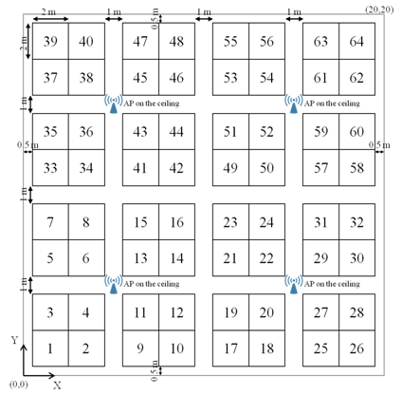
3. Scenarios and assumptions (1/3)
May 2016
Topology
Single floor office building,
8 offices: 4 APs per office i.e. 32 APs
64 cubicles per office
Each cubicle has 4 STAs so 8*64*4 = 2048 STAs
1 Cubicle = 4 STAs
8 offices
1 Office = 64 cubicles

Slide 5
3. Scenarios and assumptions (2/3)
May 2016
Channel allocation: 5GHz (based on [13])
Four 80MHz channels (Ch1 to Ch4)
Nine 40Mhz channels (Ch1 to Ch9)
Four 80MHz channels
Nine 40MHz channels
AP
Channel
1
2
3
4
5
6
7
8
9

Slide 6
3. Scenarios and assumptions (3/3)
May 2016
Parameters | Values
Traffic type | UDP CBR uplink transmissions in saturation conditions
MPDU size | 1538 Bytes (from SSD) (1544 Bytes in total incl. all overhead)
Aggregation | Aggregation: 32 MPDUs with 4-byte MPDU delimiter per A-MPDU No A-MSDU Implicit immediate BA
PPDU of Data frame | VHT PPDU (MCS 5, fixed)
Guard Interval | Short
CCA Threshold | -76 for 80MHz -79 for 40MHz
Simulator | ns-3

Slide 7
4. Metrics used for evaluation
May 2016
Aggregated throughput i.e. sum of STAs UDP throughputs observed at AP level
Fairness (Jain’s index [14])
Measure per STA throughput fairness i.e. a Jain’s fairness index of 1 means an equal portioning of throughput among STA
Jain’s fairness has to be studied conjointly with the aggregated throughput
Goodput Ratio
An illustration of fairness: Goodput Ratio GR
STA Goodput Ratio: GR_{i} = #APUDPReceived_{i} / #STAUDPSent_{i}
Aggregated Throughput is a good indicator but should not be the only one: what if the throughput gain is obtained only for few nodes at the expense of numberous others? Fairness is needed
0
75
75
75
10
20
50
75
Case 1: Jain’s index = 0.75
Case 2: Jain’s index = 0.70
Is case 1 really better than case 2?

Slide 8
5. Four 80MHz channels (1/4)
May 2016
Aggregated Throughput
*
Observations:
Margin highly affects DSC performances
DSC may allow to increase aggregated throughput compared to Legacy CCA threshold (up to 80%)
A DSC margin of 25dBm is giving the best results of all the CST tested for aggregated throughput
Conclusions:
Margin is a crucial parameter for the DSC as an incorrect margin parametrization could result in negative gain
* 80MHz: Legacy CCA threshold = -76dBm

Slide 9
5. Four 80MHz channels (2/4)
May 2016
Fairness: Jain’s Fairness Index
Observations:
DSC is not always increasing the fairness compared to Legacy CCA threshold ([12] observed the opposite for the residential scenario case whatever the tested margin)
A DSC margin of 25 seems the best compromise (same fairness than Legacy and 80% of aggregated throughput increase)
Conclusions:
DSC may increase fairness and aggregated throughput at the same time
Is Jain’s fairness representing everything? Let’s compare Legacy CCA with DSC m=25

Slide 10
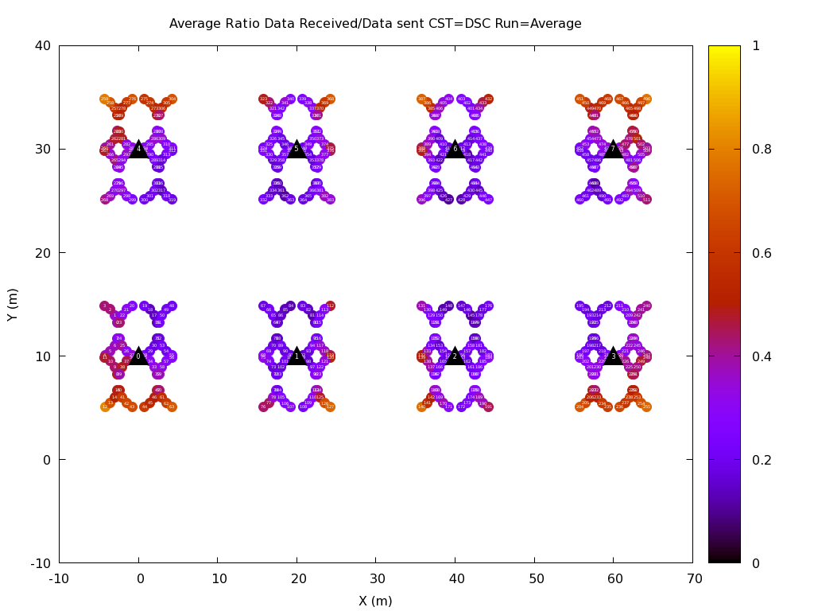
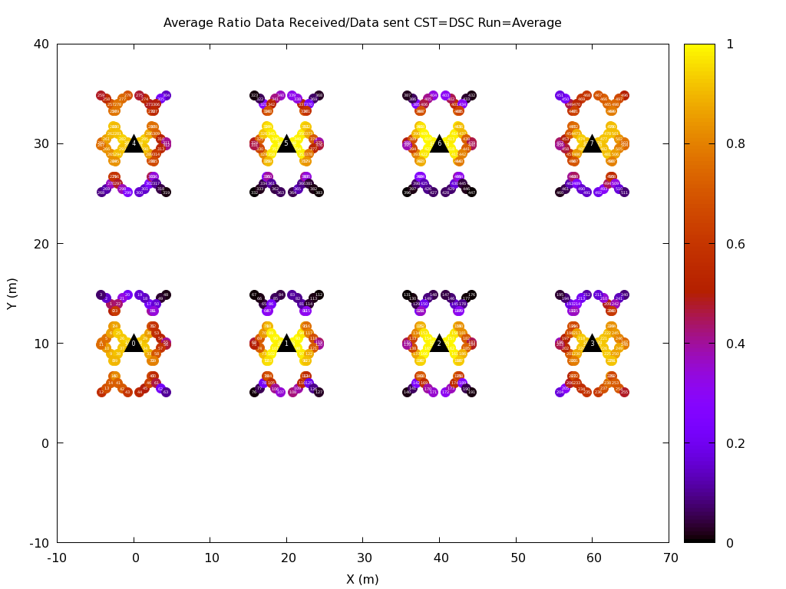
5. Four 80MHz channels (3/4)
May 2016
Goodput ratio GR: STA Goodput Ratio: GR_{i} = #APUDPReceived_{i} / #STAUDPSent_{i}
-76dBm (One channel)
DSC with m=25 (One channel)
Observations:
Legacy CCA threshold: at least a ratio of 0.10 for each STA
DSC: a non-insignificant percentage of STAs has a ratio close to 0
For Legacy STA, the closest STA has a low goodput ratio while it’s the opposite for DSC with a margin of 25
Conclusions:
DSC could worsen the situation even if aggregated throughput is increased
Jain’s fairness does not represent completely the fairness as CCA Legacy fairness is the same than DSC m=25
DSC with m=25 is not the best candidate

Slide 11
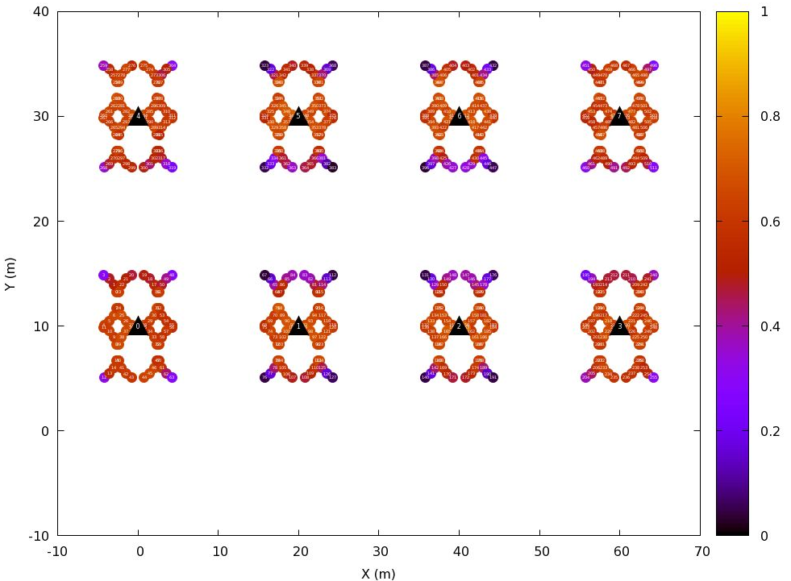
5. Four 80MHz channels (4/4)
May 2016
Probability Density Function of goodput Ratio
DSC with m=20 (One channel)
Observations:
Legacy CCA: No STA has a goodput ratio less than 0.10
DSC m=20 (best Jain Fairness): 45% of STA has a goodput ratio of 0.7
DSC m=25: 12% of STAs has a goodput ratio less than 0.1
Conclusions:
A DSC margin of 20dB is recommended for the four 80MHz scenario
DSC must be studied regarding both to fairness and goodput, not only for aggregated throughput

Slide 12
6. Nine 40MHz channel (1/3)
May 2016
Aggregated throughput
*
Observations:
Same behavior than for four 80Mhz Channel: Margin highly influences throughput
A DSC margin of -35dBm is giving the best results of all the tested margins for aggregated throughput
* 40MHz: Legacy CCA threshold = -79dBm

Slide 13
6. Nine 40MHz channel (2/3)
May 2016
Fairness: Jain’s Fairness Index
Observations:
DSC could increase fairness compared to CCA Legacy Threshold
Even if DSC with 35 margin is giving the best aggregated throughput, it does not seem to be the best candidate regarding to Jain’s fairness (m=25 seems to be as it increases both fairness and throughput)

Slide 14
6. Nine 40MHz channels (3/3)
May 2016
Probability Density Function of goodput Ratio
Observations:
Legacy CCA: 23% of STAs has a goodput ratio less than 0.10
DSC m=25 (best Jain Fairness): 65% of STA has a goodput ratio of 0.3. No STA has a ratio less than 0.1
DSC m=35: 40% of STAs has a goodput ratio less than 0.1
Conclusions:
DSC must be studied regarding to fairness and goodput, not only for aggregated throughput
A DSC margin of 25dB is recommended for the nine 40MHz scenario

Slide 15
7. Conclusions/next steps
DSC and more generally SR mechanisms must be studied not only regarding to aggregated throughput but also for STAs fairness and goodput
As stated in the SFD, “include one or more mechanisms to improve spatial reuse by allowing adjustments to one or more of the CCA-ED, 802.11 Signal Detect CCA, OBSS_PD or TXPWR threshold values. The constraints on selecting threshold values are TBD”
DSC scheme provides improvements in throughput but not always regarding to fairness and goodput. However, there is still a DSC margin value that allows increase in fairness, goodput and aggregated throughput (-20dB for four 80MHz channels and -25dB for nine 40MHz channels). DSC is a good candidate.
DSC parametrization is of crucial importance
DSC draft proposal [15]:
“A variety of methods could be used for the AP to determine these values (i.e. DSC algorithm parameter), either by pre-setting them based upon the location and environment of the network, or by a learning process”
The learning process should be investigated cause poor static DSC parameters configuration could lead to worse results than the Legacy CCA

Slide 16
8. References
Graham Smith, DSP Group, 11-13-1290-01 Dynamic Sensitivity Control for HEW
Graham Smith, DSP Group, 11-13-1487-02 Dense Apartment Complex Capacity Improvements with Channel selection and Dynamic Sensitivity Control
Graham Smith, DSP Group, 11-13-1489-05 Airport Capacity Analysis
Graham Smith, DSP Group, 11-14-0045-02 E-Education Analysis
Graham Smith, DSP Group, 11-14-0058-01 Pico Cell Use Case Analysis
Graham Smith, DSP Group, 11-14-0294-02 Dynamic Sensitivity Control Channel Selection and Legacy Sharing
Graham Smith, DSP Group, 11-14-0365-01 Dynamic Sensitivity Control Implementation
Graham Smith, DSP Group, 11-14-0328-02 Dense Apartment Complex Throughput Calculations
Graham Smith, DSP Group, 11-14-0779-00 Dynamic Sensitivity Control Practical Usage
Imad Jamil, Orange, 11-14-0523-00 Mac Simulation Results for DSC and TPC
William Carney, Sony, 11-14-0854-00 DSC and Legacy Coexistence
Shahwaiz Afaqui, 11-15-0027-1 Simulation-based evaluation of DSC in residential scenario
Graham Smith, 11-15-0548-1 Enterprise scenario and DSC
J. R., “Fairness: How to measure quantitatively?”
Graham Smith, DSP Group, 11-16-0310-1-00 CCA Proposal DSC Text

