Slide 1
Backoff Procedure Handling Upon TF Reception
Date: 2016-05-11
Authors:

Slide 2
Abstract
The submission discusses the behaviour of STA backoff procedure after receiving a TF (Trigger Frame)
We propose a method to modify the current STA backoff behaviour to give higher priority to scheduled channel access

Slide 3
Background
TF has been specified in 802.11ax to trigger data transmission from one or multiple STAs to an AP
Scheduled transmission may reduce collision probability
  The number of nodes contending simultaneously for channel access may be reduced
Scheduled MU transmission may reduce access latency
  Scheduled MU transmissions provide UL access opportunities for multiple devices simultaneously

Slide 4
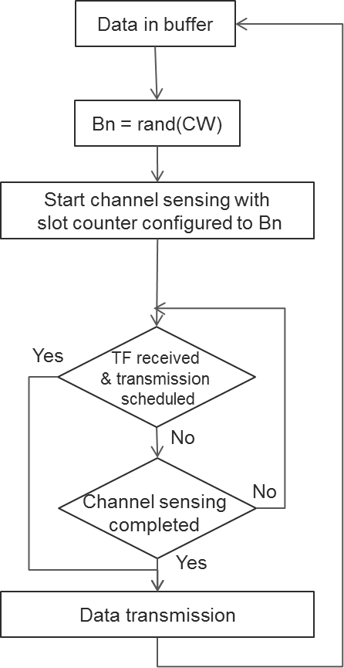
Current Behaviour
Currently, data transmission may be allowed after channel sensing or by TF scheduling.
After data is transmitted, a new value of the slot counter will be drawn for random backoff procedure if the data buffer is not empty

Slide 5
Problem of Current Behavior
When scheduled STA transmissions and sensing based STA channel access coexist, AP and STAs usually have equal opportunities to access channel
The number of nodes contending for channel access is not reduced in this case
Both collision reduction and access latency reduction may not be realized without prioritizing the scheduled transmissions

Slide 6
Proposals to Solve the Problem
Principle: once a STA obtains UL channel access from a TF, the STA will transmit its UL data during the scheduled period. After this period ends the STA will again start contending for channel access. The sensing based channel access should be down prioritized in order to reduce STA initiated channel contention
The proposed method should allow the STA apply a relatively large value of the slot counter after the STA transmits data with scheduled channel access

Slide 7
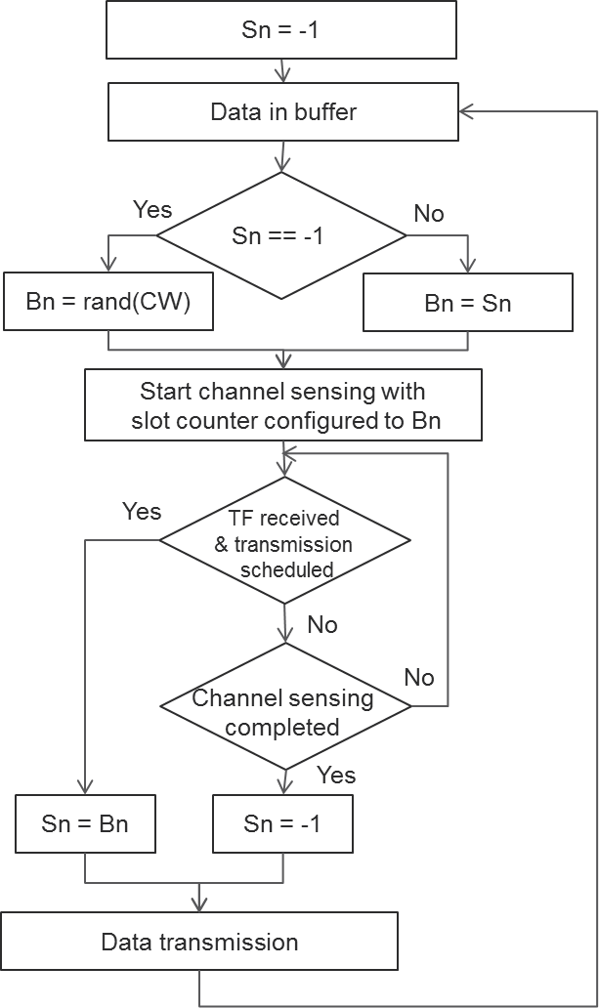
Proposed Method
A new parameter Sn is proposed to store the slot counter value
If data transmission is scheduled by a TF, the parameter Sn is set to Bn. The Bn value is then used in the subsequent channel sensing process

Slide 8
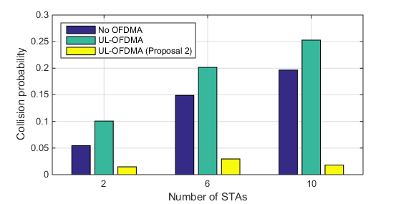
Simulation Results
Scenario: 1 AP, 2/6/10 STAs, UL full buffer traffic, RU are equally distributed among STAs
When UL-OFDMA is applied with TF scheduling, the collision probability increases since the AP becomes an additional contending node for channel access
Collision probability is reduced significantly by the proposed method
NO OFDMA
UL OFDMA
Proposed method

Slide 9
Discussion on the Proposed Method
Impact to latency
  The latency may be improved with reduced collision probability
  In case a STA is scheduled by an AP only once, the proposed method may increase latency in the order of tens of microseconds due to the statistically larger slot counter value
Impact to fairness
  The fairness is kept among ax STAs if all STAs apply the method
  Since legacy STA can not be scheduled by TF, the fairness between ax STAs and legacy STAs may be improved by the proposed method

Slide 10
Conclusion
A method is proposed which modifies the current channel sensing procedure in order to reduce STA initiated channel contention after STAs get scheduled channel access

Slide 11
Straw Poll
Do you believe that scheduled medium access should be prioritized over sensing based medium access?
  Yes
  No
  Abstain
Do you believe the method proposed in this contribution is a suitable remedy to achieve fairness between scheduled and sensing based access?
  Yes
  No
  Abstain

