Slide 1
QoS Handling of Trigger Frame
Date: 2016-05-11
Authors:

Slide 2
Abstract
The submission discusses the TF (Trigger Frame) transmission handling in a QoS STA
We identify two options to configure EDCA (Enhanced Distributed Channel Access) parameters for the TF
We identify two options to handle backoff for TF transmission respect to the 802.11e framework

Slide 3
Transmission Priority of TF
When an AP transmit a TF that elicits an HE trigger-based PPDU, the TF competes for channel access with other STAs
If the TF is mapped to an AC in a QoS STA, it competes for channel access with the traffic of other ACs in the same STA
The transmission priority of the TF is decided by the EDCA parameters, e.g. IFS (Inter-Frame Spacing) and CW (Contention Window) size

Slide 4
EDCA Transmission Prioritization
With EDCA, ACs have been specified in IEEE 802.11e with four priorities realized by different sensing duration before transmission
  EDCA forms basis for all devices implementing 802.11n and later
Wi-Fi Alliance Wi-Fi Multimedia (WMM) almost equal to 802.11e EDCA
AC | CWmin | CWmax | AIFSN
AC_BK | aCWmin | aCWmax | 7
AC_BE | aCWmin | aCWmax | 3
AC_VI | (aCWmin+1)/2−1 | aCWmin | 2
AC_VO | (aCWmin+1)/4−1 | (aCWmin+1)/2−1 | 2

Slide 5
EDCA Parameters for TF
Two options to configure EDCA parameters for the TF
Option 1: fixed EDCA parameters
  It’s suggested to apply AC_VO parameters to prioritize TF for scheduled transmissions
Option 2: variable EDCA parameters
  TF may have the same priority as the traffic it solicits from one or multiple STAs
  When the multiple STAs have different priorities, the TF should apply the parameters of the highest one
  It’s TBD how an AP obtain the traffic priority knowledge from the STAs, e.g. by including such info in BSR (Buffer Status Report)

Slide 6
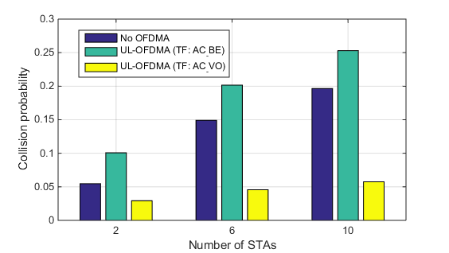
Simulation Results
Option 1 has been simulated in the following scenario
  1 AP, 2/6/10 STAs, UL full buffer traffic (AC_BE)
Collision probability is reduced significantly by the proposed method

Slide 7
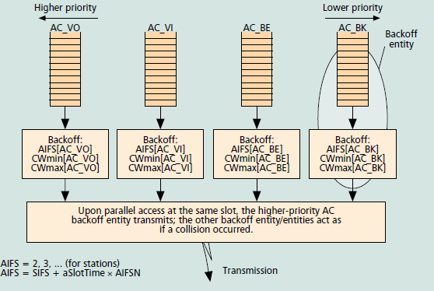
802.11e Framework of Backoff Processes in One QoS STA
In a QoS STA, each AC maintains an independent backoff process
Different ACs compete for channel access with the independent processes
Figure source: [1]

Slide 8
TF and AC Backoff Processes in a STA
Two options to handle backoff for TF transmission
Option 1: TF backoff in the 802.11e framework
  By placing TF in one of the AC queues and follow the backoff procedures specified in 802.11e
Option 2: TF backoff out of the 802.11e framework
  Once a STA decides to transmit a TF, it starts a dedicated backoff process with certain EDCA parameters
  The backoff processes specified in 802.11e halt until the TF is sent

Slide 9
Scheduling TF with TWT
TF may be scheduled with the Target Wake Time (TWT) signaling [2] [3]
  Scheduled concepts (HCCA, TWT etc.) need coordination if same frequency channel is shared
  Scheduling “gain” comes from centralized decision making
  However, neighboring schedulers do not align schedules
    Contention based during wake period reduces collision probability
Contention parameters need to be carefully selected
  If schedules are not aligned TWT periods can become very busy among neighbors
  TWT incentives devices to be mostly active during such periods

Slide 10
Conclusion
Two options are identified to configure EDCA parameters for TF
  Fixed or variable EDCA parameters
Two options are identified to handle backoff for TF transmission
  In or out of the 802.11e framework

Slide 11
Straw Poll
Do you prefer Trigger Frames to be sent with
  fixed EDCA AC_VO parameters, or
  EDCA parameters depending on the AC of solicited data, or
  don’t you have an opinion?
  A) 2 B) 15 C) 31
Do you believe a separate backoff process should be applied to TF besides the per AC processes?
  Yes
  No
  No opinion
  Y/N/A: 13/19/19

Slide 12
References
[1] S. Mangold et al., “Analysis of IEEE 802.11 for QoS Support in Wireless LANs,” Dec. 2003. IEEE Wireless Communications
[2] A. Asterjadhi (Qualcomm) et. al., 11-15-0880-02-00ax-Scheduled Trigger frames
[3] A. Asterjadhi (Qualcomm) et. al., 11-15-1319-00-00ax-Scheduled Trigger frames – Follow up

