Slide 1
802.11 May 2016 Closing Reports
Date: 2016-05-20
Authors:

Slide 2
Abstract
This document is a digest of the closing reports of all 802.11 sub-groups for presentation at the May 2016 closing plenary meeting. Attendance information and liaison reports (including liaison reports from the mid-week plenary) are also included.
R1 Adds JTC1 closing report

Slide 3
Attendance

Slide 4
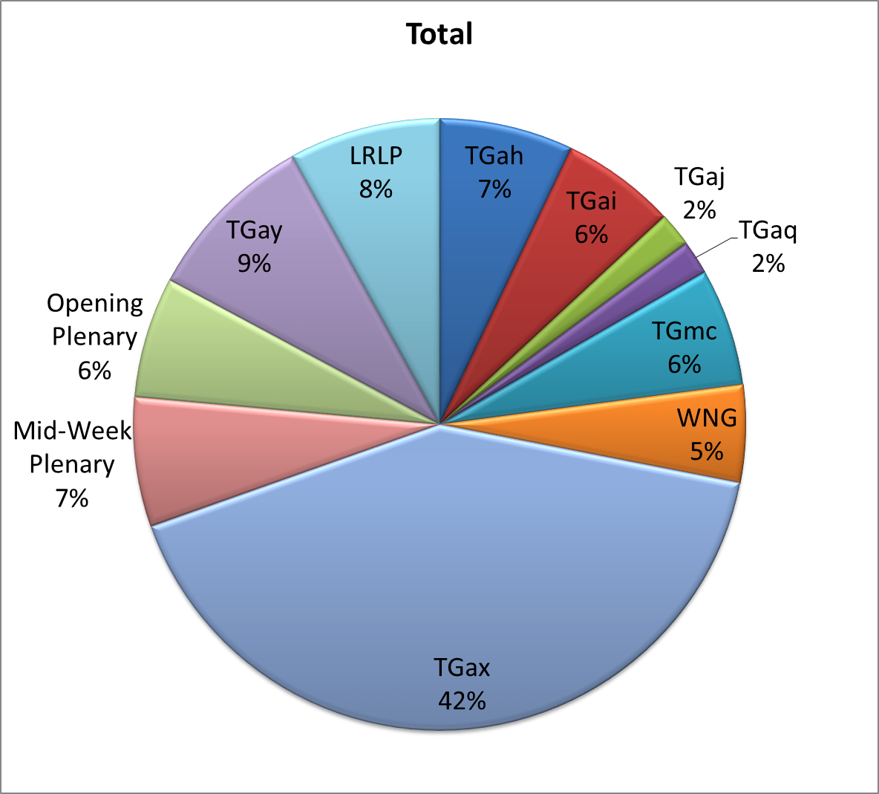
Attendance Total

Slide 5
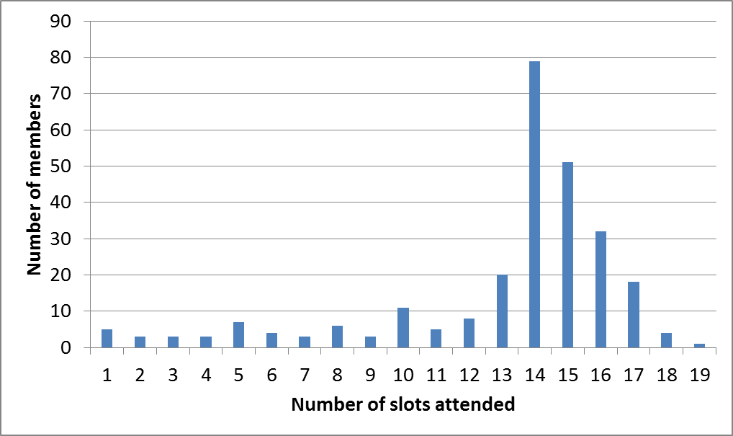
Attendance Histogram (Thu)

Slide 6
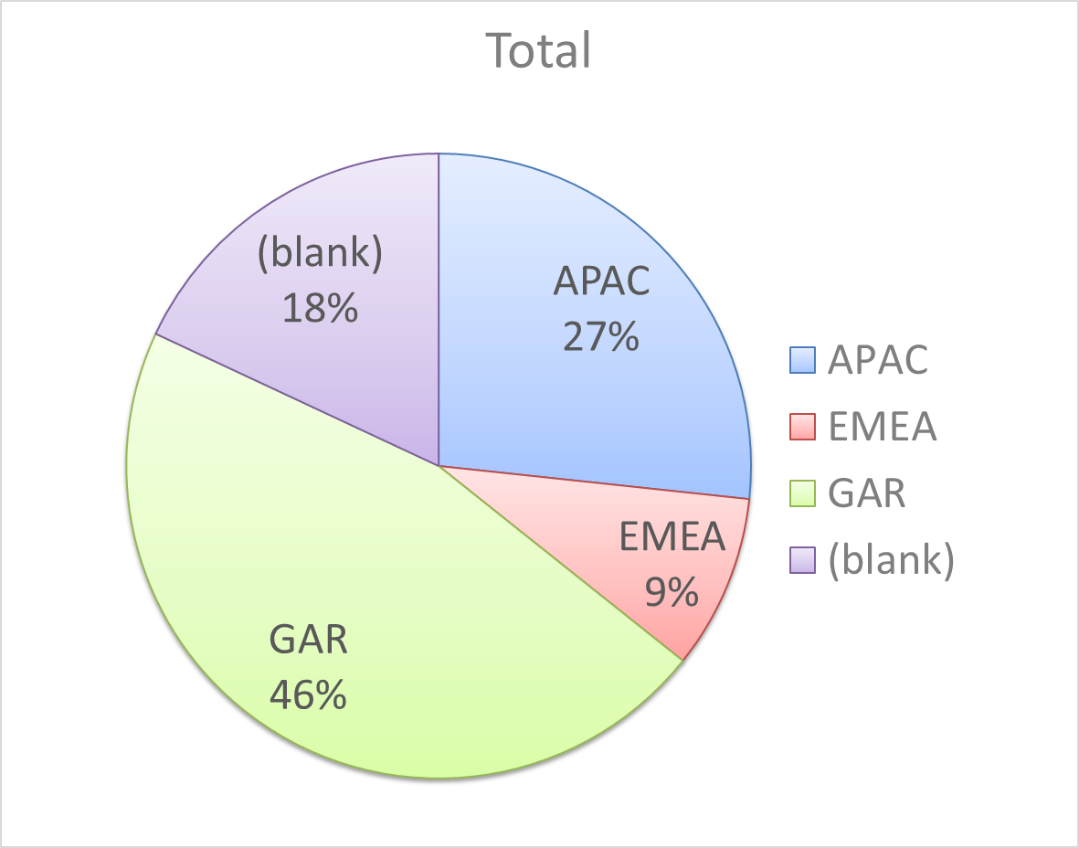
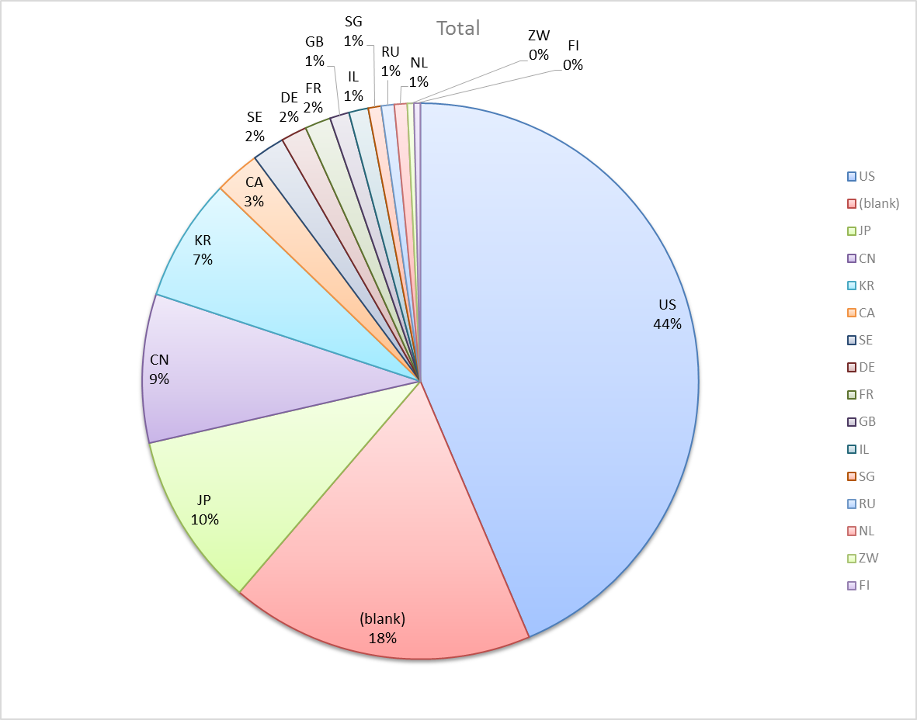
Attendance by Country

Slide 7
Doc Revision uploads by meeting (month #)

Slide 8
802.11 WG Editor’s Meeting (May ‘16)
Date: 2016-05-19
Authors:
from slide 1/7 of 11-16-0603 by Peter Ecclesine (Cisco Systems)
Notes:
July 2007

Slide 9
Volunteer Editor Contacts
TGmc – Adrian Stephens – adrian.p.stephens@intel.com, Edward Au – edward.ks.au@huawei.com, Emily Qi – emily.h.qi@intel.com
TGah – Yongho Seok yongho.seok@gmail.com, Alfred Asterjadhi – aasterja@qti.qualcomm.com
TGai – Lee Armstrong – LRA@tiac.net, Ping FANG Ping.FANG@huawei.com
TGaj – Jiamin CHEN – jiamin.chen@mail01.huawei.com , Shiwen He – shiwenhe@seu.edu.cn
TGak – Donald Eastlake – d3e3e3@gmail.com, Norm Finn – nfinn@cisco.com
TGaq – Lee Armstrong – LRA@tiac.net
  TGax – Robert Stacey – robert.stacey@intel.com
  TGay – Carlos Cordeiro – carlos.cordeiro@intel.com
  TGaz – Chao Chun Wang – chaochun.wang@mediatek.com
  Editors Emeritus:
  TGaa – Alex Ashley – alex.ashley@hotmail.co.uk
  TGac – Robert Stacey – robert.stacey@intel.com
  TGad – Carlos Cordeiro – carlos.cordeiro@intel.com
  TGae – Henry Ptasinski – henry@LOGOUT.COM
  TGaf – Peter Ecclesine – pecclesi@cisco.com
  TGaq – Dan Gal – ddrgal@gmail.com
from slide 2/7 of 11-16-0603 by Peter Ecclesine (Cisco Systems)
Notes:
July 2007

Slide 10
MDR Status
802.11 Working Group Mandatory Draft Review
  802.11-11/615r6 documents the process. MDR now in the 802.11 Operating Manual 802.11-14/0629r8. The process needs some change so the report is done after the editing is done.
P802.11aa D5.0 went through Working Group Mandatory Editorial Coordination before July 2011
P802.11ad D4.0 went through Working Group Mandatory Editorial Coordination before July 2011
P802.11ae D4.0 went through Working Group Mandatory Editorial Coordination before July 2011
P802.11ac D4.0 went through Working Group Mandatory Draft Review before January 2013
P802.11af D4.0 went through Working Group Mandatory Draft Review before May 18, 2013
REVmc D3.0 went through MDR process – 802.11-14/781r11 dated Sept 19, 2014
P802.11ah D4.0 went through MDR process – 802.11-15/247r3 dated Mar 12, 2015
P802.11ai D4.0 went through MDR process – 802.11-15/248r4 dated May 14, 2015
We need to start planning for P802.11aq and 802.11ak – expect 11aq to be ready at D5.0 (May),
Expect 11ak D4.0 to be ready in July.
from slide 3/7 of 11-16-0603 by Peter Ecclesine (Cisco Systems)

Slide 11
802.11 Style Guide
See 11-09-1034-11-0000-wg11-style-guide.doc
  We updated 802.11 WG Style Guide based on 2012 IEEE Standards Style Manual and consistency changes in final publication of the 802.11 standard
Editor’s responsibility includes checking the 2014 IEEE Standards Style Manual when creating or updating drafts. https://development.standards.ieee.org/myproject/Public/mytools/draft/styleman.pdf
Submissions with draft text should conform to both the WG11 Style Guide and IEEE Standards Style Manual
Note that the Style Guide evolves with our practice, expect a revision in March
from slide 4/7 of 11-16-0603 by Peter Ecclesine (Cisco Systems)

Slide 12
Editor Amendment Ordering
Data as of May 2016
See http://grouper.ieee.org/groups/802/11/Reports/802.11_Timelines.htm
In Nov 2015, Editors changed the running order and will revisit in July 2016, maintaining this order in the interim
Amendment Number | Task Group | Projected REVCOM Date
802.11REVmc | TGmc - 3856 | Jan 2017
802.11-2016 Amendment 1 | TGai - 190 | Jan 2017
802.11-2016 Amendment 2 | TGah - 655 | Jan 2017
802.11-2016 Amendment 3 | TGaq - 46 | Jan 2017
802.11-2016 Amendment 4 | TGak - 98 | Jan 2017
802.11-2016 Amendment 5 | TGaj - 174 | Jun 2017
802.11-2016 Amendment 6 | TGax - 159 | Mar 2019
Amendment numbering is editorial! No need to make ballot comments on these dynamic numbers!
from slide 5/7 of 11-16-0603 by Peter Ecclesine (Cisco Systems)
Notes:
July 2007

Slide 13
Draft Development Snapshot
May 2016
TG | Published or Draft Baseline Documents |  |  |  |  |  |  |  |  |  | Source | MDR | Style Guide | Editor | Snapshot Date
 | Published | mc | ai | ah | aq | ak | aj | ax | ay | az
mc | Y | 5.4 |  |  |  |  |  |  |  |  | Frame 12.0 | Yes | 2012 | Adrian Stephens Edward Au, Emily Qi | 16-May
ai | N | 5.0 | 7.1 |  |  |  |  |  |  |  | Frame 12.0 | Yes | 2012 | Lee Armstrong Ping FANG | 16-May
ah | N | 5.0 |  | 8.0 |  |  |  |  |  |  | Frame 11.0 | Yes | 2012 | Yongho Seok Alfred Asterjadhi | 17-May
aq | N | 5.0 |  |  | 4.0 |  |  |  |  |  | Frame 12.0 | No | 2012 | Lee Armstrong | 16-May
ak | N | 5.0 | 6.0 | 5.0 | 1.2 | 2.1 |  |  |  |  | Word | No | 2012 | Donald Eastlake Norm Finn | 17-May
aj | N | 4.2 | 6.2 | 5.0 | 3.0 | 1.3 | 1.0 |  |  |  | Frame 10.0 | No | 2012 | Jiamin Chen Shiwen He | 17-May
ax | N | 5.0 | 6.0 | 5.0 | 3.0 | 1.0 | 1.0 | 0.1 |  |  | Frame 12.0 | No | 2012 | Robert Stacey | 17-May
ay |  |  |  |  |  |  |  |  |  |  |  | No | 2012 | Carlos Cordeiro | 15-May
az |  |  |  |  |  |  |  |  |  |  |  |  |  | Chao Chun Wang | 18-May
Most current doc shaded green.
Changes from last report shown in red.
from slide 6/7 of 11-16-0603 by Peter Ecclesine (Cisco Systems)
Notes:
July 2009
July 2007
Peter Ecclesine (Cisco Systems)
Page 13

Slide 14
MIB style, Visio and Frame practices
I’m going to suggest going forward we use a single style with appropriately set tabs, and use leading Tabs to distinguish the syntax and description parts. (Adrian Stephens Feb 9, 2010)
Figure in an anchored frame within a table, and use a table caption as a figure caption
Keep embedded figures using visio as long as possible
  Near the end of sponsor ballot, turn these all into .wmf (windows meta file) format files (you can do this from visio using “save as”). Keep separate files for the .vsd source and the .wmf file that is linked to from frame. There is likelihood we should use .emf
Frame templates for 11aa, 11ac, 11af
Text version of MIB is available (2012, ae2012, aa2012, ad2012, acD5.0, afD5.0. mcD3.0)
from slide 7/7 of 11-16-0603 by Peter Ecclesine (Cisco Systems)

Slide 15
ARC Closing Report
Date: 2016-05-19
Authors:
from slide 1/7 of 11-16-0744 by Mark Hamilton (Ruckus Wireless)

Slide 16
Abstract
This document is the closing report for ARC SC,
May 2016 Meeting in Waikoloa, Hawaii, USA
from slide 2/7 of 11-16-0744 by Mark Hamilton (Ruckus Wireless)

Slide 17
Work Completed
Agenda is here: https://mentor.ieee.org/802.11/dcn/16/11-16-0518-03-0arc-arc-sc-agenda-may-2016.ppt
Re-affirmed Joe Levy (InterDigital) as Vice Chair and Secretary
Noted status of “802.11 as a component/5G/IMT-2020”
  Being handled in Ad Hoc, and EC SC 5G. No action needed.
Noted status of IEEE 1588 mapping to IEEE 802.11
  No changes. No action needed.
Noted status of IETF/802 Coordination
  Updated details of status and activities. No action needed.
Noted status of 802.1AC revision
  Another Sponsor Ballot closed, but still waiting for the RAC to assign an EtherType
from slide 3/7 of 11-16-0744 by Mark Hamilton (Ruckus Wireless)

Slide 18
Work Completed (cont)
Status of joint topics with TGak (General Links)
  Discussions on teleconferences about how to visually represent “stacks” and “service interfaces” may affect TGak discussions, too early to tell.
  TGak is still struggling with what an ESS means in their context. ARC SC can help with this.
MIB Design Pattern work item
  Discussed.
  No real progress recently. Have missed our target to complete a version we can include in the MDR process, out of the May meeting.
What is an ESS?
  Long discussion. No consensus, yet.
  Leaning toward a new view/definition, that includes all the “black boxes” (like DS, Bridges) and provides an end-to-end service that hides mobility/location/topology
from slide 4/7 of 11-16-0744 by Mark Hamilton (Ruckus Wireless)

Slide 19
Work Completed (cont)
Joint meeting with TGaq
  Continued discussion on “What is an ESS?”.
  It seems to work to continue the leaning toward a slightly higher-level, end-to-end service that “hides” location/mobility/topology.
from slide 5/7 of 11-16-0744 by Mark Hamilton (Ruckus Wireless)

Slide 20
Teleconference(s)
None planned
May schedule with 10 days notice
from slide 6/7 of 11-16-0744 by Mark Hamilton (Ruckus Wireless)

Slide 21
July 2016 Plans
Two standalone meeting slots planned:
  Update on 802.11 as a component/5G/IMT2020 (monitoring 802 EC SC work)
  Design Pattern for MIB attribute use
  DS/AP/Portal architecture discussions, and “what is an ESS?”
  Status of IETF work:
One joint session with Tgak and 802.1
  802.11ak architecture discussions
from slide 7/7 of 11-16-0744 by Mark Hamilton (Ruckus Wireless)

Slide 22
IEEE 802.11/15 Regulatory SC
Waikoloa Closing Report
Date: 2016-05-20
Authors:
from slide 1/6 of 11-16-0521 by Rich Kennedy, Hewlett Packard Enterprise

Slide 23
Abstract
This presentation is the closing report for the May 2016 IEEE 802.11/15 Regulatory Standing Committee meeting in Waikoloa.
from slide 2/6 of 11-16-0521 by Rich Kennedy, Hewlett Packard Enterprise

Slide 24
Agenda
Administrative items
Introduction
Reports & Discussion
  FCC DSRC Stakeholders Meeting
  FCC 16-55
  NITA IoT RFC
  ETSI Updates
  Dynamic Spectrum Alliance Global Summit
  Ofcom 5 GHz Consultation
Actions required
  Ofcom 5 GHz Consultation input for 802.18
  TBD
AOB and Adjourn
from slide 3/6 of 11-16-0521 by Rich Kennedy, Hewlett Packard Enterprise

Slide 25
Regulatory Updates
FCC meeting on sharing with ITS/DSRC in the 5.9 GHz band
FCC 16-55 Second R&O in 3.5 GHz
NTIA RFC on IoT
ETSI BRAN update
Dynamic Spectrum Alliance Global Summit
Ofcom 5 GHz Consultation
Petition for Reconsideration on U-NII-3 OOBE
from slide 4/6 of 11-16-0521 by Rich Kennedy, Hewlett Packard Enterprise

Slide 26
Input for 802.18
Ofcom consultation on opening the 5 GHz band
Ask 802.18 to address the 10 questions and prepare a response
from slide 5/6 of 11-16-0521 by Rich Kennedy, Hewlett Packard Enterprise

Slide 27
Teleconferences, etc.
No more Regulatory SC teleconferences
We will continue with SC meetings for two more meetings, until the transition to 802.18 is shown to be effective
I will continue to act as Chair until the end
from slide 6/6 of 11-16-0521 by Rich Kennedy, Hewlett Packard Enterprise

Slide 28
Closing Report
Date: 2016-05-20
Authors:
from slide 1/3 of 11-16-0728 by Jim Lansford, Chair (Qualcomm)

Slide 29
Abstract
Closing report for WNG SC for May 2016 in Waikoloa, Hawaii (USA)
from slide 2/3 of 11-16-0728 by Jim Lansford, Chair (Qualcomm)

Slide 30
Final Agenda
https://mentor.ieee.org/802.11/dcn/16/11-16-0514-01-0wng-agenda-for-wng-2016-05.ppt
Reconfirmation
Lei Wang (Marvell) was reconfirmed as vice-chair by unanimous consent
Presentations at May 2016 meeting
  “LiFi presentation and demo,” Nikola Serafimovski (PureLiFi)
    https://mentor.ieee.org/802.11/dcn/16/11-16-0708-01-0wng-lifi-presentation-and-demo.pptx
  “Proposal for LP-WUR Study Group,” Minyoung Park (Intel)
    https://mentor.ieee.org/802.11/dcn/16/11-16-0605-03-0wng-proposal-for-lp-wur-study-group.pptx
  “Discussion of 802.11 inputs to 5G EC SC,” Joseph Levy (InterDigital)
    https://mentor.ieee.org/802.11/dcn/16/11-16-0651-03-0000-802-11-discussion-of-inputs-to-802-ec-5g-sc.pptx
Minutes
  https://mentor.ieee.org/802.11/dcn/16/11-16-0706-00-0wng-wng-meeting-minutes-of-2016-may-waikoloa.docx
Plans for July 2016
  TBD
from slide 3/3 of 11-16-0728 by Jim Lansford, Chair (Qualcomm)

Slide 31
IEEE 802 JTC1 SC closing report
(May 2016)
Date: 2016-05-20
Author:
from slide 1/5 of 11-16-0754 by Peter Yee, AKAYLA

Slide 32
Abstract
Closing report for IEEE 802 JTC1 SC
for May 2016 in Waikoloa
from slide 2/5 of 11-16-0754 by Peter Yee, AKAYLA

Slide 33
The SC did not have a great deal of work this week and only one session was required
Reviewed status of PSDO pipeline
  IEEE 802 has pushed 18 standards completely through the PSDO ratification process
  IEEE 802 has 11 standards in or about to go into the PSDO ratification process
Reviewed latest PSDO activities
  802.22a and 802.22b received comments during 60-day pre-ballot
  Several standards (in 802.1, .3) have pending 60-day pre-ballots
  802.15.4 and 802.15.6 will probably be submitted soon
from slide 3/5 of 11-16-0754 by Peter Yee, AKAYLA

Slide 34
The SC did not have a great deal of work this week and only one session was required
Reviewed results for SC6 meeting in Mar 2016
  Topics of possible interest
    While various topics of potential interest were on the agenda, the minutes are not yet available
  SC6 will send IEEE 802 a liaison related to the PSDO process; we will deal with it during our July plenary session
  Next SC6 meeting is in Tunisia in early 2017
from slide 4/5 of 11-16-0754 by Peter Yee, AKAYLA

Slide 35
The SC will focus in San Diego on PSDO processes
Continue executing PSDO processes
Discuss any further material from SC6 meeting results
from slide 5/5 of 11-16-0754 by Peter Yee, AKAYLA

Slide 36
IEEE 802.11mc Closing Report for
May 2016
Date: 2016-05-19
Authors:
from slide 1/6 of 11-16-0747 by Dorothy Stanley, HPE

Slide 37
Abstract
This document contains the TGmc closing report for May 2016.
from slide 2/6 of 11-16-0747 by Dorothy Stanley, HPE

Slide 38
Status
Sponsor Ballot Comment resolution
  828 comments received (initial recirc SB, 90% approval) on P802.11REVmc D5.0. Approximately 80 comments remain to be resolved.
Considered available presentations related to comments in initial recirculation ballot
Agenda, includes motions
  https://mentor.ieee.org/802.11/dcn/16/11-16-0511-10-000m-tgmc-agenda-may-2016.pptx
Comment resolution spreadsheet
  https://mentor.ieee.org/802.11/dcn/15/11-15-0532-44-000m-revmc-sponsor-ballot-comments.xls
from slide 3/6 of 11-16-0747 by Dorothy Stanley, HPE

Slide 39
TGmc Plan of Record - modified
20 July 2012 – 12 Sept 2012 – Call for Comment/Input
29-30 Aug 2012 – NesCom, SASB PAR Approval
Sept 2012 – Begin to process CC input, 11aa, 11ae integration
Dec 2012 – March/May 2013 – 11ad integration
Jan 2013 – First WG Letter ballot - without 11ad – on D1.0
Sept 2013 – Letter ballot on D2.0
Dec 2013 – May 2014 – 11ac, 11af integration – D3.0 in May 2014
July 2014 – Mandatory Draft Review
Jan 2015 – D4.0 Recirculation
Form Sponsor Pool: Open Dec 15th or so, close Feb 20, 2015 –good for 6 months (end of July 2015)
D4.0 Initial Sponsor Ballot 2015-03-27 through 2015-04-26
D5.0 Jan 2016 Initial SB recirculation
D6.0 May 2016 Second Recirculation <- will be in June
D6.0/D7.0 June Third Recirculation
July 2016 – WG/EC Final Approval
September 2016 – RevCom/SASB Approval
Slide 39
from slide 4/6 of 11-16-0747 by Dorothy Stanley, HPE
Notes:
doc.: IEEE 802.11-10/0503r4
May 2010
Michael Montemurro, Research in Motion
Page 39

Slide 40
TGmc SB Planning
Initial Sponsor Ballot 2015-03-27 through 2015-04-26 on D4.0
January/February 2016
  Initial SB recirculation D5.0 2016 -01-11 through 2016-01-26
  Teleconferences, Feb 22-25 2016 BRC Ft. Lauderdale meeting
March/April/May 2016
  Comment resolution
June/July 2016
  2nd, 3rd recirculation D6.0, D6.0 unchanged or D7.0
July 2016 – WG/EC Final Approval
September 2016 – RevCom/SASB Approval
  RevCom Submission date: 05 Aug 2016 for Sept 16 RevCom teleconference
from slide 5/6 of 11-16-0747 by Dorothy Stanley, HPE
Notes:
doc.: IEEE 802.11-10/0503r4
May 2010
Michael Montemurro, Research in Motion
Page 40

Slide 41
May – June 2016 Meeting Planning
Objectives: Completer Initial Recirculation Sponsor Ballot comment resolution and open Second recirculation
Conference calls 10am Eastern 3 hours
  Friday May 27, June 3 teleconferences 3 hours
Ballot Resolution Committee meeting –
  None currently scheduled
Availability of 11mc in the IEEE store
  D5.0 is available (add D5.0 after SB approval), see http://www.techstreet.com/ieee/products/1867583
Forward to ISO JTC1/SC6 WG1
  D5.0 forwarded; D6.0 will be forwarded upon SB approval
from slide 6/6 of 11-16-0747 by Dorothy Stanley, HPE

Slide 42
IEEE 802.11ah Closing Report for
March 2016
Date: 2016-05-19
Authors:
from slide 1/6 of 11-16-0742 by Alfred Asterjadhi and Yongho Seok

Slide 43
Abstract
This presentation is the closing report for the Waikoloa meeting of the IEEE 802.11 TGah.
from slide 2/6 of 11-16-0742 by Alfred Asterjadhi and Yongho Seok

Slide 44
Activity in TGah
Sponsor Ballot for Draft 8.0 closed May 17th
  94.85% approval rate
  2 comments received
TGah has completed all comment resolution of the 3rd Sponsor Recirculation Ballot for Draft 8.0
  https://mentor.ieee.org/802.11/dcn/16/11-16-0721-02-00ah-tgah-sb3-comments-on-d8-0.xlsx
Agenda:
  https://mentor.ieee.org/802.11/dcn/16/11-16-0516-03-00ah-may-2016-agenda.pptx
from slide 3/6 of 11-16-0742 by Alfred Asterjadhi and Yongho Seok

Slide 45
Going forward
Prepare EC report, and ask for approval in the July F2F meeting
from slide 4/6 of 11-16-0742 by Alfred Asterjadhi and Yongho Seok

Slide 46
Teleconference
Weekly teleconferences between March 22th 2016 and August 09th 2016
  Tuesday 8PM ET for 2.5 hours
from slide 5/6 of 11-16-0742 by Alfred Asterjadhi and Yongho Seok

Slide 47
TGah Timeline –No Changes
Internal Task Group Ballot : May 2013
Initial Letter Ballot : September 2013
Initial Recirculation Letter Ballot : September 2014
Initial Sponsor Ballot : October 2015
Initial Recirculation Sponsor Ballot : January 2016
EC Approval : July 2016
Revcom Approval : September 2016
from slide 6/6 of 11-16-0742 by Alfred Asterjadhi and Yongho Seok

Slide 48
IEEE 802.11TGai
Closing Report
Date: 2016-05-20
Authors:
Name | Company | Address | Phone | email
Hiroshi MANO | Koden Techno Info K.K. | Fuji Blg 28 2F, 2-7-26 Kita-Aoyama, Minato-ku, Tokyo, 107-0061, Japan | +81-3-6890-0594 | mano@koden-ti.com hiroshi@manosan.org
from slide 1/10 of 11-16-745 by Hiroshi Mano (KDTI)

Slide 49
Abstract
This presentation is the closing report for the Waikoloa meeting of the IEEE 802.11 TGai.
from slide 2/10 of 11-16-745 by Hiroshi Mano (KDTI)

Slide 50
IEEE 802.11 FILS TGai – May 2016 Waikoloa
Goals for the Meeting:
  Approve minutes of past meeting and teleconference
  Comment resolution to 1st recirc sponsor LB
  Approve to forward the 2nd recirc sponsor LB
  Approve Timeline
  Approve Teleconference schedule
  Approve Plan for July
from slide 3/10 of 11-16-745 by Hiroshi Mano (KDTI)

Slide 51
Accomplishments TGai 1/2
7 regular slots
Approve TGai Meeting Minutes for the IEEE 802.11 Atlanta meeting:
  16-0186r0
  https://mentor.ieee.org/802.11/dcn/16/11-16-0186-00-00ai-january-2016-atlanta-sesssion-minutes.doc
Approve TGai teleconference meeting minutes of Atlanta to Waikoloa meeting.
  16-0272r09
  https://mentor.ieee.org/802.11/dcn/16/11-16-0272-09-00ai-january-may-teleconference-minutes.doc
from slide 4/10 of 11-16-745 by Hiroshi Mano (KDTI)

Slide 52
Accomplishments TGai 2/2
D7.1 was opened in WG members area.
Received 176 comments by1st recirc SB
  Resolved 172 of received comment by CRC (Teleco & Waikoloa)
  4 remained comment
Re-affirm the TG Vice Chair& Secretary
Approved Plan for July 2016
Approved Time line
Approved Teleconference schedule
from slide 5/10 of 11-16-745 by Hiroshi Mano (KDTI)

Slide 53
Plan for July
Goals for the July Meeting:
  Approve minutes of past meeting and teleconference
  Continue on comment resolution
  Approve to forward the 2nd recirc sponsor LB
  Approve Timeline
  Approve Teleconference schedule
  Approve plan for Sep
from slide 6/10 of 11-16-745 by Hiroshi Mano (KDTI)

Slide 54
Time line of TGai (No Change)
  PAR Approved, Modified, or Extended 2010-12-08
  WG Letter Ballots Initial / Recirc Mar14/Sep14/Jan15/
  Mar15/Jul15/Aug15
  MEC Done Nov14
  Form Sponsor Ballot Pool / Reform Mar15
  IEEE-SA Sponsor Ballots Initial / Recirc Sep 15/Mar 16/Jul 16/Sep 16
  Final 802.11 WG Approval Aug 16
  final or Conditional 802 EC Approval July 16
  RevCom & Standards Board Final or
  Continuous Process Approval Sep 16
  ANSI Approved N/A
from slide 7/10 of 11-16-745 by Hiroshi Mano (KDTI)

Slide 55
Teleconference Schedule
Motion:
  Approve the teleconference with 10days advanced notification before July meeting.
  Duration 1.0 Hour
  Using WEB-EX that will be provided by Task Group Chair
from slide 8/10 of 11-16-745 by Hiroshi Mano (KDTI)

Slide 56
Reference
TGai-Motion-deck (11-13-1186/44)
  https://mentor.ieee.org/802.11/dcn/13/11-13-1186-44-00ai-tgai-motion-deck.pptx
Comments from 1st recirc SB (11-16-0505/10)
  https://mentor.ieee.org/802.11/dcn/16/11-16-0505-10-00ai-tgai-comments-from-sb-1st-recirc.xlsx
from slide 9/10 of 11-16-745 by Hiroshi Mano (KDTI)

Slide 57
Thanks to all who participated!
from slide 10/10 of 11-16-745 by Hiroshi Mano (KDTI)

Slide 58
IEEE 802.11aj May 2016 Closing Report
Date: 2016-05-19
Author:
from slide 1/7 of 11-16-0729 by Jiamin Chen (Huawei)

Slide 59
Abstract
This document is the TGaj closing report for the May 2016 session.
from slide 2/7 of 11-16-0729 by Jiamin Chen (Huawei)

Slide 60
Work Completed (1/2)
  Approved March meeting minutes (11-16/0502r0)
The following comment resolution proposals have been presented
  11-16/0685r0 - LB217 Comment Resolutions to CID 99, 122, and 163
  11-16/705r2 -Proposed resolution to CID 41, 42, 44, 84, 98, 111, 151 and 168 in LB217
  11-16/715r2 - lb217-comment-resolutions-to-cid-51-104, 105, 150 and 115
  11-16/719r1 - Proposed resolution to CID 100, 101, 102, etc. in LB217
  11-16/718r0 - LB217 Comment Resolutions to CID 106 – 109
Completed all comment resolution of the LB217 for D1.0
Approved those comment resolutions and instruct editor to incorporate them into D2.0.
from slide 3/7 of 11-16-0729 by Jiamin Chen (Huawei)

Slide 61
Work Completed (2/2)
Approve a 15 day Working Group Technical Recirculation Letter Ballot asking the question “Should P802.11aj D1.0 be forwarded to Sponsor Ballot?”
  Reaffirmed Haiming WANG as vice chair of the TGaj.
Approved to co-locate future TGaj China interim with 802.11 WG interim
from slide 4/7 of 11-16-0729 by Jiamin Chen (Huawei)

Slide 62
Plan for July meeting
Comment Resolution for 802.11aj D2.0 Recirculation WG Letter Ballot
Review Task Group Timeline
from slide 5/7 of 11-16-0729 by Jiamin Chen (Huawei)

Slide 63
Conference Call Time
  7th July, 2016, 9pm ET for 1 hour
  (8th July, 2016, 9am Beijing Time)
from slide 6/7 of 11-16-0729 by Jiamin Chen (Huawei)

Slide 64
Thank you！
from slide 7/7 of 11-16-0729 by Jiamin Chen (Huawei)

Slide 65
TGak May Closing Report
Date: 2016-05-19
Authors:
from slide 1/4 of 11-16-0748 by Donald Eastlake, Huawei Technologies

Slide 66
Abstract
Closing Report of IEEE 802.11 Task Group ak at the IEEE 802.11 Meeting, March 2016, held at the Hilton Waikoloa, Big Island, Hawai‘i.
from slide 2/4 of 11-16-0748 by Donald Eastlake, Huawei Technologies

Slide 67
TGak Closing Report
Accomplishments
  Met jointly:
    With 802.11 ARC SC Thursday AM1.
  Generated Draft D2.1 and D2.2 which have been posted.
  TGak has resolved 227 of our 346 comments from recirculation LB218 and all unresolved comments have been assigned to someone.
  An annotated agenda is in 11-16/0513.
  The minutes will be in 11-16/0749.
from slide 3/4 of 11-16-0748 by Donald Eastlake, Huawei Technologies

Slide 68
TGak Closing Report
Teleconferences
  Decided to hold 1 ½ hour teleconferences, to be joint with 802.1Qbz if mutually convenient, on Monday, June 6th, 13th, and 20th, and July 11th, all at 10am Eastern US time.
July 2016 Plans
  Resolve comments from WG recirculation ballot.
  Joint meeting with 802.11 ARC SC and 802.1 TSN.
from slide 4/4 of 11-16-0748 by Donald Eastlake, Huawei Technologies

Slide 69
TGaq Closing Report
Date: 2016-05-19
Authors:
from slide 1/3 of 11-16-0737 by Stephen McCann, BlackBerry

Slide 70
Abstract
Closing report for TGaq (Pre-Association Discovery) for May 2016, Waikoloa.
from slide 2/3 of 11-16-0737 by Stephen McCann, BlackBerry

Slide 71
LB219 Comment Resolution Analysis
  93% approval, 71 comments
  Comment resolution complete and will request re-circulation letter ballot
Discussion topics
  Solicited PAD
  Service Hash element
Mandatory Draft Review (MDR)
  Will send D4.1 for MDR at the end of May/Early June
  Editor will then prepare D5.0 for letter ballot to complete by the start of the July 2016 face to face meeting
Plans for July 2016
  Work on comment resolutions from D5.0 re-circulation ballot
  Intend to request conditional sponsor ballot at the EC meeting
from slide 3/3 of 11-16-0737 by Stephen McCann, BlackBerry

Slide 72
TGax May 2016 Closing Report
Date: 2016-05-19
Authors:
from slide 1/6 of 11-16-0739 by Osama Aboul-Magd (Huawei Technologies)

Slide 73
Abstract
This document is the closing report for the TGax for the May 2016 session.
from slide 2/6 of 11-16-0739 by Osama Aboul-Magd (Huawei Technologies)

Slide 74
Work Completed
Received about 70 submissions. Majority of the submission were requesting changes to the TG Specification Framework. Few submission were addressing comment resolution mainly of the PHY clause.
Agreed to terminate the Specification Framework process. The frame of reference is Draft D0.1.
  Future submissions shall bring text to continue developing the TG draft
  The TG Technical Editor is planning to generate draft D0.2 based on outcome of this meeting
Approved the resolutions of about 200 comments, most of them addressing the PHY clause
Revisited the timeline and accepted a new modified timeline – next slide.
from slide 3/6 of 11-16-0739 by Osama Aboul-Magd (Huawei Technologies)

Slide 75
Timeline
Proposed Timeline
Current Timeline
May 2014: start of the TG
Nov. 2014: First draft of the TG SFD was approved
Jan. 2016: proposed TG draft
March 2016: Draft D0.1 was approved and CC started
September 2016: Draft 1.0 and WG letter ballot
March 2017: Draft 2.0 and recirculation
July 2017: MDR (Mandatory Document Review)
November 2017: Formation of SB pool
March 2018: Sponsor Ballot
December 2018: RevCom
May 2014: start of the TG
Nov. 2014: First draft of the TG SFD was approved
Jan. 2016: proposed TG draft
March 2016: Draft D0.1 was approved and CC started
July 2016: Draft 1.0 and WG letter ballot
March 2017: Draft 2.0 and recirculation
Jan 2018: Sponsor Ballot
from slide 4/6 of 11-16-0739 by Osama Aboul-Magd (Huawei Technologies)

Slide 76
July 2016 Goals
Continue with comment resolutions
from slide 5/6 of 11-16-0739 by Osama Aboul-Magd (Huawei Technologies)

Slide 77
Conference Call Times
June (2, 16, 30), July 14 10:00 – 12:00 ET
June 23, July 7, August 4 20:00 – 22:00 ET
from slide 6/6 of 11-16-0739 by Osama Aboul-Magd (Huawei Technologies)

Slide 78
Task Group AY
May 2016 Closing Report
Date: 2016-05-19
Authors:
from slide 1/6 of 11-16-0746 by Edward Au (Huawei Technologies)

Slide 79
Abstract
This document is the closing report for Task Group AY for the May 2016 session.
from slide 2/6 of 11-16-0746 by Edward Au (Huawei Technologies)

Slide 80
Work Completed
16 submissions were covered during the meeting covering areas related to:
  Channel model
  Usage model
  Evaluation methodology
  Specification framework document
  Technologies
Draft response to 3GPP liaison on eLWA is reviewed and approved:
  https://mentor.ieee.org/802.11/dcn/16/11-16-0694-04-00ay-draft-liaison-response-to-r2-163148.docx
from slide 3/6 of 11-16-0746 by Edward Au (Huawei Technologies)

Slide 81
Progress on Task Group documents
Doc. No. | Title of the Task Group documents | Status
15/0625r3 | IEEE 802.11 TGay use cases | Approved in November 2015 as the baseline document
15/1150r4 | Channel models for IEEE 802.11ay | Draft proposal is under review and ongoing discussion
15/1074r0 | TGay functional requirements | Approved this week as the baseline document
15/0866r3 | TGay evaluation methodology | Approved this week as the baseline document
15/1079r2 | TGay selection procedure | Approved in November 2015
15/1358r3 | Specification framework for TGay | Texts corresponding to motions #37 - #50 are inserted in the latest version after the March 2016 plenary
16/0266r1 | A compendium of motions related to the contents of the specification framework document for TGay
from slide 4/6 of 11-16-0746 by Edward Au (Huawei Technologies)

Slide 82
Goals for July 2016 plenary
Advance on Task Group documents, with emphasis on Specification Framework document
Technical presentation
from slide 5/6 of 11-16-0746 by Edward Au (Huawei Technologies)

Slide 83
Teleconference Schedule
June 29 (Wednesday), 10:00am ET to 11:00am ET
from slide 6/6 of 11-16-0746 by Edward Au (Huawei Technologies)

Slide 84
TGaz Next Generation Positioning
May Closing Report
Date: 2016-05-19
Authors:
from slide 1/6 of 11-16-0508 by Jonathan Segev, Intel Corporation

Slide 85
Abstract
This document is the Next Generation Positioning TGaz closing report for the Waikoloa meeting, May 2016.
from slide 2/6 of 11-16-0508 by Jonathan Segev, Intel Corporation

Slide 86
Work Completed
Reviewed and approved a working draft Functional Requirement Doc.
Motioned total of 17 functional requirements on accuracy/coverage and scalability sections.
Review and commit to an updated project timelines (no change to major milestones).
Agenda: See 11-16/492r3.
from slide 3/6 of 11-16-0508 by Jonathan Segev, Intel Corporation

Slide 87
Goals for July Meeting
Continue on Functional Requirement Document development.
Approve initial submissions of technical material towards SFD text where FRD is sufficiently mature.
Review technical submissions on channel models, proposed technical protocols and technical approaches and such.
from slide 4/6 of 11-16-0508 by Jonathan Segev, Intel Corporation

Slide 88
Activity timelines post the May meeting
2015
2016
2017
2018
2019
2020
2021
SG
Formation
1-15
TG formation
9-15
.11az SFD
5-2016
.11az
Draft 1.0
(Sep. 2017)
.11az
Draft 2.0
(Mar 2018)
.11az
Final
(May. 2020)
UCD
FRD
SFD feature Freeze
5/15-11/15
11/15-5/16
11az SFD
FRD Freeze
5/16-9/17
Amendment text
Accuracy
coverage
FRD/tech
approach
Spec. frame work
Amendment text development
60Ghz
FRD/tech
approach
Spec. frame work
Amendment text development
Scalability
FRD/tech
approach
Spec. frame work
Amendment text development
from slide 5/6 of 11-16-0508 by Jonathan Segev, Intel Corporation

Slide 89
Teleconference Schedule
June 15th 10:00AM ET for 1hr.
from slide 6/6 of 11-16-0508 by Jonathan Segev, Intel Corporation

Slide 90
IEEE 802.11 LRLP TIG
May 2016 Closing Report
Date: 2016-05-20
Authors:
from slide 1/2 of 11-16-0753 by Tim Godfrey, EPRI

Slide 91
LRLP Closing Report
In the opening meeting of LRLP, a straw poll indicated support for focusing LRLP primarily on low power operation, as a means to gain broader support
  Straw Poll: 25 for, 5 against, 16 abstain
In WNG, the membership of 802.11 expressed strong support for the LP-WUR proposal.
In the second meeting of LRLP, the membership expressed a strong preference against pursuing development of the low power operational mode, to focus exclusively on sleep mode through the LP-WUR
Straw poll to continue development of LRLP: 1 for, 42 against, 32 abstain)
The work of the LRLP TIG has been completed with the launch of study group addressing a similar scope. Therefore the LRLP TIG has been disbanded.
from slide 2/2 of 11-16-0753 by Tim Godfrey, EPRI

Slide 92
802.24 Vertical Applications
Technical Advisory Group
Liaison Report
Date: 2016-05-18
Author:
from slide 1/3 of 11-16-0727 by Tim Godfrey, EPRI

Slide 93
802.24 Overview
802.24 Vertical Applications TAG
802.24.1 Smart Grid TG
802.24.2 IoT TG
802.24.1 Smart Grid Task Group
  Internal / external coordination in matters related application of IEEE 802 standards for Smart Grid
  802.24.1 TG meets at Plenaries and Wireless Interims
802.24.2 IoT Task Group
  Internal / external coordination in matters related application of IEEE 802 standards for Internet of Things (IoT)
  802.24.2 TG meets at Plenaries and 802 Interims
May Agenda: 24-16-0014r0
Report 24-16-0015r1
Minutes 24-16-0016r0
from slide 2/3 of 11-16-0727 by Tim Godfrey, EPRI

Slide 94
802.24 Activities – May 2016
24.1 Smart Grid TG:
  White paper development on Sub 1 GHz wireless
    Nearing completion - Draft at: 24-15-0029r8
  Started defining next white paper
    Comparison of commercial cellular and commercial IoT services with 802 wireless standards for grid applications
    Outline developed - 24-16-0017r0
Student Paper Competition outcome
  One paper submitted
  Meareg Abreha from Ethiopia
  Paper Title “History and implementation of the IEEE 802 security architecture”
  Will present paper at July Plenary
from slide 3/3 of 11-16-0727 by Tim Godfrey, EPRI

Slide 95
IEEE 802.11-IETF Liaison Report
Date: 2016-05-18
Authors:
from slide 1/17 of 11-16-0428 by Dorothy Stanley, HPE

Slide 96
Abstract
This presentation contains the IEEE 802.11 – IETF liaison report for May 2016.
from slide 2/17 of 11-16-0428 by Dorothy Stanley, HPE

Slide 97
IETF Meetings
Upcoming Meetings:
  July 17-22, 2016 – Berlin
  November 13-18, 2016 – Seoul Korea
  March 26-31, 2017 – Chicago
  July 16-21, 2017 - Prague
http://www.ietf.org
  Newcomer training: https://www.ietf.org/edu/process-oriented-tutorials.html#newcomers
  Wireless Tutorial (Donald Eastlake), 802.11 & 802.15 tutorials (Dorothy Stanley, Charlie Perkins) https://www.ietf.org/edu/tutorials.html
  http://tools.ietf.org/dailydose/
from slide 3/17 of 11-16-0428 by Dorothy Stanley, HPE

Slide 98
IETF- IEEE 802 Liaison Activity
Joint meetings, agenda and presentations
  http://www.iab.org/activities/joint-activities/iab-ieee-coordination/
  2016-02-01 teleconference held;
  Sept 9th, 2016 F2F meeting planned
  802.1E (Privacy Considerations) and 802.c (Local MAC address usage) and 802.1 tutorials requested for July; Present 802.11/.15 tutorials again in Nov
RFC 7241, “The IEEE 802/IETF Relationship” has been published (RFC4441 update)
  https://datatracker.ietf.org/doc/rfc7241/
IEEE 802 Liaisons list is available
  http://ieee-sa.centraldesktop.com/802liaisondb/FrontPage
802 EC “IETF/IAB/IESG” 802 EC Standing Committee
  Formed March 2014, Pat Thaler as chair
  Next meeting at July Plenary
from slide 4/17 of 11-16-0428 by Dorothy Stanley, HPE

Slide 99
Multicast Topics
Multicast issues were discussed at the IETF-IEEE 802 meeting Sept 29th 2015 and a presentation given at the November 2015 IETF meeting
  See https://mentor.ieee.org/802.11/dcn/15/11-15-1261-02-0arc-mulicast-performance-optimization-features-overview-for-ietf-nov-2015.ppt
  Further actions: ietf mailing list has been established for ongoing discussion, will include additional 802. wireless groups, see http://www.ieee802.org/11/email/stds-802-11/msg01838.html
  Multicast considerations Internet draft describing use cases, issues, etc. under development, see https://tools.ietf.org/html/draft-perkins-intarea-multicast-ieee802-00
Insights
  Multicast used for multiple types of traffic including ARP/ND, routing protocols, video applications, and these might need to be transmitted at different MCS
  Implementations might consider APIs to allow MCS differentiation
  RFC 6775, Neighbor Discovery Optimization for IPv6 over Low-Power Wireless Personal Area Networks (6LoWPANs) defines a registration mechanism for accomplishing proxy ND
  Current Proxy ND support does not address Secure ND, see RFC 3971
Related documents
  http://datatracker.ietf.org/doc/draft-mcbride-mboned-wifi-mcast-problem-statement/
  http://www.ipv6council.be/IMG/pdf/20141212-08_vyncke_-_ipv6_multicast_issues-pptx.pdf
from slide 5/17 of 11-16-0428 by Dorothy Stanley, HPE

Slide 100
IETF BOFs For IETF April meeting
See https://datatracker.ietf.org/wg/bofs/
its | Intelligent Transportation Systems
mtgvenue | IAOC Meeting Venue Selection Criteria & Procedures
lpwan | Low-Power Wide Area Networks
arcing | Alternative Resolution Contexts for Internet Naming
babel | Babel routing protocol
lurk | Limited Use of Remote Keys
accord | Alternatives to Content Classification for Operator Resource Deployment
from slide 6/17 of 11-16-0428 by Dorothy Stanley, HPE

Slide 101
Of Interest to Smart Grid
6LO
  Working Group website: http://datatracker.ietf.org/wg/6lo/charter/
  Focus: IPv6 over Networks of Resource-constrained Nodes
  See WNG presentation: https://mentor.ieee.org/802.11/dcn/15/11-15-1085-00-0wng-6lowpan-over-802-11.pptx and
  http://datatracker.ietf.org/doc/draft-delcarpio-6lo-wlanah/
  https://tools.ietf.org/html/draft-thubert-6lo-routing-dispatch-06
  https://tools.ietf.org/html/draft-thubert-6lo-backbone-router-02
  Unique IPv6 Prefix Per Host, https://tools.ietf.org/html/draft-jjmb-v6ops-unique-ipv6-prefix-per-host-00
    The concepts in this document were originally developed as part of a large scale, production deployment of IPv6 support for a community Wi-Fi service.
ROLL: Working Group website: http://datatracker.ietf.org/wg/roll/
  Focus: Routing over Low Power and Lossy Networks
CORE : (Constrained RESTful Environments) Working Group website: http://datatracker.ietf.org/wg/core/
  Focus: framework for resource-oriented applications intended to run on constrained IP networks.
from slide 7/17 of 11-16-0428 by Dorothy Stanley, HPE

Slide 102
CAPPORT WG
CAPtive PORTal: https://datatracker.ietf.org/wg/capport/charter/
The CAPPORT Working Group will define secure mechanisms and protocols to
  allow endpoints to discover that they are in this sort of limited environment,
  provide a URL to interact with the Captive Portal, - allow endpoints to learn about the parameters of their confinement,
  interact with the Captive Portal to obtain information such as status and remaining access time, and
  optionally, advertise a service whereby devices can enable or disable access to the Internet without human interaction. (RFC 7710 may be a full or partial solution to the first two bullets)
Note: related to OWE proposal in TGmc, see https://mentor.ieee.org/802.11/dcn/15/11-15-1184-05-000m-owe.docx
from slide 8/17 of 11-16-0428 by Dorothy Stanley, HPE

Slide 103
RADEXT WG
See http://datatracker.ietf.org/wg/radext/
RADIUS Extensions
  The RADIUS Extensions Working Group will focus on extensions to the
  RADIUS protocol required to define extensions to the standard attribute space as well as to address cryptographic algorithm agility and use over new transports.
  In addition, RADEXT will work on RADIUS Design Guidelines and define new attributes for particular applications of authentication, authorization and
  accounting such as NAS management and local area network (LAN) usage.
Updates [May 2016]
  Updated: Data Types in the Remote Authentication Dial-In User Service Protocol (RADIUS), see https://datatracker.ietf.org/doc/draft-ietf-radext-datatypes/
  (Related) RFC 7664, “Dragonfly Key Exchange” published, see https://datatracker.ietf.org/doc/rfc7664/
from slide 9/17 of 11-16-0428 by Dorothy Stanley, HPE

Slide 104
Home Networking (homenet) WG
See https://datatracker.ietf.org/wg/homenet/
This working group focuses on the evolving networking technology
within and among relatively small "residential home" networks
  The task of the group is to produce an architecture document that outlines how to construct home networks involving multiple routers and subnets.
  This document is expected to apply the IPv6 addressing architecture, prefix delegation, global and ULA addresses, source address selection rules and other existing components of the IPv6
  architecture, as appropriate.
  Home Networking Architecture for IPv6, Published as IPv6 Home Networking Architecture Principle: http://datatracker.ietf.org/doc/rfc7368/
Updates [May 2016] Documents of interest:
  Updated: Home Networking Control Protocol, published as RFC 7788, see https://datatracker.ietf.org/doc/rfc7788/
  Of Interest: Home Network Wi-Fi Roaming, see https://datatracker.ietf.org/doc/draft-barth-homenet-wifi-roaming/
from slide 10/17 of 11-16-0428 by Dorothy Stanley, HPE

Slide 105
Operations Area Working Group
http://datatracker.ietf.org/wg/opsawg/
  Area WG processes submissions related to Operations Area WGs that have closed
  Control and Provisioning of Wireless Access Points (CAPWAP) Working Group closed in 2009
Responded to requests from OPSAWG chairs for IEEE 802.11 review
  “Alternate Tunnel Encapsulation for Data Frames in CAPWAP” http://www.ietf.org/id/draft-zhang-opsawg-capwap-cds-02.txt , see Slide 5 in11-14-0368-01
  “IEEE 802.11 MAC Profile for CAPWAP” https://datatracker.ietf.org/doc/draft-ietf-opsawg-capwap-hybridmac/ , see 11-14-0684-01
  CAPWAP Hybrid MAC published as RFC7494, http://datatracker.ietf.org/doc/rfc7494/
  “CAPWAP extension for 802.11n and Power/channel Autoconfiguration” http://datatracker.ietf.org/doc/draft-ietf-opsawg-capwap-extension/ , see 11-14-0913-01
Updates [May 2016] Operations Area Working Group work group items
  Updated: HMAC-SHA-2 Authentication Protocols in USM for SNMPv3 ,published as RFC 7630 see https://datatracker.ietf.org/doc/rfc7630/
  Updated: The TACACS+ Protocol, see https://datatracker.ietf.org/doc/draft-ietf-opsawg-tacacs/
  Alternate Tunnel Encapsulation for Data Frames in CAPWAP : No longer active: http://datatracker.ietf.org/doc/draft-ietf-opsawg-capwap-alt-tunnel/
  Of interest: RFC6632, An Overview of the IETF Network Management Protocols, see https://tools.ietf.org/html/rfc6632
  Of Interest: RFC7548, Management of Networks with Constrained Devices: Use Cases, see https://datatracker.ietf.org/doc/rfc7548/
from slide 11/17 of 11-16-0428 by Dorothy Stanley, HPE

Slide 106
Transport Layer Security (TLS)
Transport Layer Security Working Group website: http://datatracker.ietf.org/wg/tls/charter/
Work underway on a new version of TLS (used in EAP methods): Transport Layer Security Protocol Version 1.3
Updates [May 2016]
  Current draft: TLS version 1.3 http://datatracker.ietf.org/doc/draft-ietf-tls-tls13/
  Updated: Transport Layer Security (TLS) Cached Information Extension, see https://datatracker.ietf.org/doc/draft-ietf-tls-cached-info/
  Updated: Transport Layer Security (TLS) False Start, see https://datatracker.ietf.org/doc/draft-ietf-tls-falsestart/
  Submitted to IESG for publication: Negotiated Finite Field Diffie-Hellman Ephemeral Parameters for TLS, see http://datatracker.ietf.org/doc/draft-ietf-tls-negotiated-ff-dhe/
  Updated: Elliptic Curve Cryptography (ECC) Cipher Suites for Transport Layer Security (TLS) Versions 1.2 and Earlier, see http://datatracker.ietf.org/doc/draft-ietf-tls-rfc4492bis/
from slide 12/17 of 11-16-0428 by Dorothy Stanley, HPE

Slide 107
Extensions for Scalable DNS Service Discovery (dnssd)
Working Group website: http://datatracker.ietf.org/wg/dnssd/charter/
Charter: Develop scalable DNS-SD/mDNS Extension requirements and standard solutions to address problematic use of mDNS and DNS-SD in networks today
  mDNS discovery of services on other links is not possible
  Multicast transmissions over wireless are very expensive
  Addressed with different ad hoc technologies
Of interest to: Homenet, Zero configuration, Enterprise-grade vendors of 802.11 infrastructure, Multi-link mesh networking
Updates [May 2016]
  Hybrid Multicast/Unicast DNS-Based Service Discovery, see https://datatracker.ietf.org/doc/draft-ietf-dnssd-hybrid/
  DNS Push Notifications, see https://datatracker.ietf.org/doc/draft-ietf-dnssd-push/
  Scalable DNS-SD (SSD) Threats, see http://datatracker.ietf.org/doc/draft-otis-dnssd-scalable-dns-sd-threats/
from slide 13/17 of 11-16-0428 by Dorothy Stanley, HPE

Slide 108
Of Interest: Network-Based Mobility Extensions (NETEXT)
NETEXT: http://datatracker.ietf.org/wg/netext/charter/
RFC 7561 published: Mapping PMIPv6 QoS Procedures with WLAN QoS Procedures, see http://datatracker.ietf.org/doc/rfc7561/
Abstract: This document provides guidelines for achieving end to end Quality- of-Service (QoS) in a Proxy Mobile IPv6 (PMIPv6) domain where the access network is based on IEEE 802.11. RFC 7222 describes QoS negotiation between a Mobility Access Gateway (MAG) and Local Mobility Anchor (LMA) in a PMIPv6 mobility domain. The negotiated QoS parameters can be used for QoS policing and marking of packets to enforce QoS differentiation on the path between the MAG and LMA. IEEE 802.11, Wi-Fi Multimedia - Admission Control (WMM-AC) describes methods for QoS negotiation between a Wi-Fi Station (MN in PMIPv6 terminology) and an Access Point. This document provides a mapping between the above two sets of QoS procedures and the associated QoS parameters. This document is intended to be used as a companion document to RFC 7222 to enable implementation of end to end QoS.
from slide 14/17 of 11-16-0428 by Dorothy Stanley, HPE

Slide 109
Protocols for IP Multicast (PIM)
PIM: http://datatracker.ietf.org/wg/pim/charter/
  The Working Group charter includes: “Optimization approaches for IGMP and MLD to adapt to link conditions in wireless and mobile networks and be more robust to packet loss.”
  And a work item (April 2016) “submit solutions for IGMP and MLD to adapt to wireless link conditions”
  RFC 7761 published, Protocol Independent Multicast - Sparse Mode (PIM-SM): Protocol Specification (Revised), https://datatracker.ietf.org/doc/rfc7761/
Of interest:
  New: A YANG data model for Protocol-Independent Multicast (PIM), see https://datatracker.ietf.org/doc/draft-ietf-pim-yang/
  Updated: Hierarchical Join/Prune Attributes, see https://datatracker.ietf.org/doc/draft-ietf-pim-hierarchicaljoinattr/
  Of interest: MLD Security, see https://datatracker.ietf.org/doc/draft-vyncke-pim-mld-security/
  RFC 2236: Internet Group Management Protocol, Version 2 (IPv4), https://tools.ietf.org/html/rfc2236
  RFC 2710: Multicast Listener Discovery (MLD) for IPv6, https://www.ietf.org/rfc/rfc2710.txt
from slide 15/17 of 11-16-0428 by Dorothy Stanley, HPE

Slide 110
Deterministic Networking (DETNET)
DETNET: https://datatracker.ietf.org/wg/detnet/charter/
  The Deterministic Networking (DetNet) Working Group focuses on deterministic data paths that operate over Layer 2 bridged and Layer 3 routed segments, where such paths can provide bounds on latency, loss, and packet delay variation (jitter), and high reliability.
  The Working Group addresses Layer 3 aspects in support of applications requiring deterministic networking.
  The Working Group collaborates with IEEE802.1 Time Sensitive Networking (TSN), which is responsible for Layer 2 operations, to define a common architecture for both Layer 2 and Layer 3.
  Example applications for deterministic networks include professional and home audio/video, multimedia in transportation, engine control systems, and other general industrial and vehicular applications being considered by the IEEE 802.1 TSN Task Group.
Of interest:
  Deterministic Networking Problem Statement, see https://datatracker.ietf.org/doc/draft-ietf-detnet-problem-statement/
  Deterministic Networking Use Cases, see https://datatracker.ietf.org/doc/draft-ietf-detnet-use-cases/ (note 5.1.1, reference to WiFi)
  Integrated Mobile Fronthaul and Backhaul, see https://datatracker.ietf.org/doc/draft-huang-detnet-xhaul/
from slide 16/17 of 11-16-0428 by Dorothy Stanley, HPE

Slide 111
References
RFC 4017 - IEEE 802.11 Requirements on EAP Methods
Jan 2012 report (PAWS, Homenet details), https://mentor.ieee.org/802.11/dcn/12/11-12-0122-01-0000-january-2012-liaison-to-ietf.ppt
from slide 17/17 of 11-16-0428 by Dorothy Stanley, HPE

