Slide 1
Addressing the range and power requirements of indoor use cases
Date: 2016-03-14
Authors:
Slide 1

Slide 2
Introduction
This presentation reviews the use cases across their power source
  Highlights the most promising use case for successful 802.11 penetration into IoT market
    Smart Home, which contains variety of devices from non-rechargeable batteries to rechargeable to AC power
It discusses the low power and range requirement from different view points:
  Is non-rechargeable battery a key feature for STA?
  Can a simple multi-hop address long range/coverage?
Slide 2

Slide 3
Use Cases across Range and Battery Type
A summary from contributions [1-8]
  majority of use cases can meet range requirement by using a simple multi-hop protocol relying on AC-powered assisting devices
Power source
Non-rechargeable
battery
Rechargeable battery
AC Power
Longer
Agriculture
Drone
> 500
Industrial Automation
Range
Transportation
Multi-hop relying on AC-powered assisting devices
Security/Public Safety
Industrial Worker
Smart Home & Smart Buildings
Building Energy Management
Home (entertainment)
Shorter
Home (entertainment)
< 10
Assisted Living Healthcare
Distance (meters)
Slide 3

Slide 4

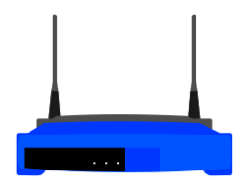
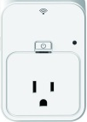
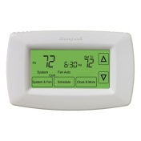
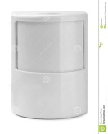
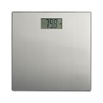
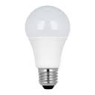
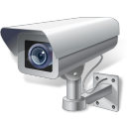

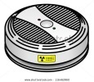
The Most Popular Use Case: Smart Home
Typical distribution of IOT devices in a smart home
Cloud
Video
monitor
Room 1
Room 2
Room 3
Access Point
plug
plug
Motion
detector
Weight scale
thermostat
LED light bulb
LED light bulb
LED light bulb
Front door
camera
Light
switch
Light
switch
Light
switch
Smoke
detector
Smoke
detector
Smoke
detector
Slide 4

Slide 5
Smart Home Services
Smart Metering
  Energy clamps for energy monitoring
  Water metering
Healthcare
  Weight, pulse rate, blood pressure…
Home Appliances and automation
  Control of heating and air conditioning
  thermostats
  Fans
  Lighting
Environmental sensors
  Temperature, humidity
Detection Sensors for Security and Safety
  Door/window sensors & locks
  Motion sensors
  Cameras for security and remote monitoring
  smoke/fire
  Gas detection
  Water leak detection
Services are similar for Assisted living, Healthcare and Smart Building use cases
  Number of devices will be different
Slide 5

Slide 6
Requirements & Topology for Smart Home
Key Requirements
  Many of the sensors in the home must last years on non-rechargeable battery
    Mix of coin cell, AAA, AA, 9V which have capacity and peak current limitations
  Whole home coverage expected
Mix of battery powered and AC powered devices in the environment
  Battery powered devices would be within a room distance from AC power devices, e.g. window sensor near AC plug or light bulb
Traffic
  Sensors & controllers are low duty cycle, small packets, non-streaming traffic, especially battery powered devices
    no stringent latency requirement on sensors
    Controllers (e.g. light switch) would require less than TBD response delay
  Cameras stream at 1-5 Mbps either continually or triggered by motion detector or user request
Slide 6

Slide 7

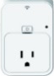



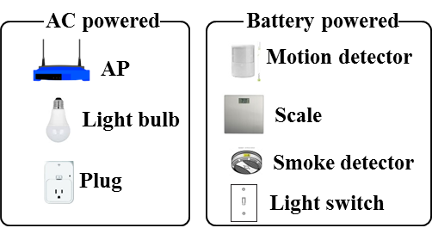
Options for Long-Range Coverage
Option 1: Long-range single-hop
  Single-hop between an AP and a STA
Option 2: Long-range multi-hop
  Multi-hop between an AP and a STA and assisting STAs in the middle
Internet
Internet
Long-range single-hop
Long-range multi-hop
Room1
Room2
Room3
Room1
Room2
Room3
AS*
AS
A battery powered STA needs to support a long transmission range
*) AS: Assisting STA
An AC powered device can assist a battery powered device to deliver data to an AP
A battery powered device doesn’t need to support long transmission range
Slide 7

Slide 8
References (1/2)
[1] IEEE 802.11-15/0775r1, WNG SC - Integrated Long Range Low Power Operation for IoT
[2] IEEE 802.11-15/1112r1, LRLP TIG - Use Case of LRLP Operation for IoT
[3] IEEE 802.11-15/1306r0, LRLP TIG - Use Case for LRLP and Full Function in STA
[4] IEEE 802.11-15/1365r0, LRLP TIG - Use Cases of LRLP Operation for IoT
[5] IEEE 802.11-15/1380r0, LRLP TIG - Digital Health Use Case
[6] IEEE 802.11-15/1383r0, LRLP TIG - Use Cases for Indoor & Outdoor
[7] IEEE 802.11-16/0058r2, LRLP TIG - Usage Scenarios and Applications For Long Range WiFi
[8] IEEE 802.11-16/0016r0, LRLP TIG - At home, IoT Use Case(s) for LRLP
Slide 8

Slide 9
References (2/2)
[9] IEEE 802.11-15/1108r0, LRLP TIG - Technical Feasibility for LRLP
[10] IEEE 802.11-15/1308r0, LRLP TIG - Link Budget Analysis
[11] IEEE 802.11-16/0026, LRLP TIG - Coexistence Problem
Slide 9

