Slide 1
AP-to-STA Positioning Use Cases
Date: 2016-03-14
Authors:

Slide 2
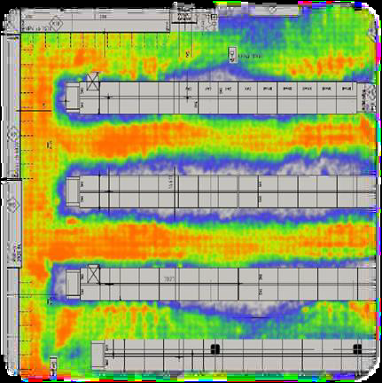
Use case 1: Position for traffic tracking in shopping mall
User:
The shopping mall administrator tracks the clients in the mall, collects position data, and analyzes to improve business and network performance.
Clients with wifi devices, such as smartphone, smart wear.
Environment: shopping mall use WiFi networks for data transmission and personnel tracking.
1 AP could cover 10~20 meters range
APs support 11n,ax,az, ac
1 AP could support 200 STAs
Use case:
Operating mode: AP2STA
Clients wander in the different stores/counters of the shopping mall or underground shopping area. The minimum store/counter has a single 3-meter counter.
Client has his/her WiFi device turned on, either associated or pre-associated to the network
Administrator uses WiFi network to locate WiFi devices to count the number of clients in different stores/counters. It can be used to identify the correlation between the user volume and time/location. Statistics is helpful in floor planning, security manpower arrangement, future wifi network design and adaption to accommodate enough connections.

Slide 3
Key Performance and Attributes
Performance requirements:
Horizontal accuracy <=1m @90%
Vertical accuracy: correct floor@99%
Latency: <500ms
Refresh Rate: > 2 location/sec
Number of simultaneous clients: < 200 per AP
Impact on Network Bandwidth: low, the impact should be independent on the number of APs involved in single user positioning
Functional requirements:
No special APP is required to be installed on STA
STA may opt in/opt out for this service

Slide 4
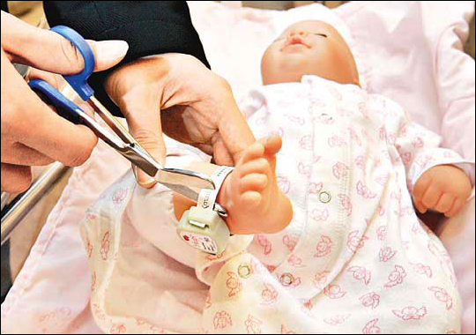
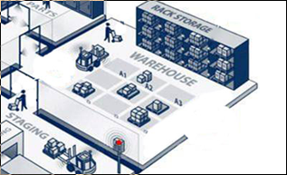
Use case 2: Position for electronic tag
User:
Person or device with WiFi electronic tag powered by coin battery.
Administrator tracks personnel and valuable devices.
Environment: hospital, factory, office tracks personnel and valuable devices.
1 AP could cover 10~20 meters range
APs support 11n,ax,az, ac
1 AP could support 500 Tags
Use case:
Operating mode: AP2STA
Administrator tracks person’s position with electronic tag to provide service or help, or control access of area.
Administrator tracks devices or goods with electronic tag to help manage asset and logistics.
Tag may send packets periodically in seconds, or AP informs the Tag to send packets periodically

Slide 5
Key Performance and Attributes
Horizontal accuracy <1m @90%
Vertical accuracy: correct floor@99%
Latency: <500ms
Refresh Rate: > 2 location/sec when tag device moves
Number of simultaneous clients: < 500 per AP
Impact on Network Bandwidth: < 3 additional frames per device/location
Support power conscious device

Slide 6
Straw Poll
Do you agree to add the use cases depicted by slide 2 ~5 of this submission to the TGaz NGP use case document 11-16-0137.
Y: N: A:

Slide 7
References
[1] https://mentor.ieee.org/802.11/dcn/16/11-16-0137-00-00az-ngp-use-case-document.pptx

