Slide 1
Power Control for UL MU
Date: 2016-03-14
Authors:
Name | Affiliation | Address | Phone | Email
Arjun Bharadwaj | Qualcomm | 5775 Morehouse Dr. San Diego, CA, USA |  | arjunb@qti.qualcomm.com
Bin Tian |  | 5775 Morehouse Dr. San Diego, CA, USA |  | btian@qti.qualcomm.com
Youhan Kim |  | 1700 Technology Drive San Jose, CA 95110, USA |  | youhank@qca.qualcomm.com
Sameer Vermani |  | 5775 Morehouse Dr. San Diego, CA, USA |  | svverman@qti.qualcomm.com

Slide 2
Authors (continued)
Name | Affiliation | Address | Phone | Email
Alice Chen | Qualcomm | 5775 Morehouse Dr. San Diego, CA, USA |  | alicel@qti.qualcomm.com
Albert Van Zelst |  | Straatweg 66-S Breukelen, 3621 BR Netherlands |  | allert@qti.qualcomm.com
Alfred Asterjadhi |  | 5775 Morehouse Dr. San Diego, CA, USA |  | aasterja@qti.qualcomm.com
Carlos Aldana |  | 1700 Technology Drive San Jose, CA 95110, USA |  | caldana@qca.qualcomm.com
George Cherian |  | 5775 Morehouse Dr. San Diego, CA, USA |  | gcherian@qti.qualcomm.com
Gwendolyn Barriac |  | 5775 Morehouse Dr. San Diego, CA, USA |  | gbarriac@qti.qualcomm.com
Hemanth Sampath |  | 5775 Morehouse Dr. San Diego, CA, USA |  | hsampath@qti.qualcomm.com
Lin Yang |  | 5775 Morehouse Dr. San Diego, CA, USA |  | linyang@qti.qualcomm.com
Menzo Wentink |  | Straatweg 66-S Breukelen, 3621 BR Netherlands |  | mwentink@qti.qualcomm.com
Naveen Kakani |  | 2100 Lakeside Boulevard Suite 475, Richardson TX 75082, USA |  | nkakani@qti.qualcomm.com
Raja Banerjea |  | 1060 Rincon Circle San Jose CA 95131, USA |  | rajab@qit.qualcomm.com
Richard Van Nee |  | Straatweg 66-S Breukelen, 3621 BR Netherlands |  | rvannee@qti.qualcomm.com
Rolf De Vegt |  | 1700 Technology Drive San Jose, CA 95110, USA |  | rolfv@qca.qualcomm.com
Simone Merlin |  | 5775 Morehouse Dr. San Diego, CA, USA |  | smerlin@qti.qualcomm.com
Tevfik Yucek |  | 1700 Technology Drive San Jose, CA 95110, USA |  | tyucek@qca.qualcomm.com
VK Jones |  | 1700 Technology Drive San Jose, CA 95110, USA |  | vkjones@qca.qualcomm.com

Slide 3
Authors (continued)
Name | Affiliation | Address | Phone | Email
Ron Porat | Broadcom |  |  | rporat@broadcom.com
Sriram Venkateswaran
Matthew Fischer |  |  |  | mfischer@broadcom.com
Zhou Lan
Leo Montreuil
Andrew Blanksby
Vinko Erceg
Mingyue Ji
Robert Stacey | Intel | 2111 NE 25th Ave, Hillsboro OR 97124, USA | +1-503-724-893 | robert.stacey@intel.com
Shahrnaz Azizi |  |  |  | shahrnaz.azizi@intel.com
Po-Kai Huang |  |  |  | po-kai.huang@intel.com
Qinghua Li |  |  |  | quinghua.li@intel.com
Xiaogang Chen |  |  |  | xiaogang.c.chen@intel.com
Chitto Ghosh |  |  |  | chittabrata.ghosh@intel.com
Laurent Cariou |  |  |  | laurent.cariou@intel.com
Yaron Alpert |  |  |  | yaron.alpert@intel.com
Assaf Gurevitz |  |  |  | assaf.gurevitz@intel.com
Ilan Sutskover |  |  |  | ilan.sutskover@intel.com

Slide 4
Authors (continued)
Name | Affiliation | Address | Phone | Email
Hongyuan Zhang | Marvell | 5488 Marvell Lane, Santa Clara, CA, 95054 | 408-222-2500 | hongyuan@marvell.com
Yakun Sun |  |  |  | yakunsun@marvell.com
Lei Wang |  |  |  | Leileiw@marvell.com
Liwen Chu |  |  |  | liwenchu@marvell.com
Jinjing Jiang |  |  |  | jinjing@marvell.com
Yan Zhang |  |  |  | yzhang@marvell.com
Rui Cao |  |  |  | ruicao@marvell.com
Sudhir Srinivasa |  |  |  | sudhirs@marvell.com
Bo Yu |  |  |  | boyu@marvell.com
Saga Tamhane |  |  |  | sagar@marvell.com
Mao Yu |  |  |  | my@marvel..com
Xiayu Zheng |  |  |  | xzheng@marvell.com
Christian Berger |  |  |  | crberger@marvell.com
Niranjan Grandhe |  |  |  | ngrandhe@marvell.com
Hui-Ling Lou |  |  |  | hlou@marvell.com

Slide 5
Authors (continued)
Name | Affiliation | Address | Phone | Email
Jianhan Liu | Mediatek USA | 2860 Junction Ave, San Jose, CA 95134, USA | +1-408-526-1899 | jianhan.Liu@mediatek.com
Thomas Pare |  |  |  | thomas.pare@mediatek.com
ChaoChun Wang |  |  |  | chaochun.wang@mediatek.com
James Wang |  |  |  | james.wang@mediatek.com
Tianyu Wu |  |  |  | tianyu.wu@mediatek.com
Russell Huang |  |  |  | russell.huang@mediatek.com
James Yee | Mediatek | No. 1 Dusing 1st Road, Hsinchu, Taiwan | +886-3-567-0766 | james.yee@mediatek.com
Alan Jauh |  |  |  | alan.jauh@mediatek.com
Frank Hsu |  |  |  | frank.hsu@mediatek.com
Joonsuk Kim | Apple |  |  | joonsuk@apple.com
Aon Mujtaba |  |  |  | mujtaba@apple.com
Guoqing Li |  |  |  | guoqing_li@apple.com
Eric Wong |  |  |  | ericwong@apple.com
Chris Hartman |  |  |  | chartman@apple.com

Slide 6
Authors (continued)
Name | Affiliation | Address | Phone | Email
David X. Yang | Huawei | F1-17, Huawei Base, Bantian, Shenzhen |  | david.yangxun@huawei.com
Jiayin Zhang |  | 5B-N8, No.2222 Xinjinqiao Road, Pudong, Shanghai | +86-18601656691 | zhangjiayin@huawei.com
Jun Luo |  | 5B-N8, No.2222 Xinjinqiao Road, Pudong, Shanghai |  | jun.l@huawei.com
Yi Luo |  | F1-17, Huawei Base, Bantian, Shenzhen | +86-18665891036 | Roy.luoyi@huawei.com
Yingpei Lin |  | 5B-N8, No.2222 Xinjinqiao Road, Pudong, Shanghai |  | linyingpei@huawei.com
Jiyong Pang |  | 5B-N8, No.2222 Xinjinqiao Road, Pudong, Shanghai |  | pangjiyong@huawei.com
Zhigang Rong |  | 10180 Telesis Court, Suite 365, San Diego, CA 92121 NA |  | zhigang.rong@huawei.com
Jian Yu |  | F1-17, Huawei Base, Bantian, Shenzhen |  | ross.yujian@huawei.com
Ming Gan |  | F1-17, Huawei Base, Bantian, Shenzhen |  | ming.gan@huawei.com
Yunsong Yang |  | 10180 Telesis Court, Suite 365, San Diego, CA 92121 NA |  | yangyunsong@huawei.com
Junghoon Suh |  | 303 Terry Fox, Suite 400 Kanata, Ottawa, Canada |  | Junghoon.Suh@huawei.com
Peter Loc |  |  |  | peterloc@iwirelesstech.com
Edward Au |  | 303 Terry Fox, Suite 400 Kanata, Ottawa, Canada |  | edward.ks.au@huawei.com
Teyan Chen |  | F1-17, Huawei Base, Bantian, Shenzhen |  | chenteyan@huawei.com
Yunbo Li |  | F1-17, Huawei Base, Bantian, Shenzhen |  | liyunbo@huawei.com

Slide 7
Authors (continued)
Name | Affiliation | Address | Phone | Email
Jinmin Kim | LG Electronics | 19, Yangjae-daero 11gil, Seocho-gu, Seoul 137-130, Korea |  | Jinmin1230.kim@lge.com
Kiseon Ryu |  |  |  | kiseon.ryu@lge.com
Jinyoung Chun |  |  |  | jiny.chun@lge.com
Jinsoo Choi |  |  |  | js.choi@lge.com
Jeongki Kim |  |  |  | jeongki.kim@lge.com
Dongguk Lim |  |  |  | dongguk.lim@lge.com
Suhwook Kim |  |  |  | suhwook.kim@lge.com
Eunsung Park |  |  |  | esung.park@lge.com
JayH Park |  |  |  | Hyunh.park@lge.com
HanGyu Cho |  |  |  | hg.cho@lge.com
Thomas Derham | Orange |  |  | thomas.derham@orange.com
Bo Sun | ZTE | #9 Wuxingduan, Xifeng Rd., Xi'an, China |  | sun.bo1@zte.com.cn
Kaiying Lv |  |  |  | lv.kaiying@zte.com.cn
Yonggang Fang |  |  |  | yfang@ztetx.com
Ke Yao |  |  |  | yao.ke5@zte.com.cn
Weimin Xing |  |  |  | xing.weimin@zte.com.cn
Brian Hart | Cisco Systems | 170 W Tasman Dr, San Jose, CA 95134 |  | brianh@cisco.com
Pooya Monajemi |  |  |  | pmonajem@cisco.com

Slide 8
Authors (continued)
Name | Affiliation | Address | Phone | Email
Fei Tong | Samsung | Innovation Park, Cambridge CB4 0DS (U.K.) | +44 1223 434633 | f.tong@samsung.com
Hyunjeong Kang |  | Maetan 3-dong; Yongtong-Gu Suwon; South Korea | +82-31-279-9028 | hyunjeong.kang@samsung.com
Kaushik Josiam |  | 1301, E. Lookout Dr, Richardson TX 75070 | (972) 761 7437 | k.josiam@samsung.com
Mark Rison |  | Innovation Park, Cambridge CB4 0DS (U.K.) | +44 1223 434600 | m.rison@samsung.com
Rakesh Taori |  | 1301, E. Lookout Dr, Richardson TX 75070 | (972) 761 7470 | rakesh.taori@samsung.com
Sanghyun Chang |  | Maetan 3-dong; Yongtong-Gu Suwon; South Korea | +82-10-8864-1751 | s29.chang@samsung.com
Yasushi Takatori | NTT | 1-1 Hikari-no-oka, Yokosuka, Kanagawa 239-0847 Japan | +81 46 859 3135 | takatori.yasushi@lab.ntt.co.jp
Yasuhiko Inoue |  |  | +81 46 859 5097 | inoue.yasuhiko@lab.ntt.co.jp
Shoko Shinohara |  |  | +81 46 859 5107 | Shinohara.shoko@lab.ntt.co.jp
Yusuke Asai |  |  | +81 46 859 3494 | asai.yusuke@lab.ntt.co.jp
Koichi Ishihara |  |  | +81 46 859 4233 | ishihara.koichi@lab.ntt.co.jp
Junichi Iwatani |  |  | +81 46 859 4222 | Iwatani.junichi@lab.ntt.co.jp
Akira Yamada | NTT DOCOMO | 3-6, Hikarinooka, Yokosuka-shi, Kanagawa, 239-8536, Japan | +81 46 840 3759 | yamadaakira@nttdocomo.com

Slide 9
Authors (continued)
Name | Affiliation | Address | Phone | Email
Masahito Mori | Sony Corp. |  |  | Masahito.Mori@jp.sony.com
Yusuke Tanaka |  |  |  | YusukeC.Tanaka@jp.sony.com
Yuichi Morioka |  |  |  | Yuichi.Morioka@jp.sony.com
Kazuyuki Sakoda |  |  |  | Kazuyuki.Sakoda@am.sony.com
William Carney |  |  |  | William.Carney@am.sony.com
Tomoko Adachi | Toshiba |  |  | tomo.adachi@toshiba.co.jp
Narendar Madhavan |  |  |  | narendar.madhavan@toshiba.co.jp
Kentaro Taniguchi |  |  |  | kentaro.taniguchi@toshiba.co.jp
Toshihisa Nabetani |  |  |  | toshihisa.nabetani@toshiba.co.jp
Tsuguhide Aoki |  |  |  | tsuguhide.aoki@toshiba.co.jp
Koji Horisaki |  |  |  | kouji.horisaki@toshiba.co.jp
David Halls |  |  |  | david.halls@toshiba-trel.com
Filippo Tosato |  |  |  | filippo.tosato@toshiba-trel.com
Zubeir Bocus |  |  |  | zubeir.bocus@toshiba-trel.com
Fengming Cao |  |  |  | fengming.cao@toshiba-trel.com
Parag Kulkarni |  |  |  | parag.kulkarni@toshiba-trel.com

Slide 10
Authors (continued)
Minho Cheong | Newracom, Inc. | 9008 Research Dr, Irvine, CA 92618 | +1-949-390-7146 | minho.cheong@newracom.com
Reza Hedayat |  |  |  | reza.hedayat@newracom.com
Young Hoon Kwon |  |  |  | younghoon.kwon@newracom.com
Yongho Seok |  |  |  | yongho.seok@newracom.com
Daewon Lee |  |  |  | daewon.lee@newracom.com
Yujin Noh |  |  |  | yujin.noh@newracom.com
Sigurd Schelstraete | Quantenna | 3450 W. Warren Ave, Fremont, CA 94538 |  | Sigurd@quantenna.com
Huizhao Wang |  |  |  | hwang@quanetnna.com

Slide 11
Introduction
Power control is required for UL OFDMA and MU-MIMO transmissions in 11ax
  To manage interference between users and from OBSS
    OFDMA: Ensure that interference between adjacent RUs are within tolerable limits
    MU-MIMO: Manage power imbalance between different streams
  Ensure AP Rx dynamic range is not exceeded
Requirements for UL MU transmission were proposed in [1]
  However, relative Tx accuracy requirements were not introduced
    Relative Tx accuracy requirements ensure that that changes to the Tx power between UL transmissions are within specified limits
In this contribution,
  Principles of power control are outlined and a signaling scheme to support the PC algorithm is proposed
  Requirements for relative Tx power accuracy are proposed

Slide 12
Principles of Power Control
STAs need to transmit with enough power to ensure adequate SNR at the AP for their assigned MCS
  Higher than needed transmit power levels may cause unnecessary interference to other users
    Especially true for low MCS transmissions with loose EVM requirements
  Promotes spatial reuse and also limits interference to OBSS
AP selects the Rx power required for each STA corresponding to the assigned MCS
  Enables the AP to adapt to different channel conditions for both SU and MU-MIMO transmissions
  Can also account for any bias due to measurement errors or Tx power inaccuracies
We propose to add signaling to support the above in the next slide

Slide 13
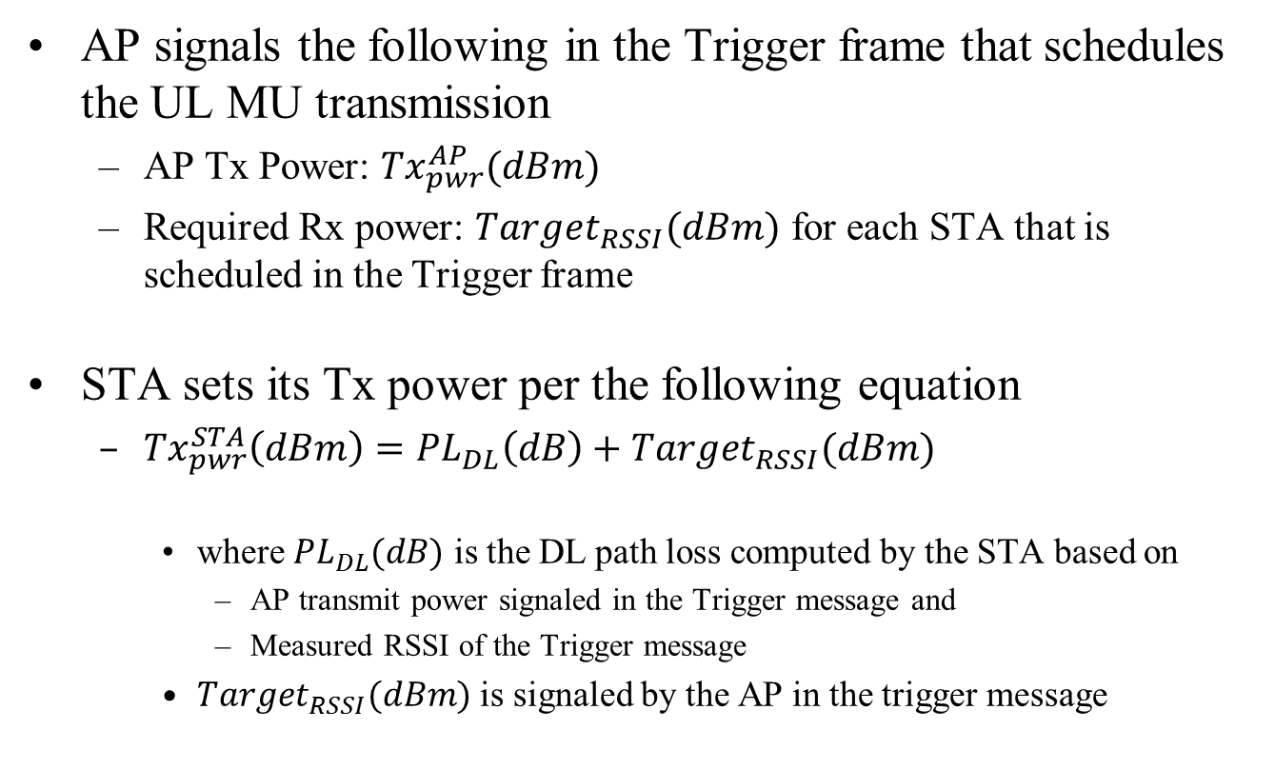
Proposed Power Control Mechanism
AP signals the following in the Trigger frame that schedules the UL MU transmission
  AP Tx Power: ${Tx}_{pwr}^{AP}(dBm)$
  Required Rx power: $Target_{RSSI}(dBm)$ for each STA that is scheduled in the Trigger frame
STA sets its Tx power per the following equation
  ${Tx}_{pwr}^{STA}\left(dBm\right)={PL}_{DL}\left(dB\right)+Target_{RSSI}(dBm)$
    where ${PL}_{DL}(dB)$ is the DL path loss computed by the STA based on
      AP transmit power signaled in the Trigger message and
      Measured RSSI of the Trigger message
    $Target_{RSSI}(dBm)$ is signaled by the AP in the trigger message

Slide 14
Signaling from STA → AP
AP needs to be aware of the available Tx power at the STA
  To select appropriate MCS levels for each STA and optimize performance
Propose to signal STA headroom to the AP in UL transmissions
  Details of the STA’s headroom definition are TBD

Slide 15
Summary of Power Control
AP signals the following through the trigger message
  AP Tx Power (dBm)
  Target RSSI (dBm) and MCS for each STA scheduled for UL MU transmission
STA autonomously sets its Tx power based on
  Computed Path Loss
    Based on AP transmit power and measured RSSI of trigger
  Target RSSI signaled by the AP
STA signals its headroom on the UL

Slide 16
Relative Tx Power Accuracy Requirement
Requirement pertains to the accuracy of adjusting Tx power between consecutive UL transmissions
  Ensures that Tx power adjustments by the STA do not exceed specified limits
Tx power adjustment from one transmission to the next can be more accurate than setting an absolute value
  Requirement mainly applies to the Class B: Low capability devices
  Class A devices already have a tight absolute Tx power requirement (+/-3dB)
We propose a relative Tx power requirement of +/- 3dB for Class B devices
  Applicable for Tx power level changes within the STA’s dynamic range

Slide 17
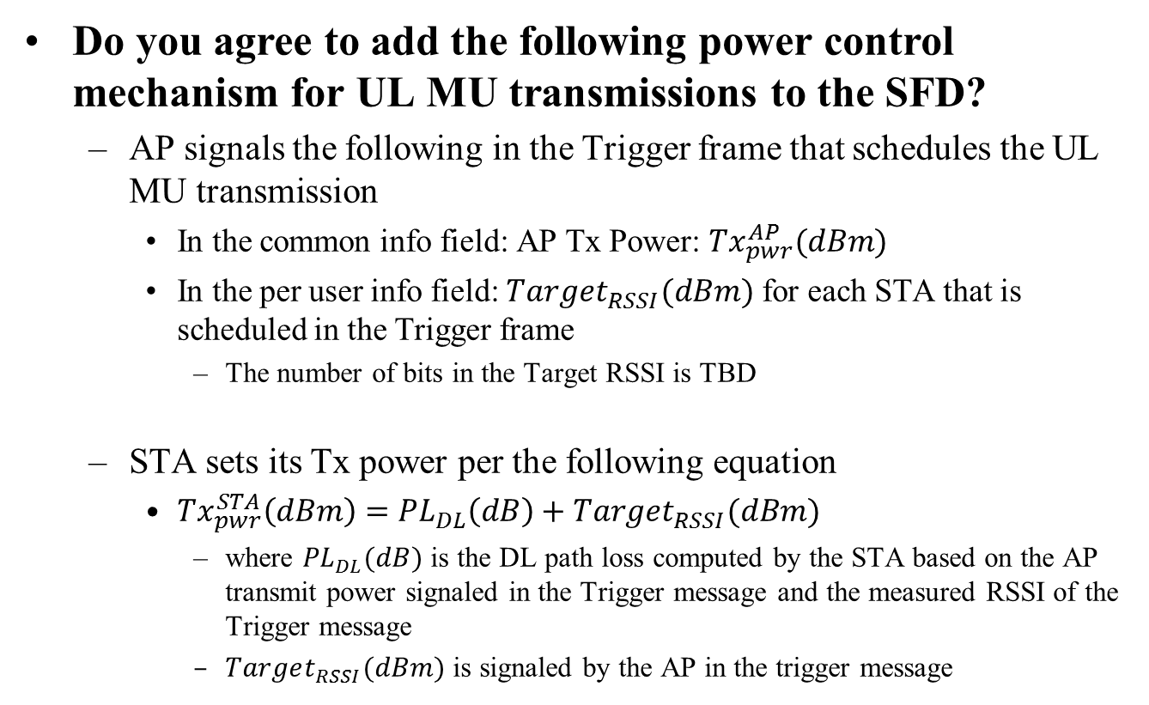
Straw Poll 1
Do you agree to add the following power control mechanism for UL MU transmissions to the SFD?
  AP signals the following in the Trigger frame that schedules the UL MU transmission
    In the common info field: AP Tx Power: ${Tx}_{pwr}^{AP}(dBm)$
    In the per user info field: $Target_{RSSI}(dBm)$ for each STA that is scheduled in the Trigger frame
      The number of bits in the Target RSSI is TBD
  STA sets its Tx power per the following equation
    ${Tx}_{pwr}^{STA}\left(dBm\right)={PL}_{DL}\left(dB\right)+Target_{RSSI}(dBm)$
      where ${PL}_{DL}(dB)$ is the DL path loss computed by the STA based on the AP transmit power signaled in the Trigger message and the measured RSSI of the Trigger message
      $Target_{RSSI}(dBm)$ is signaled by the AP in the trigger message

Slide 18
Straw Poll 2
Do you agree to add the following text to the SFD?
  STAs that participate in HE trigger-based PPDU transmit the power headroom in triggered UL MU transmissions to assist in the AP’s MCS selection
    Details of STA headroom definition are TBD

Slide 19
Straw Poll 3
Do you agree to add the following text to the SFD?
  STAs that participate in HE trigger-based PPDU shall support +/-3dB Relative Tx power requirements for Class B devices.
    Relative Tx power accuracy is defined as the accuracy of the change of the transmit power in consecutive UL MU transmissions

