Slide 1
EDMG Support Discovery
Date: 2016-03-13
Authors:
Name | Company | Address | Phone | Email
Carlos Cordeiro | Intel |  |  | Carlos.Cordeiro@intel.com

Slide 2
Background
11ay has to be backward compatible with 11ad
Therefore, among other things, support of DMG Beacon and DMG initial beamforming are required to support backward compatibility
In legacy .11 amendments, backward compatibility and support of next generation are provided through the presence of legacy and new IEs in specific frames
  HT STA: Supported Rates and BSS Membership Selectors element, and HT Capabilities element in Beacon and Probe frames
    In 2.4 GHz band, DSSS Parameter Set is also included
  VHT STA: Supported Rates and BSS Membership Selectors element, HT capabilities element and VHT Capabilities element in Beacon and Probe frames
  DMG STA: DMG Capabilities element in Probe frames or DMG Beacon in itself
In EDMG, the use of this approach would lead to:
  DMG Capabilities element and EDMG Capabilities element in DMG Beacon and Probe frames

Slide 3
Problem statement
In 11ad, we have specifically defined a new DMG Beacon frame so that it can be kept small given that it is:
  Transmitted with Control PHY
  Swept across antennas/sectors
Many 11ad implementations use the smallest size DMG Beacon
  It is important that we keep such small sized DMG Beacon in EDMG
We could require EDMG STAs to have to BF with the PCP/AP and exchange Probe frames that they can discover (or not) the EDMG Capabilities element
  However, this is not efficient and will incur higher power consumption on both sides

Slide 4
What options do we have?
Option 1: use one reserved bit from DMG Parameters field
  No additional overhead
Option 2: define a new EDMG STA Type element with the smallest possible size
  Smallest size is 4 octets, with 1 octet Information field
  Most of the 1 octet could be reserved for future types of STAs after 11ay
Option 3: carry full EDMG Capability element in DMG Beacon
  Typical approach in 11n/ac/…
  Average size is ~15 bytes

Slide 5
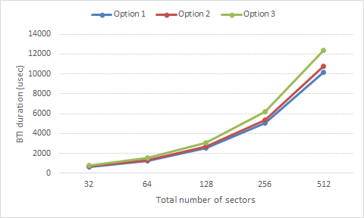
Numerical analysis
Compared to option 1 (11ad):
  Option 2 causes a 6% increase in BTI duration
  Option 3 causes a 22% increase in BTI duration

Slide 6
Recommendation for PCP/AP
We would like to keep the DMG Beacon size (and BTI duration) as small as possible
  Stick to the same design philosophy from 11ad
We do not recommend option 3
Between options 1 and 2:
  The challenge with option 2 is that it opens the door for the element to grow over time
  Option 1 is attractive since it carries no additional overhead
We recommend option 1

Slide 7
Conclusions
The traditional way (11n/ac/ad) of discovering the type of a STA is not desirable for EDMG and beyond
  Additional overhead and power consumption
Discovering whether a STA is an EDMG STA should be done with the least amount of overhead
We recommend using reserved bits for this purpose

Slide 8
Straw polls/motions
Include the following in section 3.1 of the SFD: “A EDMG Supported field shall be defined by using one reserved bit from the EDMG Parameters field. An EDMG STA shall set the EDMG Supported field to 1."

