Slide 1
Multi-STA BA Design
Date: 2016-03-11
Authors:

Slide 2
Abstract
This contribution evaluates the design of the Multi-STA BA frame and proposes potential settings.

Slide 3
Introduction
Currently, Multi-STA BA is designed to acknowledge the following frames [1]:
HE Trigger-based PPDUs
DL Multi-TID A-MPDU (addressed to a single user)
In the proposed draft, the following text applies to Multi-STA BA [2]:
“A Multi-STA Block Ack frame with BA Information for multiple AIDs shall have RA field set to the broadcast address.”
Setting the RA field to broadcast address may not be optimal
In this contribution, we want to evaluate this design and explore other settings

Slide 4
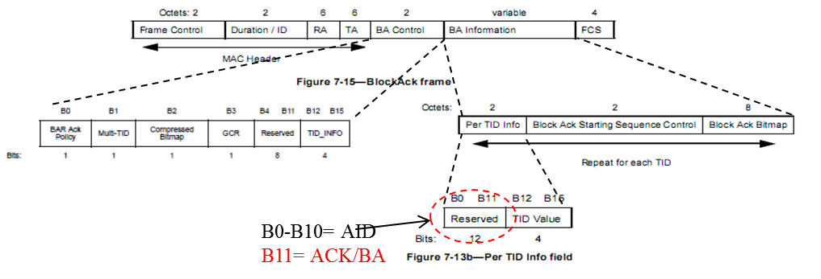
Multi-STA BA Design
In [2], RA is set to Broadcast address for Multi-STA BA with BA information for multiple AIDs
A compressed AID (11 bits) field is used to signal the IDs of the STAs being ACKed/BAed in Per TID Info field

Slide 5
Issues with Broadcast Multi-STA BA
When RA of a M-BA is set to broadcast address:
Benefit:
All STAs can receive this information; it will not be missed
Cost:
Energy efficiency: every STA must listen to the M-/BA and decode the entire frame
Compressed AID (11 bits) may not be sufficient to address all STAs in the BSS

Slide 6
Multi-STA BA RA Field Settings
11ax may consider setting the RA field of Multi-STA BA with BA info for multiple AIDs to a group address
To improve energy efficiency
Only STAs that need to decode will decode
To impose less burden on the compressed AID space: need only to indicate a subset of STAs that belong to the group
Similarly, the RA field of the UL Multi-STA BA transmitted to the AP should be set to the MAC address of the AP

Slide 7
Conclusion
The current design of Multi-STA BA is evaluated
There are benefits when the RA field of the Multi-STA BA with BA information for multiple AIDs is set to a non-broadcast address
Set to a group address when ACKing/BAing a group of STAs
Can provide higher energy efficiency and less ambiguity for compressed AID indications

Slide 8
References
11-15/0132r15, Specification Framework for TGax, Jan 2016
11-16/0024r1, Draft Specifications, March 2016

Slide 9
Straw poll 1
Do you agree to insert into the 802.11ax SFD
“ 4.2 The RA field of the Multi-STA BA with BA information for multiple AIDs may be set to a group address.”
Y/N/A

Slide 10
Straw poll 2
Do you agree to insert into the 802.11ax SFD
“ The RA field of a UL Multi-STA BA shall be set to the MAC address of the AP.”
Y/N/A

