Slide 1
Channel Modeling with PAA Orientations
Date: 2016-03-14
Authors:

Slide 2
Abstract
In this study, we use an example to demonstrate the impact of polarized antenna orientation on the channel capacity for different PAA configurations.
We propose to include orientation information of the antennas in the channel model explicitly

Slide 3
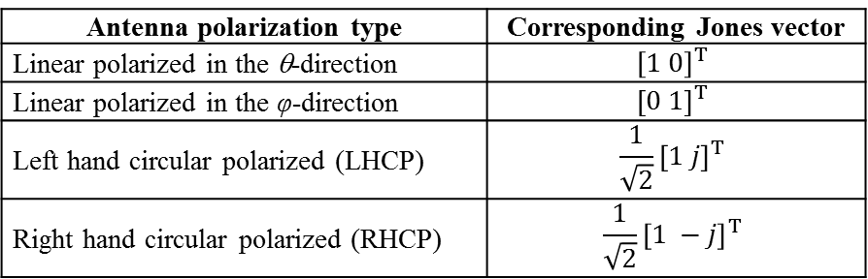
Background: Polarization
802.11ay channel model [1] adopts the polarization model of 802.11ad [2].
Jones vectors at the receiver side.
Gain coefficients between the orthogonal electric components.
Jones vectors at the transmitter side.
Antenna polarization type | Corresponding Jones vector
Linear polarized in the θ-direction | $${\left[1 0\right]}^{T}$$
Linear polarized in the φ-direction | $${\left[0 1\right]}^{T}$$
Left hand circular polarized (LHCP) | $$\frac{1}{\sqrt{2}}{\left[1 j\right]}^{T}$$
Right hand circular polarized (RHCP) | $$\frac{1}{\sqrt{2}}{\left[1 −j\right]}^{T}$$
The orthogonal components of Jones vector are defined for E_{θ} and E_{φ} components respectively [2].

Slide 4
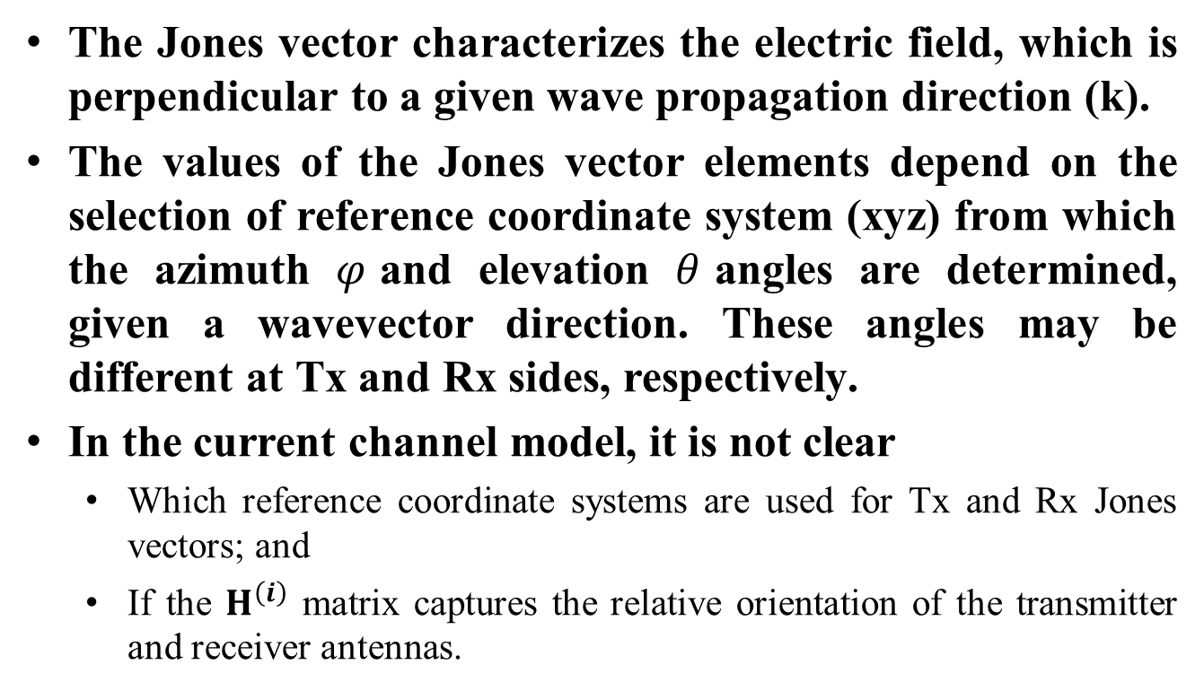
Problem
The Jones vector characterizes the electric field, which is perpendicular to a given wave propagation direction (k).
The values of the Jones vector elements depend on the selection of reference coordinate system (xyz) from which the azimuth $φ$and elevation $θ$angles are determined, given a wavevector direction. These angles may be different at Tx and Rx sides, respectively.
In the current channel model, it is not clear
  Which reference coordinate systems are used for Tx and Rx Jones vectors; and
  If the $H^{\left(i\right)}$ matrix captures the relative orientation of the transmitter and receiver antennas.

Slide 5
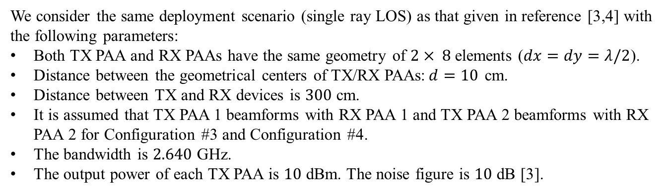
Some Examples: Assumptions
Configuration #2
(2x2 MIMO)
Configuration #3
(2x2 MIMO)
Configuration #4
(4x4 MIMO)
We consider the same deployment scenario (single ray LOS) as that given in reference [3,4] with the following parameters:
Both TX PAA and RX PAAs have the same geometry of $2× 8$elements ($dx=dy=λ/2$).
Distance between the geometrical centers of TX/RX PAAs:$d=10$ cm.
Distance between TX and RX devices is $300$ cm.
It is assumed that TX PAA 1 beamforms with RX PAA 1 and TX PAA 2 beamforms with RX PAA 2 for Configuration #3 and Configuration #4.
The bandwidth is $2.640$ GHz.
The output power of each TX PAA is $10$ dBm. The noise figure is $10$ dB [3].

Slide 6
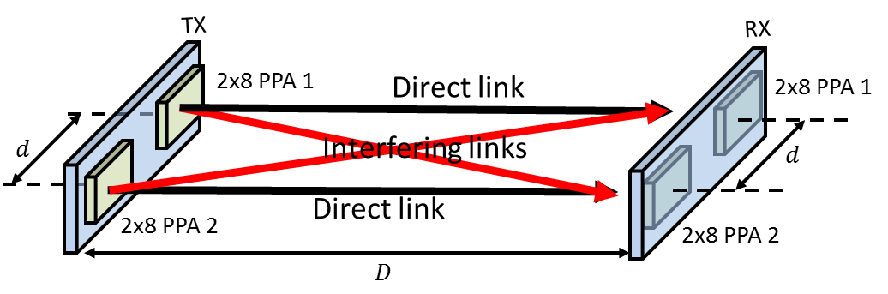
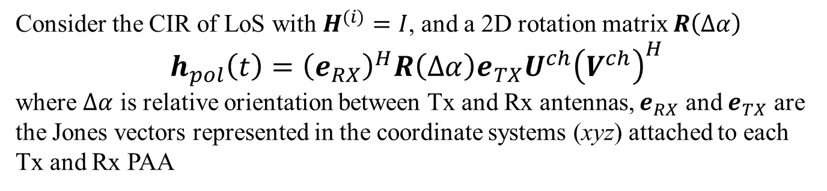

Some Examples: Capacity Results
Consider the CIR of LoS with $H^{(i)}=I$, and a 2D rotation matrix $R\left(Δα\right)$
$$h_{pol}\left(t\right)={\left(e_{RX}\right)}^{H}R\left(Δα\right)e_{TX}U^{ch}{\left(V^{ch}\right)}^{H}$$
where $Δα$ is relative orientation between Tx and Rx antennas, $e_{RX}$ and $e_{TX}$ are the Jones vectors represented in the coordinate systems (xyz) attached to each Tx and Rx PAA
V
Rotation
x
$$Δα$$
z
y
H
Link capacity depends on the relative orientation of Tx and Rx antennas and polarization of each PAA.

Slide 7
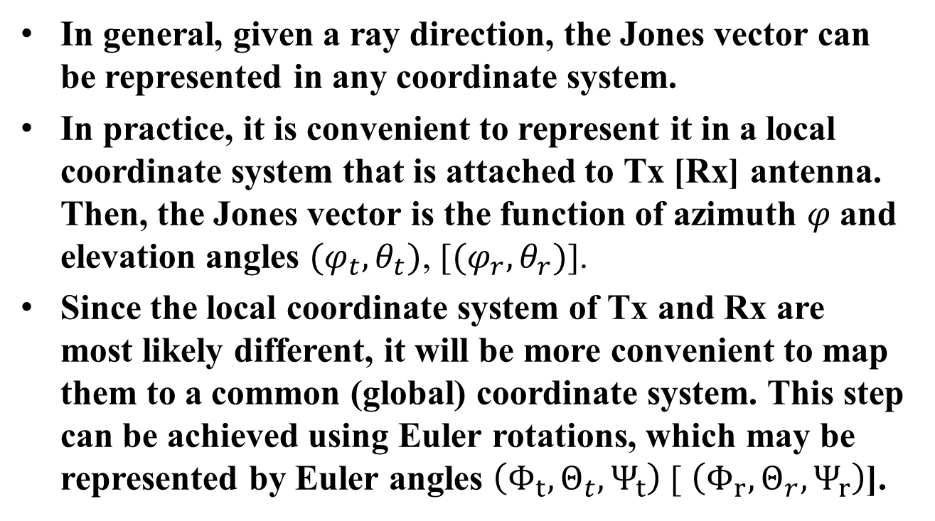
Discussion (1/2)
In general, given a ray direction, the Jones vector can be represented in any coordinate system.
In practice, it is convenient to represent it in a local coordinate system that is attached to Tx [Rx] antenna. Then, the Jones vector is the function of azimuth $φ$and elevation angles ${(φ}_{t},θ_{t})$, [${(φ}_{r},θ_{r})$].
Since the local coordinate system of Tx and Rx are most likely different, it will be more convenient to map them to a common (global) coordinate system. This step can be achieved using Euler rotations, which may be represented by Euler angles $\left(Φ_{t},Θ_{t},Ψ_{t}\right)$ [ $\left(Φ_{r},Θ_{r},Ψ_{r}\right)$].

Slide 8
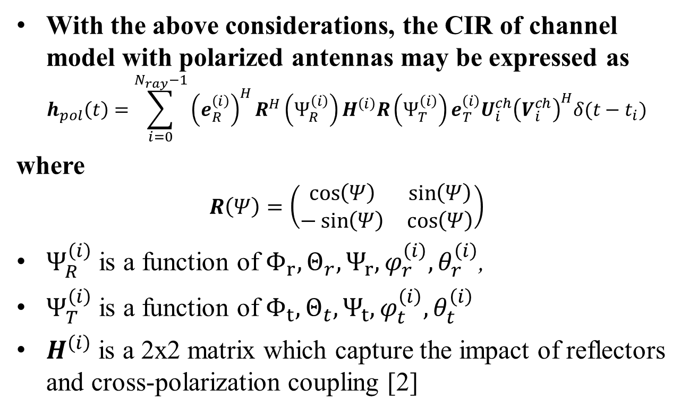
Discussion (2/2)
With the above considerations, the CIR of channel model with polarized antennas may be expressed as
$$h_{pol}\left(t\right)=\sum_{i=0}^{N_{ray}−1}{{\left(e_{R}^{\left(i\right)}\right)}^{H}R^{H}\left(Ψ_{R}^{\left(i\right)}\right)H^{\left(i\right)}R\left(Ψ_{T}^{\left(i\right)}\right)e_{T}^{\left(i\right)}U_{i}^{ch}{\left(V_{i}^{ch}\right)}^{H}δ(t−t_{i})}$$
where
$$R\left(Ψ\right)=\left(\begin{matrix}\cos\left(Ψ\right) & \sin\left(Ψ\right) \\ −\sin\left(Ψ\right) & \cos\left(Ψ\right)\end{matrix}\right)$$
$Ψ_{R}^{\left(i\right)}$ is a function of $Φ_{r},Θ_{r},Ψ_{r}, φ_{r}^{\left(i\right)}, θ_{r}^{\left(i\right)}$,
$Ψ_{T}^{\left(i\right)}$ is a function of $Φ_{t},Θ_{t},Ψ_{t}, φ_{t}^{\left(i\right)}, θ_{t}^{\left(i\right)}$
$H^{\left(i\right)}$ is a 2x2 matrix which capture the impact of reflectors and cross-polarization coupling [2]

Slide 9
Conclusion
We demonstrate the impact of antenna orientation on channel capacity for different antenna configurations.
We propose a mechanism to include antenna orientation in the polarization component of the channel model.

Slide 10
References
A. Maltsev, et al, “Channel models for IEEE 802.11ay,” IEEE doc. 11-15/1150r1.
A. Maltsev, et al, “Channel Models for 60 GHz WLAN Systems,” IEEE doc. 11-09/0334r8.
A. Maltsev, et al, “Experimental Measurements for Short Range LOS SU-MIMO,” IEEE doc. 11-15/0632r1.
R. Yang and A. Sahin, “Feasibility of SU-MIMO under Array Alignment Method,” IEEE Doc. 11-15/1333r1

Slide 11













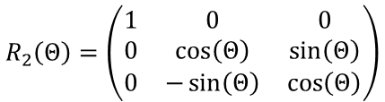









Appendix: Example of Euler Rotations
$$z$$
$$z$$
$$z′$$
$$z$$
$$z′$$
$$y′$$
$$Ψ_{}$$
$$y′$$
$$Θ_{}$$
$$y$$
$$y$$
$$y$$
$$x$$
$$x$$
$$x$$
$$Φ_{}$$
$$x′$$
$$x′$$
$$x′$$
$$R_{2}\left(Θ\right)=\left(\begin{matrix}1 & 0 & 0 \\ 0 & \cos\left(Θ\right) & \sin\left(Θ\right) \\ 0 & −\sin\left(Θ\right) & \cos\left(Θ\right)\end{matrix}\right)$$
$$R_{1}\left(Ψ\right)=\left(\begin{matrix}\cos\left(Ψ\right) & \sin\left(Ψ\right) & 0 \\ −\sin\left(Ψ\right) & \cos\left(Ψ\right) & 0 \\ 0 & 0 & 1\end{matrix}\right)$$
$$R_{1}\left(Φ\right)=\left(\begin{matrix}\cos\left(Φ\right) & \sin\left(Φ\right) & 0 \\ −\sin\left(Φ\right) & \cos\left(Φ\right) & 0 \\ 0 & 0 & 1\end{matrix}\right)$$
$$R=R_{1}\left(Ψ\right)R_{2}\left(Θ\right)R(Φ)$$

