Slide 1
NIST Channel Model for Conference Room at 83 GHz
Date: 2016-03
Authors:
Name | Affiliations | Address | Phone | email
Alexander Maltsev | Intel | Nizhny Novgorod, Russia | +7 (831) 969461 | alexander.maltsev@intel.com
Peter Papazian | NIST | Boulder, CO, USA | +1 (303) 497-7078 | peter.papazian@nist.gov
Kate Remley | NIST | Boulder, CO, USA | +1 (303) 497-3652 | kate.remley@nist.gov
Camillo Gentile | NIST | Gaithersburg, MD, USA | +1 (301) 975-3685 | camillo.gentile@nist.gov
Nada Golmie | NIST | Gaithersburg, MD, USA | +1 (301) 975-4190 | nada.golmie@nist.gov
Jian Wang | NIST | Gaithersburg, MD, USA | +1 (301) 975-8012 | jian.wang@nist.gov
Jae-Kark Choi | NIST | Gaithersburg, MD, USA | +1 (301) 975-6049 | jae-kark.choi@nist.gov
Jelena Senic | NIST | Boulder, CO, USA | +1 (303) 497-6166 | jelena.senic@nist.gov

Slide 2
Abstract
This document presents results for the Quasi-Deterministic (Q-D) Channel Model* developed by NIST using measurements taken in a conference room at 83 GHz.
*“Quasi-deterministic Approach to mmWave Channel Modeling in a Non-stationary Environment,” Maltsev, Pudeyev, Karls,
Bolotin, Morozov, Weiler, Peter, Keusgen, Globecom 2014.

Slide 3
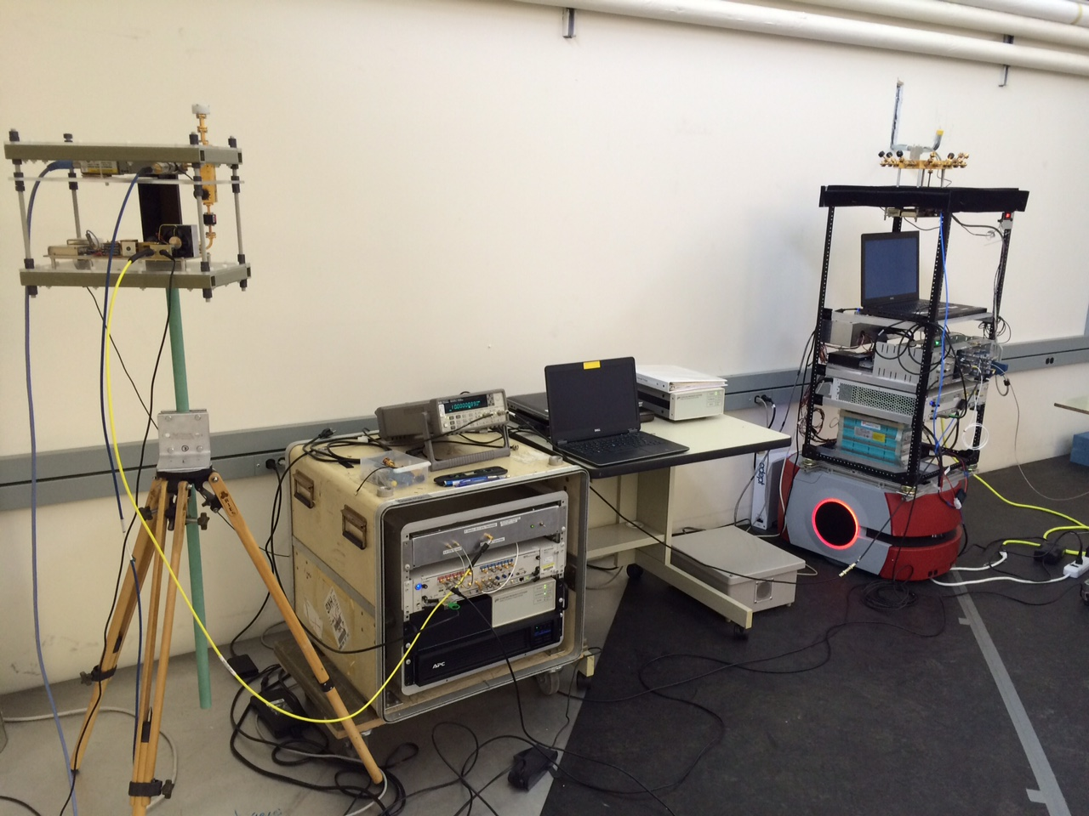
83 GHz Channel Sounder
1 TX antenna
  Omni-directional in azimuth
  45º beamwidth in elevation
16-antenna RX array
  8 elements every 45º in azimuth at 0º elevation
  8 elements every 45º in azimuth at 45º elevation
  Can extract three-dimensional AoA
  Each horn antenna has 45º beamwidth
2 GHz null-to-null bandwidth
Robot-guided navigational system
  Can collect hundreds of GB of data in just minutes
Can support use cases with high mobility
  Complete channel measurement sweep in 65.5 μs
  Untethered synchronization through rubidium clocks
Tx antenna
Rx array

Slide 4
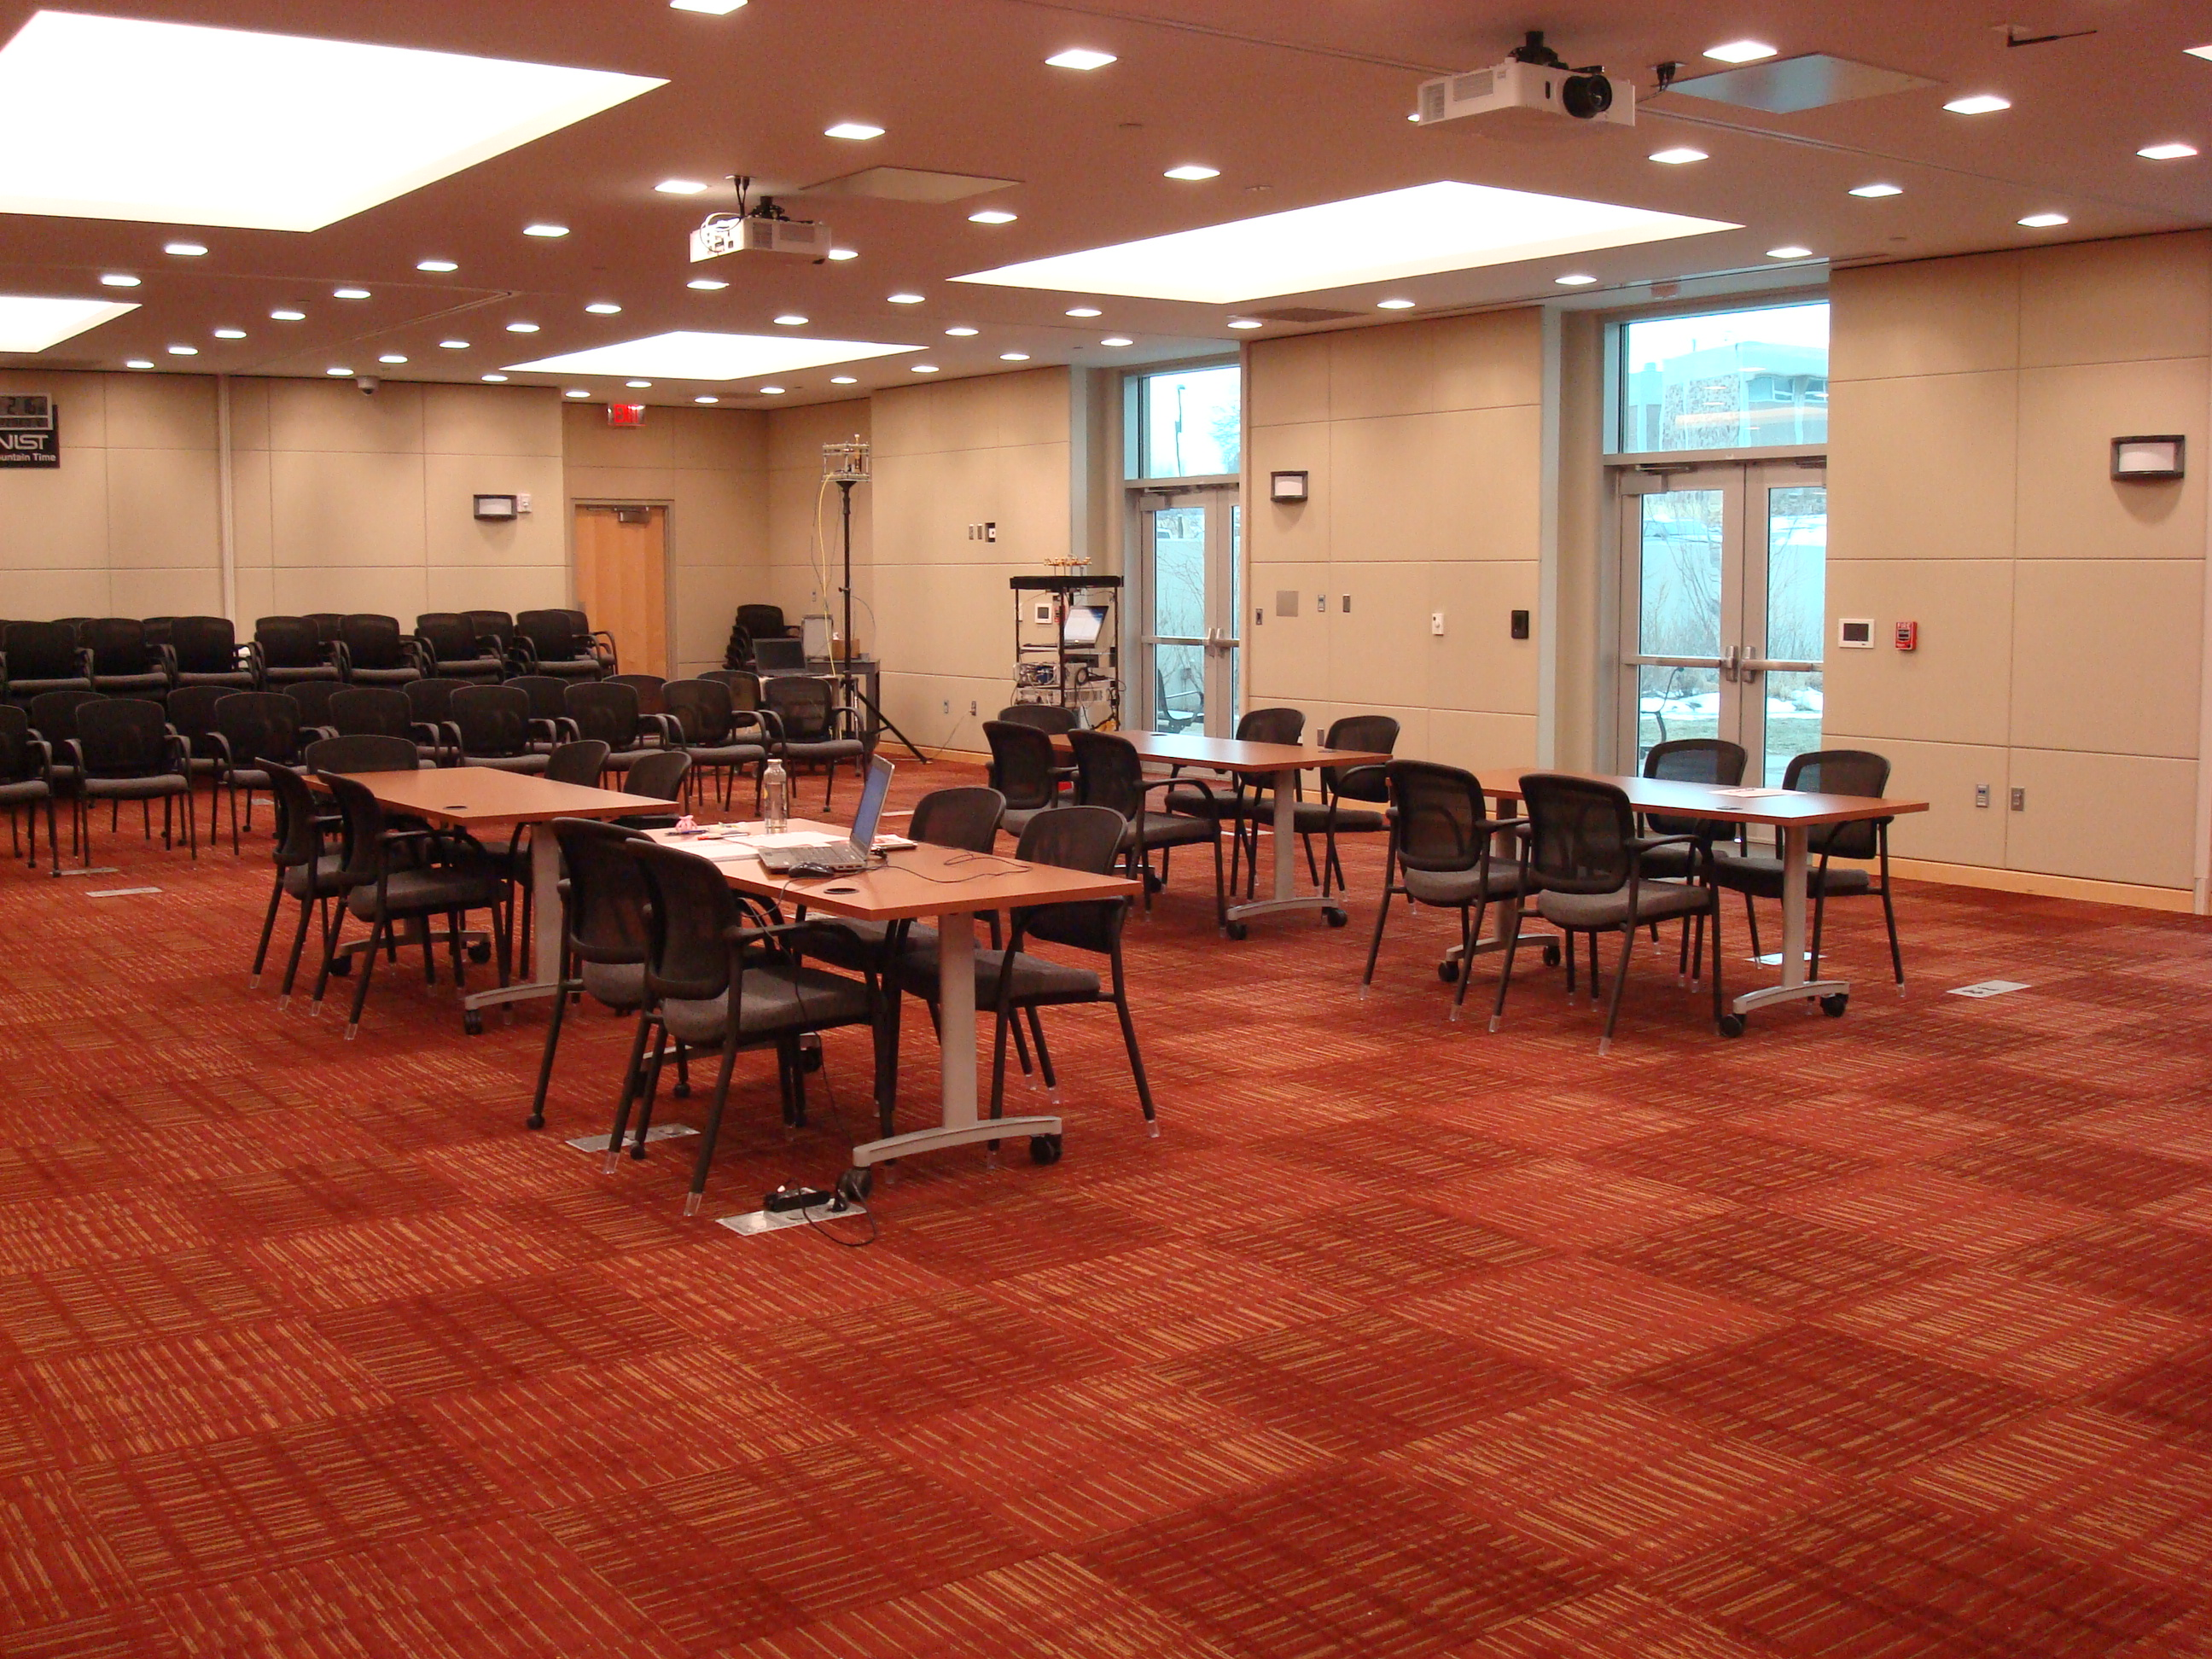
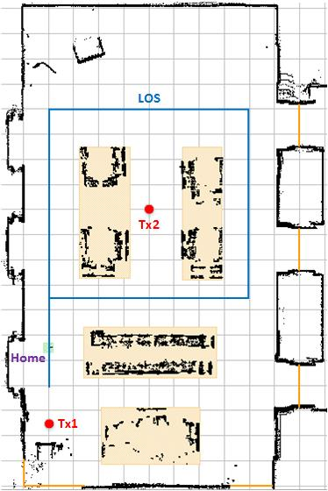
Conference Room
Tx
Rx Home
Rx Home
Photograph of room
Robot-generated floor plan
Using laser-guided navigation system, robot generates floor plan (doors, tables, chairs, etc. also traced)
Room dimensions: 10 m x 19 m x 3 m
Tx height at 2.5 m, Rx height at 1.6 m
Tx placed at corner of room
Rx follows blue LOS trajectory within room, starting from Rx Home

Slide 5
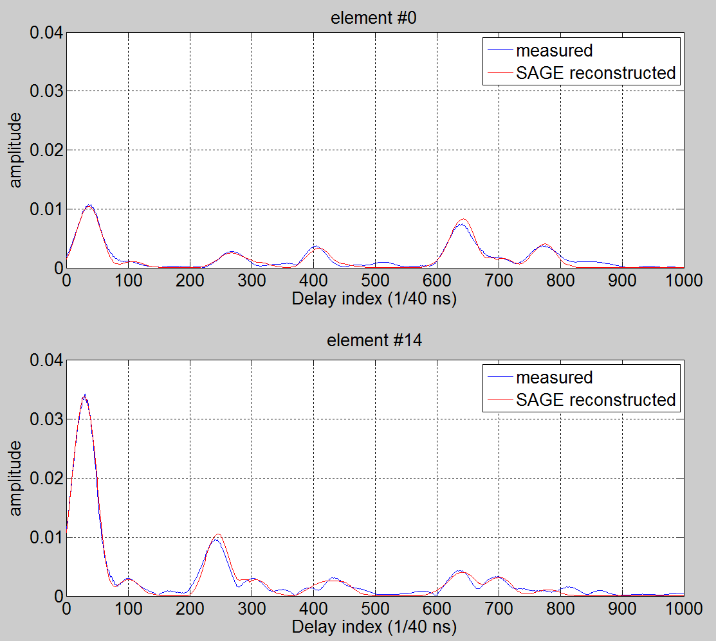
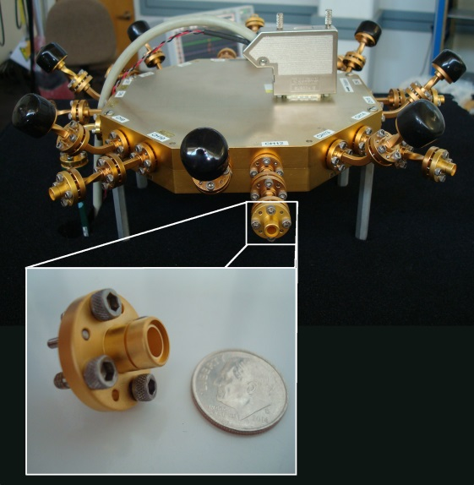
Multipath Component (MPC) Extraction
SAGE algorithm:
      Beamforming algorithm which combines PDPs from Rx elements to extract AoA based on relative delay of MPCs between elements
      Besides providing superresolution, it also deembeds the antennas from the measured response
      MPCs indexed in complex amplitude, delay, azimuth AoA, and elevation AoA
      Average azimuth AoA error for LOS ~1º
      Average elevation AoA error for LOS is ~4º
PDP
MPC 1
MPC 4
MPC 2
MPC 3
MPC 5
0 10 20 30 40
Delay (ns)
PDP
MPC 1
RX
array
MPC 2
MPC 3
MPC 4
MPC 5
0 10 20 30 40
Delay (ns)

Slide 6
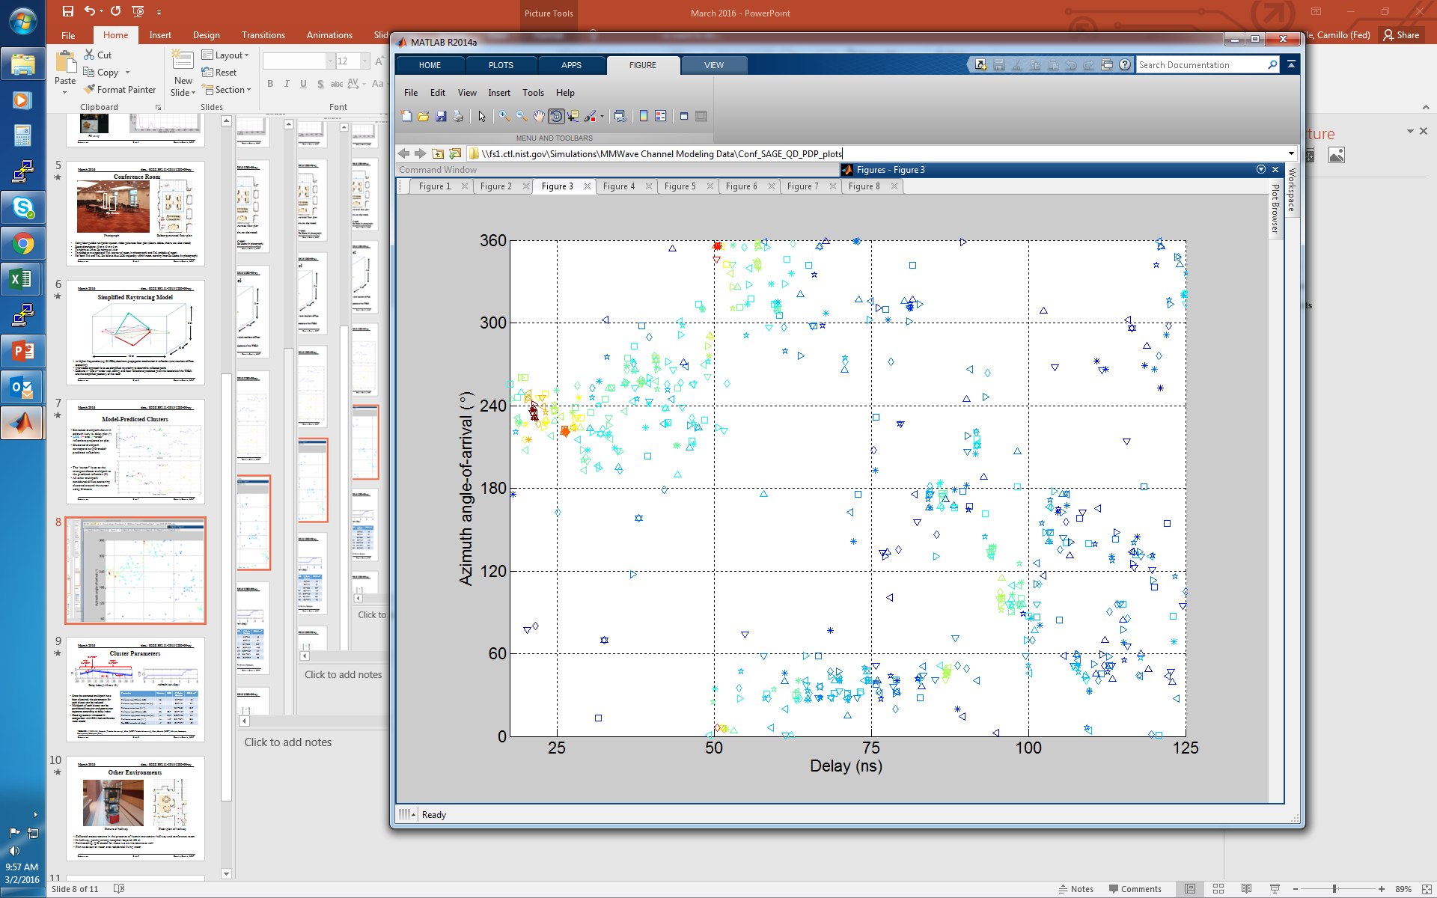
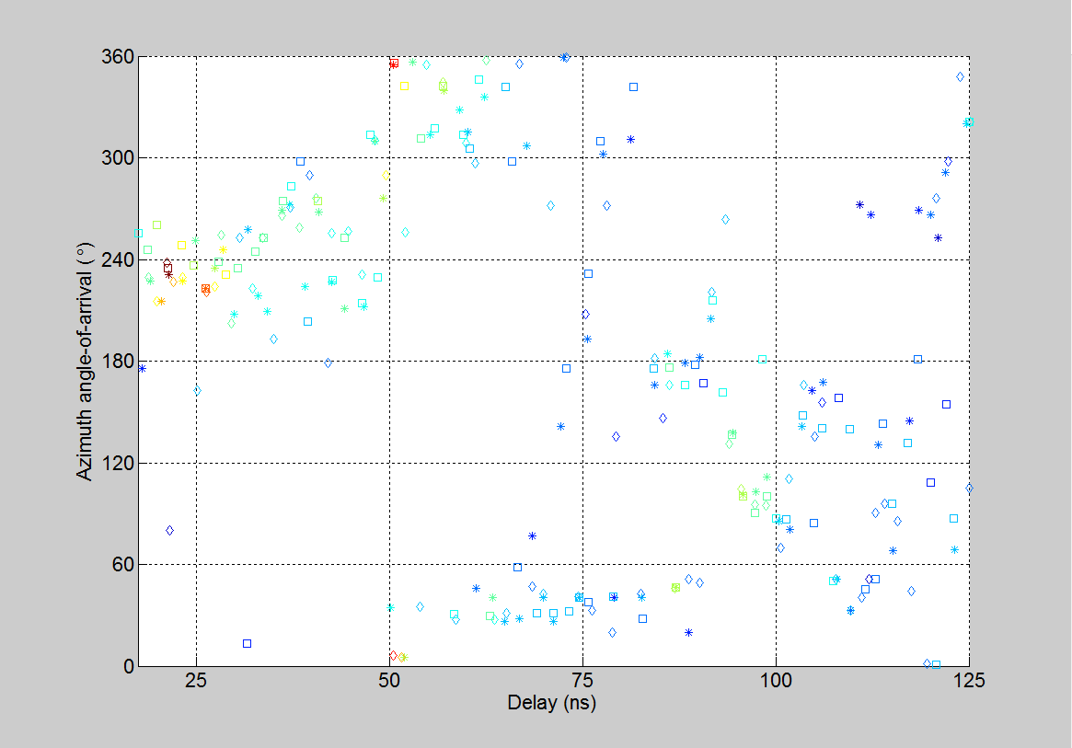
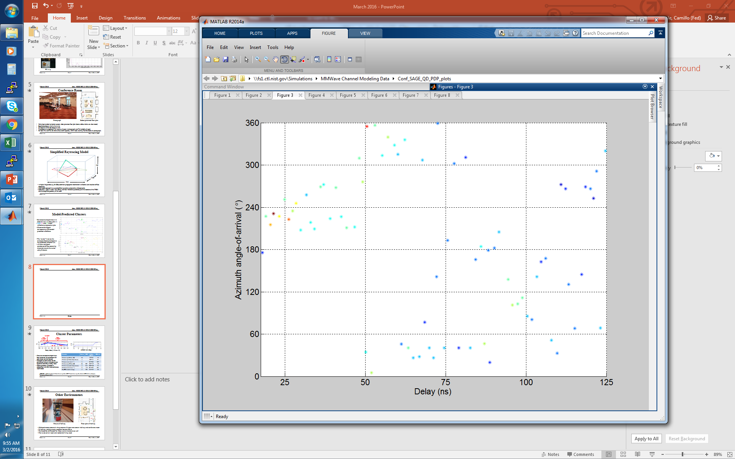
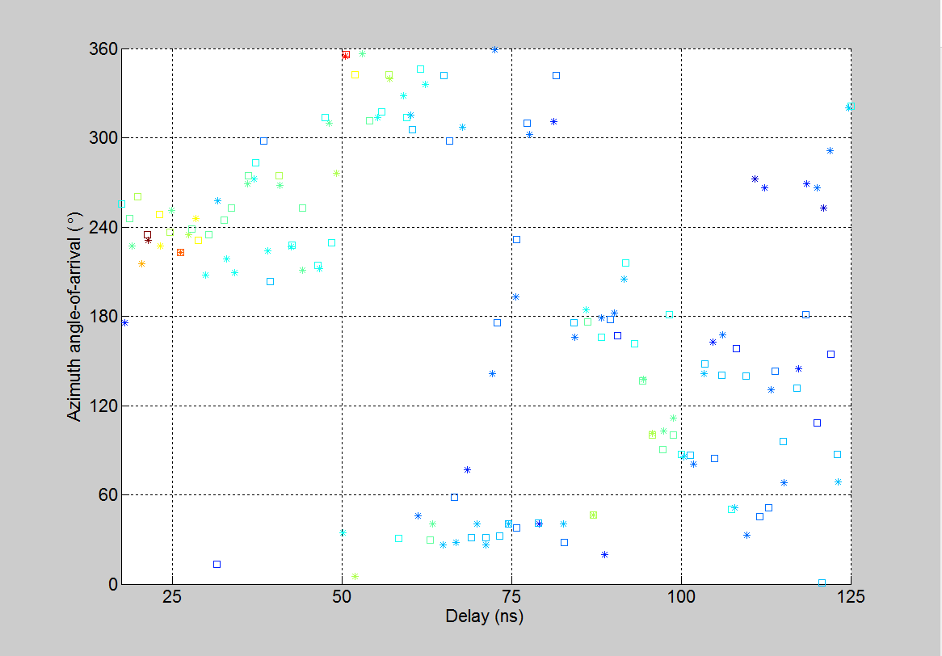
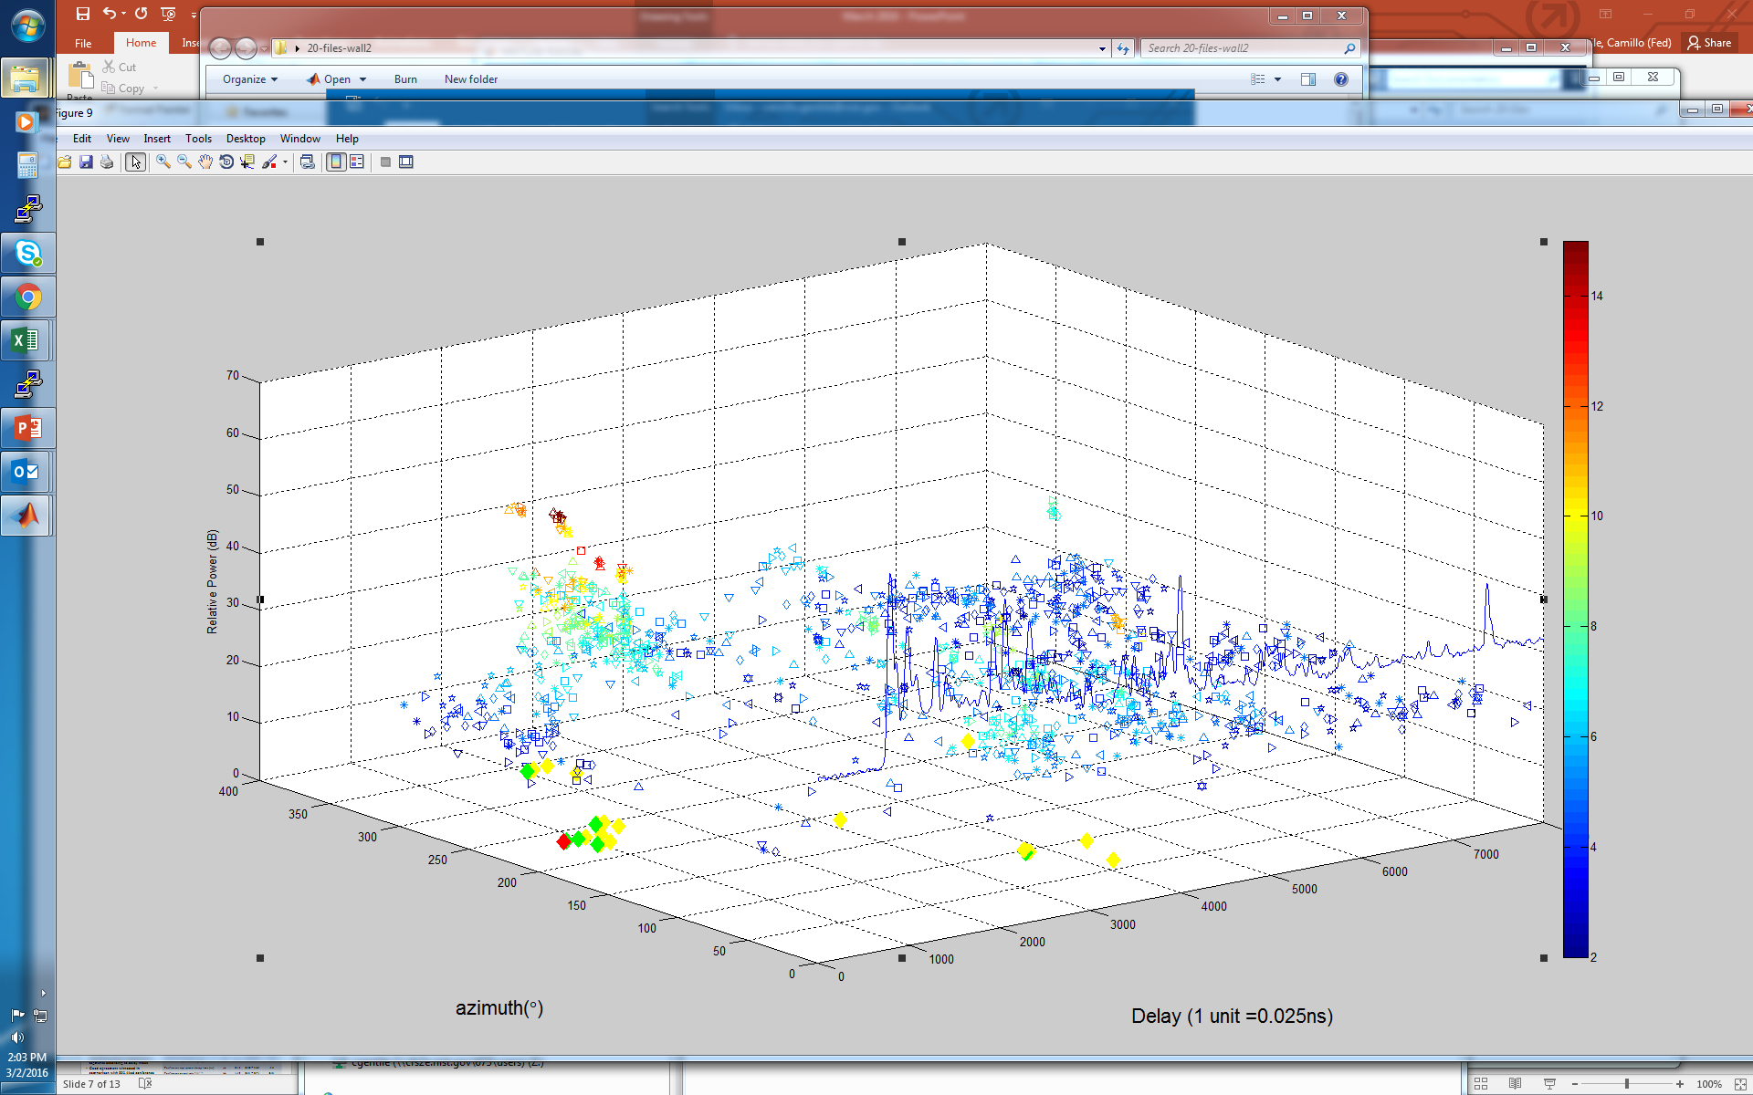
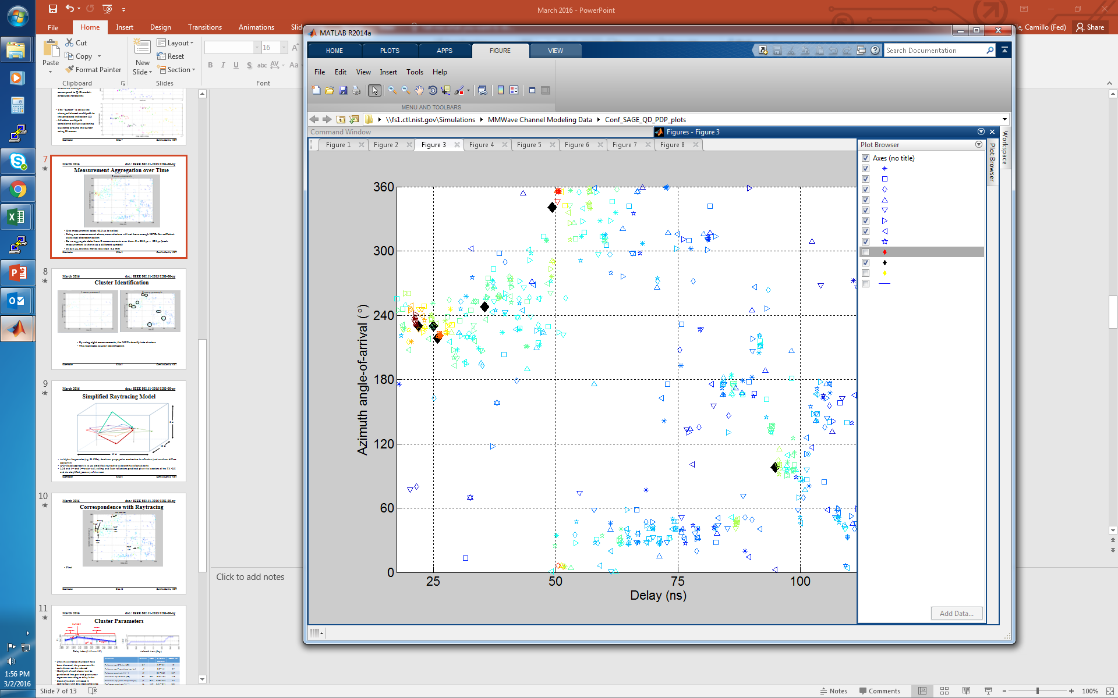
Measurement Aggregation
2 measurements
1 measurement
8 measurements
3 measurements
LOS
Measurement 1
Measurement 2
Measurement 3
Measurement 4
Measurement 5
Measurement 6
Measurement 7
Measurement 8
Power (dB)
One measurement over all 16 Rx antennas takes 65.5 µs to sweep
From each measurement, SAGE algorithm generates power vs. azimuth-elevation-delay profile (only power vs. azimuth-delay profile shown here)
Each MPC is shown color-coded according to power
Using a single measurement alone, some clusters will not have enough MPCs for sufficient statistical characterization
So we aggregate data from 8 consecutive measurements: 8 x 65.5 µs = 524 µs
In 524 µs, Rx moves less than 0.5 mm, so channel quasi-static

Slide 7
Cluster Identification
1 measurement
8 measurements
MPC clustering arises from diffuse scattering of reflected component
Cluster is composed of reflected component (AKA cursor) and diffuse components
Using a single measurement alone, clusters not apparent
When aggregating eight measurements, MPCs densify into clusters
This facilitates cluster identification

Slide 8
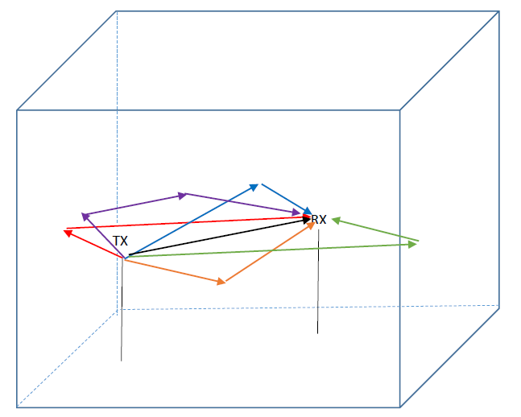
Simplified Raytracing Model
  3 m
  10 m
  19 m
  At higher frequencies (e.g. 83 GHz), dominant propagation mechanism is reflection and resultant diffuse scattering
  Q-D-Model approach is to use simplified raytracing to predict reflected paths (AKA cursors)
  Given locations of TX-RX and the simplified geometry of the room, LOS and 1st- and 2nd-order wall, ceiling, and floor reflections can be predicted

Slide 9
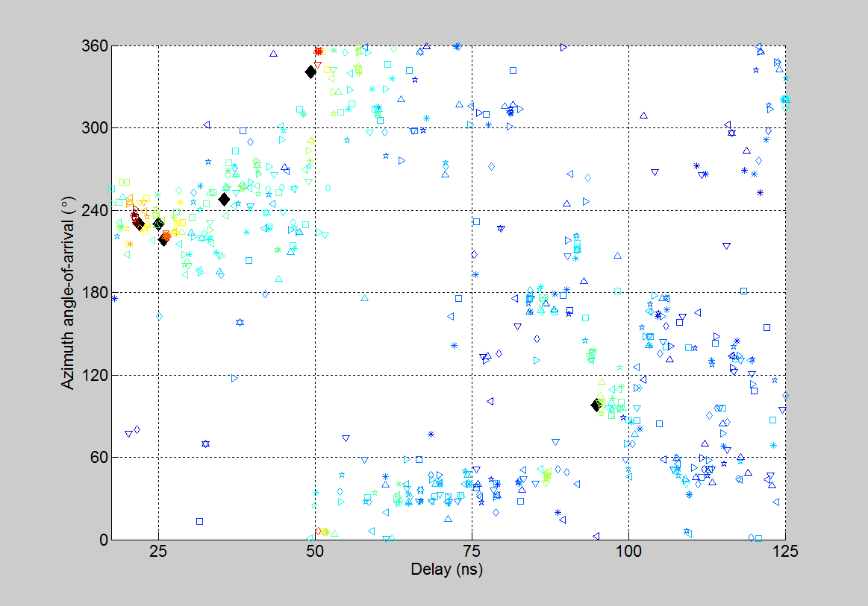
Dominant Clusters
Far side wall
Ceiling
Predicted LOS
LOS
Floor
Near
side
wall
Predicted 1st-order
reflection
Back
wall
Front
wall
Most dominant clusters correspond with LOS or 1st-order reflections predicted from raytracing

Slide 10
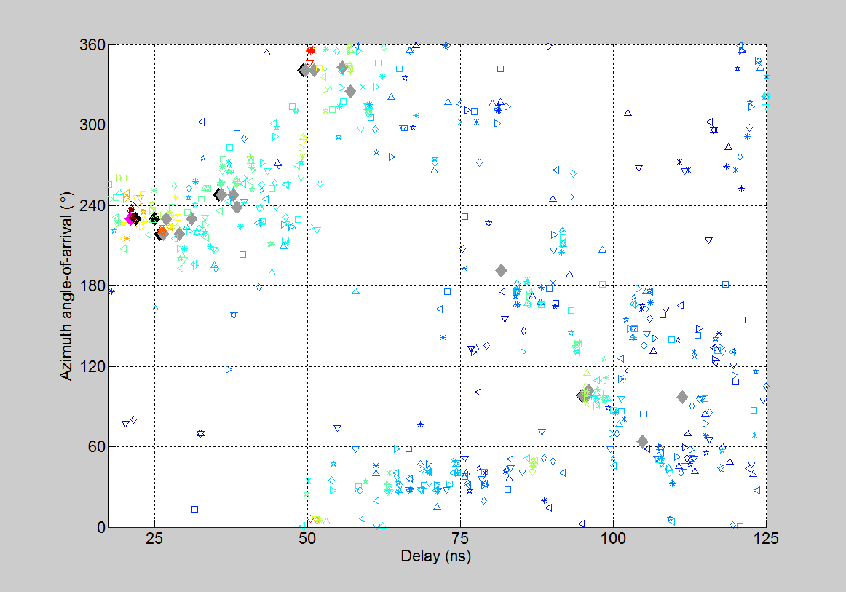
Non-dominant Clusters
Predicted LOS
Random
cluster
Predicted 1st-order
reflection
2nd-order
cluster
2nd-order
cluster
Predicted 2nd-order
reflection
Random
cluster
Most non-dominant clusters originate from 2nd-order reflections
Given the geometry of the room, 1st-order and 2nd-order reflections often overlap, making resolution between them difficult
The remaining clusters arise from random objects such as chairs, tables, etc.

Slide 11
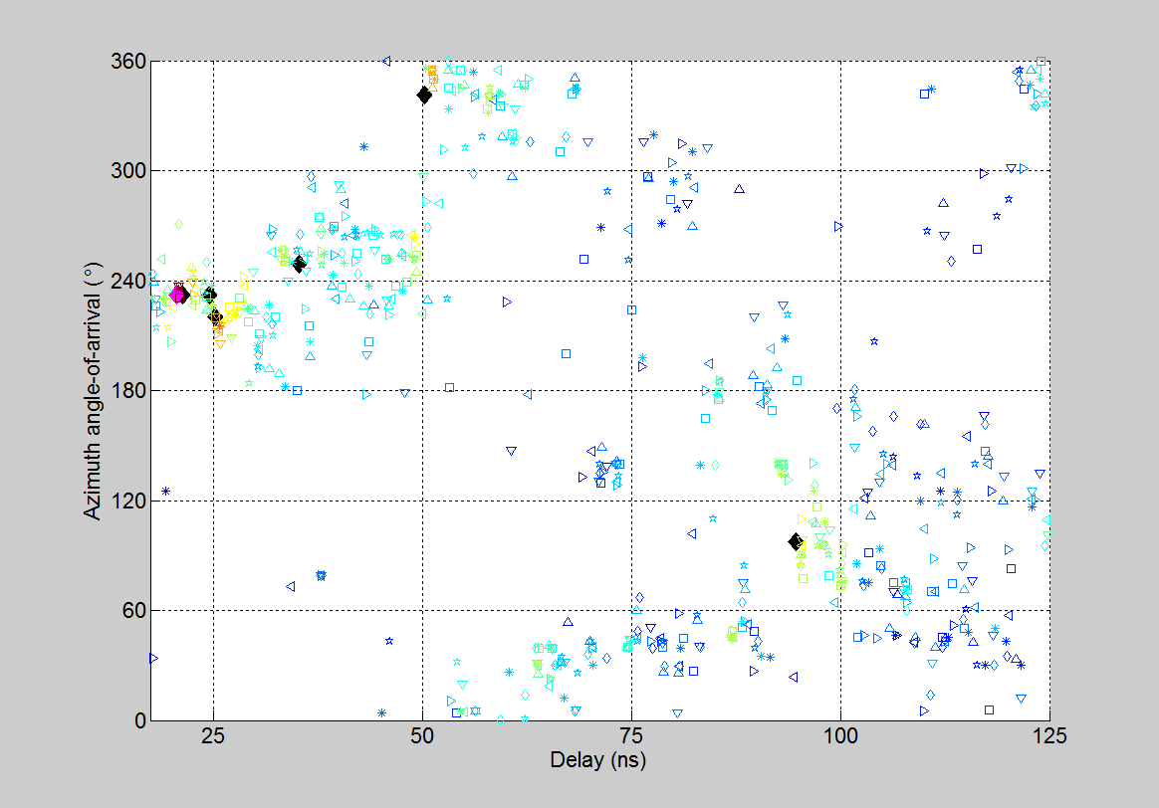
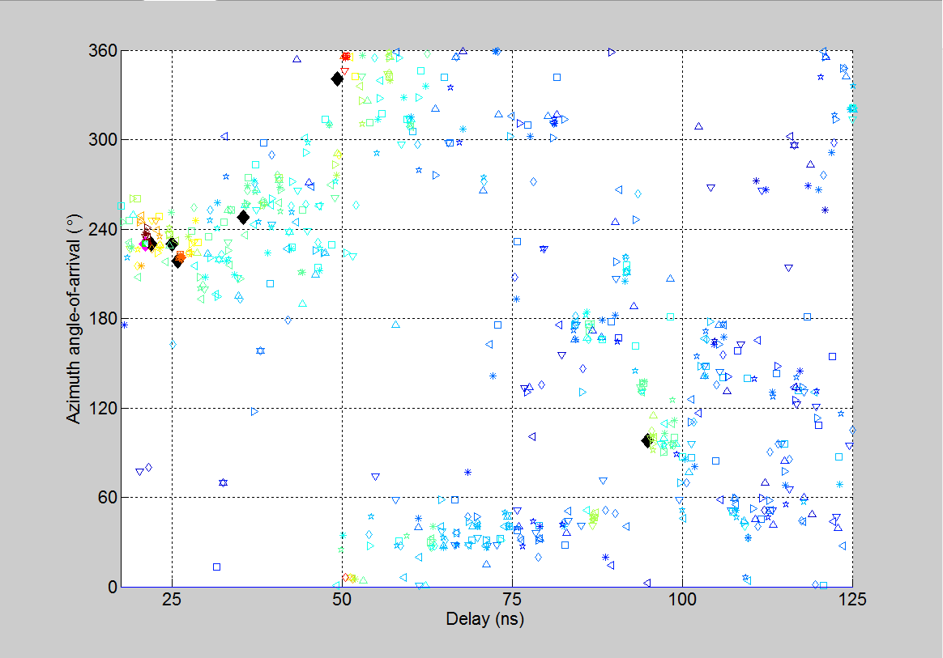
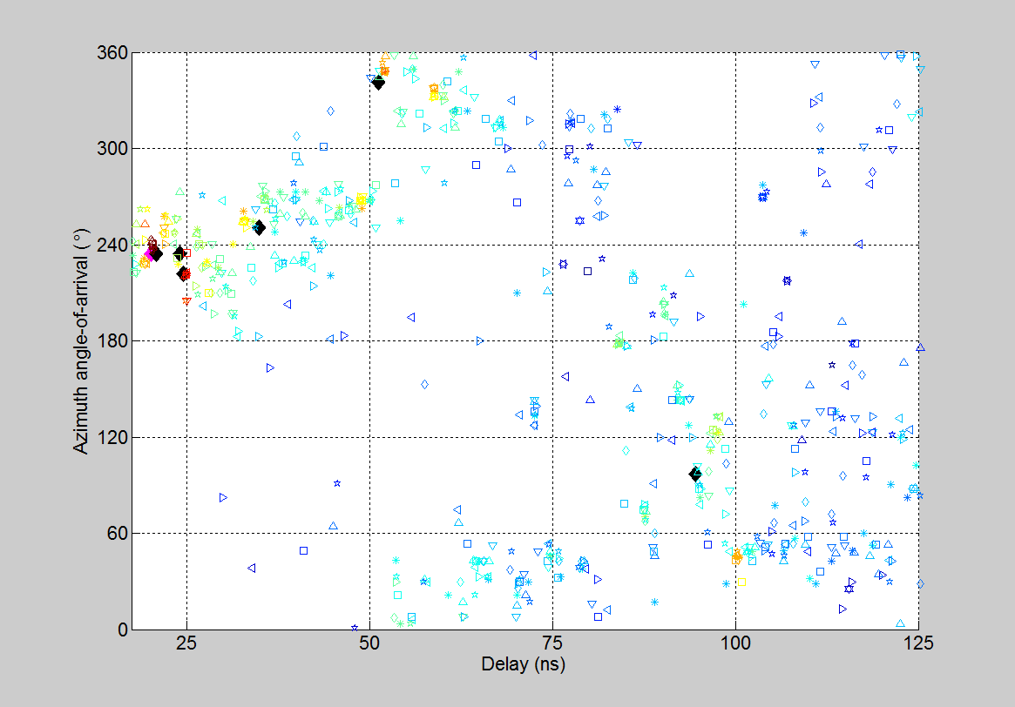
Cursor Tracking between Locations
Location 2
Location 3
Location 1
Predicted LOS
Predicted 1st-order
reflection
Errors appear between the predicted and measured cursors because:
  The geometry of the room in the raytracing model is not exact
  The measured delay and angle-of-arrival have errors
The errors are represented in the figure as ovals
Although errors exist, the predicted and measured cursors move in lockstep
For reliable cluster identification, the measured cursor is tracked between locations using the predicted cursor as a guideline
Robust tracking is possible because the successive locations are only about 10 cm apart

Slide 12
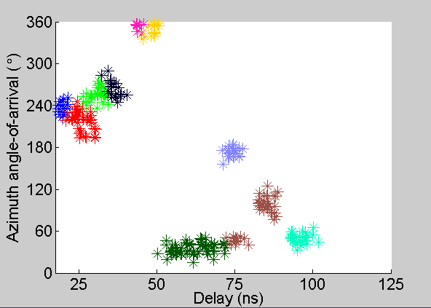
Results: Automatic Clustering
1st
2nd
LOS
2nd
1st
1st
2nd
1st
R
R
2nd
Automatic clustering algorithm identifies clusters
Each color shown here represents a different cluster
Each cluster is also automatically classified as LOS, 1st, 2nd, or random (R)

Slide 13



Results: Cluster Parameters
reflected
component
K-factor = $\frac{Reflected power}{Total diffuse power}$
Power (dB)
1/$γ$
diffuse
components
$$1/λ$$
delay (ns)
Statistics reduced from each cluster identified
Statistics aggregated across all Rx locations

Slide 14
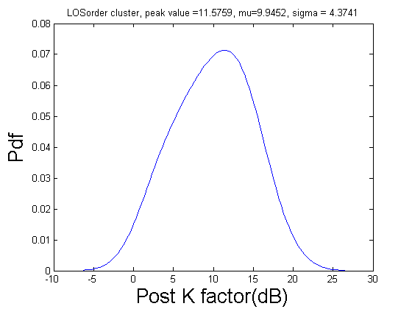
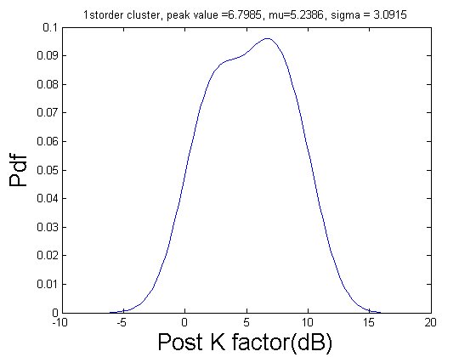
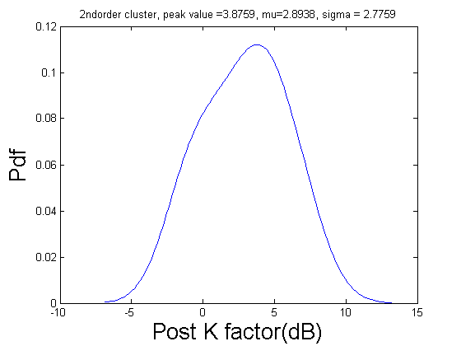
Results: Cluster K-factor
LOS
1st
2nd
Plots show distribution of K-factor for the LOS, 1st- and 2nd-order clusters
      The mean values are 9.9 dB for LOS, 5.2 dB for 1st-order, and 2.9 dB for 2nd
K-factor decreases with cluster order, meaning that reflected component becomes smaller and smaller compared to diffuse component

Slide 15
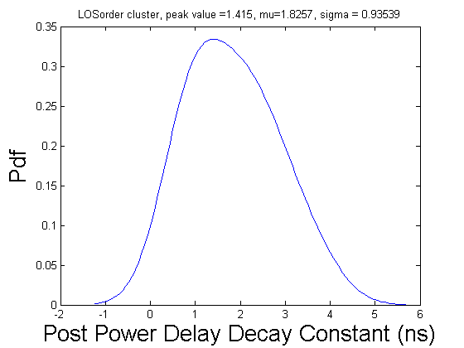
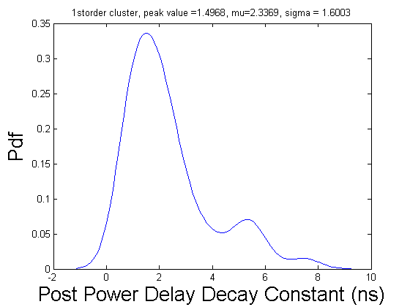
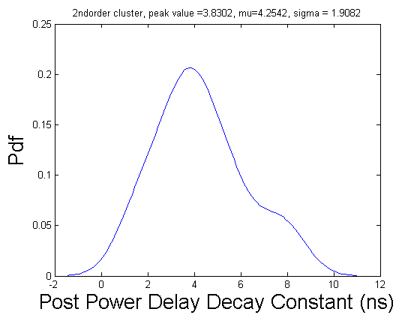
Results: Cluster Power-delay Decay Constant ($γ$)
LOS
1st
2nd
Plots show distribution of power-delay decay constant for LOS, 1st- and 2nd-order clusters
The mean values are 1.8 ns for LOS, 2.3 ns for 1st-order, and 4.3 ns for 2nd
As cluster order increases, power decays less rapidly because the reflected component becomes smaller and smaller compared to scattered component (smaller K-factor)

Slide 16
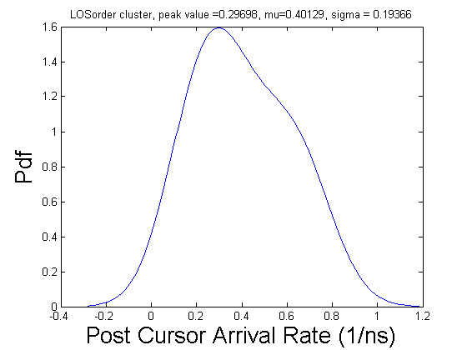
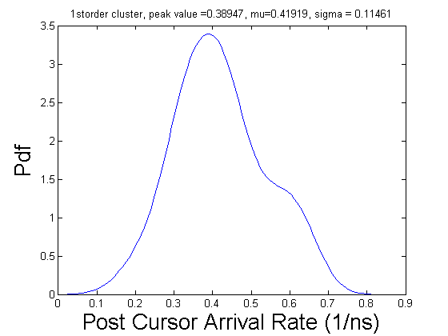
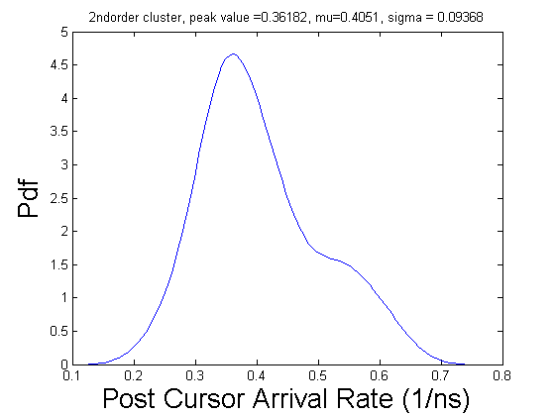
Results: Intra-cluster MPC Arrival Rate ($λ$)
LOS
1st
2nd
Plots show the distribution of intra-cluster MPC arrival rate for LOS, 1st- and 2nd-order clusters
The mean values are 0.40 ns⁻¹ for LOS, 0.42 ns⁻¹ for 1st-order, and 0.41 ns⁻¹ for 2nd
No significant difference witnessed between cluster orders

Slide 17
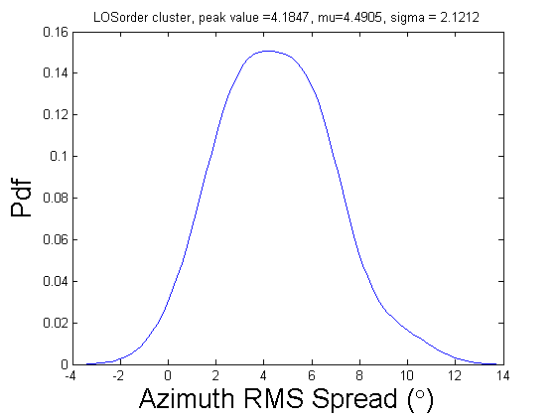
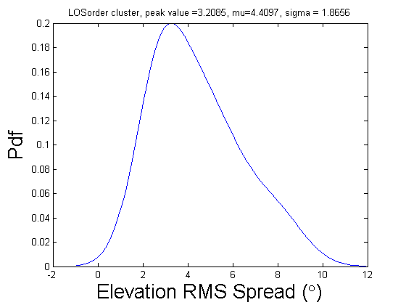
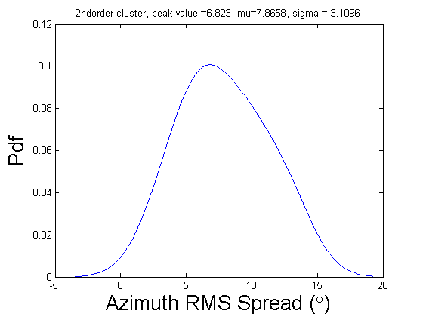
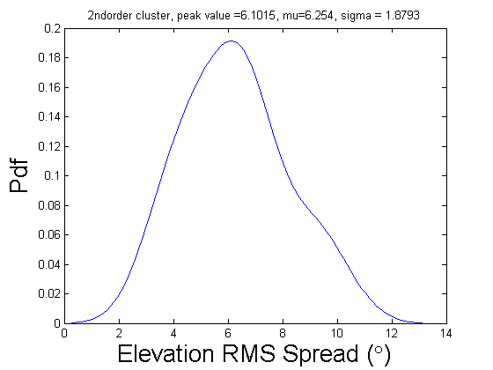
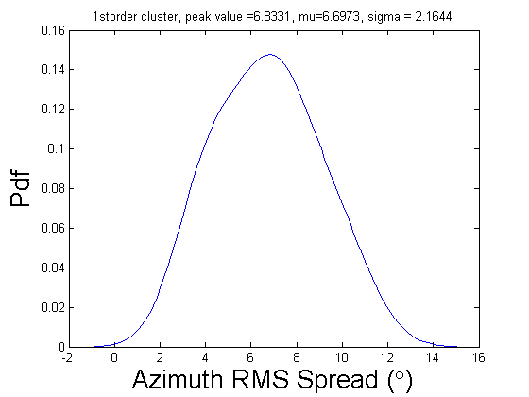
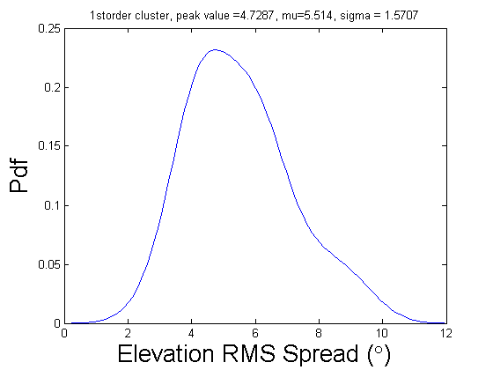
Results: Cluster RMS Azimuth / Elevation AoA Spread
LOS
2nd
1st
Plots show distribution of RMS azimuth / elevation AoA spread for the LOS, 1st-order, and 2nd-order clusters
      The mean values are 4.5º / 4.4º for LOS, 6.7º/ 5.5º for 1st-order, and 7.9 º/ 6.2 º for 2nd-order
Angular spread increases with cluster order because there is more and more scattering

Slide 18


Results: Reflection Loss
$$θ_{inc. 1st}$$
Tx
Rx
$$θ_{inc. 2nd}$$
Incident angles of 2nd-order reflections are typically larger than 1st-order reflections, hence less reflection loss
Plots show distribution of reflection loss for 1st- and 2nd-order clusters
      The mean values are 7.0 dB for 1st-order and 8.4 dB for 2nd
Graphic above depicts one reason why 2nd-order reflection loss is less than double 1st-order loss

Slide 19
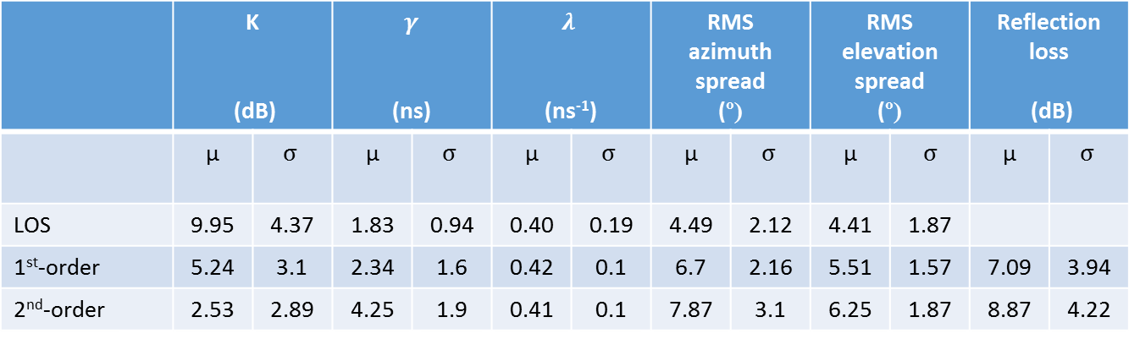
Results: Summary
 | K (dB) |  | $γ$ (ns) |  | $$λ$$ (ns⁻¹) |  | RMS azimuth spread (º) |  | RMS elevation spread (º) |  | Reflection loss (dB)
 | µ | $$σ$$ | µ | $$σ$$ | µ | $$σ$$ | µ | $$σ$$ | µ | $$σ$$ | µ | $$σ$$
LOS | 9.95 | 4.37 | 1.83 | 0.94 | 0.40 | 0.19 | 4.49 | 2.12 | 4.41 | 1.87
1st-order | 5.24 | 3.1 | 2.34 | 1.6 | 0.42 | 0.1 | 6.7 | 2.16 | 5.51 | 1.57 | 7.09 | 3.94
2nd-order | 2.53 | 2.89 | 4.25 | 1.9 | 0.41 | 0.1 | 7.87 | 3.1 | 6.25 | 1.87 | 8.87 | 4.22

Slide 20
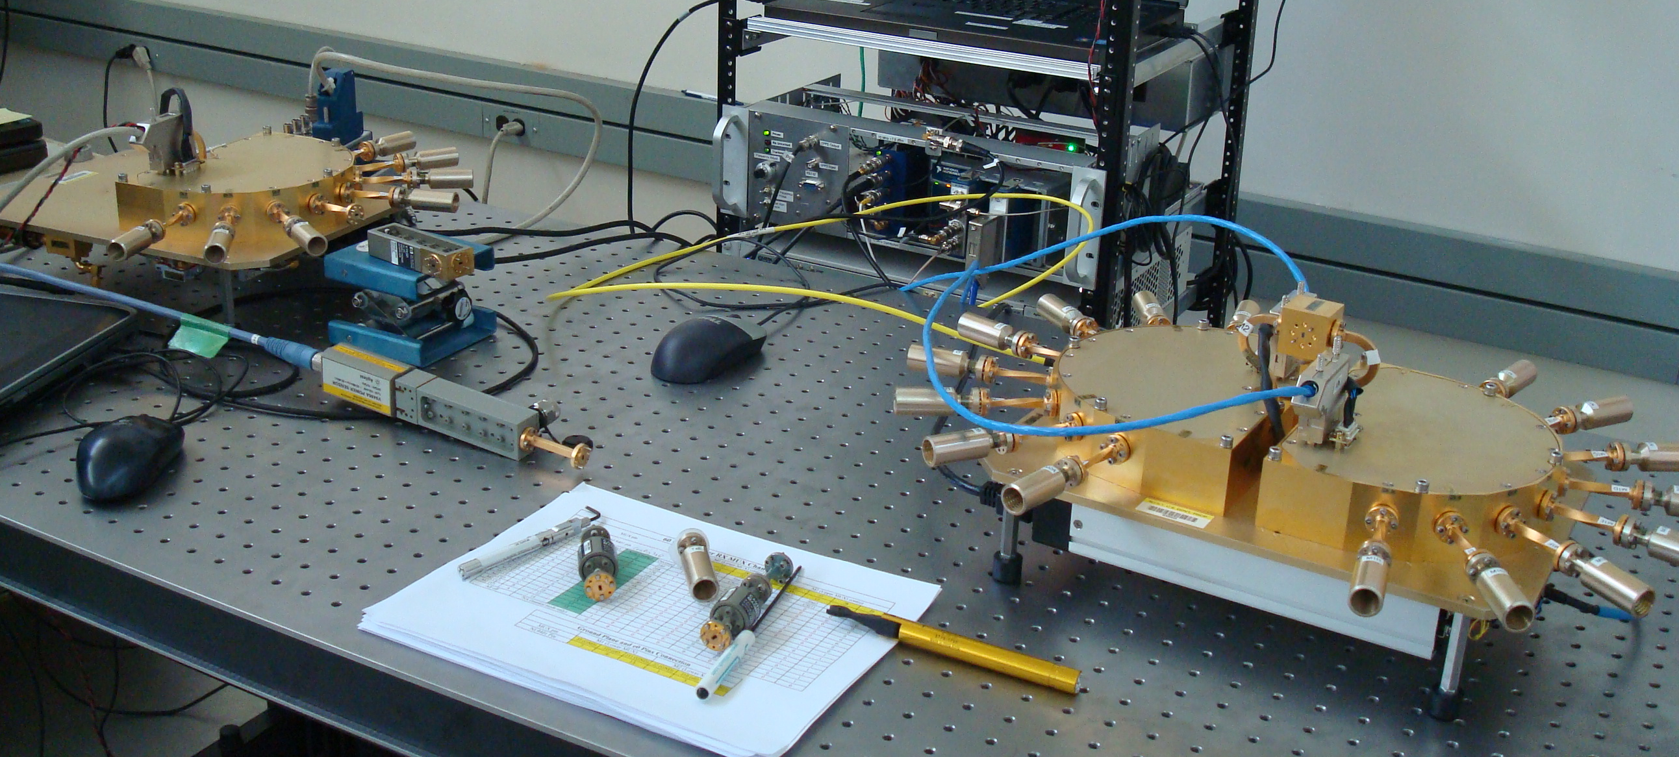
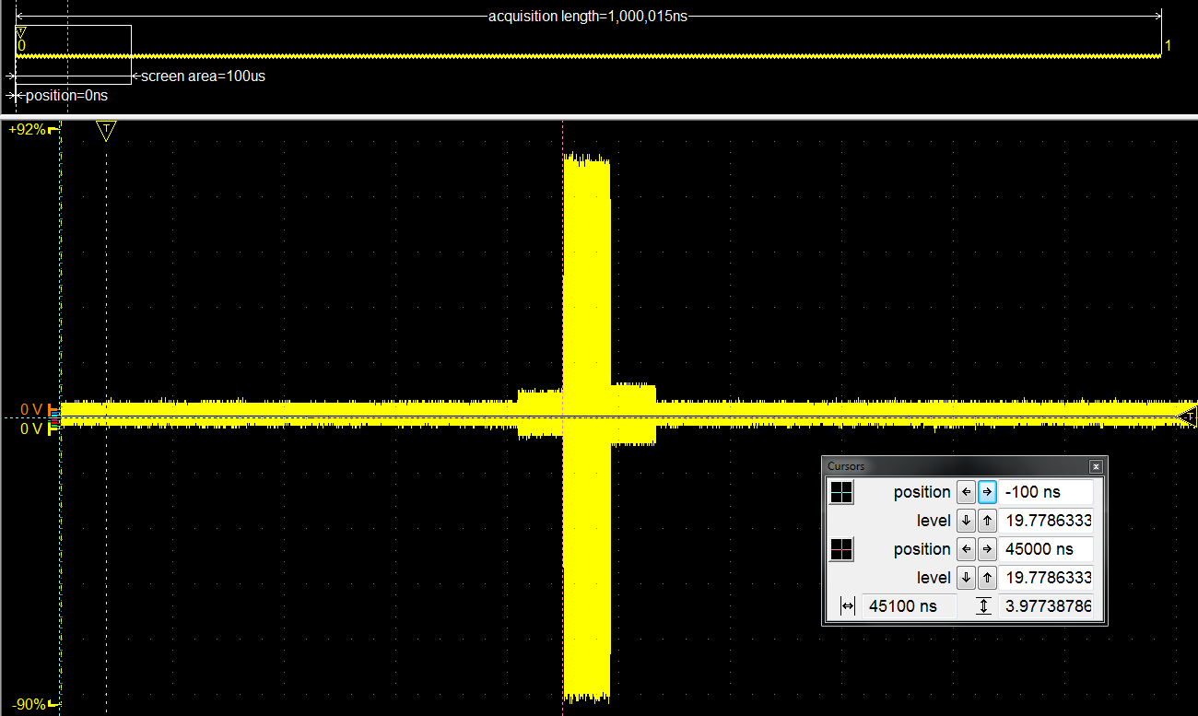
60 GHz Channel Sounder
Rx Array
Tx Array
Voltage
Time
System photograph
IF measurement
Tx array: 8 antennas, Tx power (per antenna) = 22.3 dBm , Tx gain = 25 dBi, Tx beamwidth = 22.5º
Rx array: 16 antennas, Rx gain = 18 dBi, Rx beamwidth =22.5º
One measurement over all 8 Tx antennas x 16 Rx antennas takes 524 µs to sweep
Can extract three-dimensional AoD and AoA
4 GHz bandwidth
In-house, assembled, and currently being calibrated
Start channel measurements next week
Planning to do conference room, server room, and residential environment
Should have preliminary results by May meeting

