Slide 1
Issue related to unused UL OFDMA RUs
Date: 2016-03-13
Authors:
Name | Affiliation | Address | Email
Stéphane BARON | Canon | Cesson-Sevigné, France | stephane.baron@crf.canon.fr
Patrice NEZOU |  |  | patrice.nezou@crf.canon.fr
Romain GUIGNARD |  |  | romain.guignard@crf.canon.fr
Pascal VIGER |  |  | pascal.viger@crf.canon.fr

Slide 2
Introduction
UL MU OFDMA transmission is now part of 802.11ax
The TGax SFD [1] includes specifications for the UL MU OFDMA operation
A-MPDU MAC padding is required [2]:
The transmission from all the STAs in an UL MU PPDU shall end at the time indicated in Trigger frame.
The A-MPDU padding per each STA follows the 11ac procedure.
The TGax SFD [1] includes also specifications for the random access Trigger Frame (TF-R)
A STA randomly selects any one of the assigned RUs for random access and transmits its UL PPDU in the selected RU
Through simulation, ratio of unused RUs can be high (see next slides)
This presentation discusses about a possible issue due to unused OFDMA RUs

Slide 3
Legacy collision issue already identified in the case of early STA TX termination
Extract from [2]: (802.11-15/0876, “Duration and MAC Padding for MU PPDUs”, S. Merlin, slide 10)
Each channel/stream occupied by the UL MU PPDU should be maintained busy for the time indicated by AP
If a STA was allowed to end its transmission earlier, the unused sub-channel could be acquired by an OBSS STA, which may initiate a transmissions, potentially resulting in:
Interference with the following DL BAs
Immediate BA not possible for STAs that terminated earlier
Corrupted reception of the remaining UL MU PPDUs due to interference at AP
In particular, the primary channel should not be left unused while other STAs are completing the UL MU PPDU transmission on secondary channels
Certain receiver algorithms may be affected by sudden termination of one stream
The virtual protection provided by trigger frame (NAV) or UL MU PPDU PHY preamble (deferral for the PPDU duration) is not fully reliable against OBSS [3]
Power save from early termination does not seem relevant

Slide 4
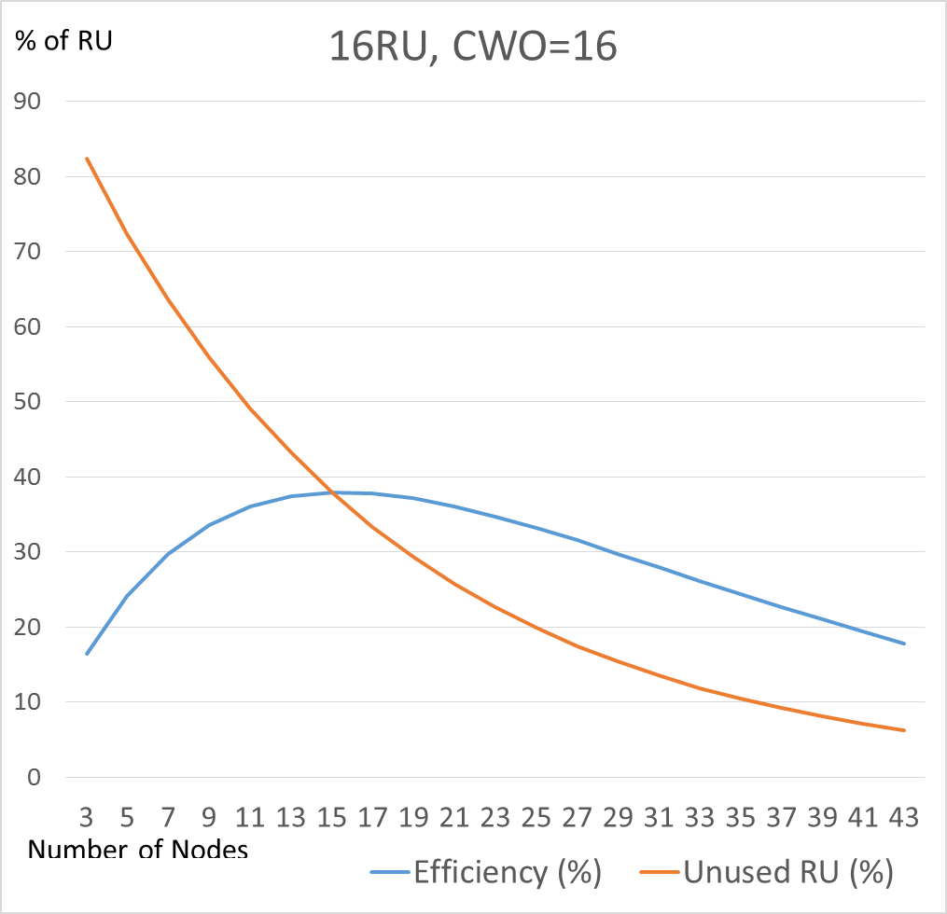
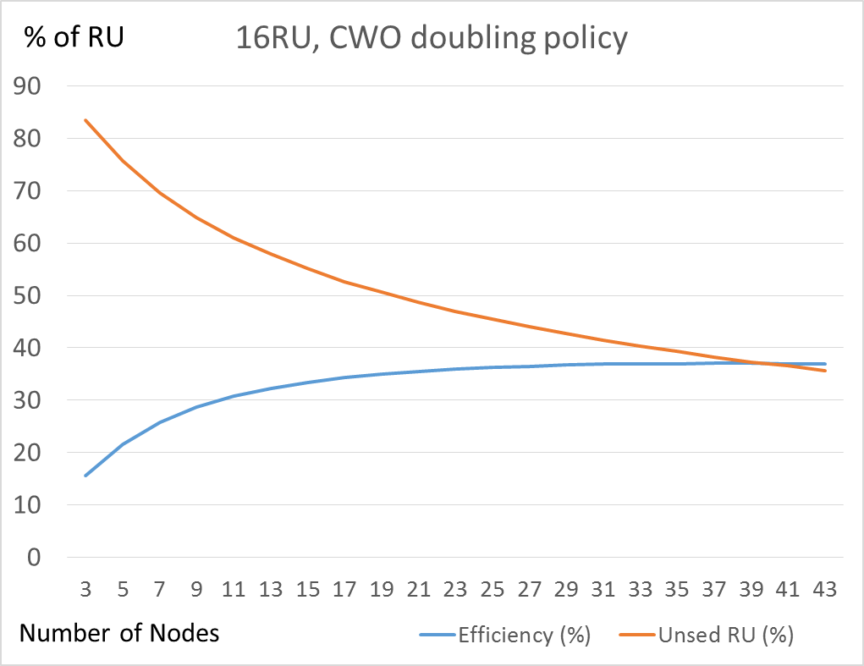
Number of unused RUs in MU_UL OFDMA is also significant… (especially in random access)
Example of simulation results for random RU allocation (TF-R):
Note: some scheduled RUs may also be empty (because scheduled station still in doze state, or no data ready for tx)
Efficiency > 33%
20% < Unused RU < 57%
Efficiency > 33%
35%<Unused RU<57%

Slide 5
Issue : unused RUs modify busy detection ?
Non-ht duplicate
OFDMA UL (random allocation)
Used RU
Primary
channel
TF-R
ACK
Collided RU
Secondary
channel
TF-R
ACK
Unused RU
Tertiary
channel
TF-R
ACK
Quaternary
channel
TF-R
ACK
SIFS
SIFS
A STA performs the energy-detect (ED) per single 20 MHz channel.
Unused RUs can mislead (legacy or foreign OBSS) STAs, so they start transmitting.
STA thinks the 20MHz sub-channel is free (false ED)

Slide 6
Conclusion
We note that the MU uplink transmission may lead to have unused RUs, and thus low-energy on corresponding 20MHz channel.
We suppose that this could impact the tentatively reserved MU TXOP, by letting other (legacy/OBSS) transmission occur (same issue as the case of early termination of RU).
As the efficiency of OFDMA random access is already low (<37%), it shall not be more damaged due to amount of unused RUs.
What are the possible solutions ?
Maintain the energy level of the partially used 20Mhz channels ?

Slide 7
References
[1] 11-15/0132r15 “Tgax Specification Framework”,
[2] 11-15/0876r1 “Duration and MAC Padding for MU PPDUs”, Simone Merlin (Qualcomm) .
[3] 11-15/0367r0 “OBSS preamble detection”, Gwen Barriac (Qualcomm)

Slide 8
Straw Poll 1
Do you agree that some configurations of unused OFDMA RUs are potentially critical for MU OFDMA TXOP, and that a further study is required ?
Y/N/A

