Slide 1
I-Q Decoupled OFDM Modulation
Date: 2016-03-14
Authors:
Name | Affiliations | Address | Phone | Email
Shouxing Simon Qu | BlackBerry, Ltd. | 1001 Farrar Rd., Ottawa, ON, Canada | 1-613-595-4205 | squ@blackberry.com

Slide 2
Abstract
OFDM has been adopted by various communications systems including IEEE 802.11.
I-Q Imbalance (IQI) has significant adverse impact on OFDM performance, as pointed out in [1]-[2].
A new OFDM modulation scheme, called I-Q Decoupled OFDM (DC-OFDM), is proposed in this submission.
In DC-OFDM, the real (I) and the imaginary (Q) time-domain signals are generated using independent input data sets.
DC-OFDM is robust to I-Q Imbalance.
DC-OFDM provides frequency diversity gain.
DC-OFDM provides same data rate as regular OFDM

Slide 3
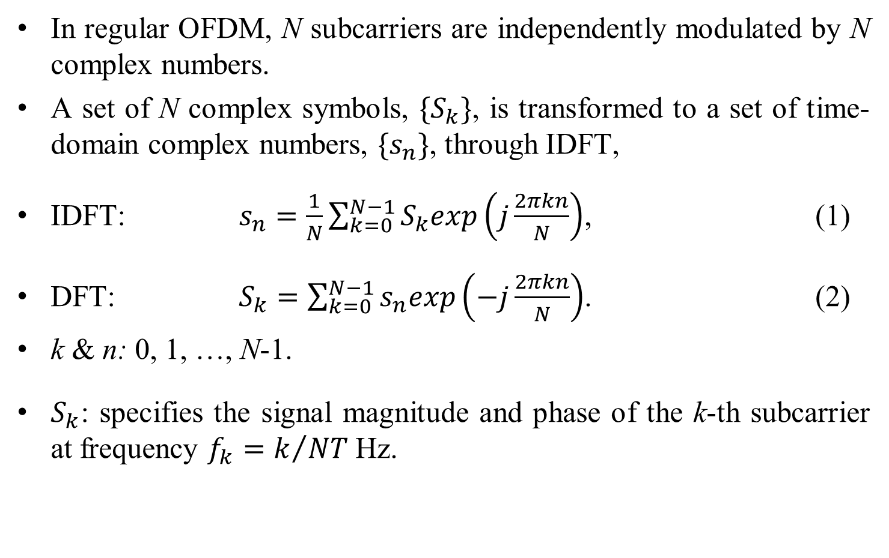
OFDM Basics
In regular OFDM, N subcarriers are independently modulated by N complex numbers.
A set of N complex symbols, $\{S_{k}\}$, is transformed to a set of time-domain complex numbers, $\{s_{n}\}$, through IDFT,
IDFT: $s_{n}=\frac{1}{N}\sum_{k=0}^{N−1}{S_{k}exp\left(j\frac{2πkn}{N}\right)}$, (1)
DFT: $S_{k}=\sum_{k=0}^{N−1}{s_{n}exp\left(−j\frac{2πkn}{N}\right)}$. (2)
k & n: 0, 1, …, N-1.
$S_{k}$: specifies the signal magnitude and phase of the k-th subcarrier at frequency $f_{k}=k/{NT}$ Hz.

Slide 4
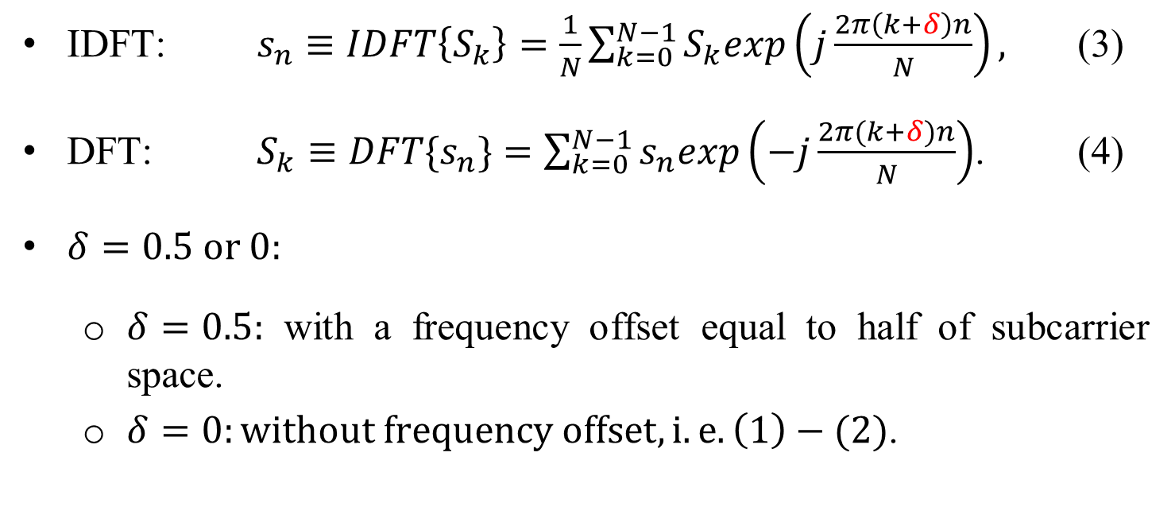
General Expressions for DFT/IDFT with Frequency Offset
IDFT: $s_{n}≡IDFT\left\{S_{k}\right\}=\frac{1}{N}\sum_{k=0}^{N−1}{S_{k}exp\left(j\frac{2π\left(k+δ\right)n}{N}\right)},$ (3)
DFT: $S_{k}≡DFT\{s_{n}\}=\sum_{k=0}^{N−1}{s_{n}exp\left(−j\frac{2π(k+δ)n}{N}\right)}$. (4)
$δ=0.5 or 0:$
  $δ=0.5:$ with a frequency offset equal to half of subcarrier space.
  $δ=0:without frequency offset, i.e. \left(1\right)−(2)$.

Slide 5
PSD
PSD
k
k
0
1
2
3
4
5
6
7
0
0
1
2
3
4
5
6
7
0
Subcarriers
Subcarriers
(a) N=8, δ = 0
(b) N=8, δ = 0.5
Fig. 1
Sequences are cyclically periodic in discrete signal processing.

Slide 6
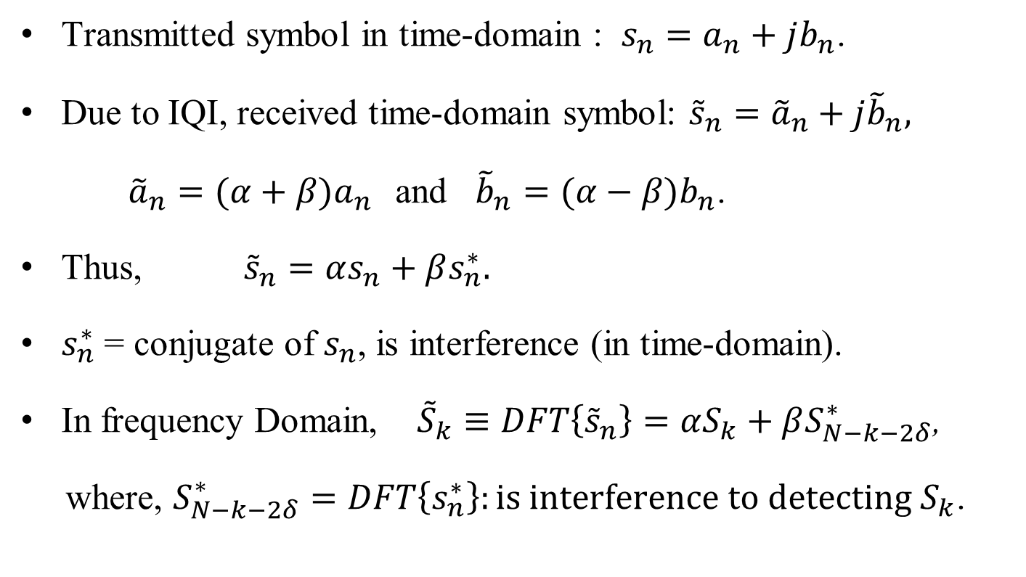
Impact of I-Q Imbalance on OFDM (1)
Transmitted symbol in time-domain : $s_{n}=a_{n}+jb_{n}$.
Due to IQI, received time-domain symbol: ${\tilde{s}}_{n}={\tilde{a}}_{n}+j{\tilde{b}}_{n},$
${\tilde{a}}_{n}=(α+β)a_{n}$ and ${\tilde{b}}_{n}=(α−β)b_{n}$.
Thus, ${\tilde{s}}_{n}=αs_{n}+βs_{n}^{∗}.$
$s_{n}^{∗}$ = conjugate of $s_{n}$, is interference (in time-domain).
In frequency Domain, ${\tilde{S}}_{k}≡DFT\left\{{\tilde{s}}_{n}\right\}=αS_{k}+βS_{N−k−2δ}^{∗}$,
where, $S_{N−k−2δ}^{∗}=DFT\left\{s_{n}^{∗}\right\}:is interference to detecting S_{k}$.

Slide 7
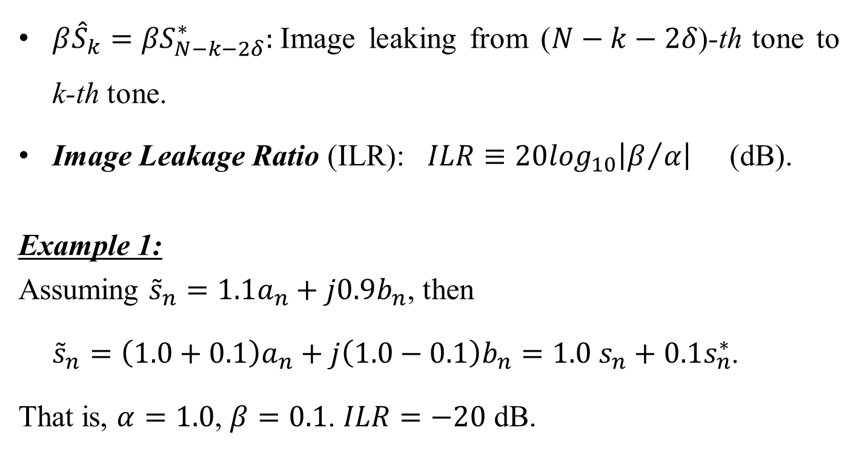
Impact of I-Q Imbalance on OFDM (2)
$β{\hat{S}}_{k}={βS}_{N−k−2δ}^{∗}:$Image leaking from ($N−k−2δ$)-th tone to k-th tone.
Image Leakage Ratio (ILR): $ILR≡20\log_{10}\left|β/α\right|$ (dB).
Example 1:
Assuming ${\tilde{s}}_{n}=1.1a_{n}+j0.9b_{n}$, then
${\tilde{s}}_{n}=\left(1.0+0.1\right)a_{n}+j\left(1.0−0.1\right)b_{n}=1.0 s_{n}+0.1s_{n}^{∗}$.
That is, $α=1.0$, $β=0.1$. $ILR=−20$ dB.

Slide 8
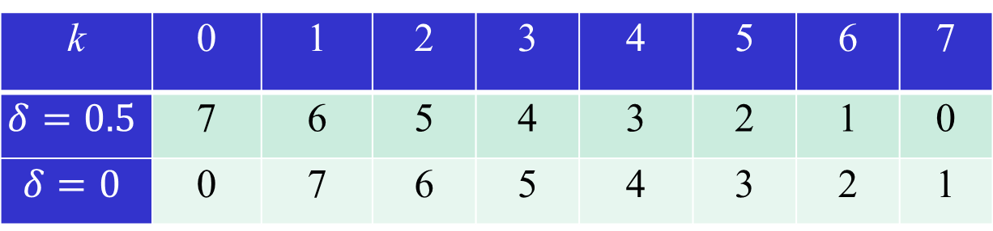
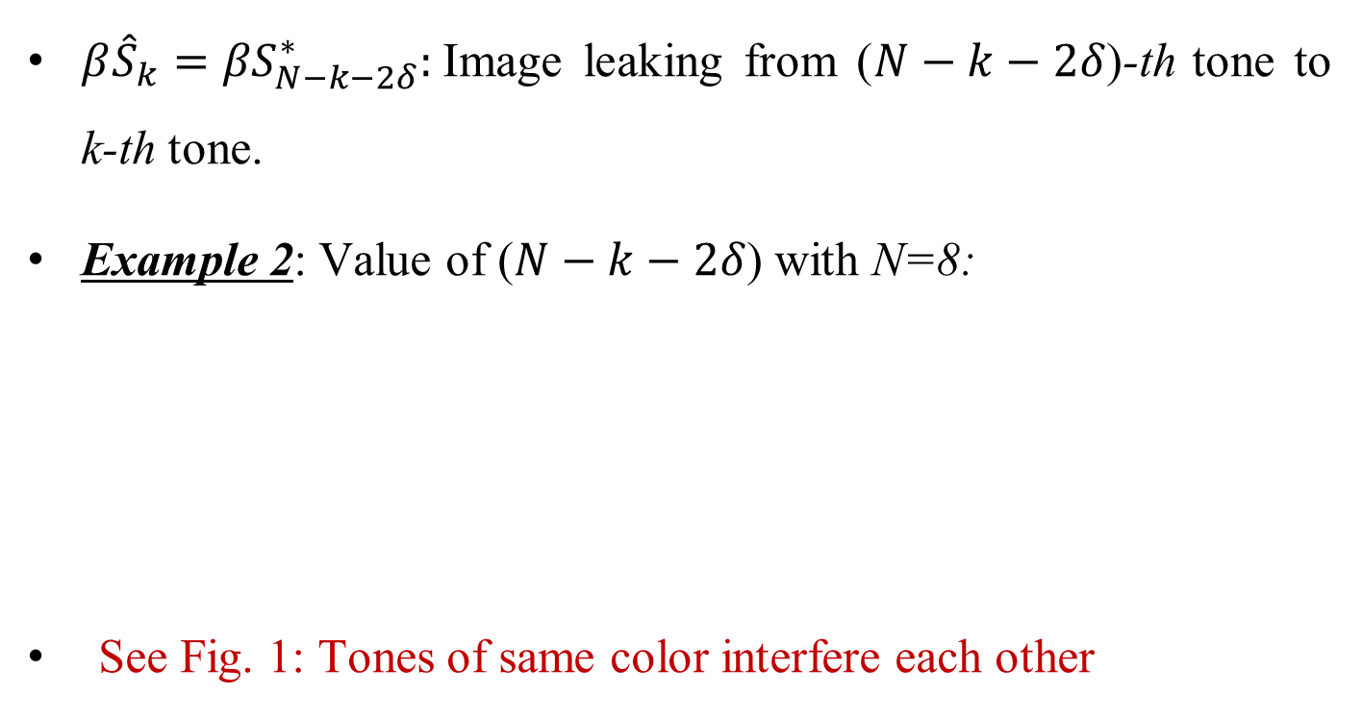
Impact of I-Q Imbalance on OFDM (3)
$β{\hat{S}}_{k}={βS}_{N−k−2δ}^{∗}:$Image leaking from ($N−k−2δ$)-th tone to k-th tone.
Example 2: Value of ($N−k−2δ$) with N=8:
See Fig. 1: Tones of same color interfere each other
k | 0 | 1 | 2 | 3 | 4 | 5 | 6 | 7
$$δ=0.5$$ | 7 | 6 | 5 | 4 | 3 | 2 | 1 | 0
$$δ=0$$ | 0 | 7 | 6 | 5 | 4 | 3 | 2 | 1

Slide 9
Impact of I-Q Imbalance on MU OFDM [1]
Image
Interference
Fig. 2

Slide 10
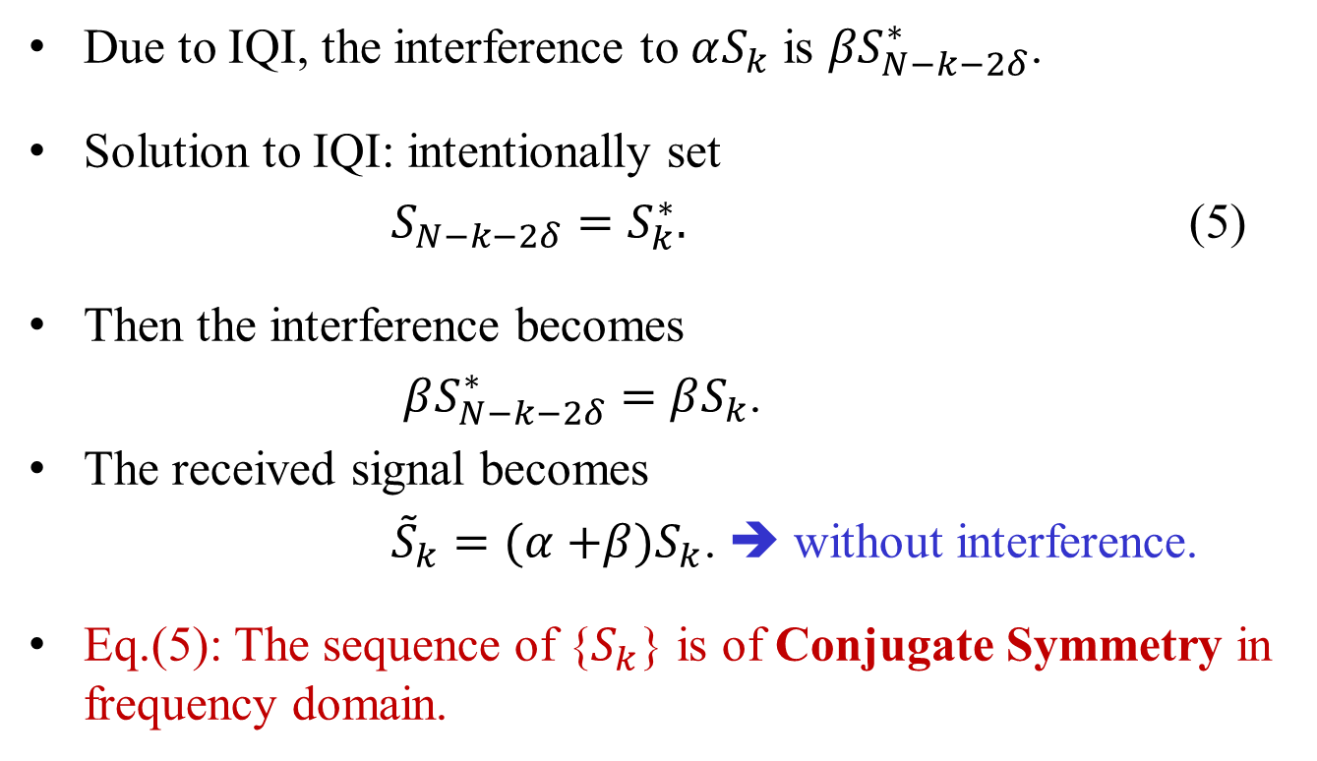
OFDM Signal Robust To I-Q Imbalance
Due to IQI, the interference to $αS_{k}$ is ${βS}_{N−k−2δ}^{∗}$.
Solution to IQI: intentionally set
$S_{N−k−2δ}=S_{k}^{∗}.$ (5)
Then the interference becomes
$βS_{N−k−2δ}^{∗}=$ $βS_{k}$.
The received signal becomes
${\tilde{S}}_{k}=(α{+β)S}_{k}$. ➔ without interference.
Eq.(5): The sequence of {$S_{k}$} is of Conjugate Symmetry in frequency domain.

Slide 11
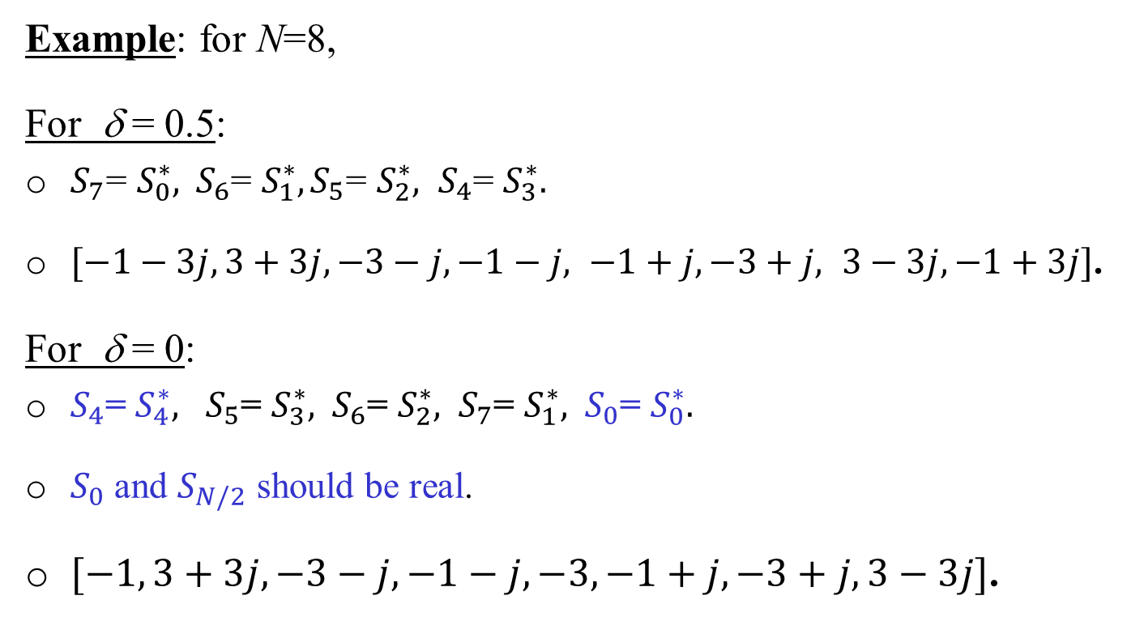
Conjugate Symmetry in Frequency Domain
Example: for N=8,
For δ = 0.5:
${S_{7}\text{=} S_{0}^{∗}, S_{6}\text{=} S_{1}^{∗}, S_{5}\text{=} S_{2}^{∗}, S}_{4}$= $S_{3}^{∗}.$
$[−1−3j, 3+3j, −3−j, −1−j, −1+j, −3+j, 3−3j, −1+3j]$.
For δ = 0:
$S_{4}$= $S_{4}^{∗}, S_{5}$= $S_{3}^{∗},$ $S_{6}$= $S_{2}^{∗},$ $S_{7}$= $S_{1}^{∗},$ $S_{0}$= $S_{0}^{∗}.$
$S_{0}$ and $S_{N/2}$ should be real.
$[−1, 3+3j, −3−j, −1−j, −3, −1+j, −3+j, 3−3j]$.

Slide 12
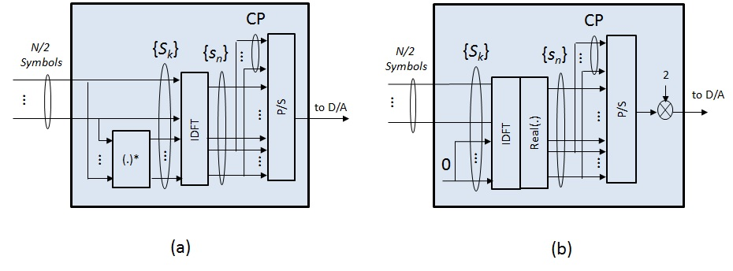
Frequency Conjugate Symmetry for δ = 0.5
Fig. 3

Slide 13
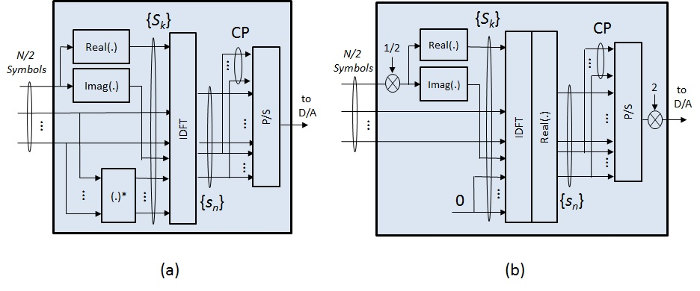
Frequency Conjugate Symmetry for δ = 0
Fig. 4

Slide 14
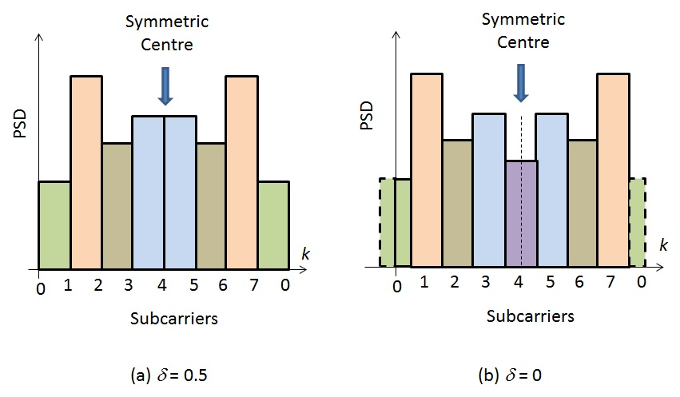
Power Spectrum with Conjugate Symmetry
Fig. 5

Slide 15
I-Q Decoupled OFDM Signal (1)
The OFDM signals with (frequency) conjugate symmetry are robust to IQI.
Problem:
  with N subcarriers, it only carries information of N/2 complex numbers.
  Compared to regular OFDM, data rate is reduced by half.

Slide 16
I-Q Decoupled OFDM Signal (2)
Property of Fourier Transform:
  A signal being conjugate symmetrical in frequency domain is a real signal in time domain.
Solution:
Generate two independent real OFDM signals, combined into a complex signal, carrying information of N complex numbers with N subcarriers.

Slide 17
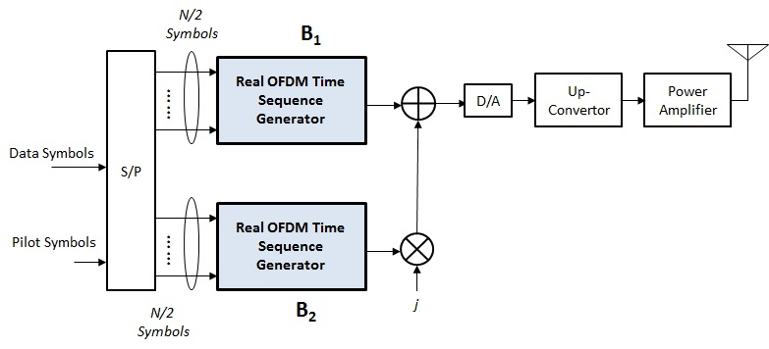
I-Q Decoupled OFDM Signal (2)
Fig. 6
B₁ and B₂ can be any box in Fig.3 and Fig. 4.

Slide 18
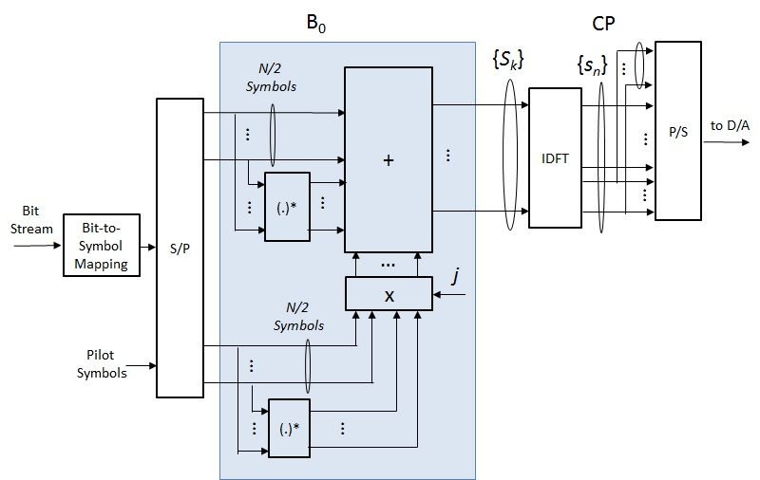
Generation of DC-OFDM Signal with Precoding
Fig. 7 ((δ = 0.5)
When B₀ is bypassed, it becomes a regular OFDM generator.

Slide 19
DC-OFDM for MU Applications
DC-OFDM can be used for single user or multi-user (MU) applications.
For MU applications: For each pair of symmetric tones,
  The two tones of each symmetric pair are allocated to a same user;
  Two tones of each symmetric pair are modulated by a data symbol and its conjugate respectively.

Slide 20
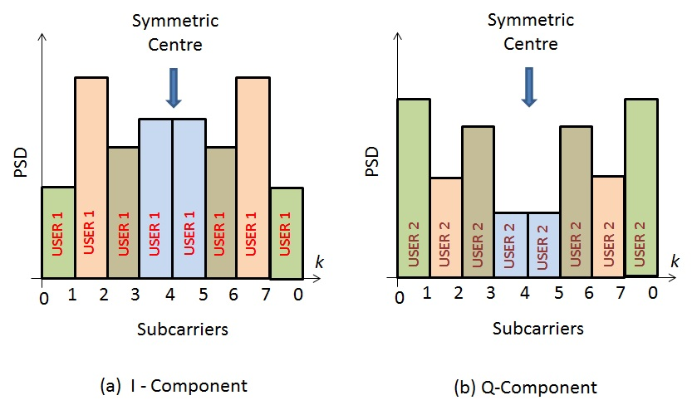
Example: Two Users, N=8, δ = 0.5
Fig. 8

Slide 21
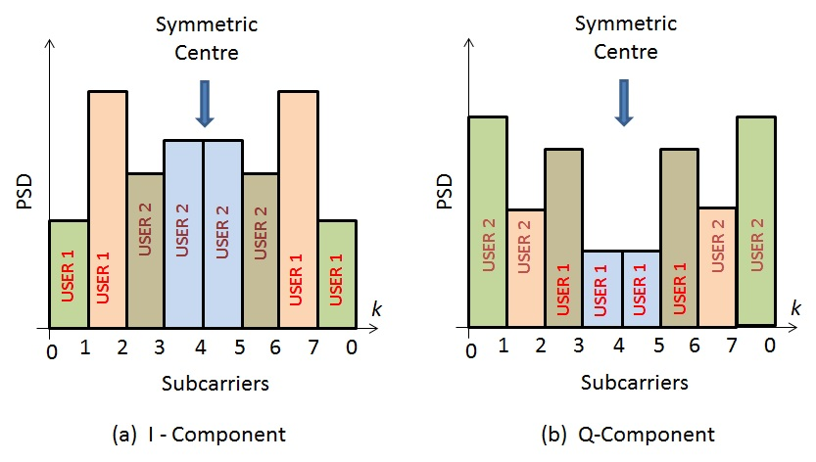
Example: Two Users, N=8, δ = 0.5
Fig. 9

Slide 22
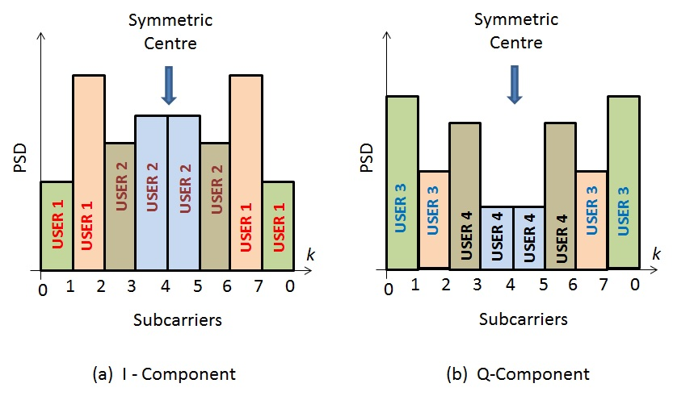
Example: Four Users, N=8, δ = 0.5
Fig. 10

Slide 23
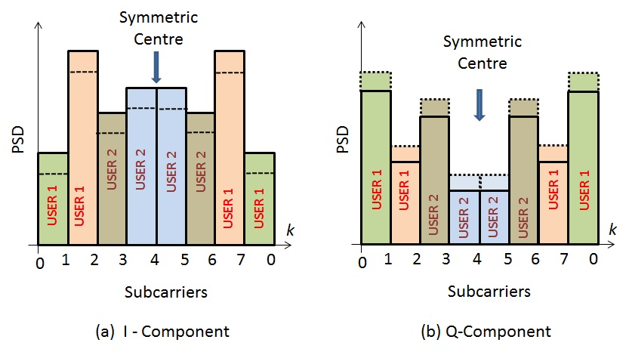
DC-OFDM with I-Q Imbalance
Fig. 11

Slide 24
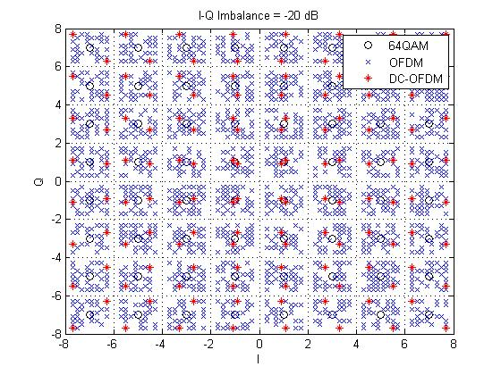
Simulation Results: I-Q Imbalance Impact
Fig. 12

Slide 25
Conclusions
IQI has adverse impact on regular OFDM systems.
Real OFDM (time-domain) signal is robust to IQI.
Real time-domain = Conjugate-symmetric in frequency domain.
DC-OFDM signal:
  A complex OFDM signal formed by two independently generated real time-domain OFDM signals.
  Robust to IQI.
  Same data rate as regular OFDM.
  Providing frequency diversity gain.
  SU & MU.

Slide 26
References
[1] Rui Yang et al., “I/Q Imbalance Impact to TGax OFDMA Uplink Reception”, IEEE 802.11-15/1314r1, Nov. 9, 2015.
[2] Marcus Windisch, and Gerhard Fettweis, “On the impact of I/Q imbalance in multi-carrier systems for different channel scenarios”, IEEE International Symposium on Circuits and Systems 2007 (ISCAS2007), New Orleans, LA, USA, May 27-30, 2007.

Slide 27
Straw Poll
1) Do you agree that I-Q decoupled OFDM is more robust to I-Q imbalance than the regular OFDM ?
2) Would you consider accepting I-Q decoupled OFDM, or a modified version of this proposal, in 802.11ay draft ?

