Slide 1
Low Complexity Beamtraining for Hybrid MIMO
Date: 2016-03-13
Authors:

Slide 2
Abstract
Beam training for Hybrid MIMO in 11ay can be expensive as number of possible beam combinations grows exponentially with number of antenna arrays.
This contribution proposes a low complexity beam training method for 11ay.
The proposed method can be supported with minimal changes in protocols and frame structures of sector level sweep (SLS) and beam refinement phase (BRP) of 11ad.
Results show significant reduction in complexity and negligible losses in resulting MIMO capacity compared to exhaustive search.

Slide 3
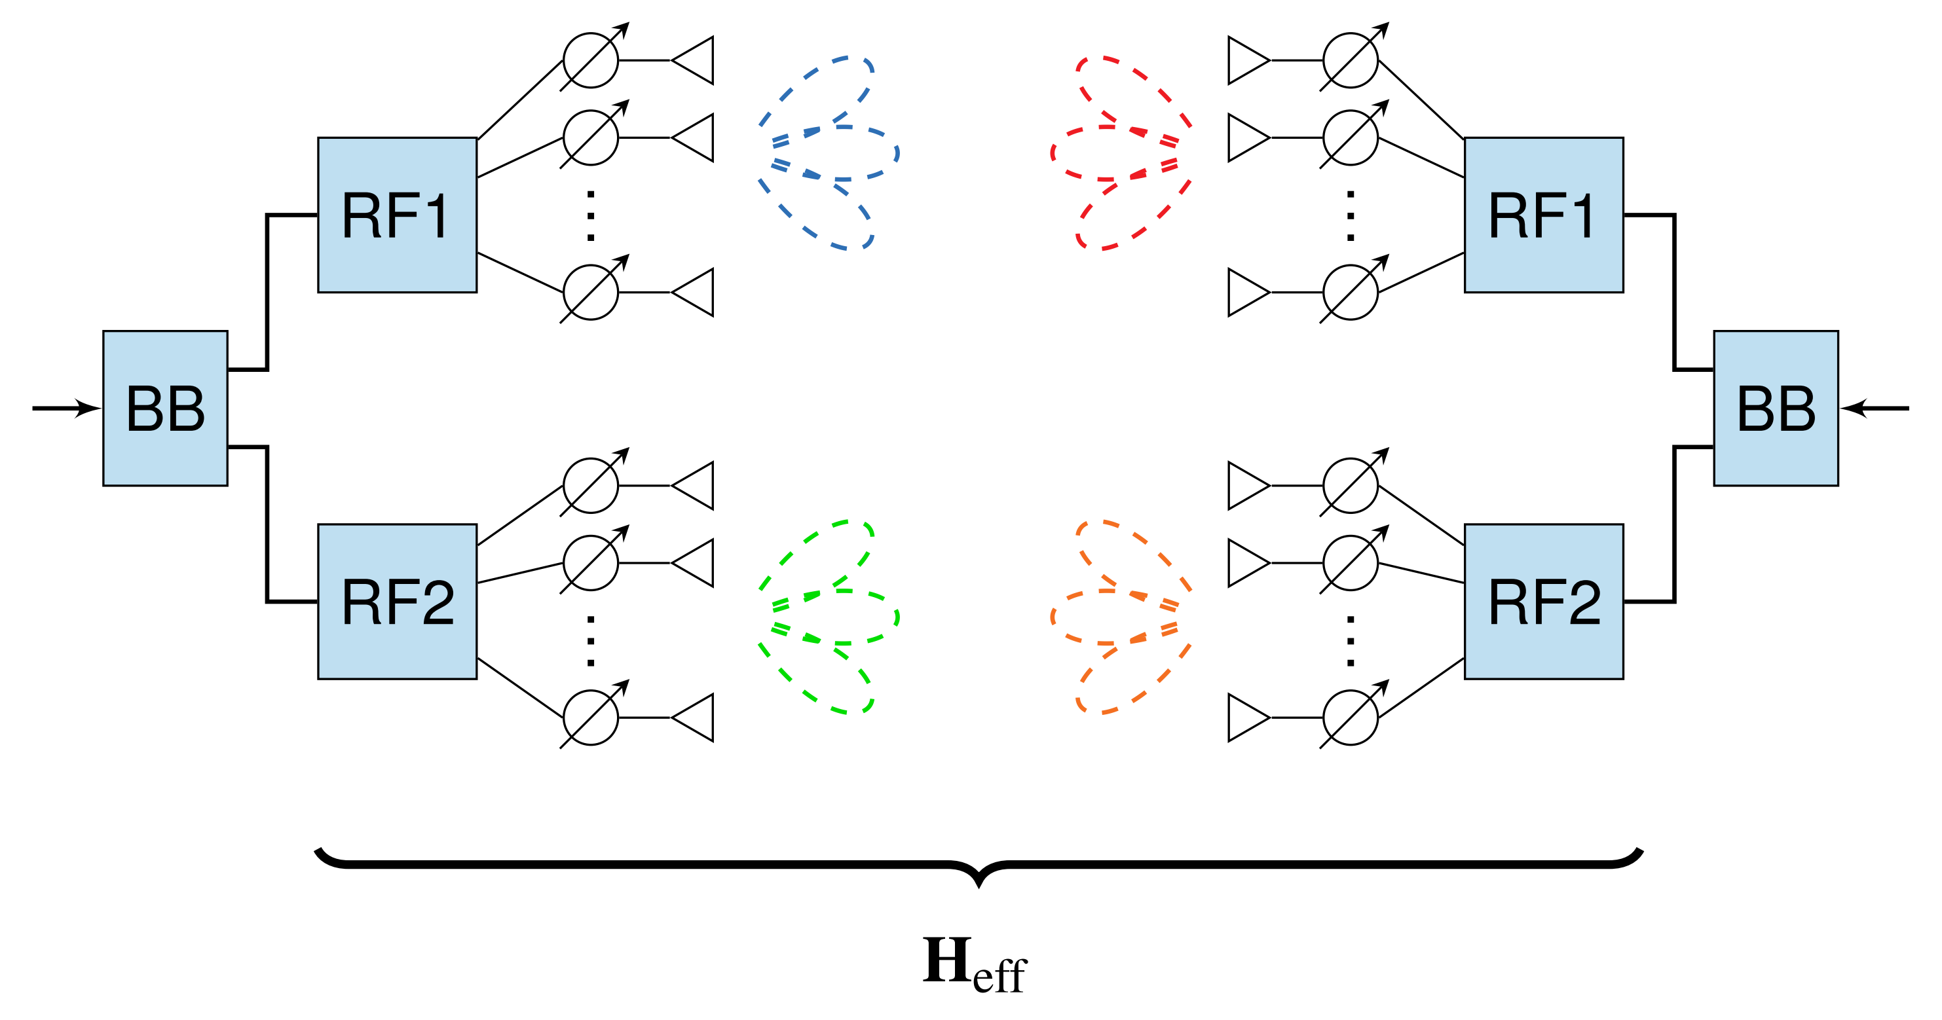
Introduction
$$i_{1}$$
$$j_{1}$$
Hybrid Beamforming consists of [1]:
analog beamforming $→$ find PAA setup to enable communication
digital beamforming $→$ find finer precoders for fixed $H_{eff}$ to enable simultaneous transmission of multiple streams
For $H_{eff}$, digital beamformers can be found in closed form as in .11n/ac
$$i_{2}$$
$$j_{2}$$
We focus on 1):
Assume a $2×2$ MIMO case, but easy to generalize
Our goal is to find beam indices:
$i_{1}:$ beam index for 1st TX PAA
$i_{2}:$ beam index for 2nd TX PAA
$j_{1}:$ beam index for 1st RX PAA
$j_{2}:$ beam index for 2nd RX PAA
such that we obtain:
$$max \left\{C\left(H_{eff}\left(i_{1},i_{2},j_{1},j_{2}\right)\right)\right\}$$

Slide 4
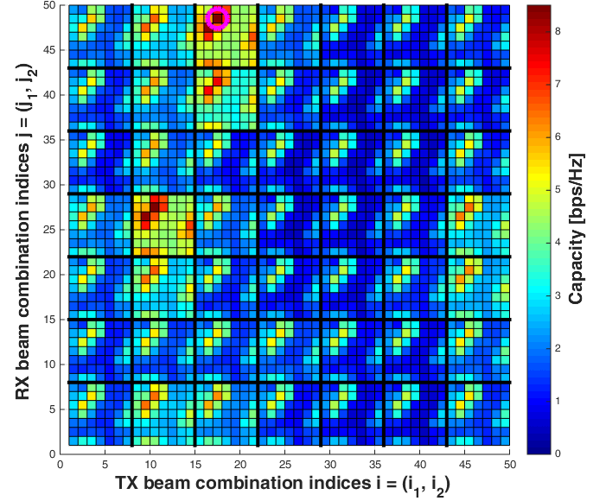
Motivation
Analog beamforming:
find beams which can achieve largest MIMO capacity without prior CSI
minimize amount of necessary training phases / channel estimations
Exhaustive search complexity of 2×2 MIMO:
$$N_{total}= N_{beamsTX}^{2} ⋅N_{beamsRX}^{2}$$
HPBW: 90°→ 7 Beams → $N_{total}$= 2401
HPBW: 60°→ 19 Beams → $N_{total}$= 1.3${⋅10}^{5}$
HPBW: 30°→ 49 Beams → $N_{total}$= 5.8∙${ 10}^{6}$
Pairwise Search [2] requires several rounds of (reduced) exhaustive searches
capacity landscape [6] with 90°HPBW
Minimize amount of necessary training phases / channel estimations
Reuse as much as possible 11.ad frame structures and protocols

Slide 5
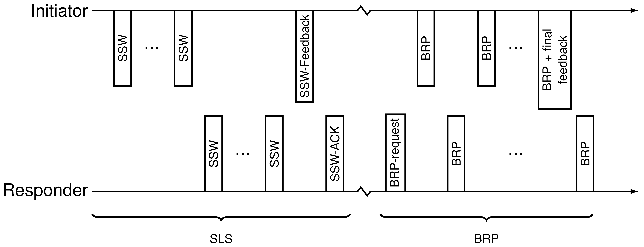
Two stage approach in 11ad [3]
Sector level sweep (SLS)
train transmit beamformers by sector sweeps (SSW) vs quasi-omni receive beamformers
Beam refinement phase (BRP)
improve receive beamformers (optional MID subphase)
improve transmit-receive beam combinations (optional BC phase)

Slide 6
Overview of proposed approach
SLS stage (assuming $2×2$ MIMO case)
Two independent SISO trainings
During the training sequence a score vector for each PAA is measured
Scores indicate the quality of every beam index at each PAA
Values can be based on SNR or RSSI
Improved BRP
Combination of best scored beams from SLS does not necessarily give best MIMO capacity but provides a good starting point $→$ Second training phase considering $h_{12}$ and $h_{21}$ in addition to $h_{11}$ and $h_{22}$
Make use of a priori information from SLS stage
2 methods to consider MIMO channel capacity
Evolutionary beamtraining
K-Best beamtraining

Slide 7
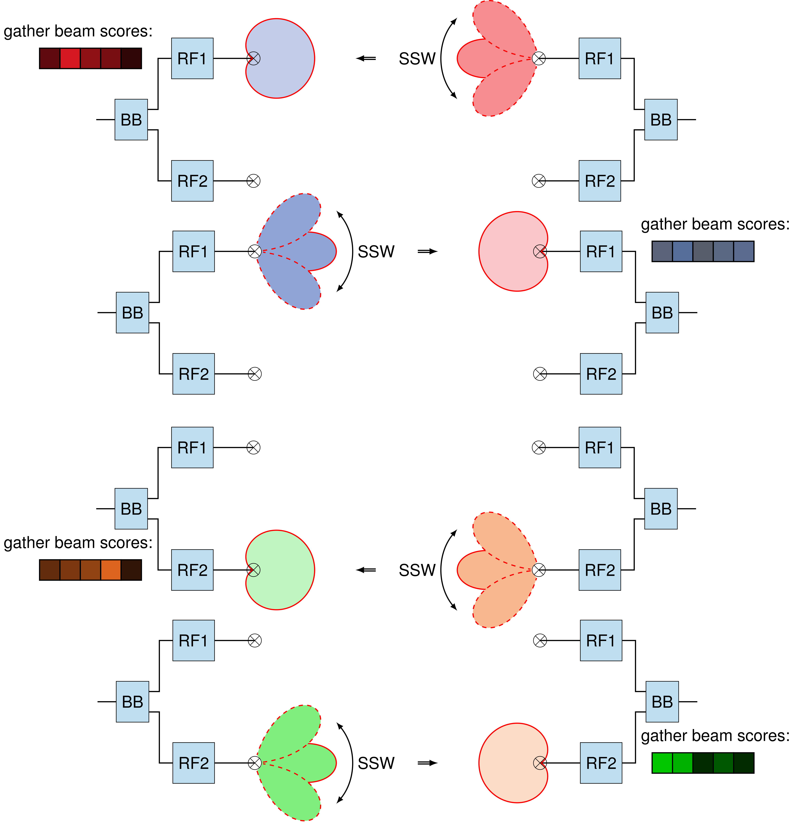
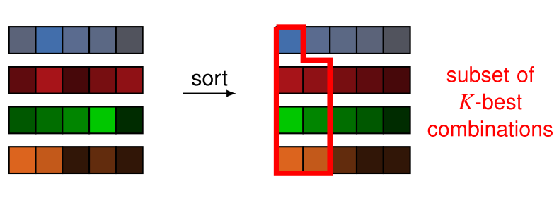
SLS stage for Hybrid MIMO
Example for $2×2$MIMO:
four SSW procedures needed
beam score vector for each PAA created during SSW
feedback of beam scores (subset) necessary
best joint beam combination candidates can be determined from sorted beam score vectors:

Slide 8
Beam refinement methods
Evolutionary beamtraining
non-deterministic approach based on random guesses
probability distribution function (PDF) derived from previously collected beam scores
ensures convergence by crossover operation
$K$-best beamtraining
deterministic approach based on beam scores
tests K best beam score combinations

Slide 9
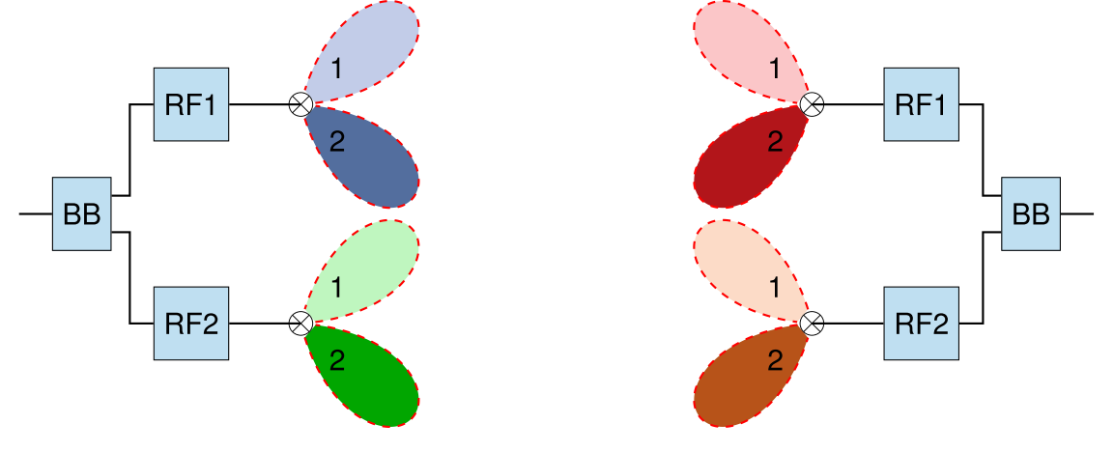
Evolutionary beamtraining
Procedure (iterative):
Best combination so far: ($i^{(∗)}$, $j^{(∗)}$) = (1 1 , 1 1)
Get random guess (“mutation”) from beam-score-based PDF: ($i , j$) = (2 2 , 2 2)
Test metric e.g. MIMO capacity for cross-over permutations: ($i^{(∗)}, j$) = (1 1, 2 2) and ($i , j^{(∗)}$) = (2 2, 1 1)
Select best combination seen so far $→$ Proceed with step 1.
Termination:
after $N_{ }$ iterations or
$n_{stable}$ iterations without metric improvement
procedure can be used in different stages of beam training procedure
within pairwise search (PS) [2]
on top of 11ad-like SLS
Drawback: Instant feedback needed after each iteration to determine “best combination”
Potential benefit in rich scattering environments

Slide 10
$K$-best beamtraining
Procedure:
calculate best $K$ candidates $V_{k}={(i}_{1}^{k}{,i}_{2}^{k}$, $j_{1}^{k},j_{2}^{k}), k=1…K$ from joint score combinations of SLS stage in descending fashion
sequentially test best candidates and measure respective capacity: $C\left(H_{eff}\left(V_{k}\right)\right)$
select beam combination from tested candidates that maximizes MIMO capacity
decide if further training required according to e.g., progress or MCS

Slide 11
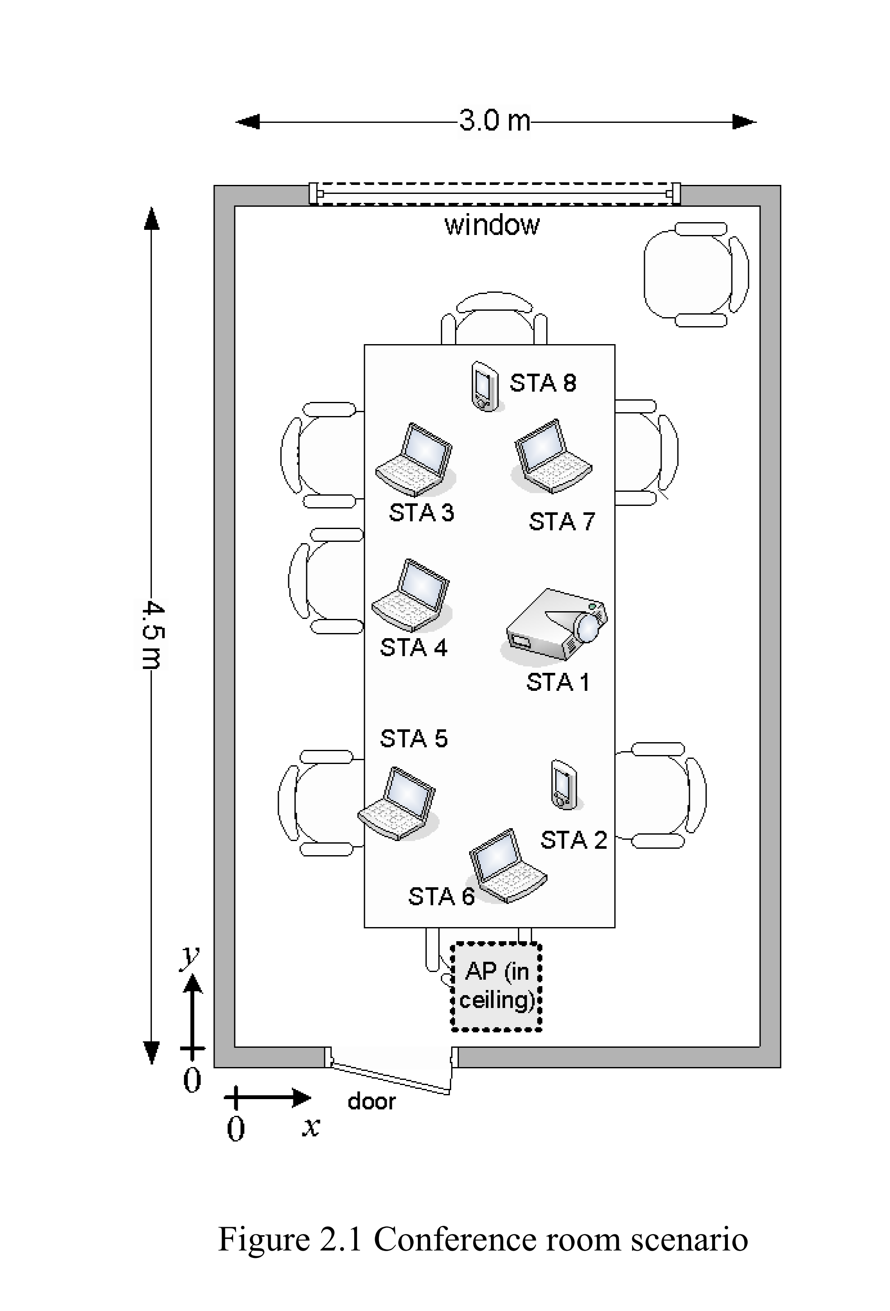
Simulation parameters
Channel model
scenario: Conference Room [5], NLOS
$(2×2)$ MIMO
SU-MIMO Configuration #2 [4]: single array, dual polarization, 2 streams
half power beamwidth 60°$→$ 19 Beams
basic steerable directional antenna model
50 channel realizations
Evaluated algorithms
exhaustive search
pairwise search
11ad-like (2 $×$ SLS)
Evolutionary algorithm
K-Best
Conference room scenario [5]

Slide 12
Complexity and performance comparison
significant reduction in complexity
negligible or no loss in performance

Slide 13
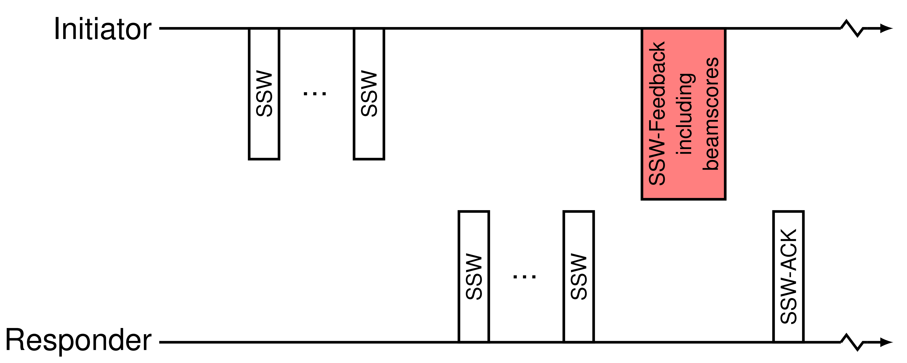
Protocol and frame structure (K-Best)
SLS:
if performed sequentially no changes needed
if performed in parallel EDMG-CEF must contain 2 orthogonal CE sequences
SLS Feedback: the scores must be acquired at either responder or initiator
Option 1: using TxSSListRequest
Option 2: extension of SSW-FBACK frames to support best (tbd) sectors rather than first best
Option 3: feedback on link 1 ${(h}_{11})$, while training on link 2$(h_{22})$

Slide 14
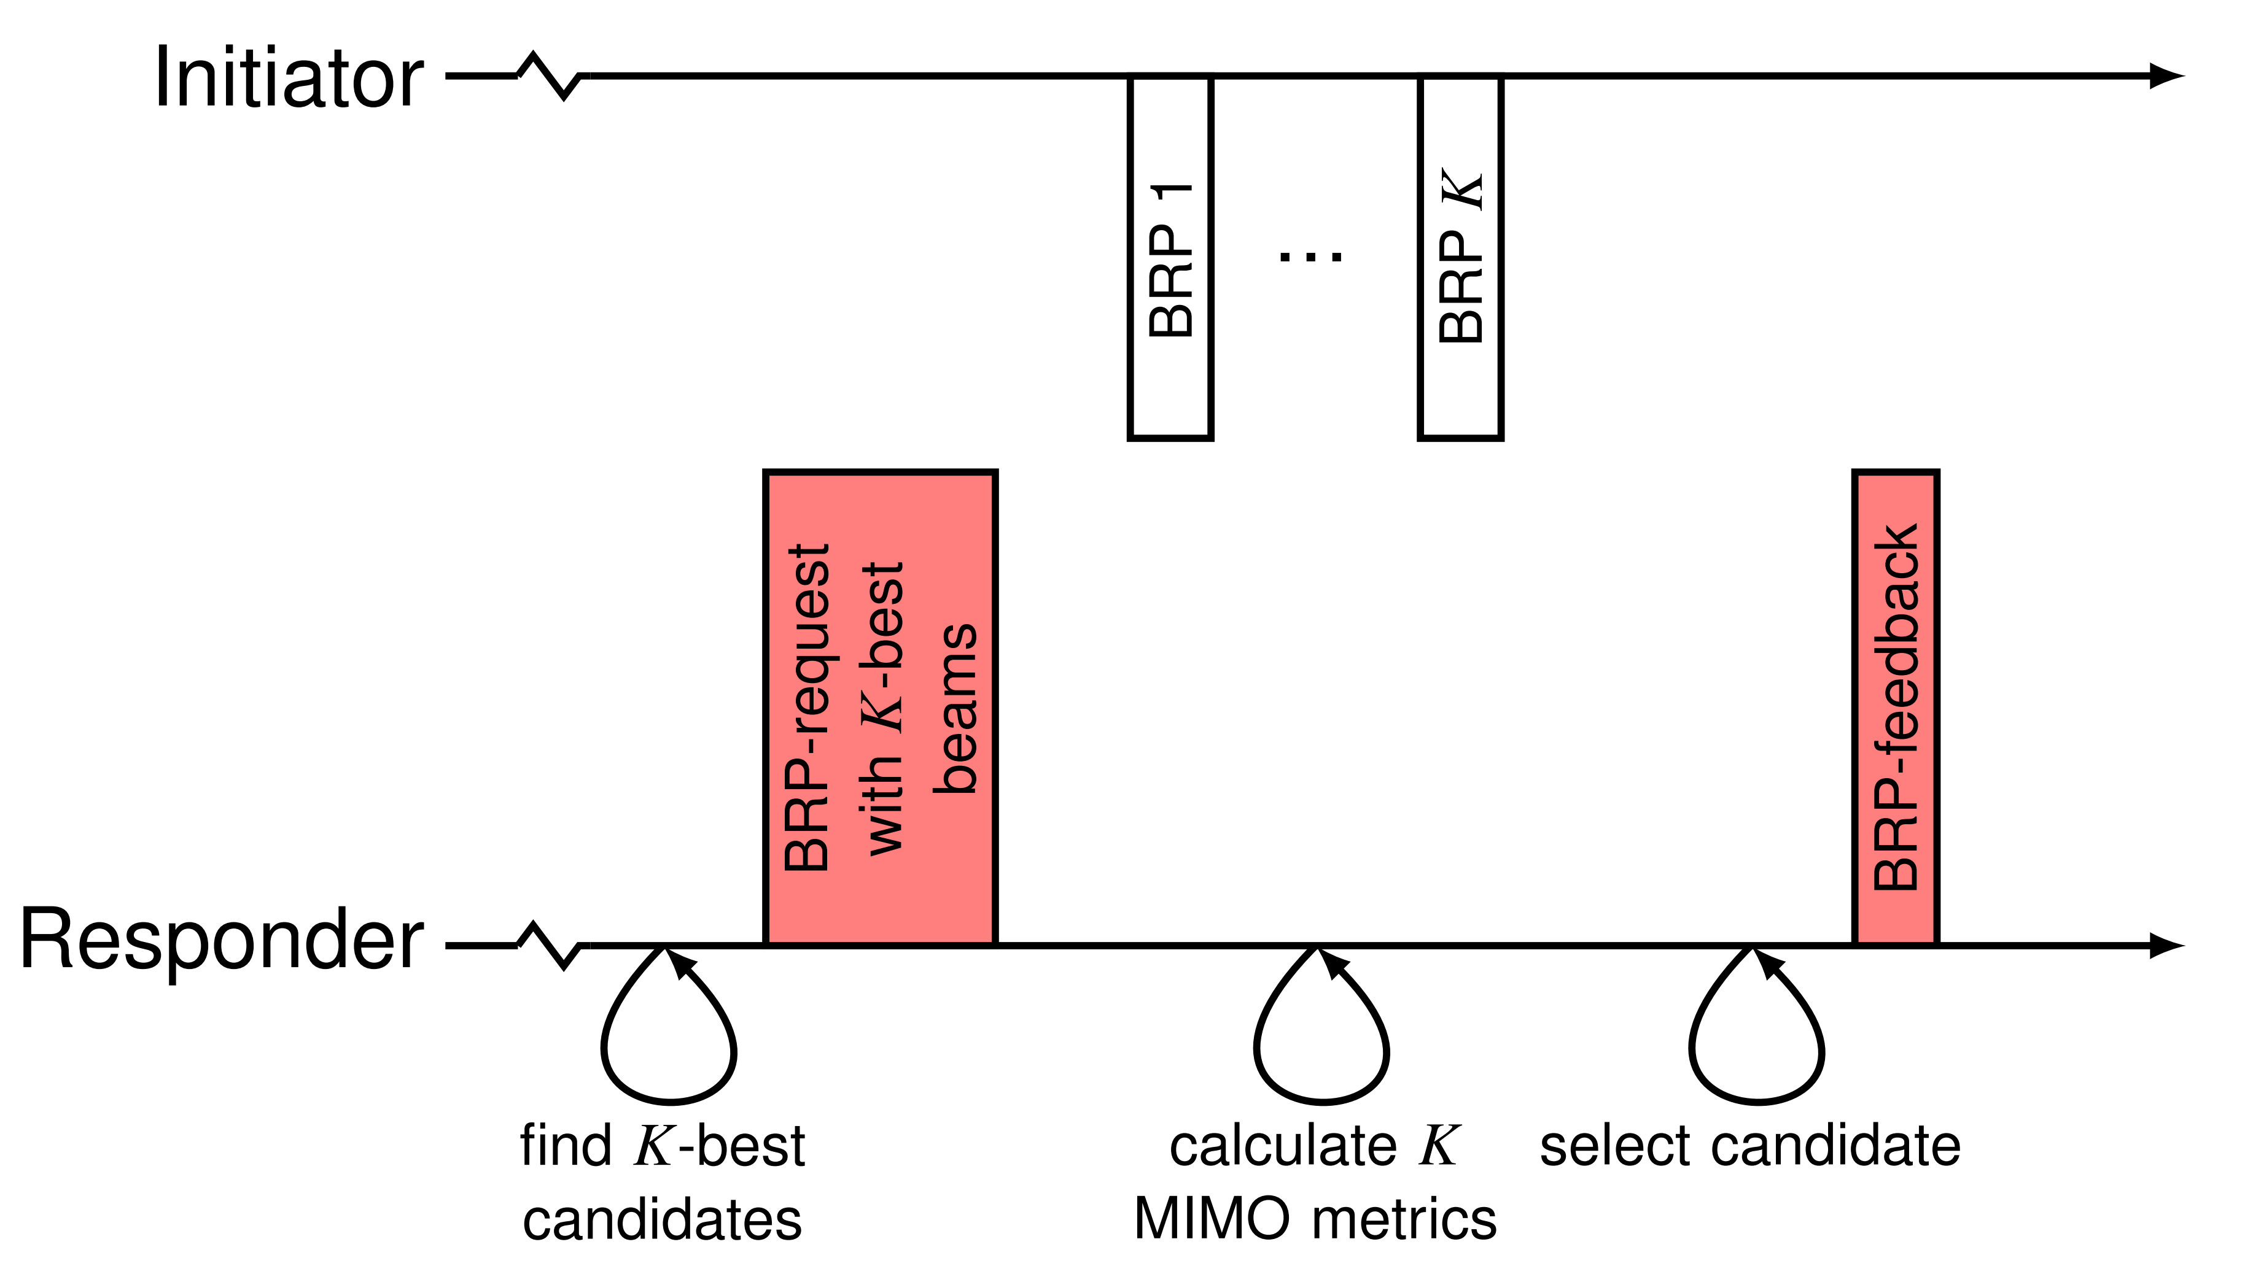
Protocol and frame structure (K-Best)
BRP:
responder requests initiator to transmit with best $K$ (tbd) beams
initiator transmits with requested beams, responder listens with corresponding beams
responder estimates channels and computes the metric (MIMO capacity)
frame structure with orthogonal TRNs [3] can be employed
Required feedback:
if further training required (e.g. improvement in obtained capacity)
indices of next best $\tilde{K}$ beams to be set at initiator based on scores
if no further training required (e.g. obtained capacity saturates or is enough for highest MCS level)
best beam combination
digital beamformer (full or reduced) or full channel measurement (for digital beamformer)

Slide 15
Conclusions
Complexity of beamtraining for hybrid MIMO configurations can be significantly reduced by using the proposed 2 stage approach
1st stage (SLS) in beam-to-omni configuration, measuring SISO metric as in 11ad
2nd stage (BRP) in beam-to-beam configuration, measuring MIMO metric
The a-priori knowledge from two SISO-SLS provides useful information for MIMO-BRP phase
Comparison of $K$-best ($K=50$) w.r.t. Pairwise Search shows
complexity reduction of approx. $93\%$
same performance as Pairwise Search
The proposed approach requires only small changes to the 802.11ad frame structures and beamtraining procedures

Slide 16
References
C. Cordeiro et al, “Next Generation 802.11ad”, doc. 11-14-0606r0.
C. Capar et al, “Efficient Beam Selection for Hybrid Beamforming”, IEEE doc. 11-15/1131r0.
A. Kasher, “Beamforming Training proposals”, doc. 11-16-0103r0.
A. Maltsev et al, “Extension of Legacy IEEE 802.11ad Channel Models for MIMO and Channel Bonding”, IEEE doc. 11-15/1356r1.
A. Maltsev et al, “Channel Models for IEEE 802.11ay”, IEEE doc. 802.11-15/1150r2.
F. Fellhauer et al, “Modelling of Spatial Separation in the 11ay Channel Model”, IEEE doc. 802.11-16/0073r1.

Slide 17
Appendix

Slide 18
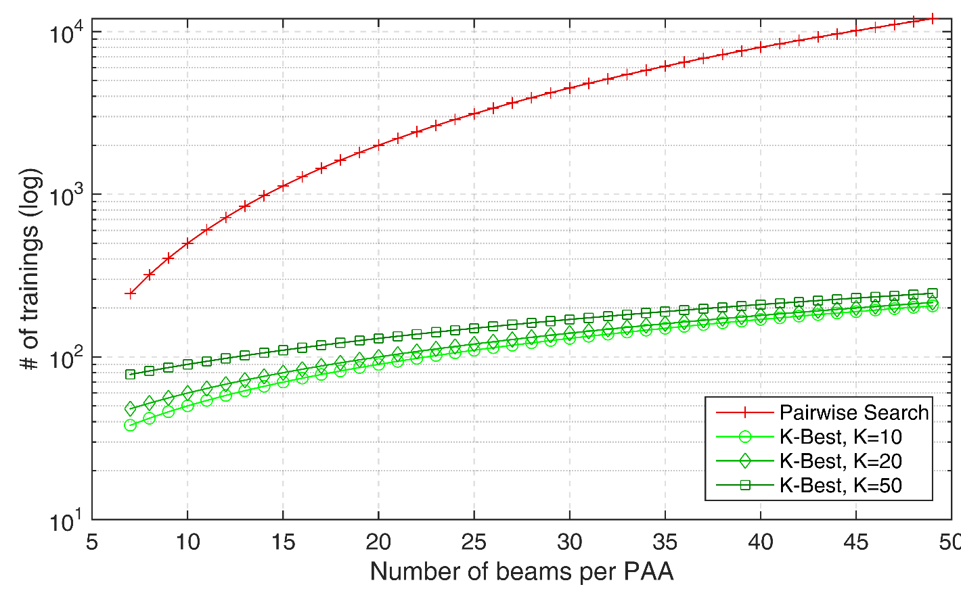
Complexity Analysis $(2×2)$ MIMO
as in slide 12
Complexity:
K-Best: $N_{trainings}=\left(N_{TX}+N_{RX}\right)⋅N_{beams}+K$
Pairwise Search: $N_{trainings}=N_{beams}^{2 }⋅\left[N_{TX}⋅N_{RX}+{(N}_{TX}−1)⋅{(N}_{RX}−1)\right]$

Slide 19
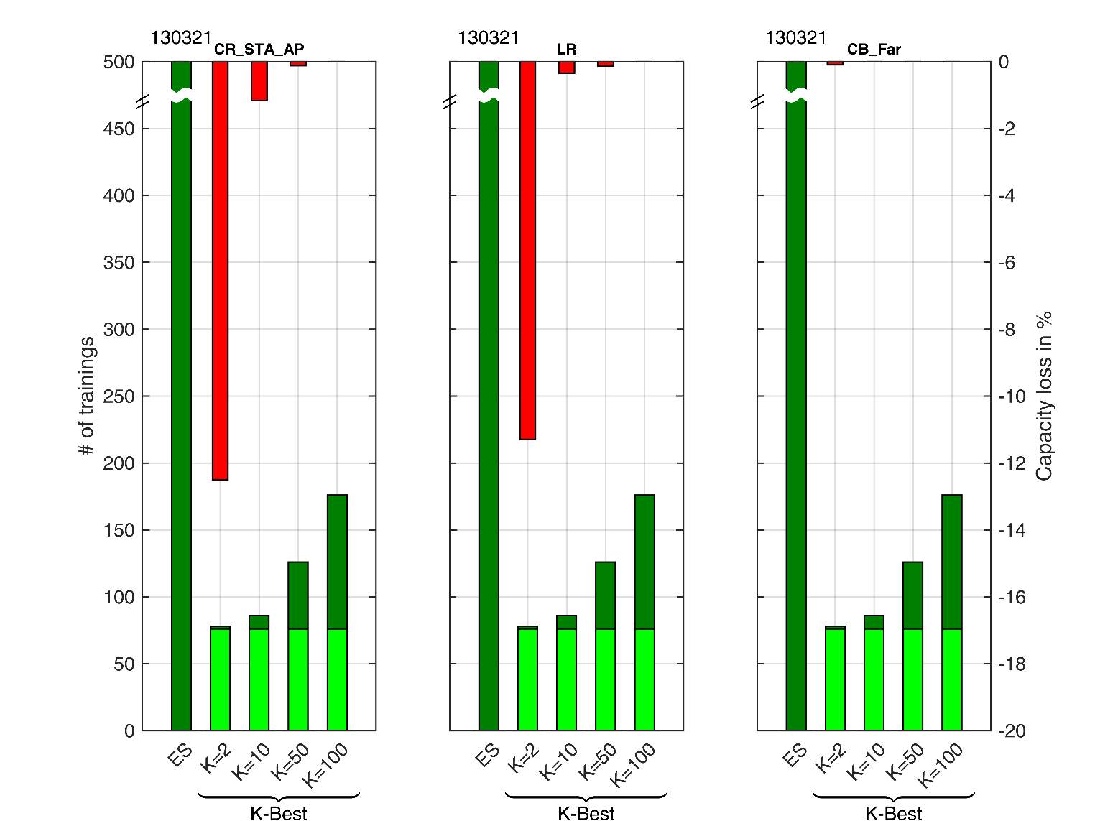
Performance comparison (continued)

