Slide 1
Block Ack (BA) performance for high EDMG PHY rates
Date: 2016-03-07
Authors:

Slide 2
Abstract
Block Ack (BA) related changes for high EDMG PHY rates

Slide 3
Problem statement
Block Ack (BA) is a MAC mechanism designed to utilize the high bit rates provided by PHY. Each time that the PHY increases the bit rates, the BA mechanism should be revisited
11ay substantially increases the PHY rate, which makes the existent BA inefficient as illustrated in the next slide
Efficiency of the BA mechanism is measured as goodput at the MAS SAP and in general depends on link utilization of the BA mechanism
Link utilization (LU) can be measured as
PSDU_size (aggregated data MPDUs) and (SIFS*2 + PPDU_size (BA)) are main factors that impact LU
$$LU=\frac{PSDU size (aggregated data MPDU)}{\left(PSDU size \left(aggregated data MPDU\right)+PHY overhead\right)+SIFS∗2+PPDU size (BA)}$$
$$LU=\frac{PSDU size (aggregated data MPDU)}{\left(PSDU size \left(aggregated data MPDU\right)+PHY overhead\right)+SIFS∗2+PPDU size (BA)}$$

Slide 4
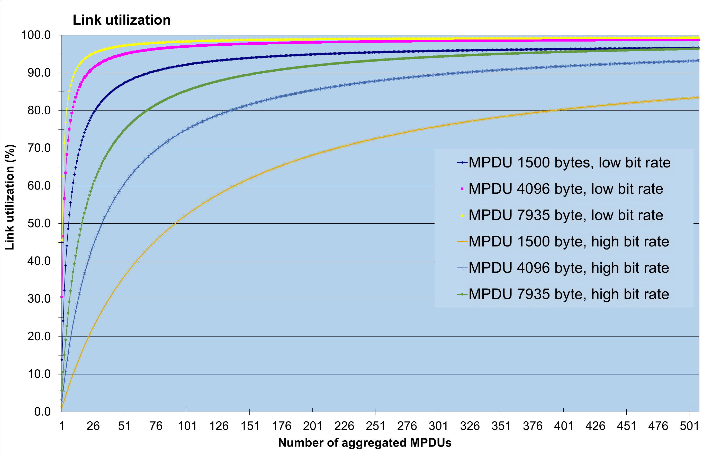
Impact of BA window size on Link Utilization
Low bit rate = 7Gbps
High bit rate =100Gbps

Slide 5
How to improve LU?
LU improvement requires:
  Increasing of PSDU_size (aggregated data MPDUs)
  Keeping (SIFS*2 + PPDU_size (BA)) as short as possible
All options to improve on the above should be studied

Slide 6
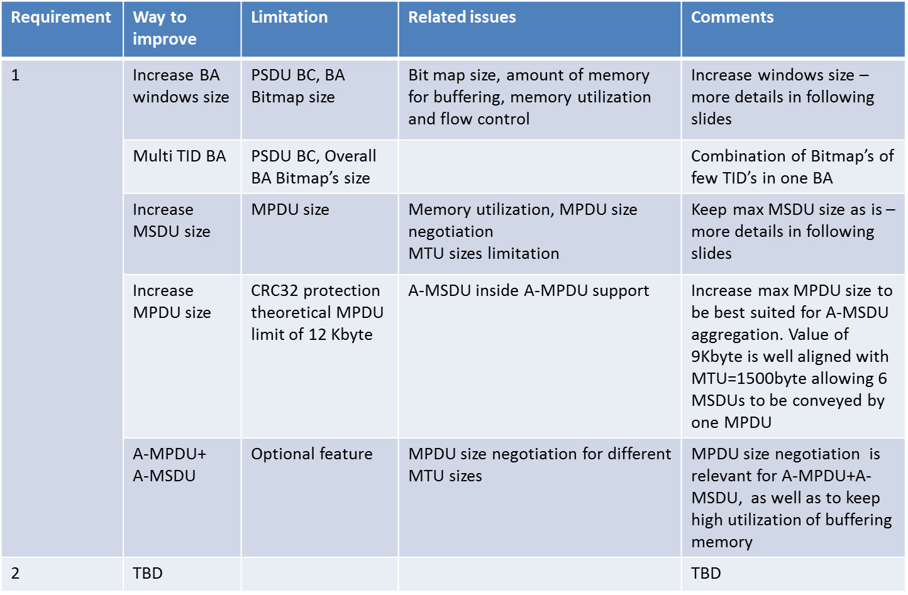
Options and limitations

Slide 7
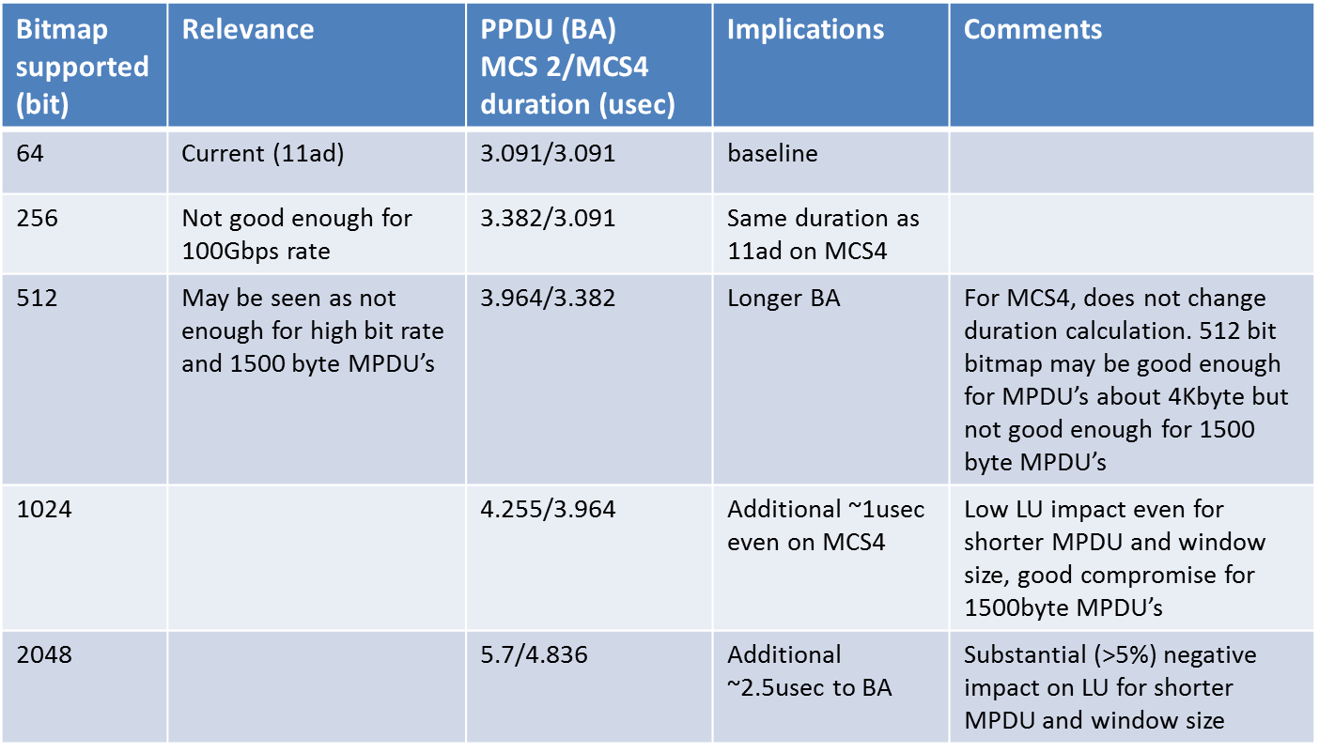
BA window size increase

Slide 8
Impact of bitmap size on link utilization (Bitmap 512 vs 1024)
Short BA length = 3.38us
Long BA length= 4.255us

Slide 9
Impact of bitmap size on link utilization (Bitmap 512 vs 2048)
Short BA length = 3.38us
Long BA length= 5.7us

Slide 10
Memory utilization
Interference cannot be eliminated in 60GHz and packets get dropped. Hence, achieving high LU by using substantially long PSDU (aggregated data MPDUs) requires large memory buffers
Not all platforms have large enough memory to keep up with the high speed of an EDMG link (100Gbps); supporting high LU requires local buffering that increases cost of the solution
Optimization of the memory buffer utilization is critical
  In case of a BA agreement that negotiates number of buffering MPDUs, the best use of the memory is achieved when the allocated buffers are of equal size to the transmitted MPDUs.
Therefore, negotiation of the MPDU size as part of BA agreement may be very useful for memory optimization to achieve high LU
  Becomes more important as MPDU size grows

Slide 11
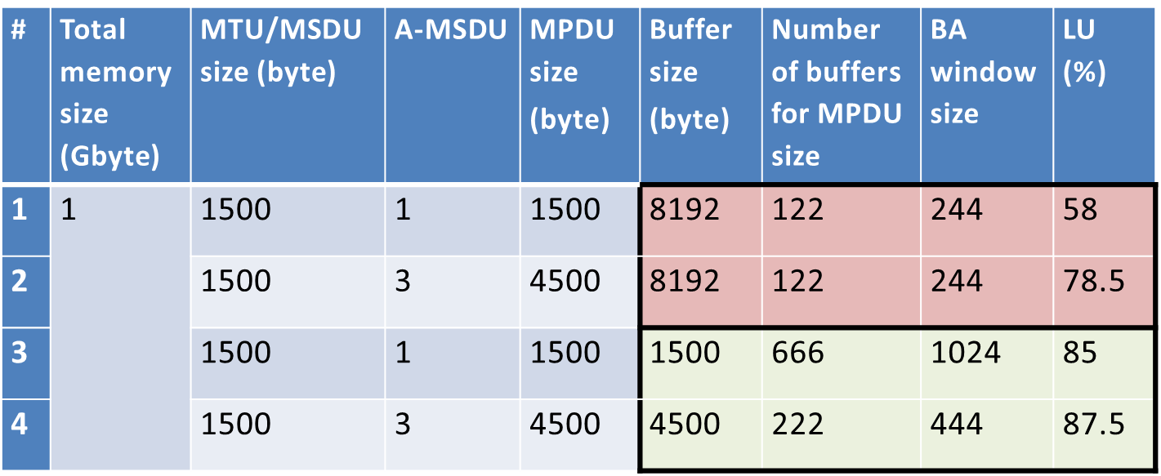


LU versus memory utilization example
Without MPDU size negotiation
Note: half of the BA window size is aggregated in one A-MPDU to keep high LU. So, only 526 buffers are utilized even when more buffers are available

Slide 12
Flow control
If the received data is not stored in main memory, then release of big amount of data accumulated in local memory to the system may become a bottleneck even in platforms with high speed memory access
  Storing of data in local memory happens when the received data cannot be released due to unsuccess of MPDUs at start of PSDU
Flow control should prevent LU degradation in case data continues to be sent to an overloaded buffer for which the data is lost
Existent mechanism of DMG Block Ack with flow control is well suited to adjust consumed link throughput to performance of an internal platform bus with granularity of single MPDU that may result in very short PSDUs transferred over the link causing very low LU. The mechanism should be modified to allow keeping high LU.

Slide 13
Recommendations
Increase bitmap of the BA to 1024 bits
Modify multi TID BA to keep high LU when aggregating few TIDs in the same A-MPDU
Extend MPDU to 9Kbyte
Provide MPDU size negotiation by adding MPDU size to ADDBA Request and Response
Modify flow control to keep high LU
Shorten overhead of BA response (TBD)

Slide 14
Straw polls/motions
SP/M: Would you agree to include the following in the SFD: “The size of the Block Ack window bitmap for EDMG STAs shall be 1024 bits”

Slide 15
Memory utilization example

Slide 16
References

