Slide 1
Additional SC MCSs in clause 20 (DMG PHY)
Date: 2016-02-02
Authors:

Slide 2
Abstract
We propose to add a set of 7 new MCSs to clause 20. The main contribution will be 64-QAM MCSs for the single carrier PHY. We also propose to add a few MCSs the close the gap between existing MCSs and the new ones.
We propose a method that will enable all legacy clause 20 compatible devices to calculate the right length (TXTIME) of the packet.

Slide 3
SC 64-QAM in clause 20 (DMG)
Evolution – Not Revolution
Closing a market gap between 11ad and 11ay
  OFDM not begin implemented.
  OFDM having “compatibility issues” with mandatory SC
Simple and compatible addition to current spec
  Compatible with legacy devices
As Much Reuse As possible

Slide 4
Why 64-QAM SC
Can Achieve higher rate (50%) higher with minimal modification to current clause 20 (802.11ad) spec.
Beneficial in short LOS links.
    Tougher links will require higher EVM (phase noise – etc.)
Can be added to a system with minimal modification of RF and IF.
Achieve 8Gbps (higher rate than 802.11ad OFDM)
  due to shorter GI and rate 7/8.
Why 64-QAM SC

Slide 5
Why Add a 7/8 rate?
Enables getting a maximum rate > 8Gbps
Fills a gap between MCS9 (QPSK 13/16) and MCS10 (16-QAM rate 5/8)
  currently the gap is about 4dB which is too high for link adaptation algorithms.
Fills a gap between the highest 16QAM rates and the lower 64QAM rates.

Slide 6
Updated MCS table
MCS Index | Modulation | N_{CBPS} | Repetition | Code Rate | Data Rate (Mbps)
1 | π/2-BPSK | 1 | 2 | 1/2 | 385
2 | π/2-BPSK | 1 | 1 | 1/2 | 770
3 | π/2-BPSK | 1 | 1 | 5/8 | 963
4 | π/2-BPSK | 1 | 1 | 3/4 | 1155
5 | π/2-BPSK | 1 | 1 | 13/16 | 1251
6 | π/2-QPSK | 2 | 1 | 1/2 | 1540
7 | π/2-QPSK | 2 | 1 | 5/8 | 1925
8 | π/2-QPSK | 2 | 1 | 3/4 | 2310
9 | π/2-QPSK | 2 | 1 | 13/16 | 2503
9.1 | π/2-QPSK | 2 | 1 | 7/8 | 2695
10 | 16-QAM | 4 | 1 | 1/2 | 3080
11 | 16-QAM | 4 | 1 | 5/8 | 3850
12 | 16-QAM | 4 | 1 | 3/4 | 4620
12.1 | 16-QAM | 4 | 1 | 13/16 | 5005
12.2 | 16-QAM | 4 | 1 | 7/8 | 5390
12.3 | 64-QAM | 6 | 1 | 5/8 | 5775
12.4 | 64-QAM | 6 | 1 | 3/4 | 6930
12.5 | 64-QAM | 6 | 1 | 13/16 | 7508
12.6 | 64-QAM | 6 | 1 | 7/8 | 8085

Slide 7
There must be a reason it is not in the spec today!
It is not in the spec today because the groups that were involved in writing the spec were not interested:
  Those who wanted higher rates went for OFDM
  Those who wanted SC, preferred robust modes (that’s why we also don’t have SC QAM-16 rate 13/16)
Today the industry have much more knowledge and confidence in 60GHz. We therefore think these additional MCSs can be implemented and are needed.

Slide 8
How to indicate it in the header
Use one reserved bit to indicate that specific MCS have different meaning than in the current spec.
The combination of length and MCS index, as interpreted by the legacy device gives the correct duration (TXTIME) of the packet.
The actual number of octets (relevant to the new devices) is calculated by a factor which is MCS specific
  e.g. length*3-α
  α is in the range of [0-3]. It is signaled using two bits from the scrambler initialization seed.
    5 bits provide enough randomness.
    legacy devices not affected – they don’t care what is the origin of the scrambler seed.

Slide 9
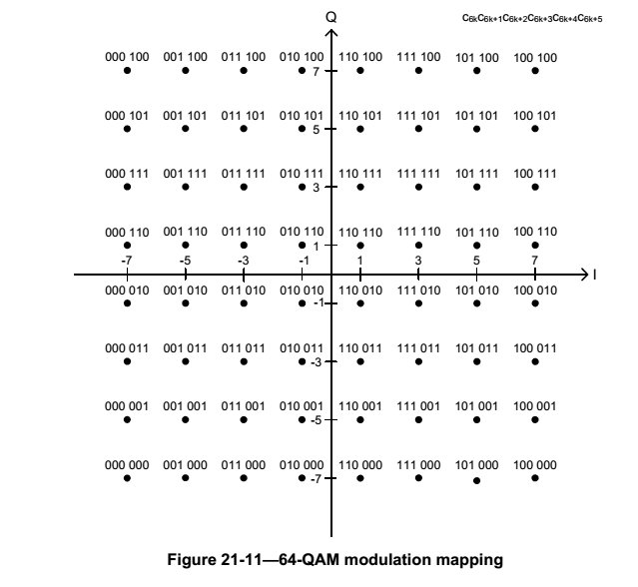
Constellation
Use the same constellation as in OFDM
Use constellation rotation as in lower SC modulation

Slide 10
Rate 7/8th
Generated by puncturing (not transmitting) 48 parity bits from rate 13/16 code words
  uses existing LDPC matrix of rate 13/16
transmitter just does not transmit the bits
receiver put equal likelihood for 1/0 for these bits.
simple implementation.

Slide 11
MAC Changes
Additional field into the DMG capabilities element
  one byte, indicating Max Extended TX/RX MCS (different subfields) and TX/RX support for code rate 7/8
Different interpretation of MCS field of the link margin element
  if the MSB is 1, different interpretation for the lowest bits.

Slide 12
References
REV MC – Draft 5.0

