Slide 1
Potential Coexistence Approach
Date: 2016-01-19
Authors:

Slide 2
Coexistence Problem
Configuration for problem [1] occurrence:
  LRLP STA is at edge of LRLP-only extended range coverage of LRLP AP
  and
  LRLP STA is in range of legacy STA. Legacy AP that legacy STA is associated to may be in or out of range of LRLP STA
  [1] 11-16-0026-00-lrlp-coexistence-problem.pptx

Slide 3
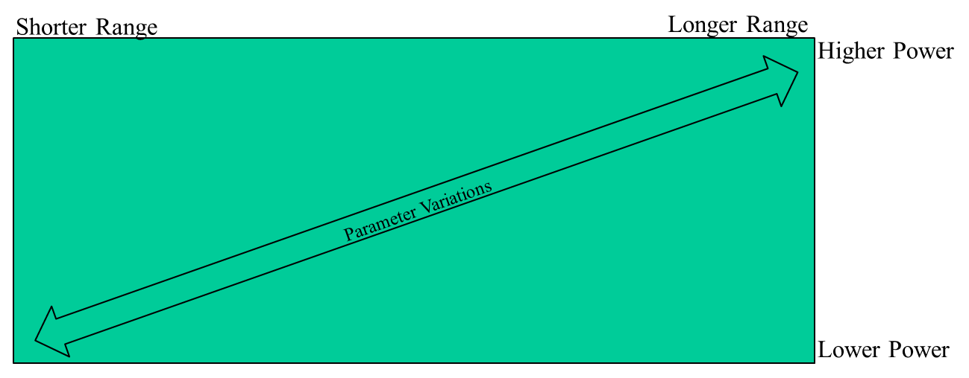
Rationale for approach
Coex Problem Area
Coexistence problem primarily occurs in the upper right quadrant of range vs power continuum

Slide 4
Potential Solution
20 MHz RX/TX capability is mandatory for long range operation
  LRLP STA at maximum range would set NAV from nearby legacy STA using 20 MHz PHY by receiving legacy waveform
  LRLP STA would send legacy preamble to set NAV and protect transmission.
  LRLP STA would use LRLP PHY mode (presumably narrowband) for MPDU
Threshold for “long range” 20 MHz protection determined by TX power – exact value TBD
Why? Many long range use cases have adequate power available to support 20 MHz operation for coexistence
  If maximum RF power is needed for the longest range use case, typically a higher level of operational power is also available at the STA.

Slide 5
Pros and Cons
Pros
  Provides coexistence at maximum range to and from legacy devices
  Maybe not an ideal solution, but a solution
Cons
  Sub-optimal from implementation (silicon) perspective. Makes design of a single LRLP STA platform to cover all use cases more difficult.
  Could bifurcate market between LP-only and LRLP devices.

Slide 6
Coexistence and Duty Cycle
There is a level of duty cycle for LRLP devices below which coexistence problems become less significant
Coexistence solutions should also be linked to duty cycle and service period limits for LRLP STAs

Slide 7
For further study
The current 802.11 standard provides a variety of mechanisms that can be used for coexistence
There may be a application or combination of existing mechanisms that can address the LRLP long range coexistence issue without requiring 20 MHz operation in extended range radius

