Slide 1
Beamforming Training proposals
Date: 2016-01-18
Authors:

Slide 2
Abstract
This document describes some improvements needed in the BF training protocol for support of MIMO and multiple antennas STAs

Slide 3
Feedback for Multiple Antennas
The 11ad sector sweep allows to select the best transmit sector (and antenna) for both initiator and responder.
The use of multiple antennas in both RX and TX in 11ay and the use of MIMO techniques implies that feedback should cover the best transmit sector per each transmit antenna and per each receive antenna.

Slide 4
Feedback for multiple antennas (cont.)
The feedback should indicate the best initiator transmit sector for each transmit antenna (indicated by antenna Id) per each of the responder receiver antennas and vice versa.
  feedback may also include the SNR.
The feedback may be appended to the SSW-Feedback and SSW-ACK or be carried in another frame after the SLS.

Slide 5
What are the challenges for 11ay BRP?
Large arrays
  How to support asymmetric links from an antenna gain perspective
  Need to allow for a large number of TRN units
SU-MIMO and MU-MIMO training
  How to send MIMO feedback
  How to enable training of multiple antennas simultaneously
Scalability to large number of STAs
  How to train multiple STAs efficiently
  How to control training duration

Slide 6
Proposals to address the challenges
Challenge | Proposal | Proposal ID
Large arrays | Allow for a larger number of TRN units | 1
SU/MU MIMO | Training of RX and TX antennas in a single BRP frame | 2
 | Orthogonal TRN sequences | 3
 | Enhanced BRP feedback | 4
Scalability to large no. of STAs | Training of multiple STAs in a single BRP procedure | 5
Proposals can be jointly used as part of the enhanced BRP

Slide 7
Proposals 1 & 2: Larger TRN Units & Training of RX and TX antennas in a single BRP frame
We can define a long packet with both TX antenna switching and RX antenna switching
  Increase the limit to 256 TRN fields (rather than 64 used in 11ad)
  This will enable testing combinations of TX and RX sectors in the same packet
  May be repeated using a small number of sectors around the area of the selected sectors above.
  Only energy or similar measures are tested in sector combination

Slide 8
Proposal 3: Orthogonal TRN sequences (1/2)
BRP
-
RX
BRP
-
TX
BRP
-
RX
BRP
-
TX
We propose to define orthogonal TRN fields in order to train multiple Tx antennas simultaneously using a normal BRP training protocol
Transmit from all TX antennas
  Data part transmitted with small delay between TX streams
  Orthogonal TRN fields enable the receiver to separate the received stream into the training fields from all the TX antennas.
  Tx antenna 1 serves as the main antenna for TX of the data part of later packets
Initial RX is through an omni antenna

Slide 9
Proposal 4 & 5: BRP feedback & Training of multiple STAs in a single BRP procedure (1/2)
Response/feedback can be obtained in at least two manners [1]:
  Scheduled: responders respond in the order indicated by the initiator in the EDMG-Header-A
    Should be the default method for SU SISO/MIMO BF
    Higher complexity and reduced timing reliability for MU SISO/MIMO BF due to scheduling
  Polling based: initiator polls each responder in the order indicated by the initiator in the EDMG-Header-A
    Not necessary for SU SISO/MIMO BF
    Lower complexity for the MU SISO/MIMO BF

Slide 10
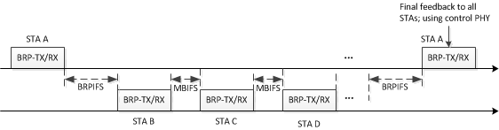
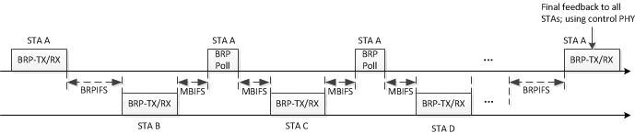
Proposal 4 & 5: BRP feedback & Training of multiple STAs in a single BRP procedure (2/2)
Generalized scheduled protocol is as follows:
Generalized polling-based protocol is as follows:
When multi-STA BRP
When multi-STA BRP

Slide 11
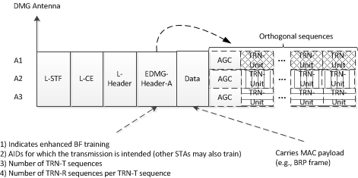
Enhanced BRP frame format for proposals 1-5
A control PHY packet with training fields (SC version possible)
Non-training parts transmitted through all antennas with small delay between antennas
Training fields transmitted concurrently through all antennas using orthogonal sequences
  Orthogonal sequence identifies TX antenna
Three possible modes:
  TX training: may be used by any EDMG STA who receives the frame. Scheduled access allowed only to addressed STA.
  RX training: several SISO STAs can be trained concurrently
  Combined training: RX training for each TX training

Slide 12
Example 1: Single STA training for SU-MIMO
We consider here simple SU-MIMO operation.
Each stream will be transmitted by one antenna/sub-array (we call it Tx)
We consider an AP with 2 antennas/sub-arrays and a STA with antennas/sub-array2
We consider that the AP-STA performs coarse MIMO Tx training with enhanced SLS, followed by fine MIMO Rx/Rx training with enhanced BRP
Tx1
Rx1
Tx2
Rx2
Tx1
Rx1
Tx2
Rx2
BF training process:
Fast/coarse Transmit MIMO BF training to establish control PHY connection
  - Enhanced SLS : training of 4 links
Fine BF training for MIMO
  - BRP BC for Tx and Rx training for Tx1, Tx 2 to Rx1, Rx2
Tx1
Rx1
Tx2
Rx2
First part of the RBP is transmitted only with the best link (out of the 4 control PHY links gotten with SLS)
Sector sweep for Tx1 and Tx2 simultaneously with orthogonal TRN fields to get fine MIMO training
BRP
Tx1
Tx2

Slide 13
Example 2: Single STA training for MU-MIMO
We consider here simple MU-MIMO operation with independent baseband processing per Stream/antenna/Sub-array.
Each STA will be served by one stream/antenna/sub-array (we call it Tx)
We consider an AP with 3 antennas/sub-arrays and a STA with only 1 antenna/sub-array
We consider that the AP performs BF training independently with each STA, but all STAs are trained in order:
To establish the best AP-STA link: best Tx antenna/sub-array (Tx1 in our example) in the AP, best Tx sector/AWV in the AP and best Rx sector/AWV in the STA
And to identify the Tx sectors/AWVs from the other Tx antennas/sub-arrays (Tx2 and 3 in our example) in the AP, that creates no interference on the STA, when it uses its best Rx sector/AWV: those sectors/antennas will be eligible to be used to transmit to other users in future MU-MIMO frame, simultaneously with that STA
The AP therefore has to collect all SNRs for each Tx-Rx sector/AWV combination. Thanks to all these information, it will be able to do STA grouping for future MU-MIMO operation.
Tx1
Rx1
Tx2
Tx3
BF training process:
Tx1
Rx1
Tx2
Tx3
Fast/coarse Transmit BF training for MISO link to establish control PHY connection
  Enhanced SLS: training of 3 links
BF training to collect best link and SNR from all combination of sectors for MU-MIMO nulling
  BRP BC for Tx and Rx training from Tx1, Tx 2 and Tx 3 to Rx1
    Collect SNR for many/all combinations of Tx sectors from Tx1, Tx2 and Tx3, and Rx sectors from Rx1
    Derive best link (best Tx and Rx antenna/sector)
    Derive Tx antenna/sector eligible for MU-MIMO: to be used to transmit to STAs with MU-MIMO simultaneously with the current STA
    Once the AP collect all these information from all STAs, it can efficiently perform MU-MIMO grouping
Rx1
Tx1
Tx2
Tx3
Low SNR

Slide 14
Conclusion
Proposed enhanced BRP supports:
  SU MIMO
  MU MIMO
  Orthogonal TRN sequences
  TX and RX antenna training within the same BRP frame
  Simultaneous training of multiple STAs
One single framework to support all 11ay modes
Performance of enhanced BRP far surpasses 11ad BRP
  Performance gap gets wider with increase in number of users and TRN (array) lengths
  Enhanced BRP shows to be scalable

Slide 15
SFD straw poll
Would you agree to insert the following in section 4 of the SFD:”
  The 11ay SLS beamforming protocol shall enable feedback of one or more sectors per TX and RX antenna.
  The 11ay beamforming protocol shall enable TX and RX training using the same BRP frame
  The 11ay beamforming protocol shall define orthogonal TRN sequences for simultaneous BF training across DMG antennas
”

