Slide 1
Single Stream Pilots in UL MU MIMO
Date: 2016-01-15
Authors:
Name | Affiliation | Address | Phone | Email
Ron Porat | Broadcom |  |  | rporat@broadcom.com
Feng Jiang
Sriram Venkateswaran
Matthew Fischer |  |  |  | mfischer@broadcom.com
Mingyue Ji
Leo Montreuil
Andrew Blanksby
Vinko Erceg

Slide 2
Authors (continued)
Robert Stacey | Intel | 2111 NE 25th Ave, Hillsboro OR 97124, USA | +1-503-724-893 | robert.stacey@intel.com
Shahrnaz Azizi |  |  |  | shahrnaz.azizi@intel.com
Po-Kai Huang |  |  |  | po-kai.huang@intel.com
Qinghua Li |  |  |  | quinghua.li@intel.com
Xiaogang Chen |  |  |  | xiaogang.c.chen@intel.com
Chitto Ghosh |  |  |  | chittabrata.ghosh@intel.com
Laurent Cariou |  |  |  | laurent.cariou@intel.com
Yaron Alpert |  |  |  | yaron.alpert@intel.com
Assaf Gurevitz |  |  |  | assaf.gurevitz@intel.com
Ilan Sutskover |  |  |  | ilan.sutskover@intel.com

Slide 3
Authors (continued)
Name | Affiliation | Address | Phone | Email
Hongyuan Zhang | Marvell | 5488 Marvell Lane, Santa Clara, CA, 95054 | 408-222-2500 | hongyuan@marvell.com
Yakun Sun |  |  |  | yakunsun@marvell.com
Lei Wang |  |  |  | Leileiw@marvell.com
Liwen Chu |  |  |  | liwenchu@marvell.com
Jinjing Jiang |  |  |  | jinjing@marvell.com
Yan Zhang |  |  |  | yzhang@marvell.com
Rui Cao |  |  |  | ruicao@marvell.com
Sudhir Srinivasa |  |  |  | sudhirs@marvell.com
Bo Yu |  |  |  | boyu@marvell.com
Saga Tamhane |  |  |  | sagar@marvell.com
Mao Yu |  |  |  | my@marvel..com
Xiayu Zheng |  |  |  | xzheng@marvell.com
Christian Berger |  |  |  | crberger@marvell.com
Niranjan Grandhe |  |  |  | ngrandhe@marvell.com
Hui-Ling Lou |  |  |  | hlou@marvell.com

Slide 4
Authors (continued)
Name | Affiliation | Address | Phone | Email
Alice Chen | Qualcomm | 5775 Morehouse Dr. San Diego, CA, USA |  | alicel@qti.qualcomm.com
Albert Van Zelst |  | Straatweg 66-S Breukelen, 3621 BR Netherlands |  | allert@qti.qualcomm.com
Alfred Asterjadhi |  | 5775 Morehouse Dr. San Diego, CA, USA |  | aasterja@qti.qualcomm.com
Arjun Bharadwaj |  | 5775 Morehouse Dr. San Diego, CA, USA |  | arjunb@qti.qualcomm.com
Bin Tian |  | 5775 Morehouse Dr. San Diego, CA, USA |  | btian@qti.qualcomm.com
Carlos Aldana |  | 1700 Technology Drive San Jose, CA 95110, USA |  | caldana@qca.qualcomm.com
George Cherian |  | 5775 Morehouse Dr. San Diego, CA, USA |  | gcherian@qti.qualcomm.com
Gwendolyn Barriac |  | 5775 Morehouse Dr. San Diego, CA, USA |  | gbarriac@qti.qualcomm.com
Hemanth Sampath |  | 5775 Morehouse Dr. San Diego, CA, USA |  | hsampath@qti.qualcomm.com
Lin Yang |  | 5775 Morehouse Dr. San Diego, CA, USA |  | linyang@qti.qualcomm.com
Menzo Wentink |  | Straatweg 66-S Breukelen, 3621 BR Netherlands |  | mwentink@qti.qualcomm.com
Naveen Kakani |  | 2100 Lakeside Boulevard Suite 475, Richardson TX 75082, USA |  | nkakani@qti.qualcomm.com
Raja Banerjea |  | 1060 Rincon Circle San Jose CA 95131, USA |  | rajab@qit.qualcomm.com
Richard Van Nee |  | Straatweg 66-S Breukelen, 3621 BR Netherlands |  | rvannee@qti.qualcomm.com

Slide 5
Authors (continued)
Name | Affiliation | Address | Phone | Email
Rolf De Vegt | Qualcomm | 1700 Technology Drive San Jose, CA 95110, USA |  | rolfv@qca.qualcomm.com
Sameer Vermani |  | 5775 Morehouse Dr. San Diego, CA, USA |  | svverman@qti.qualcomm.com
Simone Merlin |  | 5775 Morehouse Dr. San Diego, CA, USA |  | smerlin@qti.qualcomm.com
Tao Tian |  | 5775 Morehouse Dr. San Diego, CA, USA |  | ttian@qti.qualcomm.com
Tevfik Yucek |  | 1700 Technology Drive San Jose, CA 95110, USA |  | tyucek@qca.qualcomm.com
VK Jones |  | 1700 Technology Drive San Jose, CA 95110, USA |  | vkjones@qca.qualcomm.com
Youhan Kim |  | 1700 Technology Drive San Jose, CA 95110, USA |  | youhank@qca.qualcomm.com

Slide 6
Authors (continued)
Name | Affiliation | Address | Phone | Email
James Yee | Mediatek | No. 1 Dusing 1st Road, Hsinchu, Taiwan | +886-3-567-0766 | james.yee@mediatek.com
Alan Jauh |  |  |  | alan.jauh@mediatek.com
Chingwa Hu |  |  |  | chinghwa.yu@mediatek.com
Frank Hsu |  |  |  | frank.hsu@mediatek.com
Thomas Pare | Mediatek USA | 2860 Junction Ave, San Jose, CA 95134, USA | +1-408-526-1899 | thomas.pare@mediatek.com
ChaoChun Wang |  |  |  | chaochun.wang@mediatek.com
James Wang |  |  |  | james.wang@mediatek.com
Jianhan Liu |  |  |  | Jianhan.Liu@mediatek.com
Tianyu Wu |  |  |  | tianyu.wu@mediatek.com
Zhou Lan |  |  |  | Zhou.lan@mediaTek.com
Russell Huang |  |  |  | russell.huang@mediatek.com
Joonsuk Kim | Apple |  |  | joonsuk@apple.com
Aon Mujtaba |  |  |  | mujtaba@apple.com
Guoqing Li |  |  |  | guoqing_li@apple.com
Eric Wong |  |  |  | ericwong@apple.com
Chris Hartman |  |  |  | chartman@apple.com

Slide 7
Authors (continued)
Name | Affiliation | Address | Phone | Email
Peter Loc | Huawei |  |  | peterloc@iwirelesstech.com
Le Liu |  | F1-17, Huawei Base, Bantian, Shenzhen | +86-18601656691 | liule@huawei.com
Jun Luo |  | 5B-N8, No.2222 Xinjinqiao Road, Pudong, Shanghai |  | jun.l@huawei.com
Yi Luo |  | F1-17, Huawei Base, Bantian, Shenzhen | +86-18665891036 | Roy.luoyi@huawei.com
Yingpei Lin |  | 5B-N8, No.2222 Xinjinqiao Road, Pudong, Shanghai |  | linyingpei@huawei.com
Jiyong Pang |  | 5B-N8, No.2222 Xinjinqiao Road, Pudong, Shanghai |  | pangjiyong@huawei.com
Zhigang Rong |  | 10180 Telesis Court, Suite 365, San Diego, CA 92121 NA |  | zhigang.rong@huawei.com
Rob Sun |  | 303 Terry Fox, Suite 400 Kanata, Ottawa, Canada |  | Rob.Sun@huawei.com
David X. Yang |  | F1-17, Huawei Base, Bantian, Shenzhen |  | david.yangxun@huawei.com
Yunsong Yang |  | 10180 Telesis Court, Suite 365, San Diego, CA 92121 NA |  | yangyunsong@huawei.com
Junghoon Suh |  | 303 Terry Fox, Suite 400 Kanata, Ottawa, Canada |  | Junghoon.Suh@huawei.com
Jiayin Zhang |  | 5B-N8, No.2222 Xinjinqiao Road, Pudong, Shanghai | +86-18601656691 | zhangjiayin@huawei.com
Edward Au |  | 303 Terry Fox, Suite 400 Kanata, Ottawa, Canada |  | edward.ks.au@huawei.com
Teyan Chen |  | F1-17, Huawei Base, Bantian, Shenzhen |  | chenteyan@huawei.com
Yunbo Li |  | F1-17, Huawei Base, Bantian, Shenzhen |  | liyunbo@huawei.com

Slide 8
Authors (continued)
Name | Affiliation | Address | Phone | Email
Jinmin Kim | LG Electronics | 19, Yangjae-daero 11gil, Seocho-gu, Seoul 137-130, Korea |  | Jinmin1230.kim@lge.com
Kiseon Ryu |  |  |  | kiseon.ryu@lge.com
Jinyoung Chun |  |  |  | jiny.chun@lge.com
Jinsoo Choi |  |  |  | js.choi@lge.com
Jeongki Kim |  |  |  | jeongki.kim@lge.com
Dongguk Lim |  |  |  | dongguk.lim@lge.com
Suhwook Kim |  |  |  | suhwook.kim@lge.com
Eunsung Park |  |  |  | esung.park@lge.com
JayH Park |  |  |  | Hyunh.park@lge.com
HanGyu Cho |  |  |  | hg.cho@lge.com
Thomas Derham | Orange |  |  | thomas.derham@orange.com
Bo Sun | ZTE | #9 Wuxingduan, Xifeng Rd., Xi'an, China |  | sun.bo1@zte.com.cn
Kaiying Lv |  |  |  | lv.kaiying@zte.com.cn
Yonggang Fang |  |  |  | yfang@ztetx.com
Ke Yao |  |  |  | yao.ke5@zte.com.cn
Weimin Xing |  |  |  | xing.weimin@zte.com.cn
Brian Hart | Cisco Systems | 170 W Tasman Dr, San Jose, CA 95134 |  | brianh@cisco.com
Pooya Monajemi |  |  |  | pmonajem@cisco.com

Slide 9
Authors (continued)
Name | Affiliation | Address | Phone | Email
Fei Tong | Samsung | Innovation Park, Cambridge CB4 0DS (U.K.) | +44 1223 434633 | f.tong@samsung.com
Hyunjeong Kang |  | Maetan 3-dong; Yongtong-Gu Suwon; South Korea | +82-31-279-9028 | hyunjeong.kang@samsung.com
Kaushik Josiam |  | 1301, E. Lookout Dr, Richardson TX 75070 | (972) 761 7437 | k.josiam@samsung.com
Mark Rison |  | Innovation Park, Cambridge CB4 0DS (U.K.) | +44 1223 434600 | m.rison@samsung.com
Rakesh Taori |  | 1301, E. Lookout Dr, Richardson TX 75070 | (972) 761 7470 | rakesh.taori@samsung.com
Sanghyun Chang |  | Maetan 3-dong; Yongtong-Gu Suwon; South Korea | +82-10-8864-1751 | s29.chang@samsung.com
Yasushi Takatori | NTT | 1-1 Hikari-no-oka, Yokosuka, Kanagawa 239-0847 Japan | +81 46 859 3135 | takatori.yasushi@lab.ntt.co.jp
Yasuhiko Inoue |  |  | +81 46 859 5097 | inoue.yasuhiko@lab.ntt.co.jp
Shoko Shinohara |  |  | +81 46 859 5107 | Shinohara.shoko@lab.ntt.co.jp
Yusuke Asai |  |  | +81 46 859 3494 | asai.yusuke@lab.ntt.co.jp
Koichi Ishihara |  |  | +81 46 859 4233 | ishihara.koichi@lab.ntt.co.jp
Junichi Iwatani |  |  | +81 46 859 4222 | Iwatani.junichi@lab.ntt.co.jp
Akira Yamada | NTT DOCOMO | 3-6, Hikarinooka, Yokosuka-shi, Kanagawa, 239-8536, Japan | +81 46 840 3759 | yamadaakira@nttdocomo.com

Slide 10
Authors (continued)
Name | Affiliation | Address | Phone | Email
Masahito Mori | Sony Corp. |  |  | Masahito.Mori@jp.sony.com
Yusuke Tanaka |  |  |  | YusukeC.Tanaka@jp.sony.com
Yuichi Morioka |  |  |  | Yuichi.Morioka@jp.sony.com
Kazuyuki Sakoda |  |  |  | Kazuyuki.Sakoda@am.sony.com
William Carney |  |  |  | William.Carney@am.sony.com

Slide 11
Introduction
The current SFD supports single stream pilots for SU, DL/UL OFDMA and DL MU-MIMO transmissions
In this contribution we investigate the performance of single stream pilots for UL MU-MIMO, show that it performs well and propose to add support for this option

Slide 12
Proposal
Support single stream pilots in UL MU MIMO transmissions also
  Apply pilot modulation during HE-LTF exactly as in UL MU-MIMO payload
  Same implementation at the STA
  Same implementation at the AP for UL MU-MIMO LTF and payload
CFO Estimation high level
  Step 1: Estimate channel on pilot tones
    On each pilot, interpolate channel estimates from neighboring tones
  Step 2: Use channel estimate on pilots to estimate the phases on two HE-LTF symbols. Difference in phases is an estimate of the CFO.
  More details in appendix
AP uses 1 bit in the trigger frame to indicate its preference between single stream pilots and orthogonal masking sequences for CFO estimation
  No additional implementation burden at STA over today: spec framework mandates transmission of both masking sequences (for UL MU) and single stream pilots (for SU, DL/UL OFDMA, DL MU MIMO)

Slide 13
Simulation scenario
AP: 8 antennas
STA: 6 STAs with CFO = ± 400 Hz
Channel: 11nD
Timing offset: uniformly from [0, 800] ns
CSD: [0 400 200 600 350 650] ns
RF Impairments
LTFs: 2X & 4X
MCS: 7 & 9

Slide 14
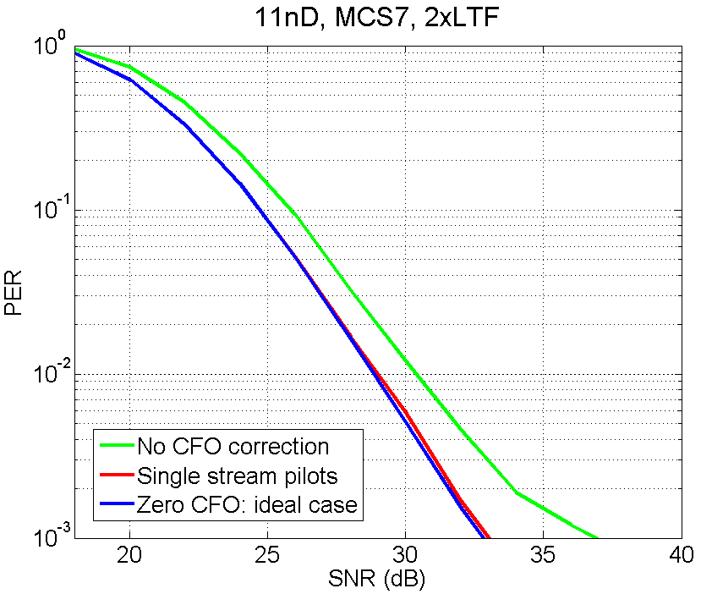
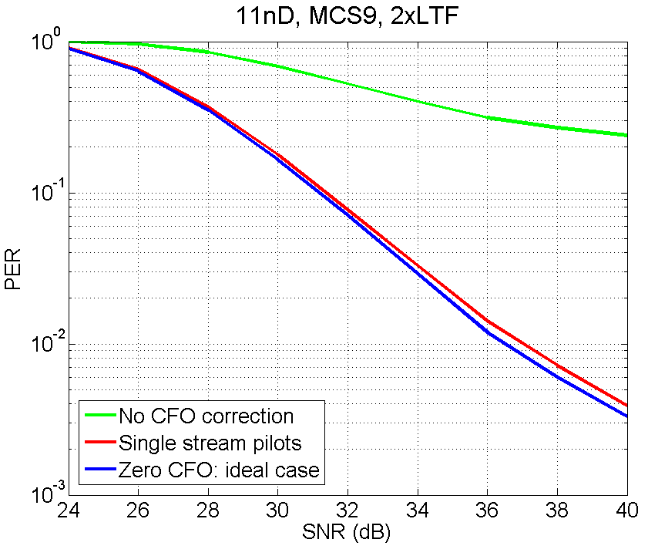
Results: 2X LTF
Correction with single stream pilots is very close to the ideal case of zero CFO

Slide 15
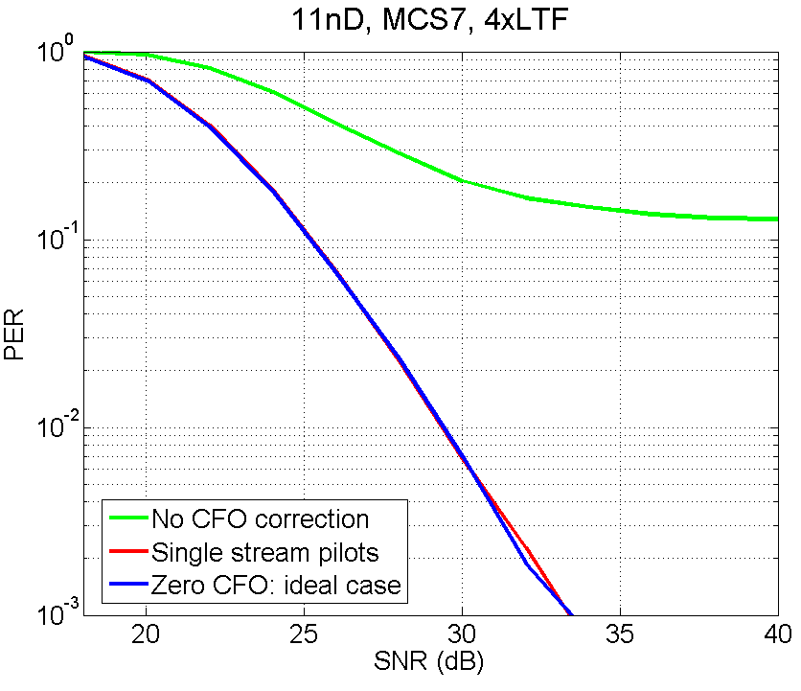
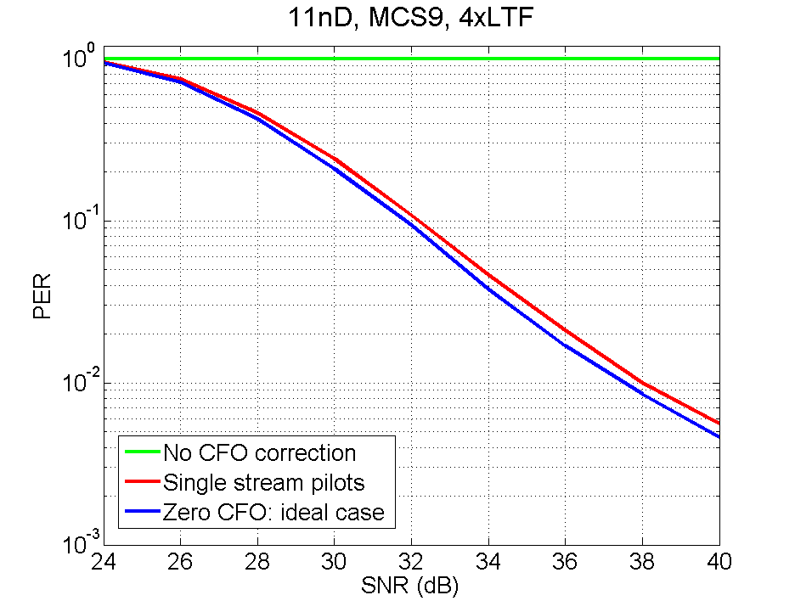
Results: 4X LTF
Correction with single stream pilots is very close to the ideal case of zero CFO

Slide 16
Conclusion
Propose to add single stream pilots in UL MU MIMO transmissions
  STA already supports single stream pilots
  Performs well in challenging scenarios
  AP uses 1 bit in the trigger frame to indicate its preference between single stream pilots and orthogonal masking sequences for CFO estimation
  No additional implementation burden relative to today
    STA needs to transmit masking sequences on LTFs (UL MU) and pilots (for SU, DL/UL OFDMA, DL MU)
    AP needs to handle single stream pilots even in UL MU during payload decoding

Slide 17
SP #1
Do you support the following change/additions to the SFD:
For UL MU MIMO transmissions, support of single stream pilots and masking the LTF sequence of each spatial stream by a distinct orthogonal code is mandatory at the transmitter side (non AP STA).
The trigger frame shall use 1 bit to indicate whether the UL MU MIMO transmission following it uses single stream pilots or a mask on each spatial stream of the LTF sequence by a distinct orthogonal code.
Yes
No
Abs

Slide 18
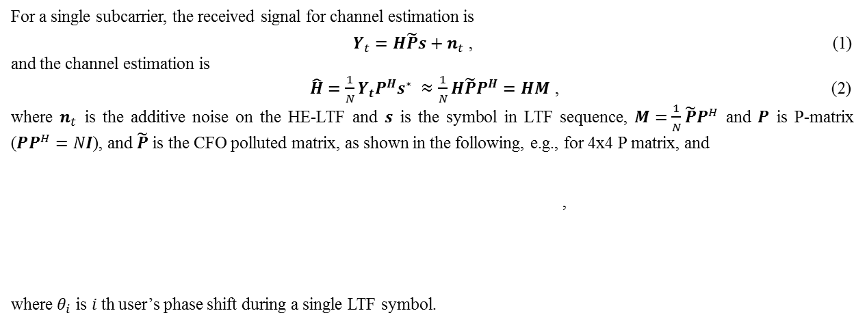
Appendix 1: Algorithm
For a single subcarrier, the received signal for channel estimation is
$Y_{t}=H\tilde{P}s+n_{t}$ , (1)
and the channel estimation is
$\hat{H}=\frac{1}{N}Y_{t}P^{H}s^{∗} ≈\frac{1}{N}H\tilde{P}P^{H}=HM$ , (2) where $n_{t}$ is the additive noise on the HE-LTF and $s$ is the symbol in LTF sequence, $M=\frac{1}{N}\tilde{P}P^{H}$ and $P$ is P-matrix ($PP^{H}=NI$), and $\tilde{P}$ is the CFO polluted matrix, as shown in the following, e.g., for 4x4 P matrix, and
,
where $θ_{i}$ is $i$th user’s phase shift during a single LTF symbol.

Slide 19
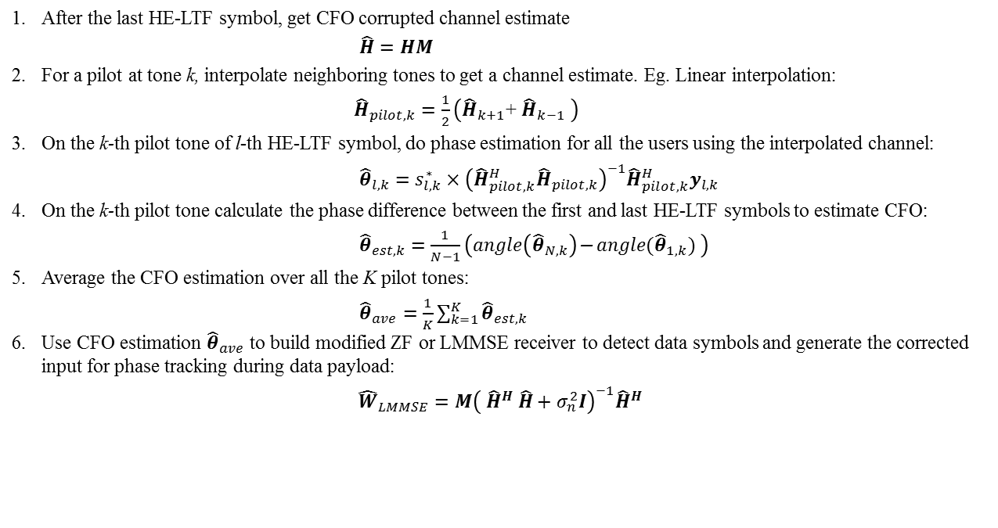
Appendix 1: Algorithm
After the last HE-LTF symbol, get CFO corrupted channel estimate
$\hat{H}=HM$
For a pilot at tone k, interpolate neighboring tones to get a channel estimate. Eg. Linear interpolation:
${\hat{H}}_{pilot, k}=\frac{1}{2}\left({\hat{H}}_{k+1}\text{+ }{\hat{H}}_{k−1} \right)$
On the k-th pilot tone of l-th HE-LTF symbol, do phase estimation for all the users using the interpolated channel:
${\hat{θ}}_{l,k}={s_{l,k}^{∗}×\left({\hat{H}}_{pilot,k}^{H}{\hat{H}}_{pilot,k}\right)}^{−1}{\hat{H}}_{pilot,k}^{H}y_{l,k}$
On the k-th pilot tone calculate the phase difference between the first and last HE-LTF symbols to estimate CFO:
${\hat{θ}}_{est,k}=\frac{1}{N−1}\left(angle\left({\hat{θ}}_{N,k}\right)\text{−} angle({\hat{θ}}_{1,k}) \right)$
Average the CFO estimation over all the K pilot tones:
${\hat{θ}}_{ave}=\frac{1}{K}\sum_{k=1}^{K}{{\hat{θ}}_{est,k}}$
Use CFO estimation ${\hat{θ}}_{ave}$ to build modified ZF or LMMSE receiver to detect data symbols and generate the corrected input for phase tracking during data payload:
${\hat{W}}_{LMMSE}=M{\left( {\hat{H}}^{H} \hat{H}+σ_{n}^{2}I\right)}^{−1}{\hat{H}}^{H}$

