Slide 1
On the Channel Model for Short Range Communications
Date: 2016-01-18
Authors:

Slide 2
Abstract
The usage scenarios for 11ay include short range communications in mmWave.
The channel model for IEEE802.11ay should capture those scenarios accurately.
In this presentation, we suggest some changes in the current channel model document [2] to meet this requirement.

Slide 3














Background (1/3)
Nine different usage scenarios are identified for TGay in reference [1]. The link distances for five of those scenarios are less than 10 meters. For ultra short range (USR) communications, the link distance can be less than 10 cm.
# | Applications and Characteristics | Propagation Conditions
1 | Ultra Short Range (USR) Communications: -Static,D2D, -Streaming/Downloading | LOS only, Indoor <10cm
2 | 8K UHD Wireless Transfer at Smart Home: -Uncompressed 8K UHD Streaming | Indoor, LOS with small NLOS chance, <5m
3 | Augmented Reality and Virtual Reality: -Low Mobility, D2D -3D UHD streaming | Indoor, LOS/NLOS <10m
4 | Data Center NG60 Inter-Rack Connectivity: -Indoor Backhaul with multi-hop* | Indoor, LOS only <10m
5 | Video/Mass-Data Distribution/Video on Demand System: - Multicast Streaming/Downloading - Dense Hotspots | Indoor, LOS/NLOS <100m
6 | Mobile Wi-Fi Offloading and Multi-Band Operation (low mobility): -Multi-band/-Multi-RAT Hotspot operation | Indoor/Outdoor, LOS/NLOS <100m
7 | Mobile Fronthauling | Outdoor, LOS <200m
8 | Wireless Backhauling with Single Hop: -Small Cell Backhauling with single hop -Small Cell Backhauling with multi-hop | Outdoor, LOS <1km <150m
9 | Office docking | Indoor LOS/NLOS < 3 m
Kiosk
Train Station
Movie, video/audio clip, magazine, newspaper, etc.
Video/audio clip, magazine, newspaper, etc.
Office docking with multiple wireless links

Slide 4
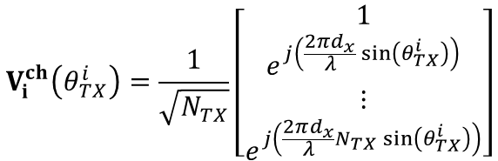
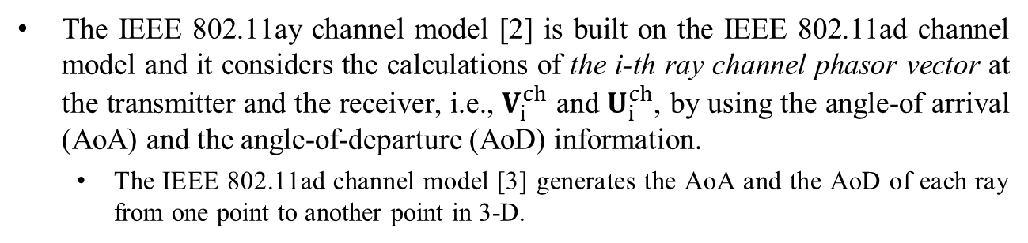
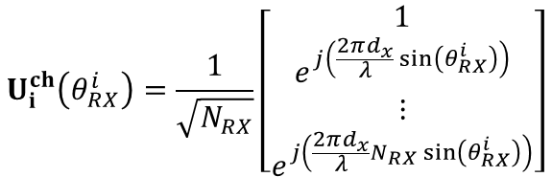
Background (2/3)
The IEEE 802.11ay channel model [2] is built on the IEEE 802.11ad channel model and it considers the calculations of the i-th ray channel phasor vector at the transmitter and the receiver, i.e., $V_{i}^{ch}$ and $U_{i}^{ch}$, by using the angle-of arrival (AoA) and the angle-of-departure (AoD) information.
  The IEEE 802.11ad channel model [3] generates the AoA and the AoD of each ray from one point to another point in 3-D.
$$U_{i}^{ch}\left(θ_{RX}^{i}\right)=\frac{1}{\sqrt{N_{RX}}}\left[\begin{matrix}1 \\ e^{j\left(\frac{2πd_{x}}{λ}\sin\left(θ_{RX}^{i}\right)\right)} \\ ⋮ \\ e^{j\left(\frac{2πd_{x}}{λ}N_{RX}\sin\left(θ_{RX}^{i}\right)\right)}\end{matrix}\right]$$
$$V_{i}^{ch}\left(θ_{TX}^{i}\right)=\frac{1}{\sqrt{N_{TX}}}\left[\begin{matrix}1 \\ e^{j\left(\frac{2πd_{x}}{λ}\sin\left(θ_{TX}^{i}\right)\right)} \\ ⋮ \\ e^{j\left(\frac{2πd_{x}}{λ}N_{TX}\sin\left(θ_{TX}^{i}\right)\right)}\end{matrix}\right]$$
[Using 2D model as an example]

Slide 5
Background (3/3)
In 11ay channel model document [2], five different SU-MIMO configurations are proposed for 802.11ay.
In those configurations, Configuration #3 and Configuration #4 consider two physically separated PAAs at transmitter and receiver.
Configuration #3
Configuration #4

Slide 6
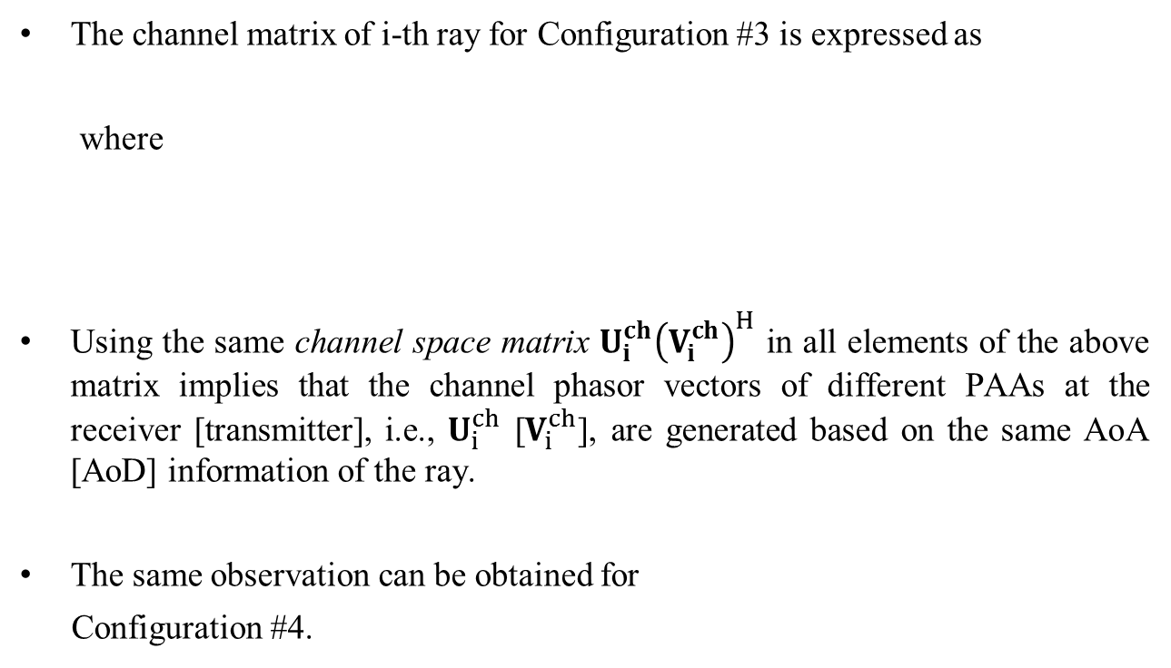
MIMO Channel Model for Physically Separated PAAs (1/3)
The channel matrix of i-th ray for Configuration #3 is expressed as
where
Using the same channel space matrix $U_{i}^{ch}{\left(V_{i}^{ch}\right)}^{H}$ in all elements of the above matrix implies that the channel phasor vectors of different PAAs at the receiver [transmitter], i.e., $U_{i}^{ch}$ [$V_{i}^{ch}$], are generated based on the same AoA [AoD] information of the ray.
The same observation can be obtained for
Configuration #4.
Same

Slide 7
MIMO Channel Model for Physically Separated PAAs (2/3)
Current SU-MIMO model
SU-MIMO model with the exact LOS direction
In practice, especially for the use cases with short link distances and LOS scenario, the AoAs to the two Rx PAAs may not be assumed the same. And, AoDs from the two Tx PAAs may not be assumed the same.
The current SU-MIMO model may lead misleading performance results for those use cases.

Slide 8
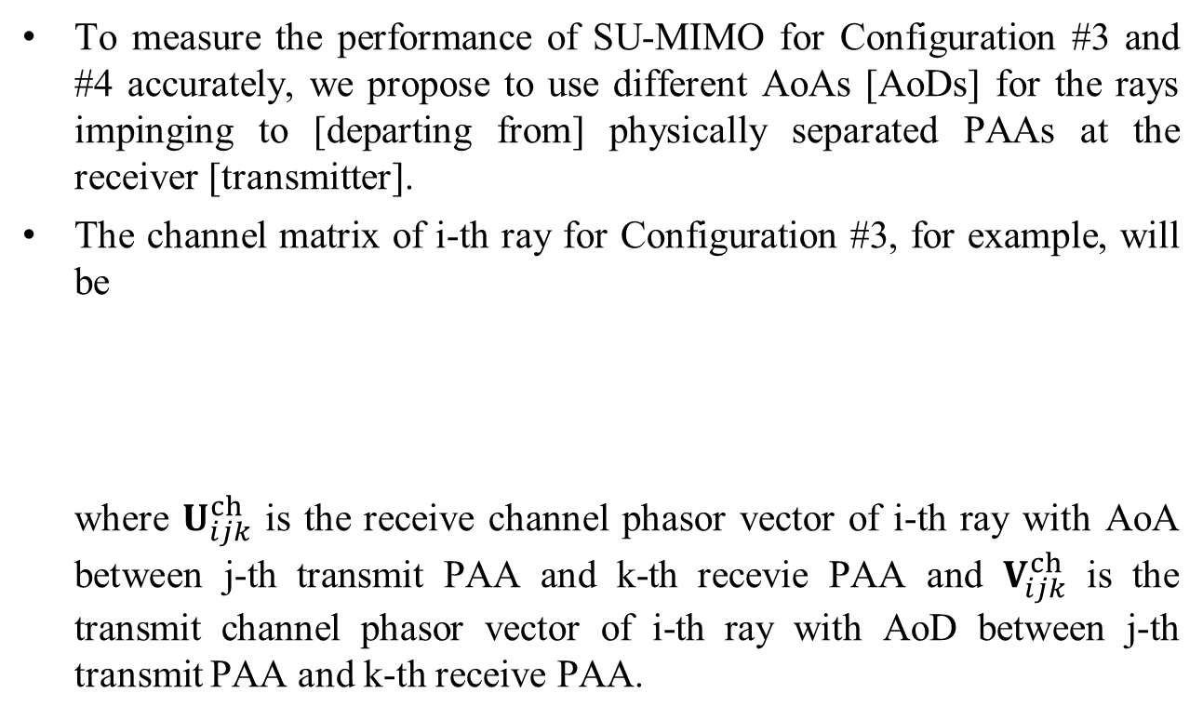
MIMO Channel Model for Physically Separated PAAs (3/3)
To measure the performance of SU-MIMO for Configuration #3 and #4 accurately, we propose to use different AoAs [AoDs] for the rays impinging to [departing from] physically separated PAAs at the receiver [transmitter].
The channel matrix of i-th ray for Configuration #3, for example, will be
where $U_{ijk}^{ch}$ is the receive channel phasor vector of i-th ray with AoA between j-th transmit PAA and k-th recevie PAA and $V_{ijk}^{ch}$ is the transmit channel phasor vector of i-th ray with AoD between j-th transmit PAA and k-th receive PAA.

Slide 9
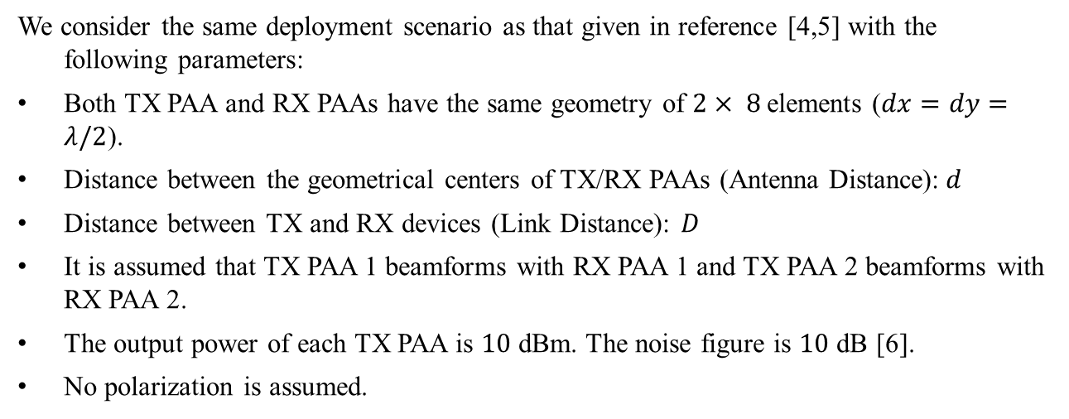



An Example for STA-STA & LOS Scenario
TX
RX
PPA 1
Direct link
PPA 1
$$d$$
Interfering links
$$d$$
PPA 2
Direct link
PPA 2
$$D$$
The simulation setup
We consider the same deployment scenario as that given in reference [4,5] with the following parameters:
Both TX PAA and RX PAAs have the same geometry of $2× 8$elements ($dx=dy=λ/2$).
Distance between the geometrical centers of TX/RX PAAs (Antenna Distance):$d$
Distance between TX and RX devices (Link Distance): $D$
It is assumed that TX PAA 1 beamforms with RX PAA 1 and TX PAA 2 beamforms with RX PAA 2.
The output power of each TX PAA is $10$ dBm. The noise figure is $10$ dB [6].
No polarization is assumed.

Slide 10

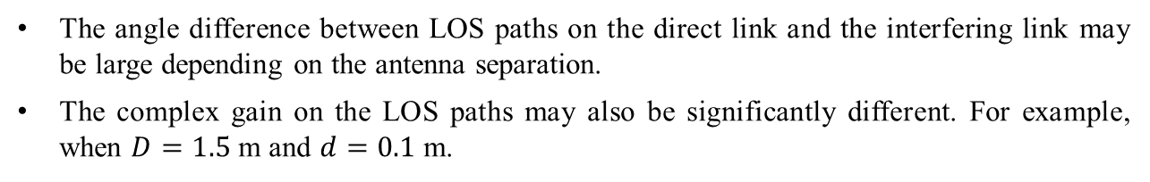

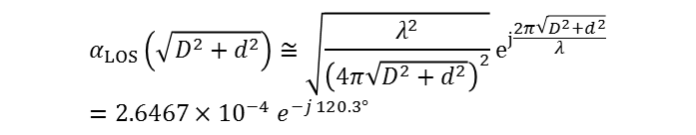
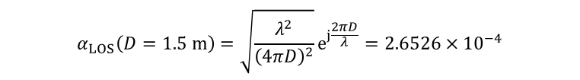

Result: Angle and Channel Gain Differences Between LOS Paths
The angle difference between LOS paths
TX
RX
PPA 1
Direct link
PPA 1
$$d$$
Interfering links
$$d$$
PPA 2
Direct link
PPA 2
$$D$$
The angle difference between LOS paths on the direct link and the interfering link may be large depending on the antenna separation.
The complex gain on the LOS paths may also be significantly different. For example, when $D=1.5$ m and $d=0.1$ m.
$$α_{LOS}\left(D=1.5 m\right)=\sqrt{\frac{λ^{2}}{{\left(4πD\right)}^{2}}}e^{j\frac{2πD}{λ}}=2.6526×{10}^{−4}$$
$$α_{LOS}\left(\sqrt{D^{2}+d^{2}}\right)≅\sqrt{\frac{λ^{2}}{{\left(4π\sqrt{D^{2}+d^{2}}\right)}^{2}}}e^{j\frac{2π\sqrt{D^{2}+d^{2}}}{λ}}=2.6467×{10}^{−4} e^{−j 120.3°}$$
Significant phase rotation

Slide 11
Result: Received Signal Strength (1/2)
Results from using accurate model
Data from [4]
The received signal strength (RSS) results derived with our simulation model follow the theoretical and measurement results provided in reference [4] as the exact LOS directions for the interfering and the direct links are considered.

Slide 12
Result: Received Signal Strength (2/2)
RSSs on
direct links
RSS results on the direct and interfering link with current SU-MIMO model
Current SU-MIMO model may not be valid for short link distance.
Current SU-MIMO model is valid for long link distance.
RSSs on the
Interfering links
As the current SU-MIMO model assumes that the LOS paths of interfering link and direct link parallel to each other, the RSS on the LOS paths on the interfering links and direct links are always the same.
On the other hand, the RSS results on the direct and interfering link may be significantly different for short link distances when the exact LOS directions are taken into account.

Slide 13
Result: Capacity
The channel capacity when exact LOS directions are considered.
Current SU-MIMO model
Since the LOS paths of interfering link and direct link parallel to each other in the current model, the rank of the channel is always 1 with the SU-MIMO model.
On the other hand, MIMO capacity can be achieved if the accurate AoA and AoD of the LOS paths are considered.

Slide 14
Conclusion
In this study, we show that the directions of the rays departing from [arriving to] different PAAs, particularly the ones on the LOS paths, should not be assumed the same when the link distance is short.
For Configuration #3 and Configuration #4 in [2], the SU-MIMO channel models should be updated to capture the impact of the physical separation of the PAAs at the devices accurately.

Slide 15
References
R. Sun, et al, “IEEE 802.11 TGay Use Cases”, IEEE doc. 11-15/0625r3
A. Maltsev, et al, “Channel models for IEEE 802.11ay,” IEEE doc. 11-15/1150r1.
A. Maltsev, et al, “Channel Models for 60 GHz WLAN Systems,” IEEE doc. 11-09/0334r8.
A. Maltsev, et al, “Experimental Measurements for Short Range LOS SU-MIMO,” IEEE doc. 11-15/0632r1.
R. Yang and A. Sahin, “Feasibility of SU-MIMO under Array Alignment Method,” IEEE Doc. 11-15/1333r1
G. Venkatesan, et al, “TGay Evaluation Methodology,” IEEE doc. 11-15/0866r1.

Slide 16
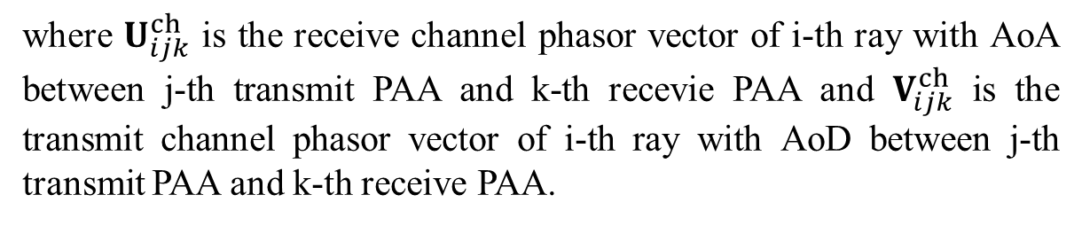
Straw Poll 1
Do you agree that Equation 3.24 in the Channel Model Document [2] should be changed as follows:
where $U_{ijk}^{ch}$ is the receive channel phasor vector of i-th ray with AoA between j-th transmit PAA and k-th recevie PAA and $V_{ijk}^{ch}$ is the transmit channel phasor vector of i-th ray with AoD between j-th transmit PAA and k-th receive PAA.
Y/N/A:

Slide 17
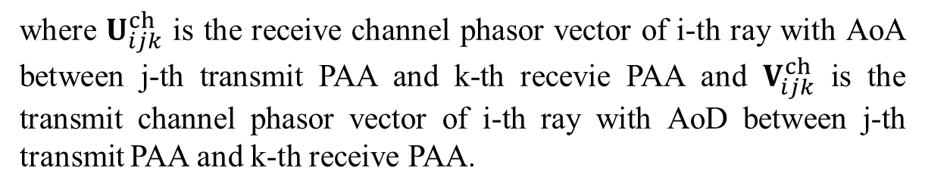
Straw Poll 2
Do you agree that Equation 3.25 in the Channel Model Document [2] should be changed as follows:
where $U_{ijk}^{ch}$ is the receive channel phasor vector of i-th ray with AoA between j-th transmit PAA and k-th recevie PAA and $V_{ijk}^{ch}$ is the transmit channel phasor vector of i-th ray with AoD between j-th transmit PAA and k-th receive PAA.
Y/N/A:

