Slide 1
Performance of Non-Uniform Constellations in Presence of Phase Noise
Date: 2016/01/17
Authors:

Slide 2
Abstract
This contribution outlines
  The performance of non-uniform constellations (NUCs) in single-carrier (SC) modulation under influence of phase noise
    NUCs of [1] with 64 signal points are considered
    NUCs are shown to be robust against phase noise
      The gain compared to uniform constellations (UCs) is even increased
  Comparison of demapping complexity
  NUC definition
    Signal points and bit labelling

Slide 3
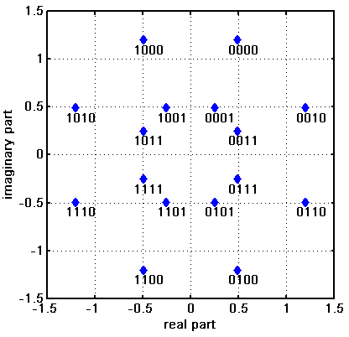
Motivation
Higher order QAMs discussed in e.g. [2-4] as a potential technology for 802.11ay
  SC: 64-QAM (up to 16-QAM in ad)
Non-uniform constellations (NUCs) provide increased performance compared to uniform constellations (UCs)
NUCs provide
  shaping gain [5, 6]
  improved robustness against impairments [7] such as
    ADC quantization
    fading channels
  a lower peak power than UCs, e.g. [1]
  a moderate increase in demapper complexity
    See later

Slide 4
Introduction
So far, the effect of phase noise on the performance of NUCs has been investigated for OFDM only
  Investigations [7] show that NUCs can maintain or even improve their gain in presence of phase noise, quantization, or fading.
In this contribution, we investigate the performance of NUCs in SC transmission
  NUCs for SC can be optimized in various ways [1]
  Here we present performance results of NUCs with
    Zero shaping gain but minimum PAPR: Cat. B
    Maximum shaping gain and unconstraint PAPR: Cat. D

Slide 5
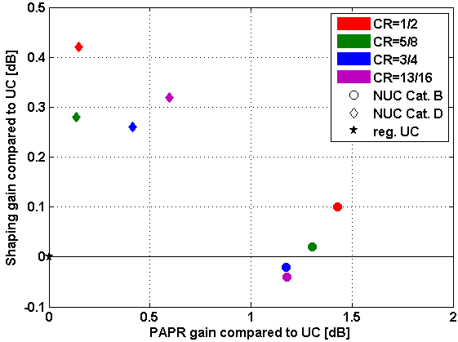
Introduction (cont.)
NUC performance in SC communications
  The overall gain has two sources
    Shaping gain
      NUCs require less SNR than UCs for same FER
    Peak power gain
      NUCs have a lower PAPR
      than UCs
  Shaping gain and peak power
  gain are not independent
  Optimization targets
Cat. D
+0.35 dB
+0.35 dB
NUC Cat. | Shaping gain | PAPR gain
B | ≈ 0 | max
D | Max | unconstraint
Cat. B
UC
+ 1.3 dB

Slide 6
Simulation Parameters
Focus on constellations with 64 signal points
  .11ad LDPC with code rates (CR): ¹/₂, ⁵/₈, ³/₄, ¹³/₁₆
SC modulation
Message length: 1000 bytes
Channel model
  AWGN
  Phase noise at transmitter and receiver
    Spectral noise mask according to evaluation methodology [9]
Receiver
  Regular approx. LLR demapper
  Phase noise mitigation
Analysis
  Performance compared at FER = 10⁻²
  Benchmark
    Regular uniform 64-QAM

Slide 7
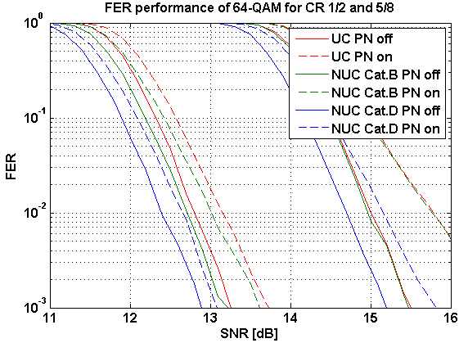
Results
FER performance w/o and w/ phase noise
  NUCs offer a shaping gain depending on Cat. and CR
    NUC requires less SNR than UC for same FER
    Cat. B and UC have
    approx. same performance
    shaping gain 0 dB
    Cat. D has a SNR gain
    compared to UC
    shaping gain up to 0.4 dB
  Phase noise yields degradation
    UC and NUC are similarly
    influenced
CR1/2
CR5/8

Slide 8
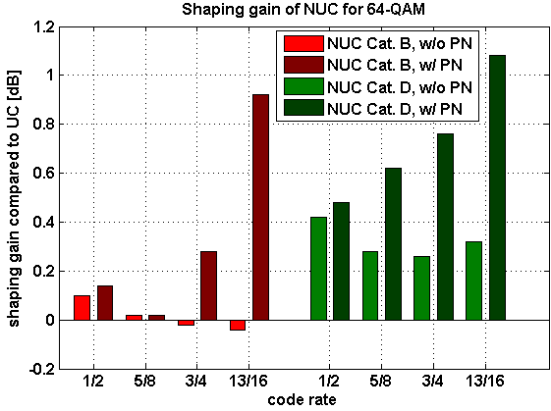
Results (cont.)
NUC shaping gain w/o and w/ phase noise as a function of CR
  Shaping gain is even further increased in presence of phase noise
    i.e. NUCs are more robust than UC
  Shaping gain increases up to 0.9 / 1.1 dB for Cat. B / Cat. D with phase noise
    Additional gain of 0.9 / 0.8 dB
Cat. B
Cat. D

Slide 9
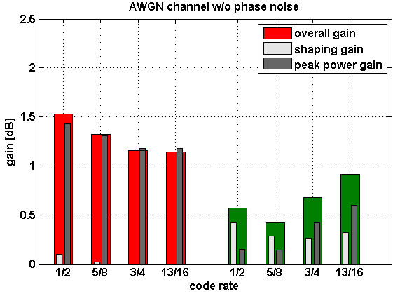
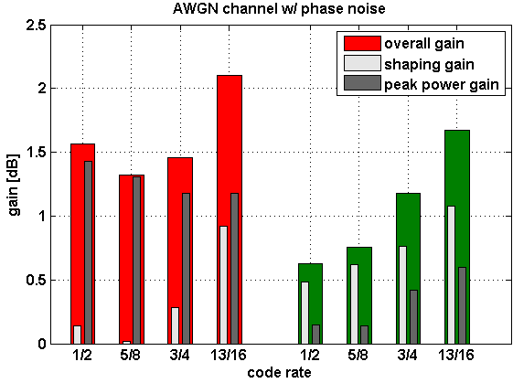
Results (cont.)
Overall NUC gain w/o and w/ phase noise
  Summation of shaping gain and peak power gain
    Shaping gain increases in presence of phase noise
    Peak power gain is unchanged
  Overall gain up to 1.5 / 2.1dB (w/o PN / w/ PN) compared to regular UC
Cat. B
Cat. B
Cat. D
Cat. D

Slide 10
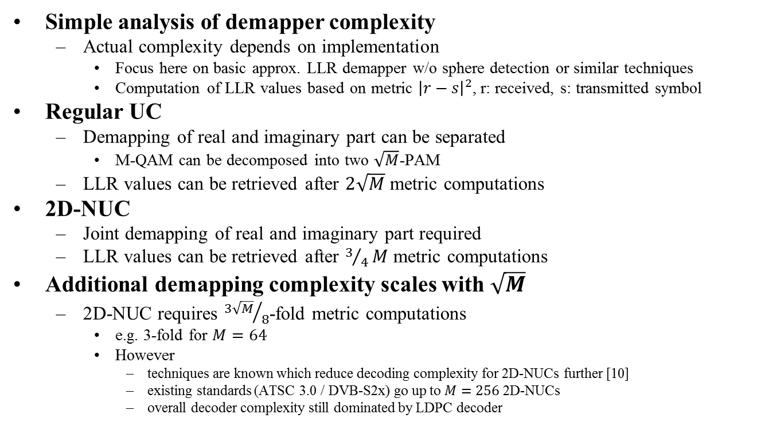
On the Demapper Complexity
Simple analysis of demapper complexity
  Actual complexity depends on implementation
    Focus here on basic approx. LLR demapper w/o sphere detection or similar techniques
    Computation of LLR values based on metric ${\left|r−s\right|}^{2}$, r: received, s: transmitted symbol
Regular UC
  Demapping of real and imaginary part can be separated
    M-QAM can be decomposed into two $\sqrt{M}$-PAM
  LLR values can be retrieved after $2\sqrt{M}$ metric computations
2D-NUC
  Joint demapping of real and imaginary part required
  LLR values can be retrieved after $3/4M$ metric computations
Additional demapping complexity scales with $\sqrt{M}$
  2D-NUC requires ${3\sqrt{M}}/8$-fold metric computations
    e.g. 3-fold for $M=64$
    However
      techniques are known which reduce decoding complexity for 2D-NUCs further [10]
      existing standards (ATSC 3.0 / DVB-S2x) go up to $M=256$ 2D-NUCs
      overall decoder complexity still dominated by LDPC decoder

Slide 11
Conclusion
Investigation of NUC performance in presence of phase noise
  Low CRs: NUC gain is at least maintained
  High CRs: Additional NUC gain
NUCs are a promising technology for .11ay
  Significant performance gains
    up to 1.6dB w/o PN
    up to 2.1dB w/ PN
  Robust
    against phase noise, quantization [7]
    in fading channels [7]
  Only a moderate complexity increase

Slide 12
References
11-15-0835-01-00ay Potential of Non-Uniform Constellations with Peak Power Constraint
11-14-1378-00-ng60 PHY rate for NG60
11-14-0652-01-0wng-wng Next Generation 802.11ad
11-15-0339-00-ng60 SC-64APSK for 11ay
11-15-0096-01-ng60 Non-uniform Constellations for higher Order QAMs
11-15-0601-00-00ay Non-uniform Constellations for 64QAM
11-15-1290-00-00ay Effect of Impairments on the Performance of Non-Uniform Constellations
11-15-1289-00-00ax Non-Uniform Constellations for 1024-QAM
11-15-0866-01-00ay 11ay evaluation methodology
M. Fuentes, D. Vargas, and D. Gómez-Barquero “Low-Complexity Demapping Algorithm for Two-Dimensional Non-Uniform Constellations”, IEEE Trans. on Broadcasting, Nov. 2015

Slide 13
Appendix

Slide 14
NUC definition for 64-QAM
Each CR requires a dedicated NUC for maximum gain
All NUCs feature quadrant symmetry
  64-QAM 2D-NUCs can be deduced from 16 signal points
    Those signal points
      reside in the 1st quadrant (Re>0, Im>0)
      define 4 bit of the mapping
  Binary reflected Gray mapping yields all other signal points
    All quadrants define further 2 bit of the mapping
  Example: 16-QAM 2D-NUC deduced from 4 signal points
10
00
Reflect on axis
11
01

Slide 15
NUC definition for Cat. B

Slide 16
NUC definition for Cat. D

Slide 17
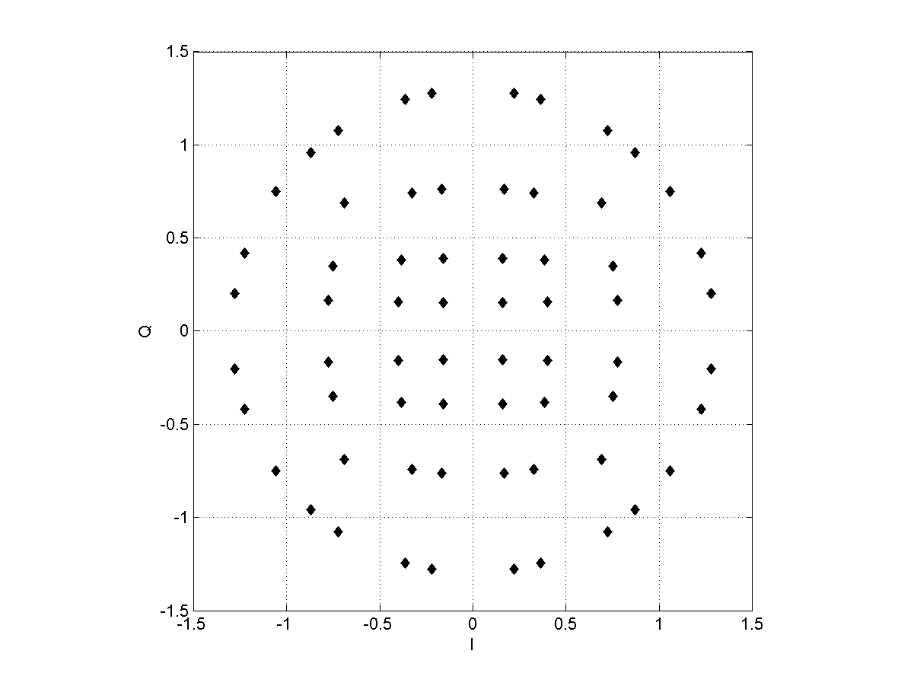
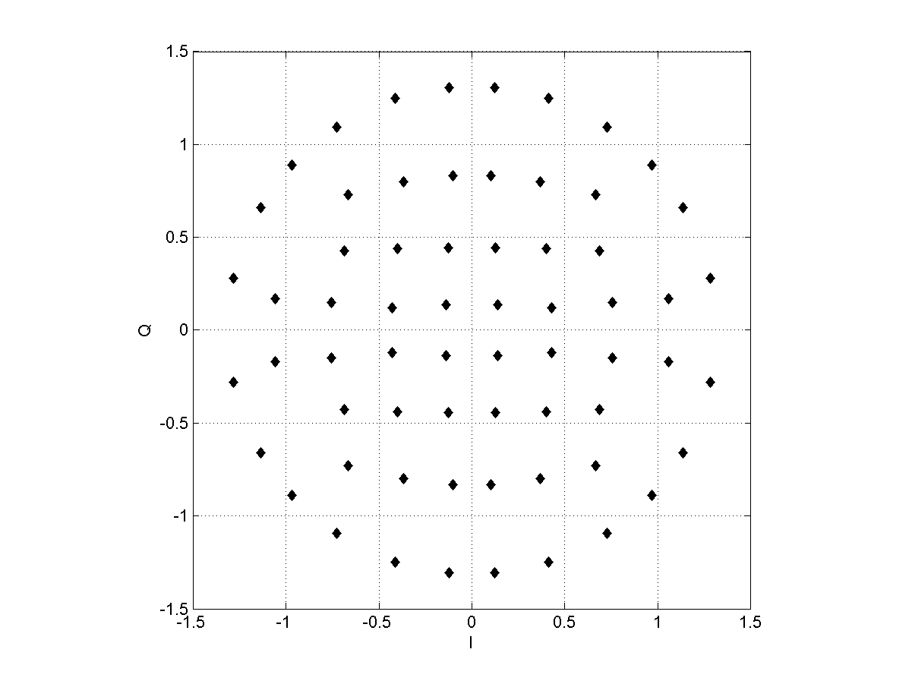
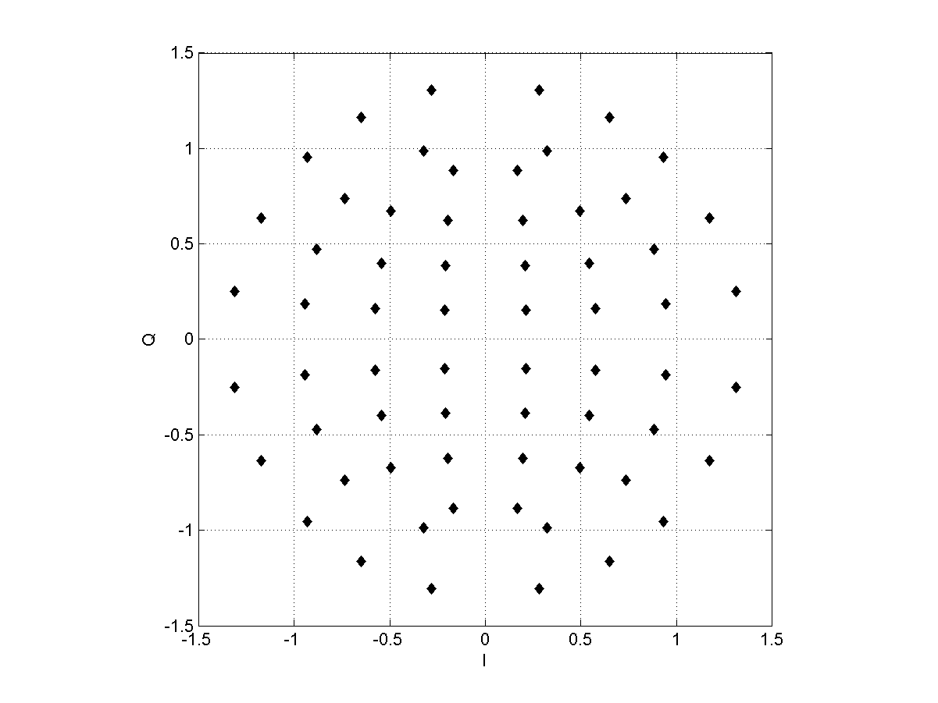
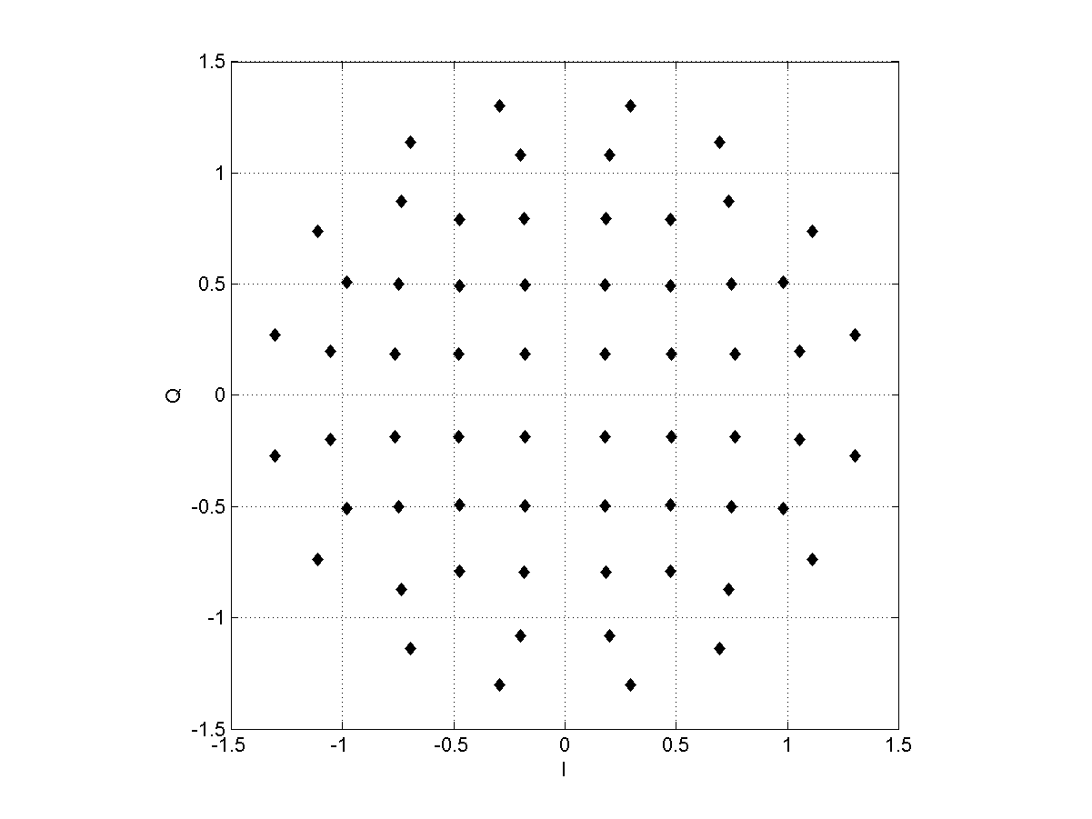
Visualization: NUCs Cat. B
CR=1/2
CR=5/8
CR=13/16
CR=3/4

Slide 18
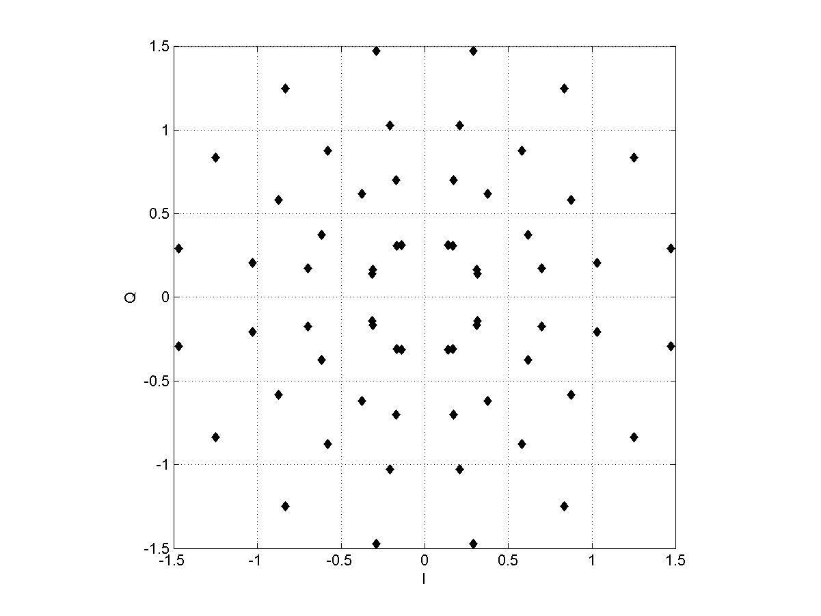
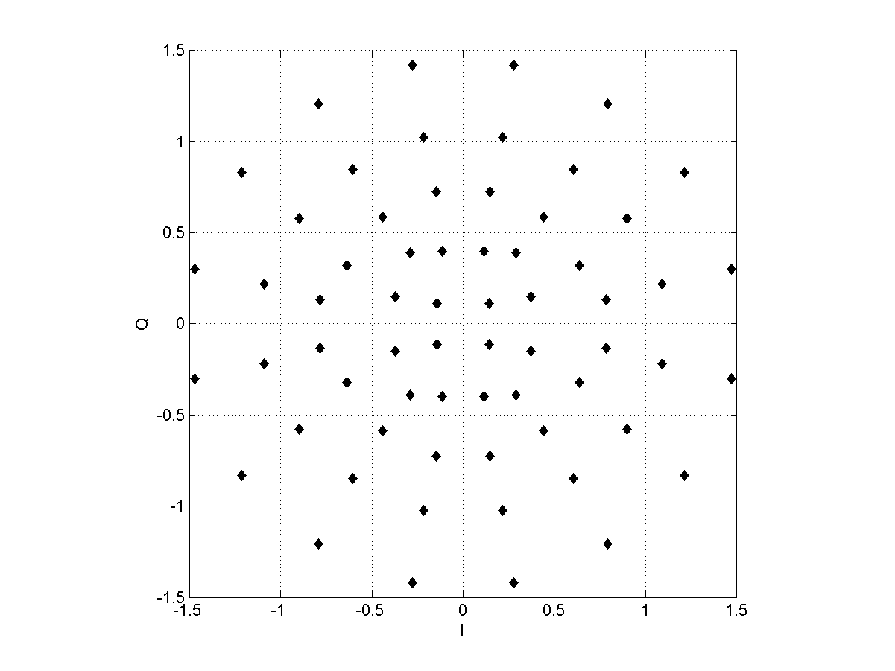
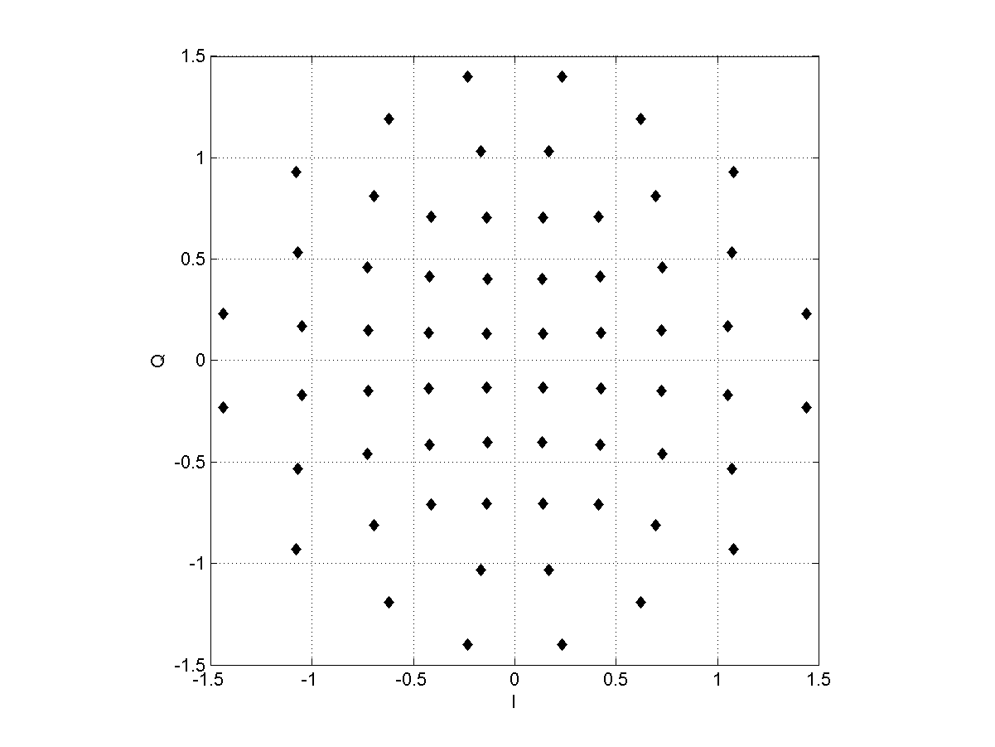
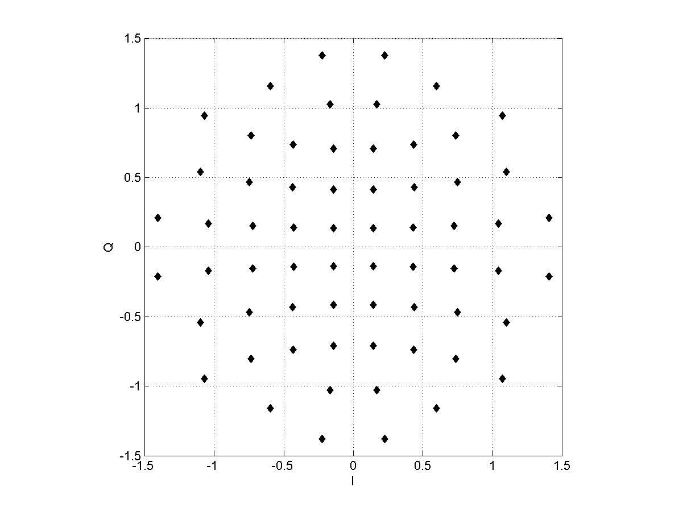
Visualization: NUCs Cat. D
CR=1/2
CR=5/8
CR=13/16
CR=3/4

