Slide 1
Duration/ID field in UL-MU
Date: 2016-01-18
Authors:

Slide 2
Abstract
A way to ease generation of multi-STA BA within SIFS after UL-MU transmission is considered.

Slide 3
UL-MU sequence [1]
SIFS
Acknowledgement frame is sent SIFS after UL MU PPDU.
Acknowledgement frame can be a multi-STA BA [2], where AIDs different from MAC addresses are used to identify BA bitmaps. → AP needs to convert MAC addresses into AIDs.

Slide 4
MAC Address-AID conversion
If STAs in UL-MU transmission are specified by a trigger frame, an AP can be prepared.
But for random access UL-OFDMA, as STAs that will transmit are unknown, requirement to generate a multi-STA BA in SIFS may be difficult depending on implementation.

Slide 5
Duration/ID field in MPDU
UL-MU PPDU induced by a trigger won’t be demodulated by third party STAs, so STAs other than the AP that triggered won’t see the Duration/ID field in the MAC header.
Third party STAs will set their NAVs by a TXOP Duration field in HE-SIG-A field in the PHY header [3][4].

Slide 6
Why not set an AID to Duration/ID field for UL-MU?
Each STAs set their AIDs in Duration/ID fields
AP can extract AIDs and form multi-STA BA
TF
PHY Hdr
MPDU(s)
M-BA
…
MPDU(s)
t
TXOP Duration in HE-SIG-A field
3rd party STAs will set/update NAV
AP doesn’t need a lookup table to form a multi-STA BA.

Slide 7
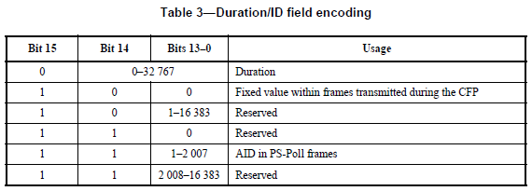
Impact of the modification
Use as an AID is already specified. – not new
TXOP Duration in HE-SIG-A field can be used instead to set a NAV. – no harm
The AIDs are also used in HE-SIG-B field when responding with non-multi-STA BAs in a DL-MU PPDU. – useful also for DL-MU BAs
[5]

Slide 8
Summary
To ease converting MAC addresses to AIDs when forming a multi-STA BA at an HE AP, setting an AID to each of the Duration/ID fields in frames transmitted in a UL-MU PPDU was proposed .

Slide 9
References
[1] 802.11-15/0365r0 “UL MU Procedure”
[2] 802.11-15/0366r2 “Multi-STA Acknowledgment”
[3] 802.11-15/1077r0 “HE-SIGA content”
[4] 802.11-15/1354r1 “SIG-A Fields and Bitwidths”
[5] IEEE Std. 802.11-2012

Slide 10
Straw Poll 1
Do you agree to add the following to the SFD?
In frames transmitted in a UL-MU PPDU, each of the Duration/ID field carries the AID of the station that transmitted the frame.
Y:N:A =

