Slide 1
Continuous Puncturing for HESIGB Encoding
Date: 2016-01-16
Authors:
Name | Affiliation | Address | Phone | Email
Yakun Sun | Marvell | 5488 Marvell Lane, Santa Clara, CA, 95054 | 408-222-2500 | yakunsun@marvell.com
Hongyuan Zhang |  |  |  | hongyuan@marvell.com
Lei Wang |  |  |  | Leileiw@marvell.com
Liwen Chu |  |  |  | liwenchu@marvell.com
Jinjing Jiang |  |  |  | jinjing@marvell.com
Yan Zhang |  |  |  | yzhang@marvell.com
Rui Cao |  |  |  | ruicao@marvell.com
Sudhir Srinivasa |  |  |  | sudhirs@marvell.com
Bo Yu |  |  |  | boyu@marvell.com
Saga Tamhane |  |  |  | sagar@marvell.com
Mao Yu |  |  |  | my@marvel..com
Xiayu Zheng |  |  |  | xzheng@marvell.com
Christian Berger |  |  |  | crberger@marvell.com
Niranjan Grandhe |  |  |  | ngrandhe@marvell.com
Hui-Ling Lou |  |  |  | hlou@marvell.com

Slide 2
Authors (continued)
Name | Affiliation | Address | Phone | Email
Ron Porat | Broadcom |  |  | rporat@broadcom.com
Sriram Venkateswaran |  |  |  | mfischer@broadcom.com
Matthew Fischer
Zhou Lan
Leo Montreuil
Andrew Blanksby
Vinko Erceg
Robert Stacey | Intel | 2111 NE 25th Ave, Hillsboro OR 97124, USA | +1-503-724-893 | robert.stacey@intel.com
Shahrnaz Azizi |  |  |  | shahrnaz.azizi@intel.com
Po-Kai Huang |  |  |  | po-kai.huang@intel.com
Qinghua Li |  |  |  | quinghua.li@intel.com
Xiaogang Chen |  |  |  | xiaogang.c.chen@intel.com
Chitto Ghosh |  |  |  | chittabrata.ghosh@intel.com
Laurent Cariou |  |  |  | laurent.cariou@intel.com
Yaron Alpert |  |  |  | yaron.alpert@intel.com
Assaf Gurevitz |  |  |  | assaf.gurevitz@intel.com
Ilan Sutskover |  |  |  | ilan.sutskover@intel.com

Slide 3
Authors (continued)
Name | Affiliation | Address | Phone | Email
Alice Chen | Qualcomm | 5775 Morehouse Dr. San Diego, CA, USA |  | alicel@qti.qualcomm.com
Albert Van Zelst |  | Straatweg 66-S Breukelen, 3621 BR Netherlands |  | allert@qti.qualcomm.com
Alfred Asterjadhi |  | 5775 Morehouse Dr. San Diego, CA, USA |  | aasterja@qti.qualcomm.com
Arjun Bharadwaj |  | 5775 Morehouse Dr. San Diego, CA, USA |  | arjunb@qti.qualcomm.com
Bin Tian |  | 5775 Morehouse Dr. San Diego, CA, USA |  | btian@qti.qualcomm.com
Carlos Aldana |  | 1700 Technology Drive San Jose, CA 95110, USA |  | caldana@qca.qualcomm.com
George Cherian |  | 5775 Morehouse Dr. San Diego, CA, USA |  | gcherian@qti.qualcomm.com
Gwendolyn Barriac |  | 5775 Morehouse Dr. San Diego, CA, USA |  | gbarriac@qti.qualcomm.com
Hemanth Sampath |  | 5775 Morehouse Dr. San Diego, CA, USA |  | hsampath@qti.qualcomm.com
Lin Yang |  | 5775 Morehouse Dr. San Diego, CA, USA |  | linyang@qti.qualcomm.com
Menzo Wentink |  | Straatweg 66-S Breukelen, 3621 BR Netherlands |  | mwentink@qti.qualcomm.com
Naveen Kakani |  | 2100 Lakeside Boulevard Suite 475, Richardson TX 75082, USA |  | nkakani@qti.qualcomm.com
Raja Banerjea |  | 1060 Rincon Circle San Jose CA 95131, USA |  | rajab@qit.qualcomm.com
Richard Van Nee |  | Straatweg 66-S Breukelen, 3621 BR Netherlands |  | rvannee@qti.qualcomm.com

Slide 4
Authors (continued)
Name | Affiliation | Address | Phone | Email
Rolf De Vegt | Qualcomm | 1700 Technology Drive San Jose, CA 95110, USA |  | rolfv@qca.qualcomm.com
Sameer Vermani |  | 5775 Morehouse Dr. San Diego, CA, USA |  | svverman@qti.qualcomm.com
Simone Merlin |  | 5775 Morehouse Dr. San Diego, CA, USA |  | smerlin@qti.qualcomm.com
Tao Tian |  | 5775 Morehouse Dr. San Diego, CA, USA |  | ttian@qti.qualcomm.com
Tevfik Yucek |  | 1700 Technology Drive San Jose, CA 95110, USA |  | tyucek@qca.qualcomm.com
VK Jones |  | 1700 Technology Drive San Jose, CA 95110, USA |  | vkjones@qca.qualcomm.com
Youhan Kim |  | 1700 Technology Drive San Jose, CA 95110, USA |  | youhank@qca.qualcomm.com

Slide 5
Authors (continued)
Name | Affiliation | Address | Phone | Email
Jianhan Liu | Mediatek USA | 2860 Junction Ave, San Jose, CA 95134, USA | +1-408-526-1899 | jianhan.Liu@mediatek.com
Thomas Pare |  |  |  | thomas.pare@mediatek.com
ChaoChun Wang |  |  |  | chaochun.wang@mediatek.com
James Wang |  |  |  | james.wang@mediatek.com
Tianyu Wu |  |  |  | tianyu.wu@mediatek.com
Russell Huang |  |  |  | russell.huang@mediatek.com
James Yee | Mediatek | No. 1 Dusing 1st Road, Hsinchu, Taiwan | +886-3-567-0766 | james.yee@mediatek.com
Alan Jauh |  |  |  | alan.jauh@mediatek.com
Frank Hsu |  |  |  | frank.hsu@mediatek.com
Joonsuk Kim | Apple |  |  | joonsuk@apple.com
Aon Mujtaba |  |  |  | mujtaba@apple.com
Guoqing Li |  |  |  | guoqing_li@apple.com
Eric Wong |  |  |  | ericwong@apple.com
Chris Hartman |  |  |  | chartman@apple.com

Slide 6
Authors (continued)
Name | Affiliation | Address | Phone | Email
Peter Loc | Huawei |  |  | peterloc@iwirelesstech.com
Le Liu |  | F1-17, Huawei Base, Bantian, Shenzhen | +86-18601656691 | liule@huawei.com
Jun Luo |  | 5B-N8, No.2222 Xinjinqiao Road, Pudong, Shanghai |  | jun.l@huawei.com
Yi Luo |  | F1-17, Huawei Base, Bantian, Shenzhen | +86-18665891036 | Roy.luoyi@huawei.com
Yingpei Lin |  | 5B-N8, No.2222 Xinjinqiao Road, Pudong, Shanghai |  | linyingpei@huawei.com
Jiyong Pang |  | 5B-N8, No.2222 Xinjinqiao Road, Pudong, Shanghai |  | pangjiyong@huawei.com
Zhigang Rong |  | 10180 Telesis Court, Suite 365, San Diego, CA 92121 NA |  | zhigang.rong@huawei.com
Rob Sun |  | 303 Terry Fox, Suite 400 Kanata, Ottawa, Canada |  | Rob.Sun@huawei.com
David X. Yang |  | F1-17, Huawei Base, Bantian, Shenzhen |  | david.yangxun@huawei.com
Yunsong Yang |  | 10180 Telesis Court, Suite 365, San Diego, CA 92121 NA |  | yangyunsong@huawei.com
Junghoon Suh |  | 303 Terry Fox, Suite 400 Kanata, Ottawa, Canada |  | Junghoon.Suh@huawei.com
Jiayin Zhang |  | 5B-N8, No.2222 Xinjinqiao Road, Pudong, Shanghai | +86-18601656691 | zhangjiayin@huawei.com
Edward Au |  | 303 Terry Fox, Suite 400 Kanata, Ottawa, Canada |  | edward.ks.au@huawei.com
Teyan Chen |  | F1-17, Huawei Base, Bantian, Shenzhen |  | chenteyan@huawei.com
Yunbo Li |  | F1-17, Huawei Base, Bantian, Shenzhen |  | liyunbo@huawei.com

Slide 7
Authors (continued)
Name | Affiliation | Address | Phone | Email
Jinmin Kim | LG Electronics | 19, Yangjae-daero 11gil, Seocho-gu, Seoul 137-130, Korea |  | Jinmin1230.kim@lge.com
Kiseon Ryu |  |  |  | kiseon.ryu@lge.com
Jinyoung Chun |  |  |  | jiny.chun@lge.com
Jinsoo Choi |  |  |  | js.choi@lge.com
Jeongki Kim |  |  |  | jeongki.kim@lge.com
Dongguk Lim |  |  |  | dongguk.lim@lge.com
Suhwook Kim |  |  |  | suhwook.kim@lge.com
Eunsung Park |  |  |  | esung.park@lge.com
JayH Park |  |  |  | Hyunh.park@lge.com
HanGyu Cho |  |  |  | hg.cho@lge.com
Thomas Derham | Orange |  |  | thomas.derham@orange.com
Bo Sun | ZTE | #9 Wuxingduan, Xifeng Rd., Xi'an, China |  | sun.bo1@zte.com.cn
Kaiying Lv |  |  |  | lv.kaiying@zte.com.cn
Yonggang Fang |  |  |  | yfang@ztetx.com
Ke Yao |  |  |  | yao.ke5@zte.com.cn
Weimin Xing |  |  |  | xing.weimin@zte.com.cn
Brian Hart | Cisco Systems | 170 W Tasman Dr, San Jose, CA 95134 |  | brianh@cisco.com
Pooya Monajemi |  |  |  | pmonajem@cisco.com

Slide 8
Authors (continued)
Name | Affiliation | Address | Phone | Email
Fei Tong | Samsung | Innovation Park, Cambridge CB4 0DS (U.K.) | +44 1223 434633 | f.tong@samsung.com
Hyunjeong Kang |  | Maetan 3-dong; Yongtong-Gu Suwon; South Korea | +82-31-279-9028 | hyunjeong.kang@samsung.com
Kaushik Josiam |  | 1301, E. Lookout Dr, Richardson TX 75070 | (972) 761 7437 | k.josiam@samsung.com
Mark Rison |  | Innovation Park, Cambridge CB4 0DS (U.K.) | +44 1223 434600 | m.rison@samsung.com
Rakesh Taori |  | 1301, E. Lookout Dr, Richardson TX 75070 | (972) 761 7470 | rakesh.taori@samsung.com
Sanghyun Chang |  | Maetan 3-dong; Yongtong-Gu Suwon; South Korea | +82-10-8864-1751 | s29.chang@samsung.com
Yasushi Takatori | NTT | 1-1 Hikari-no-oka, Yokosuka, Kanagawa 239-0847 Japan | +81 46 859 3135 | takatori.yasushi@lab.ntt.co.jp
Yasuhiko Inoue |  |  | +81 46 859 5097 | inoue.yasuhiko@lab.ntt.co.jp
Shoko Shinohara |  |  | +81 46 859 5107 | Shinohara.shoko@lab.ntt.co.jp
Yusuke Asai |  |  | +81 46 859 3494 | asai.yusuke@lab.ntt.co.jp
Koichi Ishihara |  |  | +81 46 859 4233 | ishihara.koichi@lab.ntt.co.jp
Junichi Iwatani |  |  | +81 46 859 4222 | Iwatani.junichi@lab.ntt.co.jp
Akira Yamada | NTT DOCOMO | 3-6, Hikarinooka, Yokosuka-shi, Kanagawa, 239-8536, Japan | +81 46 840 3759 | yamadaakira@nttdocomo.com

Slide 9
Authors (continued)
Name | Affiliation | Address | Phone | Email
Masahito Mori | Sony Corp. |  |  | Masahito.Mori@jp.sony.com
Yusuke Tanaka |  |  |  | YusukeC.Tanaka@jp.sony.com
Yuichi Morioka |  |  |  | Yuichi.Morioka@jp.sony.com
Kazuyuki Sakoda |  |  |  | Kazuyuki.Sakoda@am.sony.com
William Carney |  |  |  | William.Carney@am.sony.com

Slide 10
Overview
Fact 1 about HE-SIGB:
  Consists of a common field, and multiple user-specific fields
  The length of common field can be varying per BW
  The length of the last user specific field may be different with the rest.
  Each field ends with 6 zero tail bits.
Fact 2 about HE-SIGB:
  HE-SIGB (in each 20MHz) is encoded using BCC with common and user blocks separated in the bit domain.
  Multiple MCS (MCS0~5) can be used for HE-SIGB, so the coding rate may be less than ½ by puncturing.
Question: how to puncture in HESIGB?

Slide 11
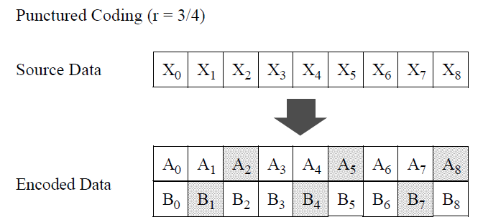
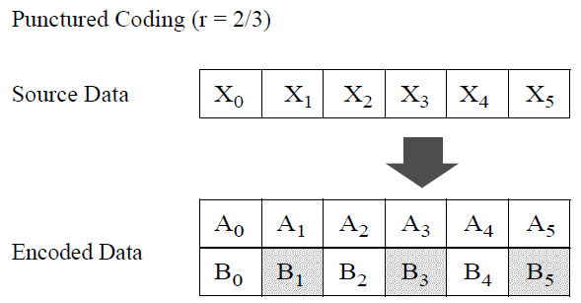
Puncturing for BCC
The two output bit streams of rate-1/2 BCC encoder are split into multiple “puncture patterns” and some bits are “stolen” to meet the coding rate.
Each field (both common and user-specific) is not an integer number of “puncturing patterns”.
How to puncture?

Slide 12
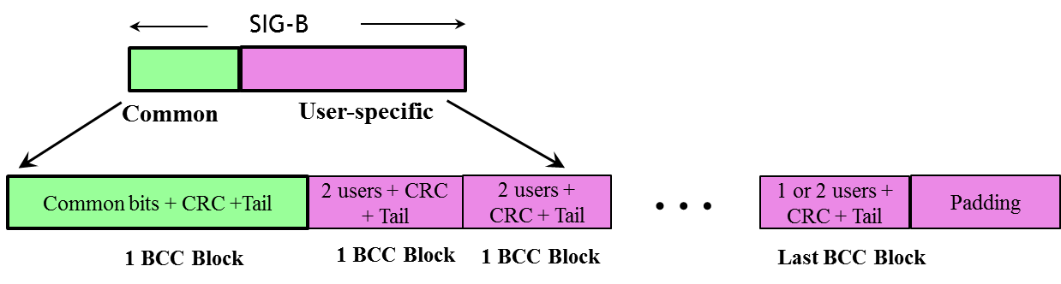
Puncturing for HESIGB Encoding
What if padding for each field to integer number of puncturing patterns?
  Not efficient → may end up more HESIGB symbols
  Complicates both transmission and reception.
  Not allowed by the current SFD: “The last user information is immediately followed by tail bits (regardless of whether the number of users is odd or even) and padding bits are only added after those tail bits”
What if define each HESIGB field to be an integer numbers of puncturing patterns?
  Again, not efficient → HESIGB is already long, and great efforts have been made to make it concise.
  It needs to support both rate 2/3 and ¾ → the length of field must to be a multiple of 18bit → very inflexible and insufficient.
Continuous puncturing of all fields
  Very efficient and simple (see following slides)

Slide 13
Continuous BCC Puncturing/Encoding
To simplify SIGB content design by supporting arbitrary length of each group, SIGB bits are continuously encoded.
Namely, the sequence of SIGB bits (after adding tail bits for each field) is passed through one Rate-1/2 BCC encoder continuously.
  6 tail bits in the end of each field reset the convolutional encoder, so it is equivalent to encode each field with individual Rate-1/2 encoder.
  This does not conflict with the passed motion.
Puncturing is done across the overall rate-1/2 BCC encoder output continuously.
  Puncturing for arbitrary SIGB length can work with one portion of padding bits.

Slide 14
Illustration of Continuous Encoding
Common Block
Tail
2 User Specific Blocks
Tail
Padding
Rate ½ BCC
Encoder
Convolution Encoder 1 Output: A_{i}
Convolution Encoder 2 Output: B_{i}
Split A_{i} and B_{i} into puncture patterns
Integer puncture patterns
Puncturing
After stealing bits
Puncturer output

Slide 15
Conclusions
Continuously puncturing the rate-1/2 encoded bits of each field is proposed
Very efficient, flexible, and simple solution to support arbitrary length of HE-SIGB fields
Effectively the HESIGB bits can be passed through a continuous BCC encoder.

Slide 16
SP
Do you support to add the following to the current SFD:
  SIGB bits for each SIGB content channel are continuously encoded with 1 BCC encoder?

