Slide 1
Follow Up for Multi-STA BA for SU Transmissions
Date: 2016-01-18
Authors:

Slide 2
Abstract
Using Multi-STA BA to acknowledge UL SU transmissions can lead to significant gain in efficiency [3]. In this contribution, we explore two UL SU transmission scenarios for their suitability of using Multi-STA BA.

Slide 3
Table of Contents
Introduction
Review of Efficiency Gain for Multi-STA BA for SU Transmissions
PSMP
Scheduled Multi-STA BA
Conclusions

Slide 4
Introduction
A HE STA may send SU transmissions, particularly, in the uplink direction
  HE STAs may not be capable of UL MU transmissions, e.g., a HE STA may be capable of receiving DL MU frames, but not capable of transmitting UL MU frames
Multi-STA BA is shown to provide higher MAC efficiency for SU transmissions than legacy ACK/BA[3]
  Multi-STA BA is already accepted into the 802.11ax SFD for acknowledgement of UL MU transmissions [1]
Questions remain how Multi-STA BA can be used
In this contribution, we explore two UL SU scenarios in which Multi-STA BA may be used

Slide 5
Review of MAC Efficiency Analysis Results for Multi-STA BA
Significant gain in MAC efficiency is shown when Multi-STA BA is used for UL SU transmissions [3]
  MAC efficiency gain of up to 76% for 8 users compared to legacy HT-Delayed BA, and MAC efficiency gain of up to 39% for 8 users when compared to legacy HT-Immediate BA when MSDU size = 500 bytes
Questions remain how Multi-STA BA can be used to acknowledge multiple UL SU transmissions

Slide 6
Multi-STA BA for SU Transmissions
Multi-STA BA may be used to acknowledge the SU transmissions from a number of STAs
In order to enable a correct acknowledgement procedure using Multi-STA BA for SU Transmissions
  STAs that transmitted UL SU frames need to know when to listen to the Multi-STA BA
  STAs need to know when to retransmit their packets when their SU frames are not acknowledged
Multi-STA BAs need to be sent at a scheduled time or within a scheduled interval. Two scenarios may satisfy such a requirement
  PSMP
  Scheduled Multi-STA BA

Slide 7
PSMP
Currently, individual PSMP DL Transmission slots (PSMP-DTT) are needed for transmit ACK/BA for each UL SU packet transmitted in PSMP-UTTs
Using Multi-STA BA can significantly reduce medium occupation time

Slide 8
PSMP using Multi-STA BA
In the above example, using Multi-STA BA allows the AP to acknowledge four UL SU transmissions using one PSMP-DTT.
MAC efficiency gain may be calculated using analysis

Slide 9
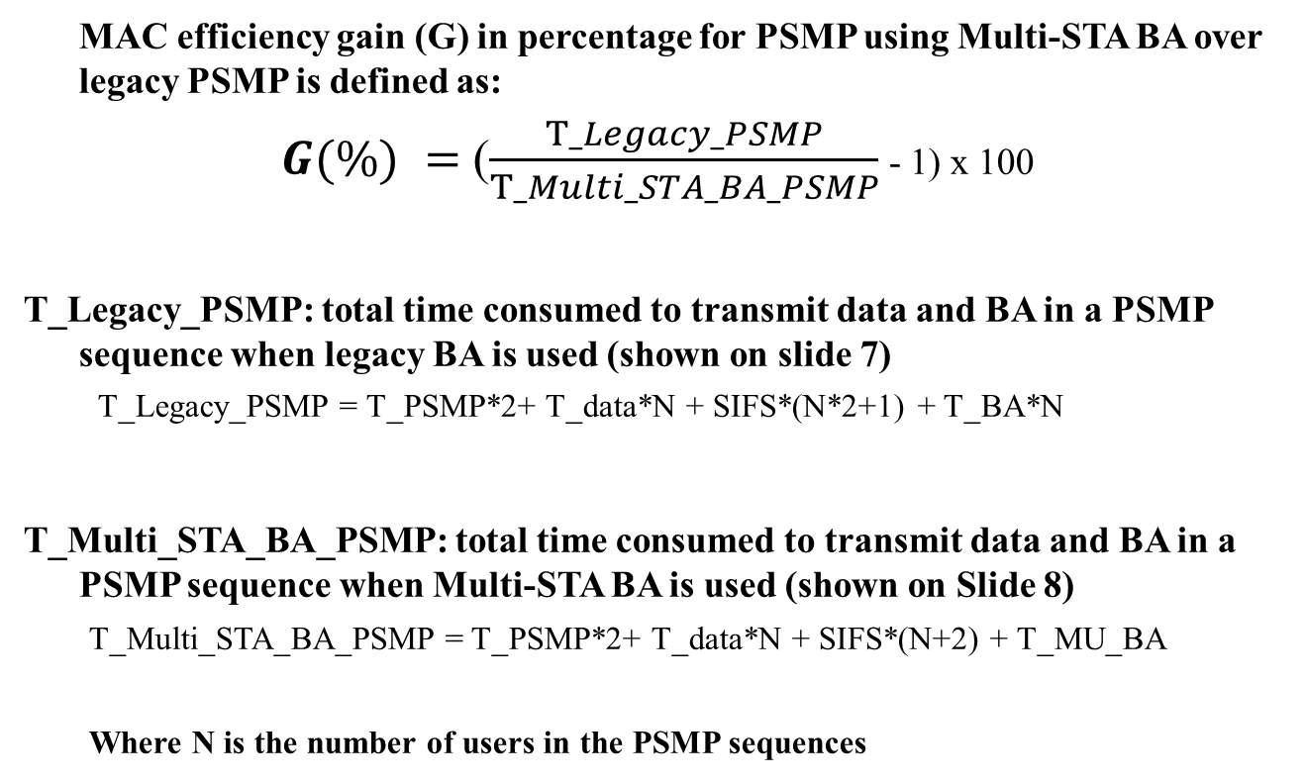
MAC Efficiency for PSMP with Multi-STA BA
MAC efficiency gain (G) in percentage for PSMP using Multi-STA BA over legacy PSMP is defined as:
$G(\%) =$ ($\frac{T_Legacy_PSMP}{T_Multi_STA_BA_PSMP}$ - 1) x 100
T_Legacy_PSMP: total time consumed to transmit data and BA in a PSMP sequence when legacy BA is used (shown on slide 7)
  T_Legacy_PSMP = T_PSMP*2+ T_data*N + SIFS*(N*2+1) + T_BA*N
T_Multi_STA_BA_PSMP: total time consumed to transmit data and BA in a PSMP sequence when Multi-STA BA is used (shown on Slide 8)
    T_Multi_STA_BA_PSMP = T_PSMP*2+ T_data*N + SIFS*(N+2) + T_MU_BA
    Where N is the number of users in the PSMP sequences

Slide 10
MAC Efficiency Analysis Assumptions
Assumptions for UL SU Data transmissions:
  All the users have the same data packet size and the same amount of data
  All UL SU data transmissions are A-MPDUs
  All the users use the same MCS
  Control frames, i.e., BA, Multi-STA BA use MCS0
Assumptions for DL BA transmissions:
  Scenario 1: Legacy PSMP with BA (Slide 7)
  Scenario 2: PSMP using Multi-STA BA (Slide 8)
Description | Value
Preamble duration | 52 µs
Block ACK duration | 96 µs
N (# of users in PSMP) | 4
OFDM symbol duration (incl. CP) | 16 µs
# of data sub carriers | 234
Multi_STA BA duration (4 users) | 128 µs

Slide 11
MAC Efficiency for PSMP with Multi-STA BA
Observations:
MAC efficiency gain of up to 39% for 4 users when Multi-STA BA is used in a PSMP sequence compared to legacy PSMP
MAC efficiency gain (G) increases when the size of the A-MPDUs transmitted by STAs in a PSMP sequence decreases

Slide 12
Scheduled Multi-STA BA
If Multi-STA BA are transmitted at scheduled time or within scheduled intervals, it may provide sufficient information for STAs for the correct functioning of the acknowledgement procedure
Multi-STA BA may be scheduled by leveraging the following designs already accepted into 802.11ax SFD
  TWT scheduling
  ACK scheduling information in MAC header
    E.g., similar to design in SFD: Scheduling information for UL MU Acknowledgement from STA may be contained within the HE variant of the HT Control Field. [1]
MAC efficiency gain for scheduled Multi-STA BA is expected to be similar to those shown on Slide 5, 24 and 25

Slide 13
Conclusion
Using Multi-STA BA to acknowledge UL SU transmissions can significantly improve MAC efficiency
Multi-STA BA may be used in PSMP sequences and scheduled Multi-STA BA scenarios

Slide 14
References
11-15/0132r13, Specification Framework for Tgax
11-15/0366r2, Multi-STA Acknowledgement
11-15/0567r1, Multi-STA BA for SU Transmissions

Slide 15
Straw Poll 1
Do you agree that:
x.y.z The spec should allow the use of Multi-STA BA frame to acknowledge UL SU transmissions in PSMP sequences

Slide 16
Straw Poll 2
Do you agree that:
x.y.z The spec should allow the use of Multi-STA BA frame to acknowledge UL SU transmissions

Slide 17
Appendix

Slide 18
Legacy Immediate SU BA/ACKs
Legacy ACK:
  ACK sent SIFS after each packet
HT-Immediate BA
  BA sent SIFS after A-MPDU
STA1
Data
STA2
Data
ACK
ACK
STA1
A-MPDU
STA2
A-MPDU
BA
BA

Slide 19
Legacy Delayed SU BA
HT-Delayed BA:
  BAR included in A-MPDU
  BA sent with unspecified delay
ACK/BA to individual STAs still represent significant overhead
May be optimized for higher MAC efficiency
STA1
A-MPDU
ACK
STA2
A-MPDU
ACK
BAR
BAR
BA
BA

Slide 20
Multi-STA BA for SU Transmissions
Multi-STA BA has been introduced to acknowledge UL MU transmissions [2]
The same multi-STA BA may be used to acknowledge UL SU transmissions to provide higher MAC efficiency
When compared to Legacy Delayed SU BA, multi-STA BA is more efficient due to
  Less inter frame spaces
  Less medium access contention
  More compact frame design
STA1
A-MPDU
STA2
A-MPDU
STA3
A-MPDU
STA4
A-MPDU
Multi-STA
ACK/BA

Slide 21
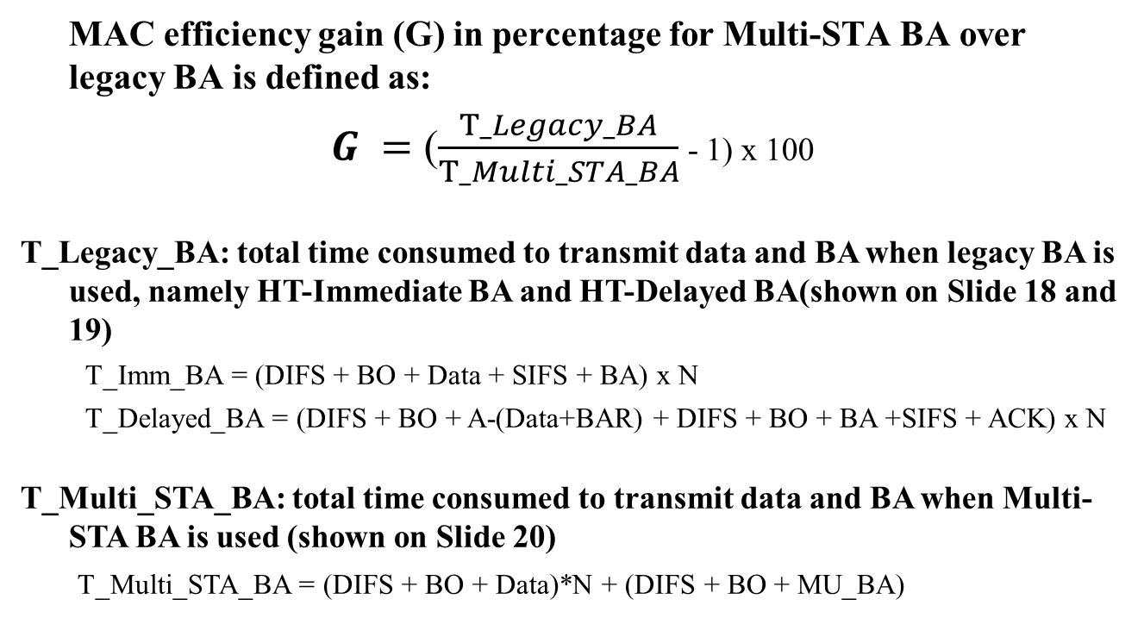
MAC Efficiency for Multi-STA BA
MAC efficiency gain (G) in percentage for Multi-STA BA over legacy BA is defined as:
$G =$ ($\frac{T_Legacy_BA}{T_Multi_STA_BA}$ - 1) x 100
T_Legacy_BA: total time consumed to transmit data and BA when legacy BA is used, namely HT-Immediate BA and HT-Delayed BA(shown on Slide 18 and 19)
  T_Imm_BA = (DIFS + BO + Data + SIFS + BA) x N
  T_Delayed_BA = (DIFS + BO + A-(Data+BAR) + DIFS + BO + BA +SIFS + ACK) x N
T_Multi_STA_BA: total time consumed to transmit data and BA when Multi-STA BA is used (shown on Slide 20)
    T_Multi_STA_BA = (DIFS + BO + Data)*N + (DIFS + BO + MU_BA)

Slide 22
MAC Efficiency Analysis Assumptions
Assumptions for UL SU Data transmissions:
  All the users have the same data packet size and the same amount of data
  All UL SU data transmissions are A-MPDUs
  All the users use the same MCS
  Control frames, i.e., BA, ACK, Multi-STA BA use MCS0
Assumptions for DL BA transmissions:
  Scenario 1: HT-Immediate BA (Slide 18)
  Scenario 2: HT-Delayed BA (Slide 19)
  Scenario 3: Multi-STA BA (Slide 20)

Slide 23
MAC Efficiency Analysis Assumptions
Description | Value
Contention duration | 27 µs (3 time slots)
Preamble duration | 48 µs
Block ACK duration | 96 µs
# of users | 2, 4 , 6 , 8
OFDM symbol duration (including CP) | 16 µs
# of data sub carriers | 234
Multi_STA BA duration (2/4/6/8 users) | 112/128/160/192 µs
Preamble duration 48us [1]
L-STF | L-LTF | L-SIG | HE-SIG-A | HE-LTF
8µs | 8µs | 4µs | 12µs | 16µs

Slide 24
MAC efficiency gain (G) for Multi-STA BA over legacy BA
Observations:
MAC efficiency gain (G) increases when a Multi-STA BA is used to acknowledge higher number of SU transmissions
MAC efficiency gain of up to 76% for 8 users compared to legacy HT-Delayed BA, and MAC efficiency gain of up to 39% for 8 users when compared to legacy HT-Immediate BA

Slide 25
MAC efficiency gain (G) for Multi-STA BA over legacy BA
Observations:
MAC efficiency gain (G) for Multi-STA BA decreases when the packet size increases
When Multi-STA BA is used to acknowledge 4 UL SU transmissions, a MAC efficient gain of up to 91% can be achieved when compared to HT-Delayed BA, and a MAC efficiency gain of up to 38% can be achieved when compared to using HT-Immediate BA

