Slide 1
At home, IoT Use Case(s) for LRLP
Date: 2016-01-18
Authors:

Slide 2
Contents of this Contribution
Several LRLP use cases for an Indoor environment was address in [1,2,3,4]
In this presentation we going to present the “At-home, IoT” use case(s) including:
Accumulated/ additional to pervious Indoor LRLP use case(s)
Full 802.11 (coexistence with legacy)
Intel

Slide 3
At home, IoT use case(s) Pre-Conditions
Low cost
IoT endpoint device costs (similar to ZigBee, BT, etc.)
System costs (infrastructure, installation, maintenance, etc.)
May connect all IoT to minimal (possibly single) aggregation point (AP/IOT-Hub)
Support various IoT device types device
Powered, chargeable, long battery life
Common protocol for all IoT device
Always available, scheduled, triggered
Coexistence/ Cooperation
May Cooperate with Legacy WLAN networks
Other IoT technologies
Reliable/ trusted
Low mobility
Intel

Slide 4
At home, IoT use case(s)-Description
Combination of the following use case(s)/ functionalities
IoT Smart lighting and HVAC/climate control:
Remotely control the temperature and lighting of rooms in apartment
IoT Smart-Access and Security:
Controlling the access (doors, locks) as well as monitoring any type of security sensor
Smart Home appliances connectivity:
User controls home appliances through the IoT-Hub
Activity detection:
Using the Smart Sensors to detect people/devices activity
Smart display and control:
User can control the system (locally and remotely) using mobile phone, IoT control panel, computer, etc.
Display to smart device while doing real-time streaming
Intel

Slide 5
At home, IoT use case(s) Use Case Details-How it can be done?
Using IoT motion sensors and smart device (phone/wearable)
Detect movement (people enter, stay or leave a room)
Detect the temperature and lights intensity
Activity sensing
Using IoT controllers to:
Operation control
Turn on and off lights
Open and close windows and shutters
etc.
Smart appliances Control
Collect stored information and status
Control air condition output temperature and operation
etc.
Alert user of smart device status change
Smart device “health” status
Smart appliance operational status (laundry machine, dish washer, …)
Intel

Slide 6
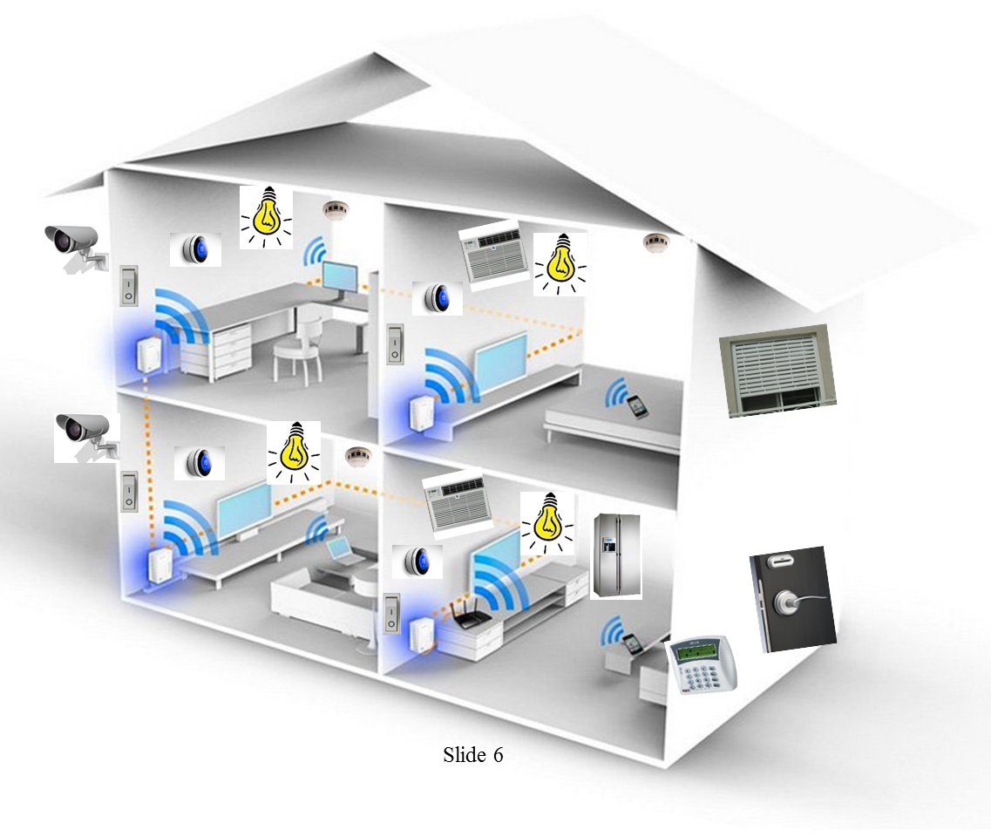
Full 802.11 At home, IoT use case(s)

Slide 7
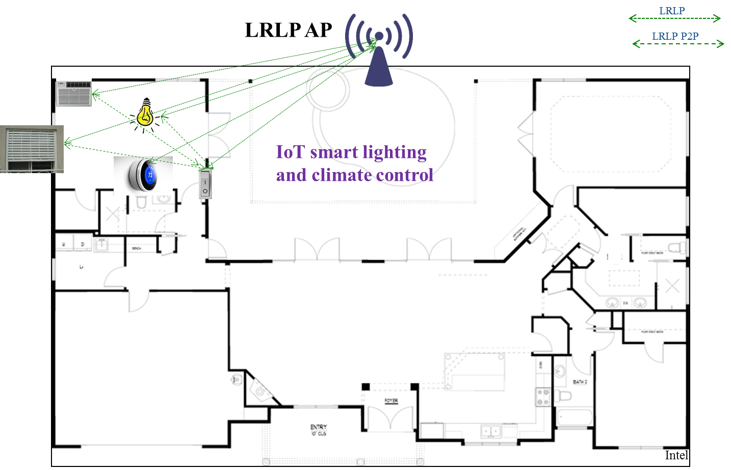
LRLP only At home, IoT use case(s)

Slide 8
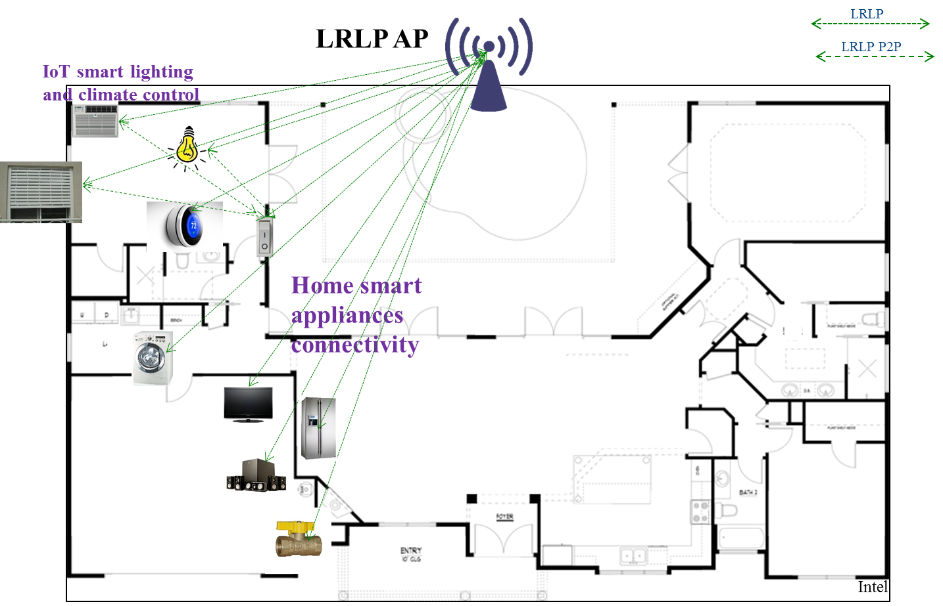
LRLP only At home, IoT use case(s)

Slide 9
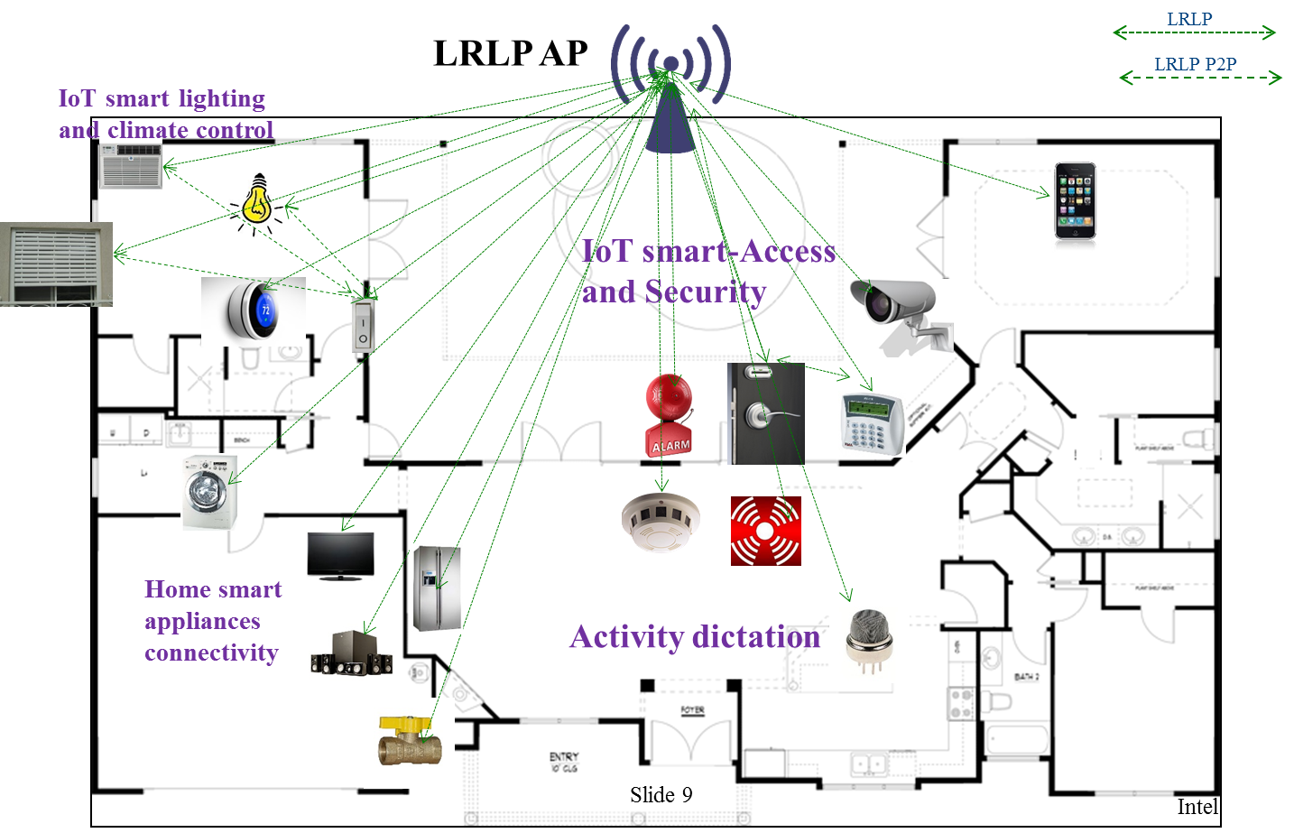
LRLP only At home, IoT use case(s)

Slide 10
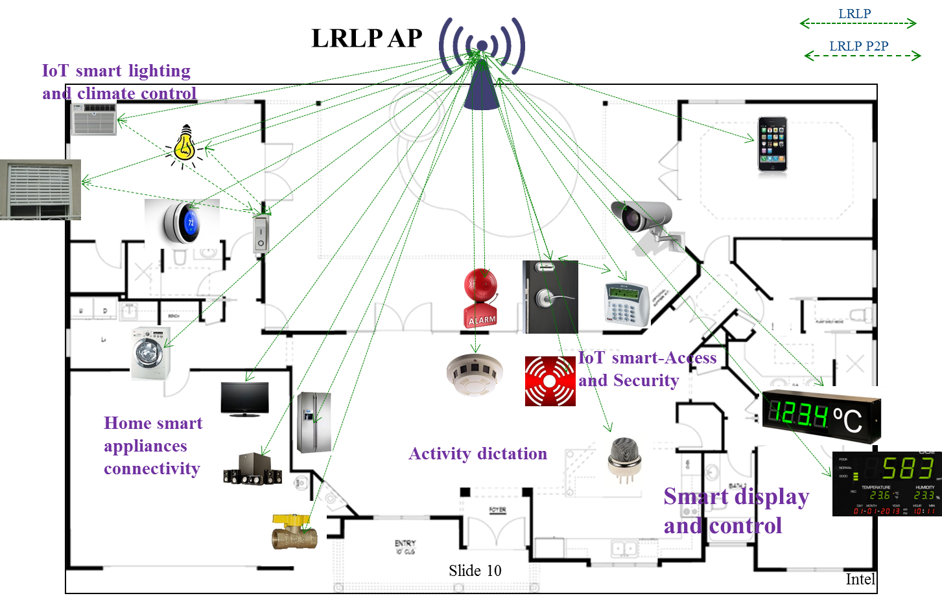
LRLP only At home, IoT use case(s)

Slide 11
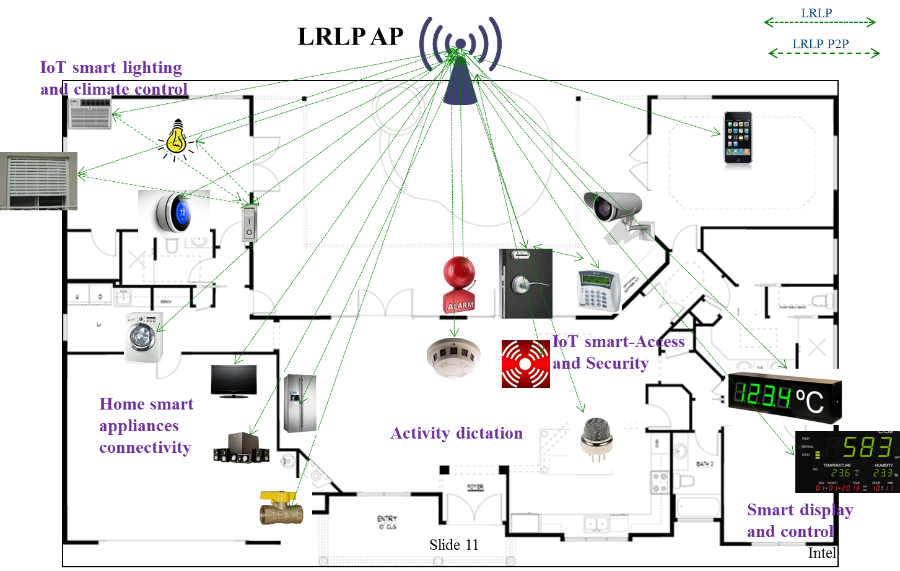
LRLP only At home, IoT use case(s)

Slide 12
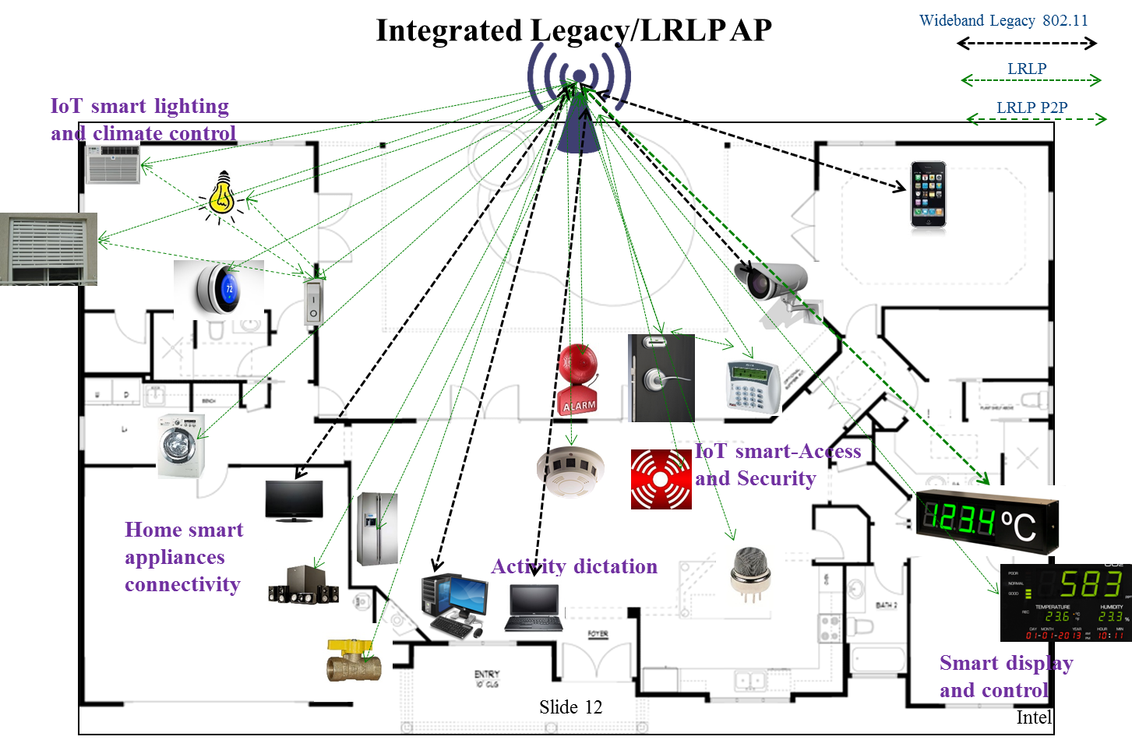
Full 802.11 At home, IoT use case(s)

Slide 13
At home, IoT use case(s) Traffic Conditions
Potential interference from overlapping LRLP, 802.11 and other networks (e.g. neighbors, other WLANs , other un- certified IoT).
IOT, WLAN networking and video steaming should be operational simultaneously in unlicensed bands
Similar coverage (reach) to legacy indoor 802.11 device (in particular same 11b low-power reach).
Intel

Slide 14
At home, IoT use case(s)- Environment*
Operating in multi-room indoor environment.
Typical distances between STAs and AP in the multi-room are < 50m.
i.e. support of a “indoor long range” indoor IoT device
LRLP metrics
MCS 0 -3
>= 2MHz up to 10MHz
-10dBm up to 23dBm TX power EIRP (low cost and quality LNAs and PAs), single antenna up to several antenna
Up to 50m(**) ~ 2-5 concrete walls penetration (with range reduction)
“non-battery-operated” / “Battery-operated” (device)
LRLP AP / P2P operation scenarios
Scenario I : Regular AP/ asymmetric power balance (UL/ DL)
i.e. UL range limits
Scenario II : PtP/ low cost AP /symmetric power balance (UL/ DL)
(*) Initial figures-for discussion
(**) For : Building Energy Management Systems (BEMS) [4]
Intel

Slide 15
Summary
We have presented At home, IoT use case(s) for LRLP operation with IoT devices
We have also proposed the metrics for At home use case(s)
Intel

Slide 16
Straw Poll # 1
Do you use the “At home, IoT” use case(s) as part of the reference use cases for LRLP ?
Yes
No
Abstain
Slide 16
Intel

Slide 17
References
[1] IEEE 802.11-15/1140r1, Long range low power Use Cases for Indoor
[2] IEEE 802.11-15/1383r0, LRLP TIG - Use Cases for Indoor & Outdoor
[3] IEEE 802.11-15/1365r0, LRLP TIG - Use Cases of LRLP Operation for IoT
[4] IEEE 802.11-15/1112r1 Use Case of LRLP Operation for IoT
Slide 17
Intel

