Slide 1
Explicit Block Ack Request in DL MU PPDU
Date: 2016-01-14
Authors:

Slide 2
Introduction
4.2 DL MU operation [1]
Ack Policy field set to 01 (Trigger based UL MU Ack) has the following normative behavior for an HE STA:
  The addressed recipient that receives the trigger information, within a DL MU PPDU returns an immediate Ack/BlockAck response, either individually or as part of an A-MPDU after the PPDU carrying the frame, according to the trigger information carried in the same DL MU PPDU
  The addressed recipient that does receive no valid trigger information takes no action upon the receipt of the frame, except for recording the state (if necessary)
This rule is for an Implicit Block Ack Request that solicits an Trigger based UL MU Ack

Slide 3
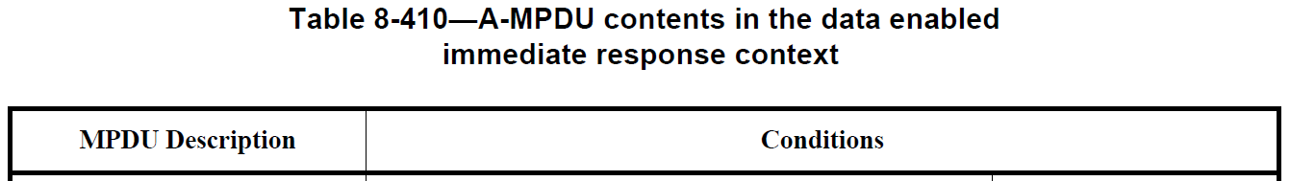
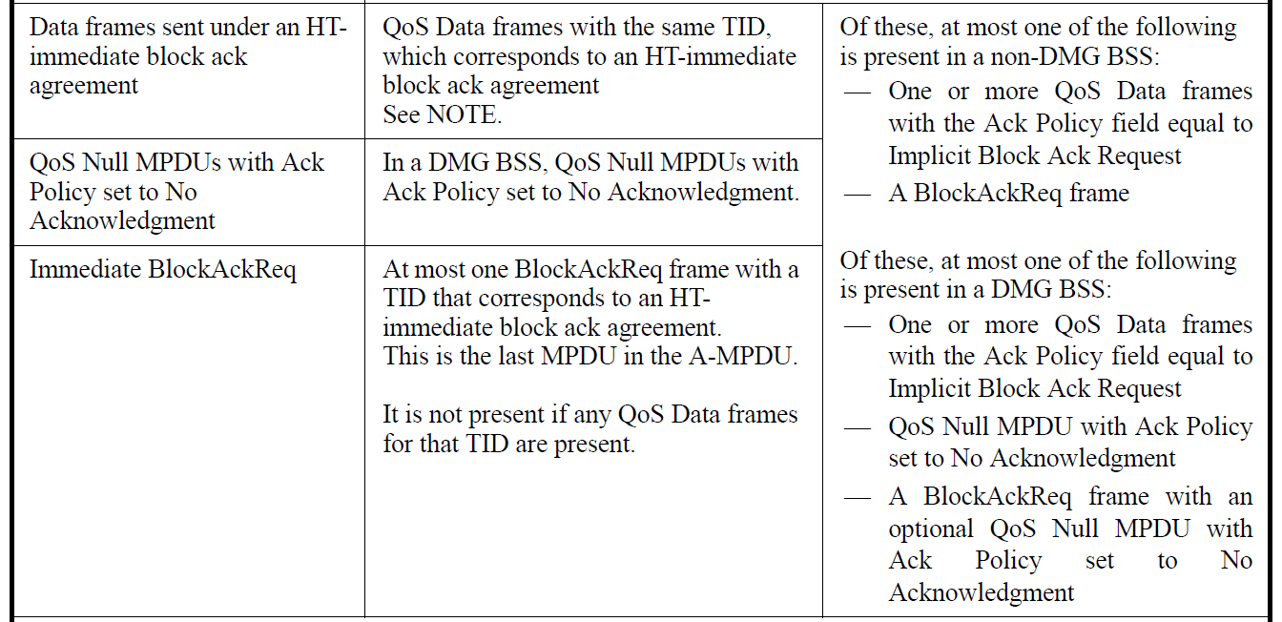
Introduction
Also, an Explicit Block Ack Request can be transmitted in DL MU PPDU

Slide 4
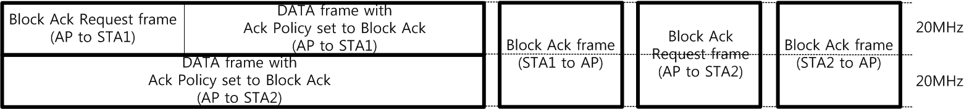
Explicit Block Ack Request in DL MU PPDU
SU Acknowledgment
  Block Ack Request frame elicits an immediate response (SU PPDU)
    When the Block AcK Request eliciting an immediate response carried in SU PPDU is transmitted, the Ack Policy field of DATA addressed to other recipients shall not be set to 00 (Normal Ack or Implicit Block Ack Request) and 01 (Trigger based UL MU Ack)

Slide 5
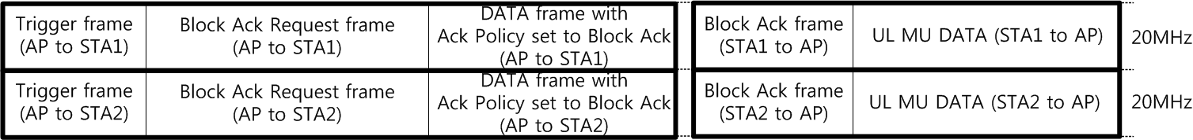
Explicit Block Ack Request in DL MU PPDU
MU Acknowledgment
  Trigger information elicits immediate responses (MU PPDU)
    Trigger information means both Trigger Control frame or Trigger Control field in MAC header

Slide 6
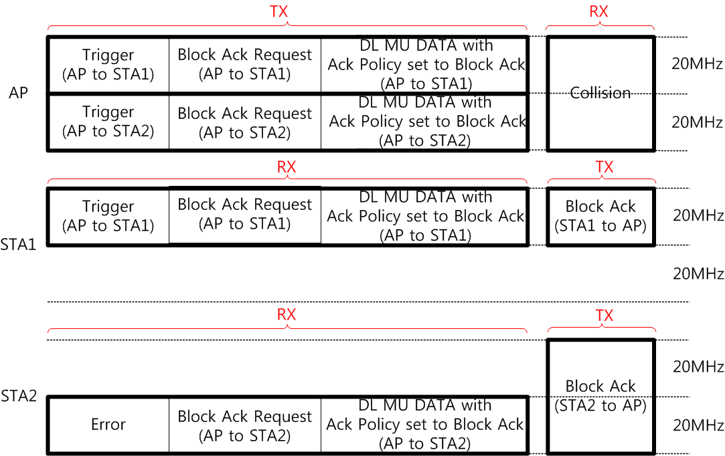
Explicit Block Ack Request in DL MU PPDU
MU Acknowledgment
  But, if an addressed recipient (e.g., STA2) does not receive a Trigger frame, it can respond with SU PPDU
Problem : Collision between immediate responses

Slide 7
HE MU Acknowledgment Proposal for Block Ack Request
First solution
  The PPDU Type (SU or MU) of an immediate response is indicated in the Block ACK Request frame (same approach with an Implicit Block Ack Request [2])
  And, the PPDU Type of an immediate response can be signaled by the BAR Ack Policy field
    BAR Ack Policy field in the Block Ack Request frame soliciting an immediate response carried in SU PPDU is set to 0
    BAR Ack Policy field in the Block Ack Request frame soliciting an immediate response carried in MU PPDU is set to 1

Slide 8
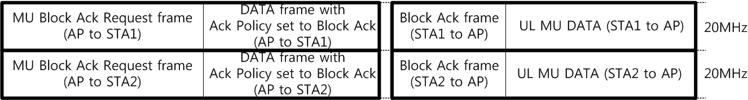
HE MU Acknowledgment Proposal for Block Ack Request
Second solution
  Block Ack Request frame for eliciting MU Acknowledgement always has the Trigger information
  MU Block Ack Request can be a best option for MU Acknowledgment
  But, one assumption is that a recipient of a MU-BAR frame can transmit other data or management frame (if UL MU transmission time is allowed) in addition to BA/ACK frame

Slide 9
Conclusion
In this presentation, HE MU Acknowledgment Procedures for an Explicit Block Ack Request have been proposed
When a response frame of MU-BAR frame is not limited to BA/ACK frame, the second solution is preferred
  It means that the Block Ack Request frame and the MU Block Ack Request frame are used for soliciting an immediate response carried in SU and MU PPDU, respectively.

Slide 10
References
[1] https://mentor.ieee.org/802.11/dcn/15/11-15-0132-13-00ax-spec-framework.docx
[2] https://mentor.ieee.org/802.11/dcn/15/11-15-1278-01-00ax-he-mu-acknowledgment-procedure.pptx

Slide 11
Straw Poll 1
Do you agree to add the TGax SFD:
  6.2.1 Trigger frame
  A recipient of a MU-BAR frame can transmit other data or management frame in addition to BA/ACK frame if it does not exceed the indicated UL MU duration.

Slide 12
Straw Poll 2
Do you agree to add the TGax SFD:
  4.2 DL MU operation
  The Block Ack Request frame and the MU-BAR frame are used for soliciting an immediate response carried in SU and MU PPDU, respectively.

Slide 13
Straw Poll 3
Do you agree to add the TGax SFD:
  4.2 DL MU operation
  PPDU Type (SU or MU) of an immediate response is indicated in the Block Ack Request frame

