Slide 1
Response to 16/0025r0
Date: 2016-01-20
Authors:

Slide 2
Abstract
Stepping through the hierarchy of documents, we will find that superior documents, except one line in LMSC, leave details to the WG
We can disconnect voting rights from attendance and ballot response. Both can exist but one does not have to depend on the other.

Slide 3
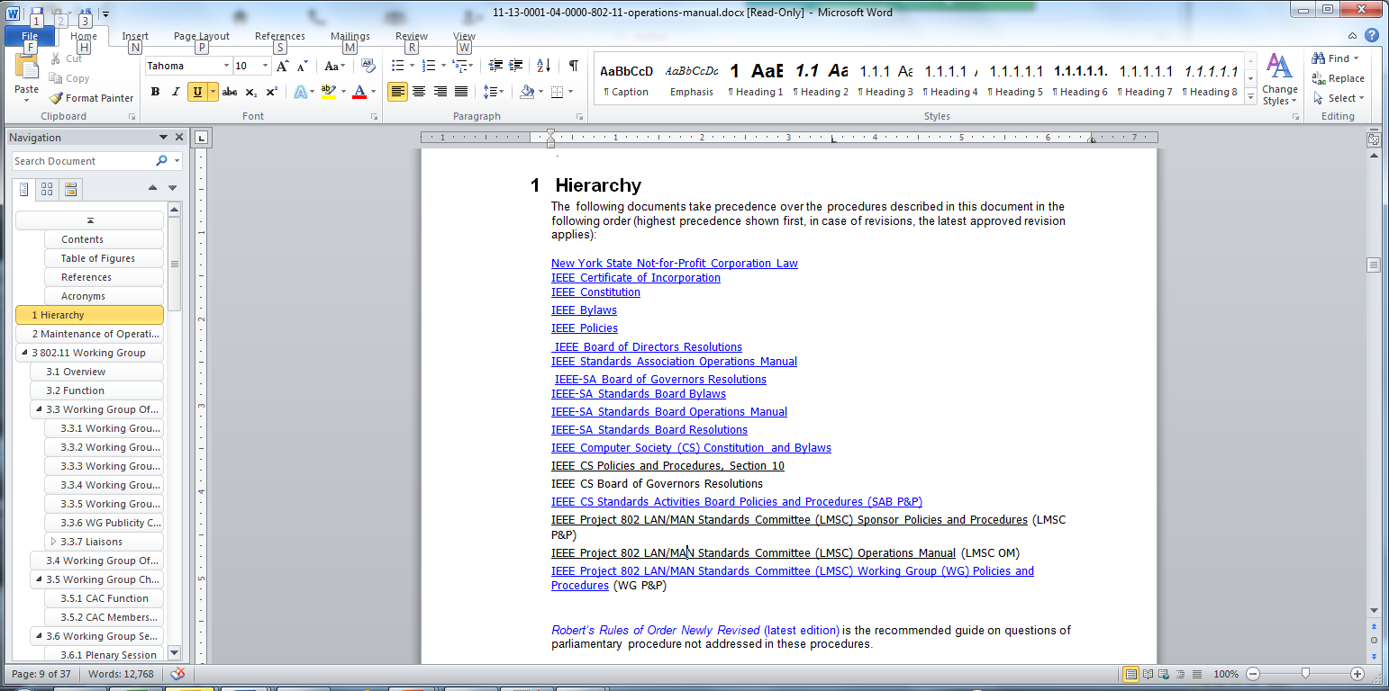
WG 802.11 Operations Manual 11-13/0001r4, clause 1
No mention of attendance
requirement for voting rights
SA AudCom Baseline Operating
Procedures for Individual
Working Groups has some
guidelines, see next page.

Slide 4
SA AudCom Baseline Operating Procedures for WG, clause 4.1.1
No requirement to wait for a third meeting. Note that SA uses the word “meeting” in the meaning of “session”
…membership shall be granted after the participant attends two consecutive meetings of an existing Working Group, and also requests membership status.
Attendance credit is granted to those who attend at least 50% of a meeting’s duration. Attendance at a meeting via teleconferencing and/or electronic means, e.g., Internet conferencing, shall count towards the attendance requirements.
If a Working Group member misses two consecutive meetings, or two consecutive Working Group letter ballots, his or her voting privilege may be revoked.
By meeting means the whole week. No requirement of being in a room for a certain amount of time
“May” means that the WG is allowed to introduce this rule if we let them. There is no requirement!

Slide 5
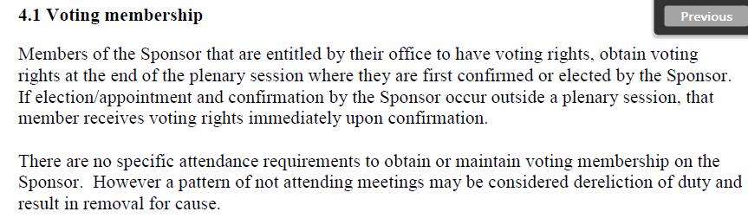
LMSC documents - I
No requirement

Slide 6
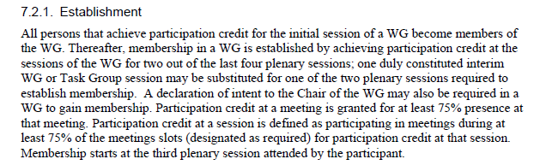
LMSC documents - II
Meeting or Session?
See SA Audcom Baseline OP
This document swap terms
as defined by SA. Terms as
used here are consistent with RROR.
Note that this is to gain and not
to maintain voting rights. Needs challenge!

Slide 7
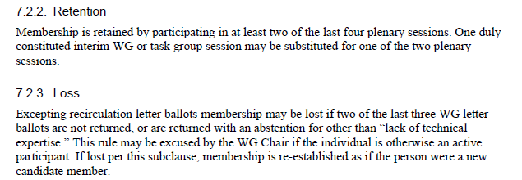
LMSC documents - III
No requirement beyond “participating”
“May lose” = optional for not returning ballots.
No provision for losing voting rights based on attendance!

Slide 8
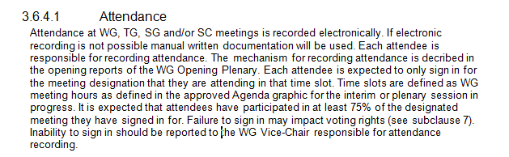
WG 802.11 Operations Manual 11-13/0001r4, clause 3.6.4.1
These rules are made up inside this WG, so we can modify them at will.

Slide 9
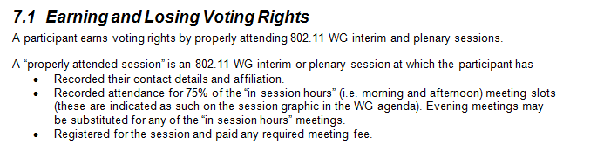
WG 802.11 Operations Manual 11-13/0001r4, clause 7.1
Naming confusion meeting/session aside, not even 802.11 WG states that you have to be inside a room 75% of the time. The second bullet, at the very least, needs to be removed.

Slide 10
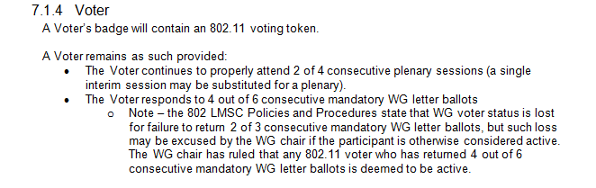
WG 802.11 Operations Manual 11-13/0001r4, clause 7.1.4
Again, no superior rules force us to do anything. It’s a “may”. This rule is also very counter-productive as it forces members with no knowledge or interest to vote yes to avoid penalty.
At a minimum, remove second bullet.

Slide 11
What this really is about
We are all senior professionals. We are not school children to reprimand for skipping class.
We are here mainly for two reasons: to learn about new technologies and to define standards that ultimately enable us to produce or buy better products.
We give up time and money to be here.
IEEE is a member driven organization. How would we have created the most successful wireless standard in history without the hard work of our members?
The power is on the floor. It’s with us.

Slide 12
Motion I
Attendance for the purpose of voting rights shall be considered satisfied by attendee picking up badge
Y/N/A:
Moved: Knut Odman
Seconded:

Slide 13
Motion II
All punitive revocation of voting rights due to not participating in WG ballots shall stop effective immediately
Y/N/A:
Moved: Knut Odman
Seconded:

Slide 14
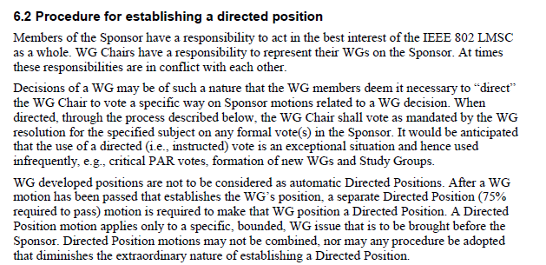
IEEE 802 LMSC Operations Manual, clause 6.2

Slide 15
Motion III
If motion I passes, the resolution shall be the Directed Position of the 802.11 Working Group.
Y/N/A:
Moved: Knut Odman
Seconded:

Slide 16
Motion IV
If motion II passes, the resolution shall be the Directed Position of the 802.11 Working Group.
Y/N/A:
Moved: Knut Odman
Seconded:

