Slide 1
STA-to-STA Positioning Use Cases
Date: 2015-11-12
Authors:

Slide 2
Motivation
STA-to-STA positioning is specified in the “Need of the project” of the 802.11az PAR:
  Current standardized technology already enables 802.11 based navigation for pedestrians, yet other usages and use cases are in need of additional positioning services:
    A more robust, accurate and precise location such as guidance to a product on a specific shelf while retaining the existing infrastructure deployment density.
    A highly scalable indoor positioning system for crowded metro stations and stadiums.
    Non-AP STA to non-AP STA positioning such as support for peer to peer connectivity and decision making.
STA-to-STA positioning use cases have not been extensively discussed and the scope needs to be clarified.

Slide 3
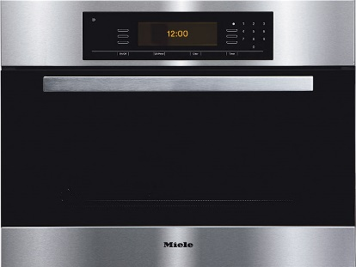
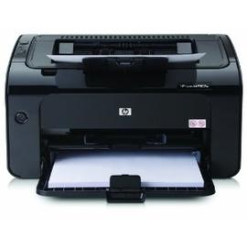

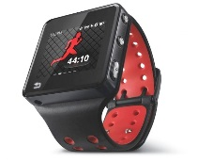
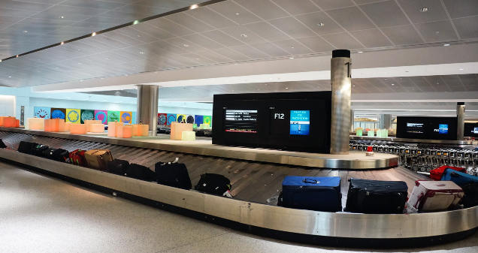





Use case 1: Distance Measurement between STAs
User:
  The user device needs to sense the target person/devices if it is in or out a specific range
Environment:
  Non-AP STAs support 11az
  Associated or unassociated STAs
  Infrastructure BSS/MBSS
Use case:
  IOT and social use cases [2]
    I’d like to have an office printer let me know if my print job is waiting to print when I walk past it, the print job was sent from my UB to cloud based spooler.
    My kitchen oven pings me to check on the cake/casserole as I pass by it.
    Smart luggage: it beeps when approaching
  Person or property monitor
    To monitor important persons or properties, such as kids, patients, workers on some specific positions. When they leave a specific area, such as kids leave a playground/ parents for a predefined threshold, monitor device will alarm.
STA1
STA2

Slide 4
Key Performance and Attributes
Linear accuracy <1m @90%
Vertical accuracy: <1m@99%
Latency: <500ms
Refresh Rate: > 2 location/sec
Number of simultaneous users: < 10 per Non-AP STA
Impact on Network Bandwidth: < 3 additional frames per device/location

Slide 5
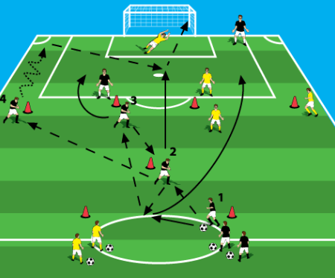
use case 2:Relative Positioning between STAs
Users:
  manager/coach/commander who needs to know the relative positions of team members
Environment
  Non-AP STAs support 11az
  Associated or unassociated STAs
  Infrastructure BSS (STA-to-STA communication/measurement support))/MBSS
Use case: professional coaching
  Soccer players may wear WiFi enabled vests, which support STA-to-STA positioning.
  The relative positions between players could be computed and transmitted to a coaching team.
  The coaching team may adjust their training strategy based on the positioning information
  Soccer players’ relative position information could be an important reference for a professional coaching team
STA4
STA1
STA2
STA3
Notes:
For the positioning in 60GHz, users’ mobility could result in the blockage problem between the mobile node and the anchor node.
The user may not always find enough AP for positioning. (At least 3 APs are required for trilateration positioning).

Slide 6
Key Performance and Attributes
Horizontal accuracy <0.5m @90%
Vertical accuracy: <1m@99%
Latency: <100ms
Refresh Rate: > 2-10 location/sec
Number of simultaneous users: < 25 per No-AP STA
Impact on Network Bandwidth: < 3 additional frames per device/location

Slide 7



Use case 3: Cooperative Positioning
Users:
  the user devices cannot find enough fix anchor notes or want to improve positioning accuracy.
Environment:
  AP and Non-AP STAs support 11az
  Associated or unassociated STAs
  Infrastructure BSS (STA-to-STA communication/measurement support))
  Cooperative STAs:
    May broadcast its cooperative capability
    May broadcast its positioning information
    May provide positioning service only during a certain period
Use cases:
  Kate goes to a Starbucks to meet her friends
  She opens her Pad to play online games when she is waiting for her friend
  Her Pad is positioning enabled and is able to provide cooperative positioning services.
  Tom is passing by the Starbucks and his smart phone uses Kate’s Pad as cooperative node to improve positioning accuracy or use it as a temporal positioning anchor node when no enough fixed anchor node (such as APs) could be found
AP1
AP2
AP3
STA2
STA1
STA4
STA3
Notes:
For the positioning in 60GHz, users’ mobility could result in the blockage problem between the mobile node and the anchor node.
The user may not always find enough AP for positioning. (At least 3 APs are required for trilateration positioning).

Slide 8
Key Performance and Attributes
Depends on the specific use cases, we use previous use case as an example:
  Horizontal accuracy <1m @90%
  Vertical accuracy: <1m@99%
  Latency: <500ms
  Refresh Rate: < 2 location/sec
  Number of simultaneous users: < 10 per No-AP STA
  Impact on Network Bandwidth: < 3 additional frames per device/location

Slide 9
Straw Poll
Do you agree to add the use cases listed in the Pages 3 to 8 as STA-to-STA positioning use cases for 802.11az use case working draft?
  Y:
  N:
  A:

Slide 10
Motion
To instruct the use case document editor to add use cases depicted by slides 3 to 8 of submission 11-15-1436r2 to the use case working draft document.
Move:
2nd:
Y: N: A:

Slide 11
References
[1] 802.11 NGP SG Proposed PAR
[2] 11-14-1193-01-0wng-beyond-indoor-navigation

