Slide 1
MIMO for GNP
Date: 2015-11-10
Authors:

Slide 2
Abstract
Demonstrate the gains from MIMO to ranging performance and possible gains in off channel time and power consumption

Slide 3
Motivation
Demonstrate the performance improvement of using MIMO for accuracy and coverage focus topic.
Demonstrate feasibility
Discuss derived functional requirements

Slide 4
Goals
Improved Accuracy and coverage (using the definition in the Use Case document)
  Under NLoS conditions (focused on Channel Model D: Typical Office env, sea of cublicles, large conference room(s))
Lower medium usage and improved power consumptions
  Do away with schedules
  Simplify the role that an AP plays and move most of the computation to the non-AP STA
  Reduce the number of frames exchanged
  Eliminate waiting for response/measurements from peer

Slide 5
Improved Accuracy with MIMO
Channel D NLoS 10ns tap spacing
40MHz
20dB SNR
Channel generation as a CSI

Slide 6
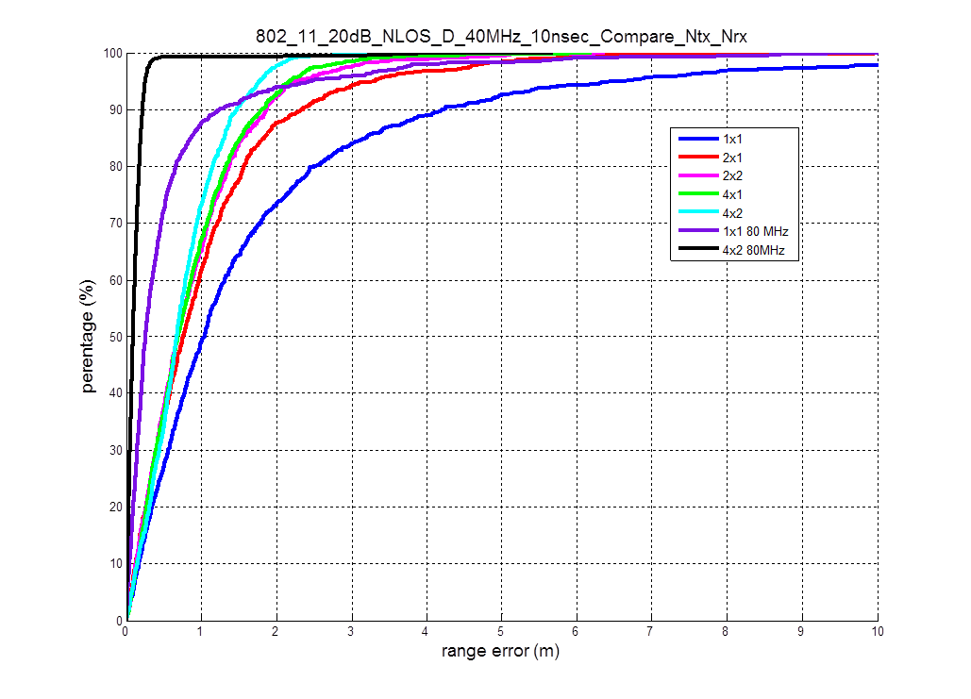
Improved Accuracy with MIMO

Slide 7
Possible Protocol
Based on the existing NDP sounding protocol
computational burden moved to the ISTA.
Single Medium Reservation.

Slide 8
NDP protocol advantages
One contention for medium reservation
No scheduling burden
NO waiting for AP calculation
Full MIMO support
Symmetrical measurement – done on NDP for both sides (no duplicate-ack)
Short latency ~0.5ms

Slide 9
Power Improvements
Initiator does not wait for an additional message exchange
  2 FTM messages, the second one carries measurements made on the first
FTM requires three successful medium acquisitions while NDP requires only one
NDP message exchanges complete in .5ms compared to at least 15 ms with FTM
NDP is significantly more power efficient

Slide 10
Value and Feasibility
We have shown that MIMO improves ranging performance significantly.
We have shown a protocol that reduces the off channel time by at least a factor of 10 to less than 1ms.

