Slide 1
11ax Support for IoT – Requirements and Technological Implications
Date: 2015-11-11
Authors:
Name | Affiliation | Address | Phone | Email
Shimi Shilo | Huawei Technologies. Co., Ltd. |  |  | shimi.shilo@huawei.com
Doron Ezri |  |  |  | doron.ezri@huawei.com
Oded Redlich |  |  |  | oded.redlich@huawei.com
Genadiy Tsodik |  |  |  | genadiy.tsodik@huawei.com
Le Liu |  |  |  | liule@huawei.com
Sheng Liu |  |  |  | martin.liu@huawei.com
Yi Luo |  |  |  | roy.luoyi@huawei.com
Peter Loc |  |  |  | peterloc@iwirelesstech.com
Jiayin Zhang |  |  |  | zhangjiayin@huawei.com
Junghoon Suh |  |  |  | Junghoon.Suh@huawei.com

Slide 2
Introduction
In the previous F2F we discussed the general outline for supporting IoT in 11ax [1]
We also outlined three main pillars that need to be taken into consideration in order to effectively support IoT in 11ax:
Number of Devices
Energy Consumption
Range Extension
In this presentation we want to suggest essential requirements for efficient support of IoT in 11ax and their technological implications

Slide 3
Essential Requirements
We consider the following as essential requirements for efficiently supporting IoT STAs in 11ax:
Reducing the energy consumption
Supporting a very large number of STAs per AP
Reduced implementation cost of IoT STAs
Improved coverage and tolerating low signal powers, including long-range STAs
Support variant types of IoT devices in an integrated chipset
The next slides discuss these requirements in more detail; we will then discuss their technological implications

Slide 4
Requirements - Energy Consumption
A large number of IoT devices is envisaged to be in operation for very long periods of time – in some cases exceeding 10 years
Many of these devices will be battery operated, so obviously in this case energy consumption becomes a very important consideration
We need to strive for features allowing 11ax IoT devices to operate at least 10 years on a single battery

Slide 5
Requirements - Large Number of Devices
The number of IoT devices is expected to be very large, and much larger than non-IoT devices; the network therefore has to support a much larger number of devices
In 3GPP Rel. 13 it is stated that “A system that can support a large number of devices, each generating a small amount of data is required. At cell level, it is expected that each household in a cell may have up to 40 MTC devices…” [2]
Based on expected cell radius (~600m), this translates into more than 50K clients per sector [2]
If an 11ax AP needs to support only 10% of the number of STAs LTE does, it means an 11ax AP needs to support 5K STAs

Slide 6
Requirements - Ultra Low-Cost Implementation
A huge number of IoT STAs is expected to be deployed, a number far larger than the number of non-IoT STAs
Lowering the cost of implementation of IoT STAs is an important enabler for implementation of IoT in 11ax and for encouraging large deployments
Design for low cost implementation should be based on an analysis which takes into consideration all costs/price components; for example:
RF module (power amplifier, filters, front-end, oscillator, etc.)
Baseband module (filters, FFT, encoder/decoder, etc.)
Memories

Slide 7
Requirements – Improved Range and Coverage
Coverage, including tolerating low signal strength, is an important aspect for IoT devices
Consider for example smart meters located in low-coverage areas such as basements and elevators
We need to define a minimum improvement in terms of link margin (coverage enhancement) – perhaps similar to the 10dB link margin improvement as suggested by the Long Range Low Power (LRLP) TIG [3]
We may want to increase the 10dB link margin improvement (to ~15-20dB) to further increase the coverage of 11ax IoT

Slide 8
Requirements – Improved Range and Coverage
Some of the IoT STAs are expected to be located far from the AP – consider for example meters for smart farming spread within a large field
The existing OFDMA parameters limit the range of STAs to approximately 500m cell radius (implied immediately from the 3.2usec cyclic prefix)
We may consider different use-cases and different coverage types; for example:
Maximal range for very low rate long range devices (hundreds of bps)
Medium range for high rate devices (tens/hundreds of kbps)

Slide 9
Summary – Essential Requirements
The following table summarizes the requirements which are essential for IoT in 11ax:
Requirement | Goals
Energy Consumption | At least 10 year operation on a single battery
Large number of STAs | Thousands of STAs per AP
Ultra Low Cost implementation STAs | Significant implementation cost reduction, analysis of implementation cost associated with each module
Improved Coverage and Long Range | Defining a link margin improvement (10-20dB), defining use-cases and coverage types

Slide 10
Implications - Energy Consumption
Several methods may be used to reduce energy consumption:
Minimizing both Tx time and Rx time (including MAC header compression)
Advanced sleep mode mechanisms
Reducing baseband processing (lowering BW, simplified detection, etc.)
Limiting the maximum transmit power
Lowering the PAPR of the transmitted signal, which can be used to increase the PA’s efficiency

Slide 11
Implications - Ultra Low-Cost Implementation
Current 802.11 is based on (mostly) symmetry between DL and UL; in IoT we may want to break this symmetry and focus on simplifying the client side (for example differentiation in transmission schemes)
In order to reduce the implementation cost, we can look at:
Limiting the maximum bandwidth (perhaps reuse RF modules from other technologies, such as Bluetooth)
Reduced transmission complexity with minimal number of modes
Limiting the peak rate
Reducing the PAPR
Relaxing RF (including LO) requirements

Slide 12
Implications – Improved Range and Coverage
In order to extend the range and improve coverage, we can look at:
Introducing an uplink timing advance correction mechanism which will align near and far STAs so that they are all received at the AP within the cyclic prefix (see figure on next page)
Change the OFDMA parameters (smaller subcarrier spacing can lead to longer symbol/CP duration and solve the round-trip delay problem above)
Lowering the PAPR of the transmitted signal so that the input backoff can be reduced
Using a different air interface for long range STAs (will be described in more detail in the next slides)

Slide 13
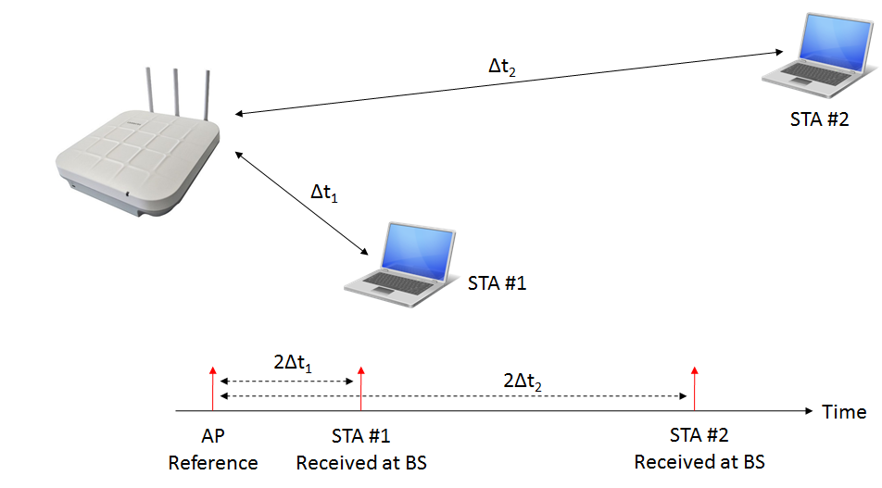
Implications – Improved Range and Coverage
When near and far STAs are not aligned, their transmissions may be received at the AP with a significant delay (depending on relative distance between them) which can cause ISI

Slide 14
Air Interface for IoT
There may be several approaches for designing an air interface dedicated to IoT STAs
We will focus on two different high-level designs:
Maintaining the same subcarrier spacing and a single FFT at the receiver
Using different OFDMA parameters and/or air interface
In the next slides, we give more details on each approach using several examples

Slide 15
Air Interface for IoT
Maintaining the same subcarrier spacing and a single FFT at the receiver
For example, we may reuse the same OFDMA parameters but use a very narrow bandwidth (e.g. a few subcarriers or even a single subcarrier) – this can significantly lower the PAPR of the transmitted signal and extend the coverage
Alternatively, we can support flexibility in the transmitter waveform, as long as it is fully orthogonal with OFDMA and co-existing with OFDMA (we will give some more detail on this in later slides)

Slide 16
Air Interface for IoT
Using different OFDMA parameters and/or air interface
We may define smaller subcarrier spacing (within part of the spectrum) for IoT transmission – this means longer OFDMA symbols and longer CP, which increases the range and coverage; this can also be used with smaller bandwidth transmission
We may leave parts of the spectrum vacant for a different air interface, such as Bluetooth, ZigBee, etc. – in this case we need to define the relevant requirements in terms of OOB emissions, co-existence with 802.11, CCA, etc.

Slide 17
Air Interface for IoT
A vacant spectrum for a different air interface may look like the following:
20MHz Legacy Preamble
40MHz HE Preamble (also indicating vacant spectrum)
DL HE Data to STA #1
Vacant Spectrum for other technologies
DL HE Data to STA #2
20MHz Legacy Preamble
DL HE Data to STA #3

Slide 18
Co-Existence with OFDMA
We consider the following (as an example) single carrier scheme with CP (e.g. SC-FDMA) where , and is a (periodic) waveform, band limited to the OFDM tones
This means that may be written as

Slide 19
Co-Existence with OFDMA
Concurrently we have regular OFDMA signals, gathered as
The incoming signal is a sum of both SC and OFDMA signals
Therefore, the FFT output at the receiver is

Slide 20
Co-Existence with OFDMA
The OFDMA contribution to the FFT output is naturally
The SC contribution to the FFT output is
Periodic with period

Slide 21
Co-Existence with OFDMA
So in total we have the following FFT output* which of course implies full orthogonality between the SC and the OFDMA components
SC Part
SC Tx
FFT
OFDMA Tx
OFDMA Part
*With channels we have

Slide 22
Scope of IoT Support within 11ax
Support of IoT is a very broad topic with a large number of candidate solutions and technologies, from very simple approaches (e.g. narrowband OFDMA transmission with identical OFDMA parameters) to much more sophisticated ones (e.g. totally new air interface, change of OFDMA parameters for IoT spectrum)
A reasonable way forward that does not have significant implications on 11ax timeline may consider different phases for different solutions
Naturally we can start with a quick inclusion of narrowband transmission with OFDMA/orthogonal transmission
In the next phase, we can focus on more advanced solutions such that the timeline for the first phase is relatively unchanged

Slide 23
Summary
We’ve outlined the essential requirements for efficiently supporting IoT STAs in 11ax
We have also discussed the respective technological implications
Additionally, we considered dividing the accommodation of IoT into several phases, such that the original 11ax timeline is relatively unchanged

Slide 24
References
[1] IEEE 802.11-15/1134r2 – 11ax Support for IoT
[2] 3GPP TR 45.820 V2.1.0 – Cellular System Support for Ultra Low Complexity and Low Throughput Internet of Things (Release 13)
[3] IEEE 802.11-15/0775r1 WNG Integrated Long Range Low Power Operation for IoT

