Slide 1
Use Cases of LRLP Operation for IoT
Date: 2015-11-11
Authors:

Slide 2
Contents of this Contribution
Introduction to LRLP
Indoor Use Case: Industrial connected worker
Outdoor Use Case: Precision Agriculture
Metrics for LRLP

Slide 3
Long Range Low Power Operation
Longer Range operation
  In mainstream 802.11
Lower Power operation
  Enable battery powered IoT
Integrated with mainstream networks
  Interoperable in mixed BSS case
Integrated with mainstream products
  Negligible incremental cost for implementation at an AP
  Acceptable to have a specialized low-cost silicon for LRLP STA, but the AP should be based on standard silicon.
Intended for M2M – managed impact on existing network
  Medium Occupancy Limit, average occupancy limit
  Other mechanisms as appropriate

Slide 4
Indoor Use Case: Industrial Connected Worker
Wireless Sensors and Mobile Hub (MH): Sensor instruments (for gesture, activity detection, gas level sensing, etc.) are clip-on Wi-Fi devices worn by an industrial worker that monitor the environment within an industrial floor and communicate LRLP metrics to his MH. The MH is a Wi-Fi device capable of sensor data fusion and equipped with GPS, indoor positioning, audio, and wireless charging
Environment: The workers in an industrial have Wi-Fi devices (for example, Wi-Fi helmet camera) with embedded sensors for environment monitoring. These sensors exchange packets with the MH in pre-defined intervals. Multiple MHs communicate with an IoT Gateway over Wi-Fi links for local (internal) processing and upload aggregated data based on LRLP metrics to the remote server or Cloud. Surveillance of indoor environment within the industrial floor is achieved through a portal.

Slide 5
Use Case Details
  Metrics of interest near a heating assembly unit is reported by various sensors worn by a connected worker in periodic intervals to his MH.
  The MH aggregates data from the various sensors and stores for local processing.
  Aggregated data is communicated by each worker through his MH to the Cloud for visualization and potential alerts for the remote manager accessible via the portal
  A threshold (dynamic) is set at the MH for each of the operating metrics (internal temperature, gas level, or lack of air in tank) for data analytics
  If a threshold value is reached based on data processing, the MH sends an alarm to the worker with suggestive actions

Slide 6




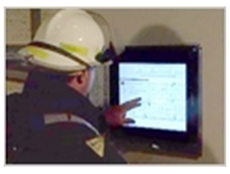



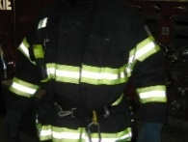
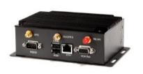
Industrial Connected Worker
Wi-Fi
Portal
(actionable intelligence)
Mobile Hub (MH)
(Portable Worker Gateway)
Worker-worn
Wi-Fi
Cloud
Cellular
Helmet with camera
MH
Cellular
Wi-Fi
Wi-Fi
Coat with embedded Wi-Fi sensors
IoT Gateway / AP

Slide 7
Metrics for Indoor LRLP Use Case
Data transmission rate:
  Sensors to MH: Ranging between 2-10Mbps
Transmission range:
  Sensors to MH: Ranging between 1m to 20m
Peak power consumption: This metric controls the power consumption during activity periods in specified duty cycle of LRLP operation
Average current consumption: Battery life time is inversely related to this metric and is measured in mA

Slide 8
Outdoor Use Case: Precision Agriculture
Wireless sensors: Sensor instruments (for soil moisture, temperature, etc.) are randomly deployed in the agricultural land
Actuators: Water pump and power meters for irrigation are installed in the land with operation controlled by the IoT Gateway
Environment: The farmer uses an IoT Gateway as a data aggregator collecting measurements from sensors placed in the agricultural land of 100acres. The farmer may also install video DSS for remote monitoring. The data is sent by the sensors to the IoT Gateway for local processing. The data is communicated over a backhaul network by the IoT Gateway to the Cloud. Differentiated services may be provided remotely in terms of pest models, user experience, big data and data analytics, irrigation models, nutrients model, disease model, etc.

Slide 9
Use Case Details
  Metrics of interest are measured by the wireless sensors deployed in the agricultural land
  The farmer sets a specific threshold on soil moisture content or humidity concentration at the IoT Gateway
  The IoT Gateway collects sensor measurements on soil moisture content over a Wi-Fi interface and checks for any measurement with respect to the defined threshold
  The IoT Gateway sends processed data to the Cloud for remote processing and monitoring
  If the soil moisture content is reduced below the defined threshold, the IoT Gateway switches the water pump to irrigate the specific affected area only.

Slide 10

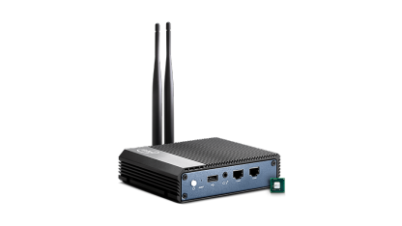
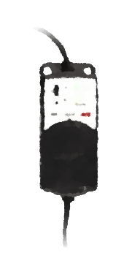
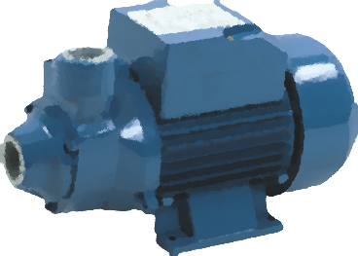
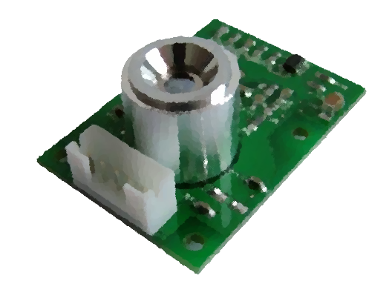
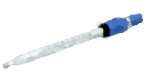
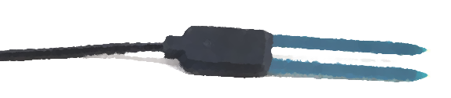
Precision Agriculture
November 2015 2015
Cloud Services
Nutrient Models
Disease Models
Backhaul Network
(Cellular etc.)
Irrigation Models
Pest Models
Local Communications
IoT Gateway
Wi-Fi
User Experience
Wi-Fi
Actuators
Sensors
Big Data & Analytics
Power Meter Actuator
Water Pump
Temperature
Soil
pH
© Intel Corp
© Intel Corp
Slide 10

Slide 11
Metrics for Outdoor LRLP Use Case
Data transmission rate:
  Sensors to IoT Gateway: Up to 512Kbps
Transmission range:
  Sensors to IoT Gateway: Longer range greater than 500m (LoS with foliage loss)
  Use case does not dictate star or mesh topology
Peak power consumption: This metric controls the power consumption during activity periods in specified duty cycle of LRLP operation
Average current consumption: Battery life time is inversely related to this metric and is measured in mA

Slide 12
Summary
We have presented two use cases for LRLP operation with IoT devices
  Industrial connected worker
  Precision Agriculture
We have also proposed the metrics for indoor and outdoor LRLP use cases

Slide 13
References
[1] IEEE 11-15/0775r1: Integrated Long Range Low Power Operation for IoT

