Slide 1
Extension of Legacy IEEE 802.11ad Channel Models for MIMO and Channel Bonding
Date: 2015-11-11
Authors:

Slide 2
Introduction
This presentation describes an extension of legacy IEEE 802.11ad channel model to support SU-MIMO and channel bonding PHY features proposed in 11ay.
The first part of the presentation provides an overview of the 11ad channel model requirements, scenarios, general channel structure, beamforming algorithm, and implementation details.
The second part provides channel model requirements for 11ay and the practical steps for 11ad channel model update to support new PHY features.

Slide 3
IEEE 802.11ad Channel Model Requirements
The channel model for 60 GHz WLAN systems described in [1] was developed to support standardization process in IEEE 802.11ad TG.
The developed model takes into account propagation properties of 60 GHz channel and assumes application to 60 GHz WLAN technology. The considered model satisfies to the following requirements:
  Provide accurate space-time characteristics of the propagation channel (basic requirement);
  Support beamforming with steerable directional antennas at both TX and RX sides with no limitation on the antenna technology;
  Account for polarization characteristics of antennas and signals;
  Support non-stationary characteristics of the propagation channel arising from people motion around the area causing time-dependent channel variations.
The considered model supports SISO channel and does not support MIMO configurations.

Slide 4
IEEE 802.11ad Use Cases
In accordance with the developed evaluation methodology in [2], several typical WLAN use cases were considered, including:
  Small Conference Room (CR) scenario: in this scenario the link is established either between two STAs located on the table or between AP and STA with AP located near the ceiling in small CR;
  Enterprise Cubicle (EC) scenario: in this scenario the link is established between AP and STA with AP located near the celling above the chain of the cubicles and STA on the table inside the cubicle; cubicles are mounted at the large floor of the high tech building;
  Living Room (LR) scenario: in this scenario the link is established between the set top box (STB) and TV receiving uncompressed video; the position of STB can be different in the room however the TV set is stationary mounted on one of the walls;
The described models support indoor environments and do not support any outdoor scenarios.

Slide 5
General Structure of IEEE 802.11ad Model
The IEEE 802.11ad channel model adopts clustering approach with each cluster consisting of several rays closely spaced in time and angular domains.
Channel impulse response without polarization support:
where:
  h is a generated channel impulse response;
  t, ϕ_{tx}, θ_{tx}, ϕ_{rx}, θ_{rx} are time and azimuth and elevation angles at the transmitter and receiver, respectively;
  A^{(i)} and C^{(i)} are the gain and the channel impulse response for i-th cluster respectively;
  δ( )- is the Dirac delta function;
  T^{(i)}, Φ_{tx}^{(i)}, Θ_{tx}^{(i)}, Φ_{rx}^{(i)}, Θ_{rx}^{(i)} are time-angular coordinates of i-th cluster;
  α^{(i,k)} is the amplitude of the k-th ray of i-th cluster;
  τ^{(i,k)}, ϕ_{tx}^{(i,k)}, θ_{tx}^{(i,k)}, ϕ_{rx}^{(i,k)}, θ_{rx}^{(i,k)} are relative time-angular coordinates of k-th ray of i-th cluster;

Slide 6
General Structure of IEEE 802.11ad Model (Cont’d)
Channel impulse response with polarization support:
  The polarization characteristics of the model were introduced at the cluster level, assuming that all rays comprising one cluster have (approximately) the same polarization characteristics.
  Therefore, extending the channel structure for polarization support requires changing scalar cluster gain coefficients A^{(i)} by 2x2 cluster polarization matrices H^{(i)}, and the channel impulse responses realization to be described by matrix h.
  The structure of the model for intra cluster channel impulse response C^{(i)} is kept unchanged from the scalar case.

Slide 7
Polarization Support
Polarization is a property of EM waves describing the orientation of electric field E and magnetic intensity H orientation in space and time.
The vector H due to properties of EM waves can always be unambiguously found if E orientation and the direction of propagation are known.
Hence the polarization properties are usually described for E vector only.
In the far field zone of the EM field radiated by the antenna, the electric vector E is a function of the radiation direction (φ, θ) and decreases as r⁻¹ with increase of the distance r.
An illustration of the transmitted E vector in the far field zone is shown in the figure.
Experimental proof of the strong polarization impact on 60 GHz WLAN systems is given in [3].

Slide 8
Polarization Modeling
In the IEEE 802.11ad channel model wave polarization is described using Jones vector introduced in optics for description of the polarized light.
In general case, a Jones vector is composed of two components of the electric field. The Jones vector e is defined as the normalized two-dimensional electrical field vector E.
The first element of the Jones vector is a real number. The second element of this vector is a complex number. The phase of the second component defines the phase difference between orthogonal components of the E field.
Examples of antennas polarization description using Jones vector
Antenna polarization type | Corresponding Jones vector
Linear polarized in the θ-direction | (1, 0)
Linear polarized in the φ-direction | (0, 1)
Left hand circular polarized (LHCP) | (1, j)/sqrt(2)
Right hand circular polarized (RHCP) | (1, -j)/sqrt(2)
IEEE 802.11ad channel model does not support dual polarized antennas.

Slide 9
Polarization Modeling (Cont’d)
IEEE 802.11ad cannel model supports linear (vertical or horizontal), LHCP, RHCP polarizations.
With the selected E field bases (E_{θ} and E_{φ} components) for the TX and RX antennas, the polarization characteristics of each ray of the propagation channel may be described by channel polarization matrix H.
The transmission equation for a single ray channel can be written as:
where x and y are the transmitted and received signals, e_{TX} and e_{RX} are the polarization (Jones) vectors for the TX and RX antennas respectively.
Components of polarization matrix H define gain coefficients between the E_{θ} and E_{φ} components at the TX and RX antennas.

Slide 10
Beamforming Space Filtering
Application of antennas at the TX and RX sides is equivalent to the spatial filtering procedure.
The Channel Impulse Response (CIR) after application of TX and RX antennas depends only on the Time of Arrival (ToA).
CIR after beamforming without polarization support:
where g_{TX}(φ, θ) and g_{RX}(φ, θ) are antenna gain functions defining antenna patterns for TX and RX antennas accordingly.
In case of the isotropic radiator antenna, the gain function is a constant value for all space directions and does not depend on azimuth and elevation angles.
Note: antenna gain function g(φ, θ) is changed when antenna changes its spatial orientation. Therefore, the CIR also depends on the antenna pattern spatial orientation.

Slide 11
Beamforming Space Filtering (Cont’d)
Channel impulse response with polarization support:
  where g_{TX}(φ, θ) and g_{RX}(φ, θ) are antenna gain vector functions (supporting polarization characteristics) for TX and RX antennas respectively.
  The antenna gain vector functions are defined as follows:
  where g_{TX}(φ, θ) and g_{RX}(φ, θ) are scalar antenna gain functions and e_{TX}, e_{RX} are Jones vectors describing TX and RX antenna polarization properties.

Slide 12
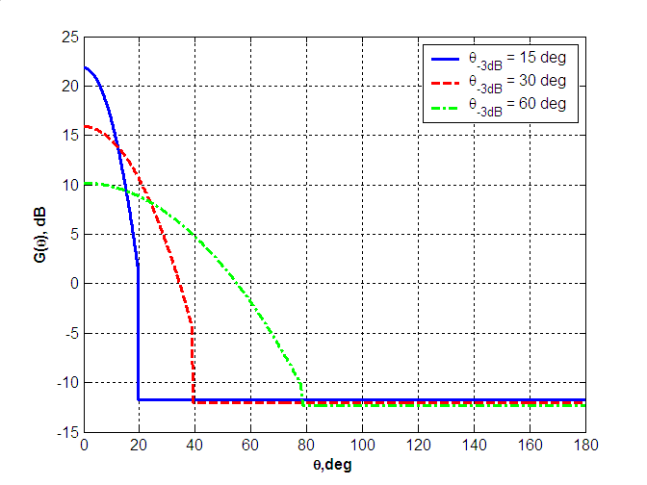
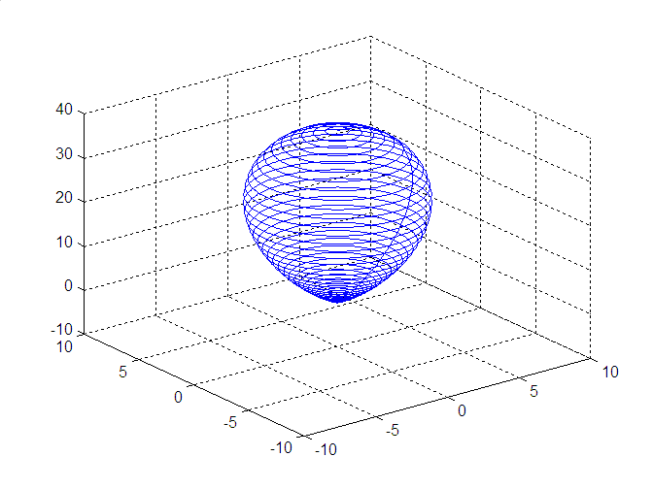
Antenna Model
Basic steerable antenna model, [1]:
  Main lobe is defined by the Gaussian profile in linear scale (parabolic form in dB scale);
  Axial symmetry;
  Constant level of side lobes;
Input parameter:
  Half Power Beam Width (HPBW) of the main lobe θ_{-3dB};
  All other parameters are derived from the HPBW;
Figure above shows examples of antenna patterns of the basic antenna model for different values of θ_{-3dB}.
Figure below shows a 3D antenna pattern for θ_{-3dB} = 30⁰.

Slide 13
Basic System of Coordinates
The primary (XYZ) coordinate system is introduced for transmitter and receiver as shown in the figure.
At the transmitter (or receiver) ray spatial coordinates are defined by the pair of angles:
  Azimuth angle φ, (0, 360⁰);
  Zenith angle θ, (0, 180⁰);
X axis for both TX and RX systems is collocated with the LOS direction.
Channel is generated for the isotropic to isotropic case.
Note: If TX and RX are located at the different heights (for example, for AP – STA scenario), then X axis lies in the vertical plane comprising LOS direction.
X-Y plane is always parallel to the floor level.

Slide 14
Beamforming Algorithm
To perform spatial beamforming search the coordinates system (XYZ)_{r} is associated with the 3D antenna pattern shown at the previous slide.
The 3D antenna pattern is positioned in space applying (XYZ)_{r} system rotation relative to the basic system of coordinates (XYZ) associated with the TX/RX.
The positioning is done applying Euler’s rotations:
  First rotation: rotation in azimuth plane by the angle φ_{r} over Z_{r} axis;
  Second rotation: rotation in elevation plane by the angle θ_{r} over X_{r} axis;
  Third rotation: rotation over Z_{r} axis, it is not needed if the antenna pattern has an axial symmetry;
Beamforming criterion: Maximum Power Ray (MPR) algorithm, [1];
Euler’s rotations

Slide 15
IEEE 802.11ad Channel Model Implementation
The Matlab code implementing IEEE 802.11ad channel model for Conference Room (CR), Enterprise Cubicle (EC), and Living Room (LR) environments was made publically available, [4].
The process of CIR generation is shown below:
Channel model output:
  Channel Impulse Response (CIR) realization in continuous time;
  CIR can be converted to the discrete time depending on the sample rate Fs;

Slide 16
IEEE 802.11ay Channel Model Requirements
The IEEE 802.11ay channel model should support new PHY features including SU-MIMO and channel bonding.
Based on the proposed SU-MIMO configurations in [5], IEEE 802.11ay model should satisfy to the following requirements:
  Support Phased Antenna Array (PAA) antennas with single and dual polarizations with an arbitrary number of elements at both TX and RX sides;
  Support SU-MIMO configurations proposed in [5] and beamforming algorithms providing optimal Antenna Weight Vectors (AWVs) for signal transmission and reception in accordance with given criterion;
  Provide Channel Impulse Response (CIR) realizations at the sample rates 2.64 GHz, 2 x 2,64 GHz, 3 x 2.64 GHz to support channel bonding;
The considered legacy channel models will not support MU-MIMO extension. MU-MIMO configuration is applied for large scale indoor and outdoor environments only.

Slide 17
Phased Antenna Array Support
Let’s consider an example of planar array of rectangular geometry and size 4 x 4 elements. Figure below shows the PAA and associated system of coordinates.
The pair of azimuth and zenith angles (φ, θ) defines ray spatial coordinates.
d_{x} and d_{y} are the distances between elements along different array dimensions, each element of the array is defined by the pair of indexes (n_{x}, n_{y}).
The system of coordinates associated with the PAA is set up relative to the basic system associated with TX and RX and introduced at the previous slide.
The setup is done applying Euler’s rotations considered above.

Slide 18
Phased Antenna Array Support (Cont’d)
Following the clustering approach channel impulse response represents a superposition of the clusters with each cluster consisting of several rays closely spaced in time and angular domains.
Let’s consider a single ray incident to the to the PAA as a plane wave describing by the wave vector k.
The phase shift for element with indexes (n_{x}, n_{y}) of two dimensional array for the spatial receive direction (θ_{i}^{RX}, φ_{i}^{RX}) is defined as follows:
where d_{x} and d_{y} are the distances between elements along different array dimensions, k_{x} and k_{y} are projections of wave vector into the X and Y axis correspondingly, θ_{i}^{RX} defines an incident elevation angle, φ_{i}^{RX} defines an incident azimuth angle, and λ is a wavelength.

Slide 19
Phased Antenna Array Support (Cont’d)
The two dimensional planar array supposes two dimensional indexing, however one can introduce one dimensional indexing in the following way:
where N_{x} is the number of elements along X axis, N_{y} is the number of elements along Y axis, and N_{x} * N_{y} = N_{RX}.
The receive channel phasor vector component is defined in accordance with the following equation:

Slide 20
Phased Antenna Array Support (Cont’d)
Similar, the transmit channel phasor vector component is defined as follows:
Therefore even in the two dimensional case one can use one dimensional indexing and represent V_{i}^{ch} and U_{i}^{ch} channel vectors using column vector.
The channel space matrix describing the single ray channel between N_{TX} and N_{RX} elements for the PAA can be written as follows:
where A_{i} is amplitude of the ray and V_{i}^{ch} and U_{i}^{ch} are channel vectors. Both vectors are column vectors and symbol H denotes Hermitian transpose function.

Slide 21
General Channel Structure for PAA
Channel matrix for a single ray defines the phase relations between all elements of the TX and RX arrays. The amplitude does not depend on the element and is equal to A_{i}.
Note that this matrix has size of N_{RX} by N_{TX} and all its rows and columns are linear dependent. It follows that the single ray channel is described by the matrix with rank 1.
Generalizing CIR for the case of multi-ray channel one can represent it as a superposition of a number of rays.
CIR without polarization support is defined as follows:
where δ() is a delta function and N_{taps} defines the number of rays or taps in the channel matrix. It defines a space-time channel structure and can have a rank greater than 1 for the time instance t.

Slide 22
General Channel Structure for PAA (Cont’d)
Channel impulse response with polarization support:
  where H_{i} is polarization matrix for ray with index i, e_{TX} and e_{RX} are Jones vectors defining the polarization type for TX and RX.
  Note that polarization characteristics still can be introduced at the cluster level, in that case the rays comprising a single cluster will have identical H_{i} matrices.

Slide 23
Beamforming Space Filtering for PAA
Application of antennas at the TX and RX sides is equivalent to the spatial filtering procedure.
The Channel Impulse Response (CIR) after application of TX and RX Antenna Weight Vectors (AWVs) depends only on the Time of Arrival (ToA).
CIR after beamforming without polarization support:
where V and U are transmit and receive AWVs accordingly. Vectors V and U are column vectors, hence U^{H}U_{i}^{ch} and (V_{i}^{ch})^{H}V define the dot products.
CIR after beamforming with polarization support:

Slide 24
Channel for SU-MIMO Configurations
Configuration #1: single array, single polarization, 2 streams
e_{V} – Jones vector for vertical polarization, (V₁, U₁) TX/RX beamforming vectors for stream #1, (V₂, U₂) – stream #2;

Slide 25
Channel for SU-MIMO Configurations (Cont’d)
Configuration #2: single array, dual polarization, 2 streams
e_{V} – Jones vector for vertical polarization, e_{H} – Jones vector for horizontal polarization, (V₁, U₁) TX/RX beamforming vectors for stream #1, (V₂, U₂) – stream #2;
e_{V} – stream #1, e_{H} – stream #2;

Slide 26
Channel for SU-MIMO Configurations (Cont’d)
Configuration #3: dual array, single polarization, 2 streams
e_{V} – Jones vector for vertical polarization, e_{H} – Jones vector for horizontal polarization, (V₁, U₁) TX/RX beamforming vectors for stream #1, (V₂, U₂) – stream #2;
e_{V} – stream #1, e_{H} – stream #2;

Slide 27
Channel for SU-MIMO Configurations (Cont’d)
Configuration #4: dual array, dual polarization, 4 streams
(e_{V} V₁, U₁) – stream #1, (e_{H} V₂, U₂) – stream #2, (e_{V} V₃, U₃) – stream #3, (e_{H} V₄, U₄) – stream #4;

Slide 28
Channel for SU-MIMO Configurations (Cont’d)
Configuration #5: single array, single to dual polarization, 1 stream
Device 1 configuration:
e_{V} – Jones vector for vertical polarization, e_{H} – Jones vector for horizontal polarization, (V₁, U₁) TX/RX beamforming vectors for stream #1;
Device 2 configuration:

Slide 29
Channel Bonding
Channel Impulse Responses (CIRs) are generated in continuous time and therefore can be sampled with different time resolution depending on the signal bandwidth, i.e. 2.64 GHz, 2 x 2.64 GHz, and 3 x 2.64 GHz.
IEEE 802.11ad model is based on the channel measurements of the intra-cluster structure conducted with signal bandwidth equal to 3.0 GHz, [6], [7].
For the bonded channels additional channel measurements should be completed to verify intra-cluster channel structure proposed in 11ad model.

Slide 30
Conclusions
This presentation describes the practical steps for 11ad channel model update to support SU-MIMO and channel bonding PHY features proposed in 11ay.
The channel structure defining the channel for the Phased Antenna Arrays (PAAs) was proposed.
It was shown that SU-MIMO configurations defined in [5] can be naturally supported using the proposed channel structure.
The enhanced time resolution for the Channel Impulse Response (CIR) function required to support channel bonding can be achieved adjusting Fs parameters in the legacy 11ad model.
However additional experimental verification is required to justify 11ad model for the intra-cluster channel structure.

Slide 31
References
A. Maltsev et al, “Channel Models for 60 GHz WLAN Systems,” IEEE doc. 11-09/0334r8.
E. Perahia, “TGad Evaluation Methodology,” IEEE doc. 11-09/0296r16.
A. Maltsev et al., “Impact of Polarization Characteristics on 60 GHz Indoor Radio Communication Systems,” Antennas and Wireless Propagation Letters, vol. 9, pp. 413 - 416, 2010.
R. Maslennikov, et al, “Implementation of 60 GHz WLAN Channel Model,” IEEE doc. 11-09/0854r3.
A. Maltsev, et al., “SU-MIMO Configurations for IEEE 802.11ay,” IEEE doc. 11-15/1145r0.
Hirokazu Sawada, et al., “Intra-Cluster response Model and Parameter for Channel Modeling at 60 GHz,” IEEE doc 112 r3, January 2010.
Hirokazu Sawada, “Intra-cluster response model and parameter for the enterprise cubicle environments at 60GHz,” IEEE doc 372 r0, March 2010.

