Slide 1
SC 64-QAM in clause 21 PHY
Date: 2015-10-26
Authors:

Slide 2
Abstract
This presentation proposes to add SC 64QAM to clause 21. This will enable SC devices with high throughput while maintaining full compatibility with legacy clause 21 devices.

Slide 3
SC 64-QAM in REVmc
Evolution – Not Revolution
2. Simple Addition to current clause 21
fully compatible with legacy devices – can accurately calculate the duration of the packet.
3. As Much Reuse As possible
4. Yet – will not impede TGay

Slide 4
Why 64-QAM SC
Can Achieve higher rate (50%) higher with minimal modification to current 802.11ad text.
Can be useful in short LOS links.
    Tougher links will require higher EVM (phase noise – etc.)
Can be added to a system with minimal modification of RF and IF.
Achieve higher rates than 802.11ad OFDM

Slide 5
Why in RevMC
Higher rates may be required in the 2018 time frame to support high resolution displays.
It is unlikely that TGay will be stable early enough to enable products at that time frame
SC has better performance than OFDM in near LOS channels

Slide 6
Proprietary SC 64 QAM – suggested mcs
 | mcs | modulation | bits/ symbol | Coding rate |  | Bit rate
SC | 10 | 16-QAM | 4 | 1/2 | 0.5 | 3080
SC | 11 | 16-QAM | 4 | 5/8 | 0.625 | 3850
SC | 12 | 16-QAM | 4 | 3/4 | 0.75 | 4620
SC | New | 64-QAM | 6 | 5/8 | 0.625 | 5775
SC | New | 64-QAM | 6 | 3/4 | 0.75 | 6930
SC | New | 64-QAM | 6 | 13/16 | 0.8125 | 7507.5
OFDM | 22 | 64-QAM | 6 | 5/8 | 0.625 | 5197.5
OFDM | 23 | 64-QAM | 6 | 3/4 | 0.75 | 6237
OFDM | 24 | 64-QAM | 6 | 13/16 | 0.8125 | 6756.75
At given coding rate, SC data rate is 10% higher

Slide 7
There must be a reason it is not in the spec today!
It is not in the spec today because the groups that were involved in writing the spec were not interested:
  Those who wanted higher rates went for OFDM
  Those who wanted SC, preferred robust modes (that’s why we also don’t have SC 13/16)

Slide 8
What changes are needed in the spec
Constellation shape
Mapper: Bit to symbol mapping
Interleaving
Signaling the MCS in the PHY header
Signaling the capability for 64QAM
Signaling these MCS in the link adaptation element.

Slide 9
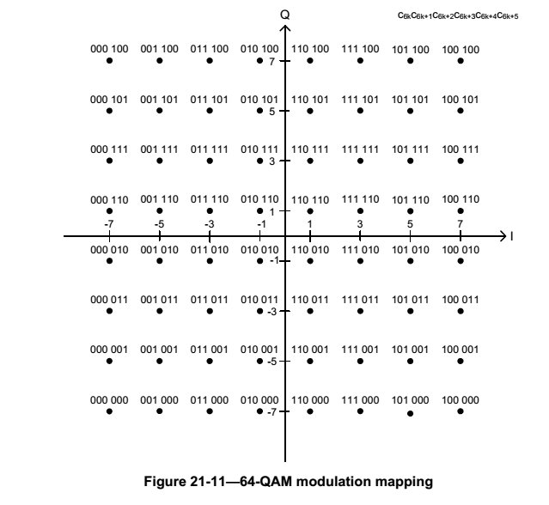
Constellation shape and Mapper for QAM64
c₀c₁c₂ c₃c₄c₅
The mapping for QAM64 is the same
as defined for QAM64, OFDM in 11ad
I and Q are independently coded
Grey coding

Slide 10
Interleaver
Currently SC uses no interleaver
An Interleaver is proposed for 64 QAM only
When 4 LDPC code words are part of a single SC-FFT BLK, an interleaver can improve phase noise resilience
Interleaving is done after “Modulation Mapping” and before “Symbol Blocking and Guard Insertion”
Interleaving is between the 4 CW’s of a single FFT block
Interleaving is in blocks of 16 symbols (=96 bits)
Sensitivity improvement (AWGN, typical PN)
  rate 13/16: 0.5 dB
  rate 3/4: 0.5 dB
  rate 5/8: 0.3 dB

Slide 11
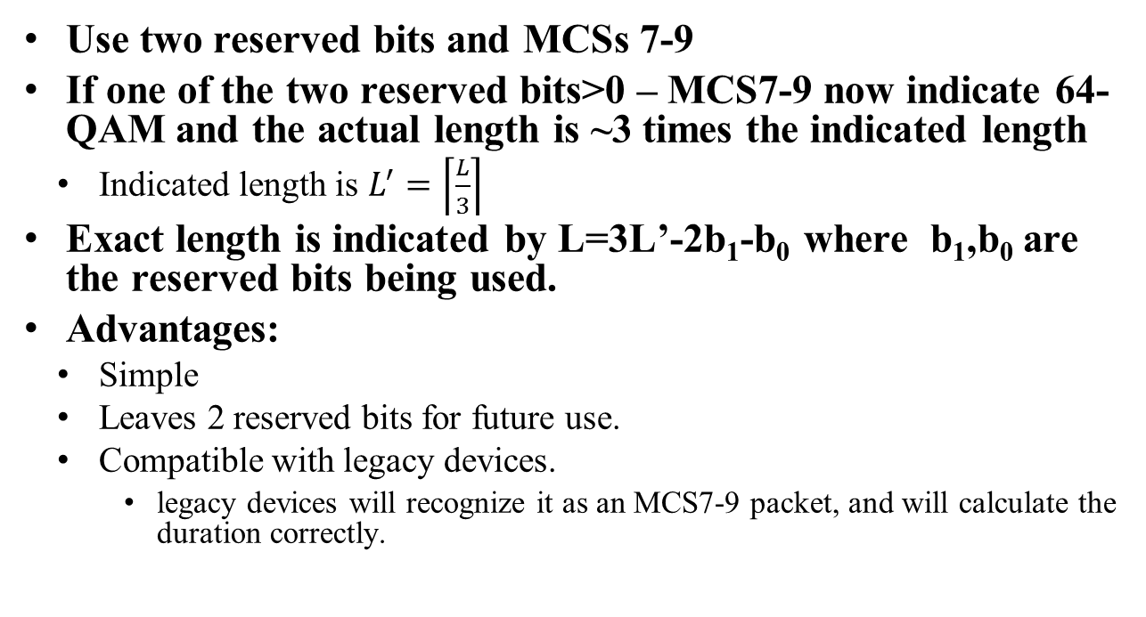
How to indicate it in the header
Use two reserved bits and MCSs 7-9
If one of the two reserved bits>0 – MCS7-9 now indicate 64-QAM and the actual length is ~3 times the indicated length
  Indicated length is $L^{′}=\left\lceil \frac{L}{3}\right\rceil$
Exact length is indicated by L=3L’-2b₁-b₀ where b₁,b₀ are the reserved bits being used.
Advantages:
  Simple
  Leaves 2 reserved bits for future use.
  Compatible with legacy devices.
    legacy devices will recognize it as an MCS7-9 packet, and will calculate the duration correctly.

Slide 12
How is the header indication compatible with 11ay
11ay may need bits in the “legacy header” to indicate modulations or packet types that need early processing:
  OFDM
  Different channel estimates.
11ay can use one of the reserved bit in the “legacy header”
  This bit will indicate that the packet is an 11ay packet
  This bit will also indicate that the “Last RSSI” field (4 bits) will be used to transfer 11ay specific info
    Legacy devices do not need this field – it is not needed for calculation of the duration of the packet.
    11ay devices need this field (especially the intended receiver) – it would be reproduced in the 11ay EDMG-A header.

Slide 13
How can we indicate the capability
Option 1
  use one reserved bit of the supported MCS set subfield
    Setting this bit to 1 will indicate that the STA is capable of TX and RX of all 64QAM MCSs
    Valid only if Maximum SC TX MCS and Maximum SC Rx MCS is 12.
Option 2:
  Like option 1, but use the two reserved bits to separately indicate 64QAM support on RX and 64QAM support on TX

Slide 14
How to indicate these MCS in the Link Margin element?
The MCS is indicate in 8 bits
  use the MSB to indicate that the MCS is a 64QAM MCS
  with the bit set, MCS 7-9 would indicate 64QAM MCSs with the corresponding rates (5/8, ¾, 13/16)

Slide 15
Performance Results
MCS | Modulation | Rate | Th-put Mbit/s | Sensitivity AWGN [dB] | Sensitivity Ch3[dB]
1 | BPSK | 1/4* | 385 | -2.7 | -2.3
2 | BPSK | 1/2 | 770 | -0.7 | -0.2
3 | BPSK | 5/8 | 962.5 | 0.4 | 1.1
4 | BPSK | 3/4 | 1155 | 1.9 | 2.6
5 | BPSK | 13/16 | 1251.25 | 2.8 | 3.5
6 | QPSK | 1/2 | 1540 | 2.6 | 3.3
7 | QPSK | 5/8 | 1925 | 3.6 | 4.5
8 | QPSK | 3/4 | 2310 | 5.1 | 6.3
9 | QPSK | 13/16 | 2502.5 | 6.0 | 7.0
10 | 16-QAM | 1/2 | 3080 | 8.8 | 10.9
11 | 16-QAM | 5/8 | 3850 | 10.3 | 11.8
12 | 16-QAM | 3/4 | 4620 | 11.8 | 13.8
7bis | 64-QAM | 5/8 | 5775 | 16.1 | 18.1
8bis | 64-QAM | 3/4 | 6930 | 18.2 | 20.5
9bis | 64-QAM | 13/16 | 7507 | 19.8 | 22.3
Random constant added.
With full impairments (PA, Phase Noise, TX DC offset, Frequency offset)

Slide 16
Summary
Simple, contained change to the spec.
No effect on legacy devices
Plenty of room for TGay changes.

Slide 17
References

