Slide 1
MCS for HE-SIG-B
Date: 2015-11-08
Authors:
Name | Affiliation | Address | Phone | Email
Dongguk Lim | LG Electronics | 19, Yangjae-daero 11gil, Seocho-gu, Seoul 137-130, Korea |  | dongguk.lim@lge.com
Jinsoo Choi |  |  |  | js.choi@lge.com
Eunsung Park |  |  |  | esung.park@lge.com
Jinmin Kim |  |  |  | jinmin1230.kim@lge.com
Jinyoung Chun |  |  |  | jiny.chun@lge.com
Kiseon Ryu |  |  |  | kiseon.ryu@lge.com
Suhwook Kim |  |  |  | suhwook.kim@lge.com
Jeongki Kim |  |  |  | jeongki.kim@lge.com
JayH Park |  |  |  | Hyunh.park@lge.com
HanGyu Cho |  |  |  | hg.cho@lge.com

Slide 2
Authors (continued)
Name | Affiliation | Address | Phone | Email
Ron Porat | Broadcom |  |  | rporat@broadcom.com
Sriram Venkateswaran |  |  |  | mfischer@broadcom.com
Matthew Fischer
Leo Montreuil
Andrew Blanksby
Vinko Erceg
Robert Stacey | Intel | 2111 NE 25th Ave, Hillsboro OR 97124, USA | +1-503-724-893 | robert.stacey@intel.com
Shahrnaz Azizi |  |  |  | shahrnaz.azizi@intel.com
Po-Kai Huang |  |  |  | po-kai.huang@intel.com
Qinghua Li |  |  |  | quinghua.li@intel.com
Xiaogang Chen |  |  |  | xiaogang.c.chen@intel.com
Chitto Ghosh |  |  |  | chittabrata.ghosh@intel.com
Laurent Cariou |  |  |  | laurent.cariou@intel.com
Yaron Alpert |  |  |  | yaron.alpert@intel.com
Assaf Gurevitz |  |  |  | assaf.gurevitz@intel.com
Ilan Sutskover |  |  |  | ilan.sutskover@intel.com

Slide 3
Authors (continued)
Name | Affiliation | Address | Phone | Email
Hongyuan Zhang | Marvell | 5488 Marvell Lane, Santa Clara, CA, 95054 | 408-222-2500 | hongyuan@marvell.com
Yakun Sun |  |  |  | yakunsun@marvell.com
Lei Wang |  |  |  | Leileiw@marvell.com
Liwen Chu |  |  |  | liwenchu@marvell.com
Jinjing Jiang |  |  |  | jinjing@marvell.com
Yan Zhang |  |  |  | yzhang@marvell.com
Rui Cao |  |  |  | ruicao@marvell.com
Sudhir Srinivasa |  |  |  | sudhirs@marvell.com
Bo Yu |  |  |  | boyu@marvell.com
Saga Tamhane |  |  |  | sagar@marvell.com
Mao Yu |  |  |  | my@marvel..com
Xiayu Zheng |  |  |  | xzheng@marvell.com
Christian Berger |  |  |  | crberger@marvell.com
Niranjan Grandhe |  |  |  | ngrandhe@marvell.com
Hui-Ling Lou |  |  |  | hlou@marvell.com

Slide 4
Authors (continued)
Name | Affiliation | Address | Phone | Email
James Yee | Mediatek | No. 1 Dusing 1st Road, Hsinchu, Taiwan | +886-3-567-0766 | james.yee@mediatek.com
Alan Jauh |  |  |  | alan.jauh@mediatek.com
Chingwa Hu |  |  |  | chinghwa.yu@mediatek.com
Frank Hsu |  |  |  | frank.hsu@mediatek.com
Thomas Pare | Mediatek USA | 2860 Junction Ave, San Jose, CA 95134, USA | +1-408-526-1899 | thomas.pare@mediatek.com
ChaoChun Wang |  |  |  | chaochun.wang@mediatek.com
James Wang |  |  |  | james.wang@mediatek.com
Jianhan Liu |  |  |  | Jianhan.Liu@mediatek.com
Tianyu Wu |  |  |  | tianyu.wu@mediatek.com
Zhou Lan |  |  |  | Zhou.lan@mediaTek.com
Russell Huang |  |  |  | russell.huang@mediatek.com
Joonsuk Kim | Apple |  |  | joonsuk@apple.com
Aon Mujtaba |  |  |  | mujtaba@apple.com
Guoqing Li |  |  |  | guoqing_li@apple.com
Eric Wong |  |  |  | ericwong@apple.com
Chris Hartman |  |  |  | chartman@apple.com

Slide 5
Authors (continued)
Name | Affiliation | Address | Phone | Email
Peter Loc | Huawei |  |  | peterloc@iwirelesstech.com
Le Liu |  | F1-17, Huawei Base, Bantian, Shenzhen | +86-18601656691 | liule@huawei.com
Jun Luo |  | 5B-N8, No.2222 Xinjinqiao Road, Pudong, Shanghai |  | jun.l@huawei.com
Yi Luo |  | F1-17, Huawei Base, Bantian, Shenzhen | +86-18665891036 | Roy.luoyi@huawei.com
Yingpei Lin |  | 5B-N8, No.2222 Xinjinqiao Road, Pudong, Shanghai |  | linyingpei@huawei.com
Jiyong Pang |  | 5B-N8, No.2222 Xinjinqiao Road, Pudong, Shanghai |  | pangjiyong@huawei.com
Zhigang Rong |  | 10180 Telesis Court, Suite 365, San Diego, CA 92121 NA |  | zhigang.rong@huawei.com
Rob Sun |  | 303 Terry Fox, Suite 400 Kanata, Ottawa, Canada |  | Rob.Sun@huawei.com
David X. Yang |  | F1-17, Huawei Base, Bantian, Shenzhen |  | david.yangxun@huawei.com
Yunsong Yang |  | 10180 Telesis Court, Suite 365, San Diego, CA 92121 NA |  | yangyunsong@huawei.com
Junghoon Suh |  | 303 Terry Fox, Suite 400 Kanata, Ottawa, Canada |  | Junghoon.Suh@huawei.com
Jiayin Zhang |  | 5B-N8, No.2222 Xinjinqiao Road, Pudong, Shanghai | +86-18601656691 | zhangjiayin@huawei.com
Edward Au |  | 303 Terry Fox, Suite 400 Kanata, Ottawa, Canada |  | edward.ks.au@huawei.com
Teyan Chen |  | F1-17, Huawei Base, Bantian, Shenzhen |  | chenteyan@huawei.com
Yunbo Li |  | F1-17, Huawei Base, Bantian, Shenzhen |  | liyunbo@huawei.com

Slide 6
Name | Affiliation | Address | Phone | Email
Fei Tong | Samsung | Innovation Park, Cambridge CB4 0DS (U.K.) | +44 1223 434633 | f.tong@samsung.com
Hyunjeong Kang |  | Maetan 3-dong; Yongtong-Gu Suwon; South Korea | +82-31-279-9028 | hyunjeong.kang@samsung.com
Kaushik Josiam |  | 1301, E. Lookout Dr, Richardson TX 75070 | (972) 761 7437 | k.josiam@samsung.com
Mark Rison |  | Innovation Park, Cambridge CB4 0DS (U.K.) | +44 1223 434600 | m.rison@samsung.com
Rakesh Taori |  | 1301, E. Lookout Dr, Richardson TX 75070 | (972) 761 7470 | rakesh.taori@samsung.com
Sanghyun Chang |  | Maetan 3-dong; Yongtong-Gu Suwon; South Korea | +82-10-8864-1751 | s29.chang@samsung.com
Yasushi Takatori | NTT | 1-1 Hikari-no-oka, Yokosuka, Kanagawa 239-0847 Japan |  | takatori.yasushi@lab.ntt.co.jp
Yasuhiko Inoue |  |  |  | inoue.yasuhiko@lab.ntt.co.jp
Shoko Shinohara |  |  |  | Shinohara.shoko@lab.ntt.co.jp
Yusuke Asai |  |  |  | asai.yusuke@lab.ntt.co.jp
Koichi Ishihara |  |  |  | ishihara.koichi@lab.ntt.co.jp
Junichi Iwatani |  |  |  | Iwatani.junichi@lab.ntt.co.jp
Akira Yamada | NTT DOCOMO | 3-6, Hikarinooka, Yokosuka-shi, Kanagawa, 239-8536, Japan |  | yamadaakira@nttdocomo.com
Fujio Watanabe |  | 3240 Hillview Ave, Palo Alto, CA 94304 |  | watanabe@docomoinnovations.com
Haralabos Papadopoulos |  |  |  | hpapadopoulos@docomoinnovations.com

Slide 7
Authors (continued)
Name | Affiliation | Address | Phone | Email
Masahito Mori | Sony Corp. |  |  | Masahito.Mori@jp.sony.com
Yusuke Tanaka |  |  |  | YusukeC.Tanaka@jp.sony.com
Yuichi Morioka |  |  |  | Yuichi.Morioka@jp.sony.com
Kazuyuki Sakoda |  |  |  | Kazuyuki.Sakoda@am.sony.com
William Carney |  |  |  | William.Carney@am.sony.com
Bo Sun | ZTE | #9 Wuxingduan, Xifeng Rd., Xi'an, China |  | sun.bo1@zte.com.cn
Kaiying Lv |  |  |  | lv.kaiying@zte.com.cn
Yonggang Fang |  |  |  | yfang@ztetx.com
Ke Yao |  |  |  | yao.ke5@zte.com.cn
Weimin Xing |  |  |  | xing.weimin@zte.com.cn
Brian Hart | Cisco Systems | 170 W Tasman Dr, San Jose, CA 95134 |  | brianh@cisco.com
Pooya Monajemi |  |  |  | pmonajem@cisco.com
Rolf De Vegt | Qualcomm | 1700 Technology Drive San Jose, CA 95110, USA |  | rolfv@qca.qualcomm.com
Sameer Vermani |  | 5775 Morehouse Dr. San Diego, CA, USA |  | svverman@qti.qualcomm.com
Simone Merlin |  | 5775 Morehouse Dr. San Diego, CA, USA |  | smerlin@qti.qualcomm.com
Tevfik Yucek |  | 1700 Technology Drive San Jose, CA 95110, USA |  | tyucek@qca.qualcomm.com
VK Jones |  | 1700 Technology Drive San Jose, CA 95110, USA |  | vkjones@qca.qualcomm.com

Slide 8
Authors (continued)
Name | Affiliation | Address | Phone | Email
Lin Yang | Qualcomm | 5775 Morehouse Dr. San Diego, CA, USA |  | linyang@qti.qualcomm.com
Bin Tian |  | 5775 Morehouse Dr. San Diego, CA, USA |  | btian@qti.qualcomm.com
Youhan Kim |  | 1700 Technology Drive San Jose, CA 95110, USA |  | youhank@qca.qualcomm.com
Sameer Vermani |  | 5775 Morehouse Dr. San Diego, CA, USA |  | svverman@qti.qualcomm.com
Alice Chen |  | 5775 Morehouse Dr. San Diego, CA, USA |  | alicel@qti.qualcomm.com
Albert Van Zelst |  | Straatweg 66-S Breukelen, 3621 BR Netherlands |  | allert@qti.qualcomm.com
Alfred Asterjadhi |  | 5775 Morehouse Dr. San Diego, CA, USA |  | aasterja@qti.qualcomm.com
Arjun Bharadwaj |  | 5775 Morehouse Dr. San Diego, CA, USA |  | arjunb@qti.qualcomm.com
Carlos Aldana |  | 1700 Technology Drive San Jose, CA 95110, USA |  | caldana@qca.qualcomm.com
George Cherian |  | 5775 Morehouse Dr. San Diego, CA, USA |  | gcherian@qti.qualcomm.com
Gwendolyn Barriac |  | 5775 Morehouse Dr. San Diego, CA, USA |  | gbarriac@qti.qualcomm.com
Hemanth Sampath |  | 5775 Morehouse Dr. San Diego, CA, USA |  | hsampath@qti.qualcomm.com
Menzo Wentink |  | Straatweg 66-S Breukelen, 3621 BR Netherlands |  | mwentink@qti.qualcomm.com
Naveen Kakani |  | 2100 Lakeside Blvd, Suite 475, RichardsonTX, USA |  | nkakani@qti.qualcomm.com
Raja Banerjea |  | 1060 Rincon Circle San Jose CA 95131, USA |  | rajab@qit.qualcomm.com
Richard Van Nee |  | Straatweg 66-S Breukelen, 3621 BR Netherlands |  | rvannee@qti.qualcomm.com

Slide 9
Introduction
We have decided how to construct the HE-SIG-B and what encoding method for HE-SIG-B to be used in given BW [1]
But, MCS values for HE-SIG-B are not yet defined so far
  In 11ac, only MCS0 was used to VHT-SIG-A field for robust transmission including 3rd party STAs (similar in HE-SIG-A as well now)
  However, HE-SIG-B only conveys specific information of recipient STAs that means the possibility of using higher MCSs for efficiency
    We can consider using variable MCSs on HE-SIG-B according to STA’s status.
In this contribution, we discuss MCS set for effective HE-SIG-B transmission

Slide 10
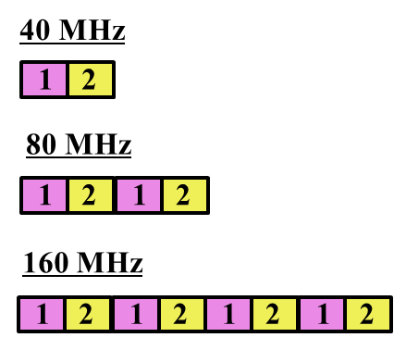
Recap : HE-SIG-B (1/2)
The current SFD [1] defines HE-SIG-B as follows:
  HE-SIG-B is encoded on a per 20 MHz basis using BCC with common and user blocks separated in the bit domain
  For bandwidths ≥ 40 MHz, the number of 20 MHz subbands carrying different content is two and with structure as shown in Figure 1. Each square in the figure represents 20 MHz subband and 1/2 represents different signaling information
Figure 1 - 20 MHz subchannel content for HE-SIG-B
for bandwidths ≥ 40 MHz

Slide 11
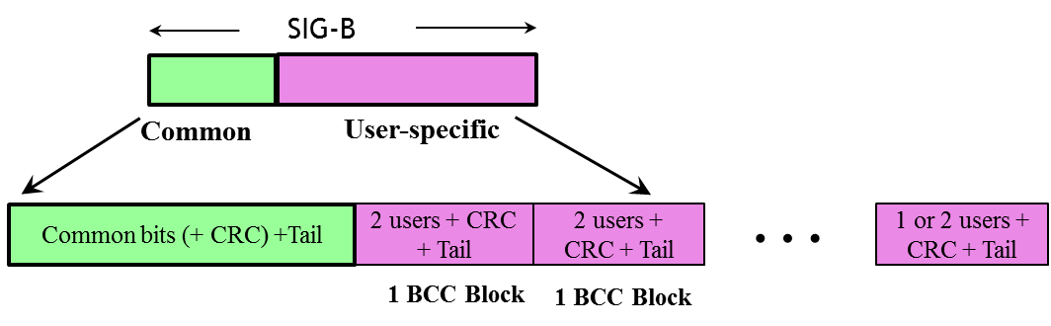
Recap : HE-SIG-B (2/2)
The encoding structure of each BCC in HE-SIG-B is shown in Figure 2 and described below:
  Two users are grouped together and jointly encoded in each BCC block in the user specific section of HE-SIG-B
  The CRC in the common block is TBD
  The last user information is immediately followed by tail bits (regardless of whether the number of users is odd or even) and padding bits are only added after those tail bits
        Figure 2 - Encoding structure in HE-SIG-B

Slide 12
Need for variable MCS for HE-SIG-B
In 11ax, by using the OFDMA / MU-MIMO transmission, we can support many devices in a PPDU
  We should transmit the user specific information of those devices at the same time that is transmitted through HE-SIG-B field
  So, it is required to convey a lot of HE-SIG-B symbols as the number of multiplexed devices increase and the overall preamble overhead grows up
  To reduce the HE-SIG-B overhead, we can consider using variable MCS for HE-SIG-B
    By adapting a suitable MCS according to the STA’s status, we can transmit the HE-SIG-B more efficiently
In the next slide, we check STA’s status according to each scenarios

Slide 13
SNR Characteristics
We collect long term SNR (signal to noise only) for allocated STAs in downlink
  Considering path loss, shadowing, antenna gain, etc., without short term channel gain
  Transmission happens in both directions
SNR statistics are different according to different CCA levels
We also collect difference of SINR, i.e. long term SINR_{per20MHz}- long term SNR, for the STA
Next two slides show both statistics
  We assume that number of allocation per 20MHz is same
  Results for other scenarios are in the Appendix
In this contribution, “Scenario” means Simulation Scenario (SC) in [2]

Slide 14
Long term SNR / difference of SINR distribution (Scenario 1)
Allocation = 8, 80MHz
Long term SNR, SC1
Difference of SINR per 20Mhz, SC1, Allocation = 8
CCA level | Mean | Standard deviation
-62dbm | -26.4108 | 7.3299
-72dbm | -21.1188 | 6.9581
-82dbm | -12.3417 | 5.9641

Slide 15
Cont.
Allocation = 16, 80MHz
Difference of SINR per 20Mhz, SC1, Allocation = 16
Long term SNR, SC1
CCA level | Mean | Standard deviation
-62dbm | -26.6370 | 7.0865
-72dbm | -21.4742 | 6.6767
-82dbm | -12.6414 | 5.7354

Slide 16
Cont.
Here, we can observe that more than 50% of SNR of STA has a higher value than 20dB
  Therefore, higher MCSs than MCS0 can be used for HE-SIG-B transmission in many cases
Based on SNR distribution of STAs, we checked out Aggregated control FER* and HE-SIG-B overhead
  For example, range of MCS level for HE-SIG-B is MCS0 ~ 5(6) in our simulation
    Simulation parameters are in the Appendix
  * Aggregated Control FER = (1-Aggregated control success)
  where aggregated control success means L-SIG, HE-SIG-A and HE-SIG-B are successfully decoded

Slide 17
Performance (1/2)
Scenario 1
  In Aggregate control FER, all MCSs can provide finer granularity of link adaptation at 10% FER point
Scenario 1, Allocation =8, Aggregated control FER
Scenario 1, Allocation =16, Aggregated control FER

Slide 18
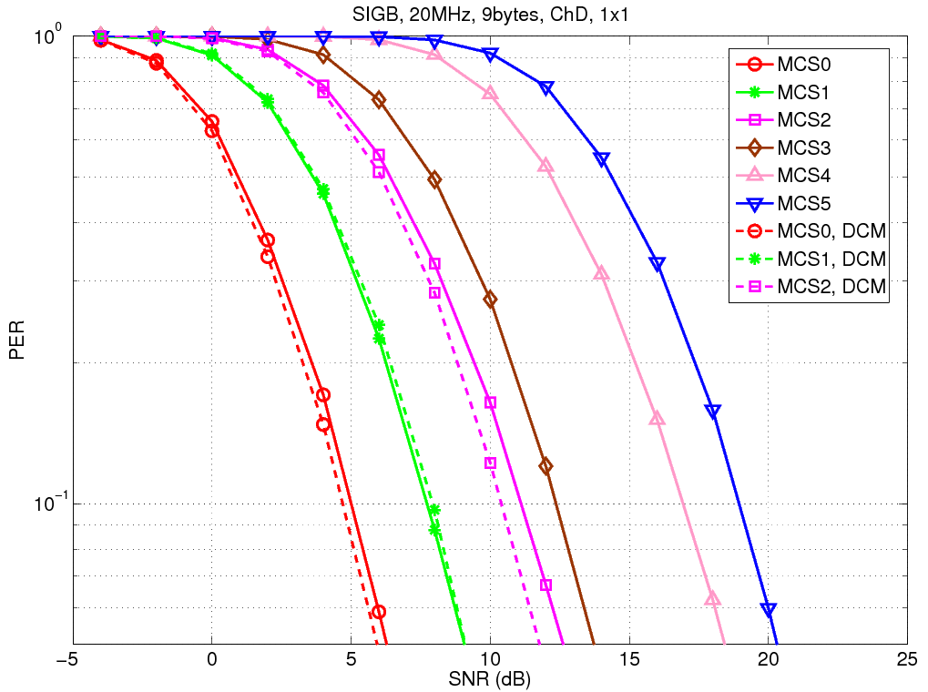
Performance (2/2)
In aspect of FER (for HE-SIG-B), MCS2 and MCS3 provide finer granularity in link adaption in HE-SIG-B
Simulation assumption is in the Appendix

Slide 19
Selected MCS Distribution
Scenario 1
  We can observe that High MCS which is larger than MCS5 is rarely selected although small number of STA is allocated in BW.
    We can check that MCSs which are larger than MCS5 are chosen up to 5%.
    And, according to increasing of allocated STA, the MCS larger than MCS5 is rarely used.
  Using of high MCS larger than MCS5 is not very valid in HE-SIG-B
MCS |  | 0~5 | 6
Alloc = 8 | Ch1 | 94.3593 | 5.6407
 | Ch2 | 94.3713 | 5.6287
Alloc = 16 | Ch1 | 100 | 0
 | Ch2 | 100 | 0
Alloc = 32 | Ch1 | 100 | 0
 | Ch2 | 100 | 0

Slide 20
Assumption on overhead analysis
To calculate the overhead of HE-SIG-B, we use the target SNR per MCS and SNR distribution of STA
  The target SNR is the required SINR at 1% Aggregated control PER
In the next slide, we calculate the averaging overhead of HE-SIG-B by applying candidated MCS set in indoor channels
  E.g., MCS set : {0,1,2,3,4,5}

Slide 21
Overhead analysis
HE-SIG-B overhead according to MCS set (-82dbm, 80MHz, TGnD)
  Like as L-SIG and HE-SIG-A, only MCS0 is used for HE-SIG-B
  By using MCS set : {0,1,2,3,4,5}
    It means the average number of symbols required for HE-SIG-B transmission
    We can observe that number of symbols for HE-SIG-B is effectively reduced by using variable MCSs
Number of allocation | 8 alloc | 16 alloc | 32 alloc
Number of symbol | 4.9167 | 8.9167 | 16.9167
Number of allocation | 8 alloc | 16 alloc | 32 alloc
Scenario 1 | 2.2062 | 5.3100 | 12.5784
Scenario 2 | 1.3788 | 3.2460 | 7.8139
Scenario 3 | 1.5997 | 4.0301 | 9.3925

Slide 22
Conclusion
In this contribution, we show the performance and overhead of HE-SIG-B according to MCS set in indoor channels
  In indoor environments, MCS {0,1,2,3,4,5} seems good candidates for HE-SIG-B transmission
Therefore, we propose that MCS set of HE-SIG-B is constructed with MCS0, MCS1, MCS2, MCS3, MCS4, MCS5

Slide 23
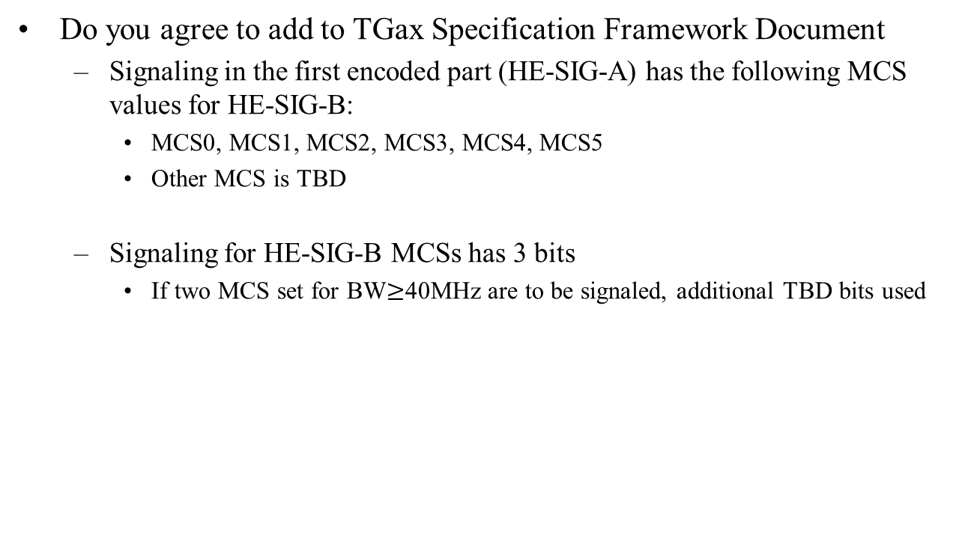
Straw poll #1
Do you agree to add to TGax Specification Framework Document
  Signaling in the first encoded part (HE-SIG-A) has the following MCS values for HE-SIG-B:
    MCS0, MCS1, MCS2, MCS3, MCS4, MCS5
    Other MCS is TBD
  Signaling for HE-SIG-B MCSs has 3 bits
    If two MCS set for BW$≥$40MHz are to be signaled, additional TBD bits used

Slide 24
Reference
[1] 11-15-0132-09-00ax-spec-framework
[2] 11-14-0980-14-00ax-simulation-scenarios
[3] 11-15-1068-01-00ax-reliable-transmission-schemes-for-he-sig-b-and-data

Slide 25
Appendix

Slide 26
Long term SNR / difference of SINR distribution (Scenario 2)
Allocation = 8, 80MHz
Difference of SINR per 20Mhz, SC2, Allocation = 8
Long term SNR, SC2
CCA level | Mean | Standard deviation
-62dbm | -28.9016 | 3.9529
-72dbm | -26.3211 | 4.2670
-82dbm | -15.4266 | 5.4420

Slide 27
Long term SNR / difference of SINR distribution (Scenario 2)
Allocation = 16, 80MHz
Difference of SINR per 20Mhz, SC2, Allocation = 16
Long term SNR, SC2
CCA level | Mean | Standard deviation
-62dbm | -29.9550 | 3.6807
-72dbm | -26.8174 | 4.1084
-82dbm | -16.0685 | 5.1370

Slide 28
Long term SNR / difference of SINR distribution (Scenario 3)
Allocation = 8, 80MHz
Difference of SINR per 20Mhz, SC3, Allocation = 8
Long term SNR, SC1
CCA level | Mean | Standard deviation
-62dbm | -31.9531 | 3.1476
-72dbm | -28.4105 | 3.3857
-82dbm | -18.3299 | 3.7593

Slide 29
Long term SNR / difference of SINR distribution (Scenario 3)
Allocation = 16, 80MHz
Difference of SINR per 20Mhz, SC3, Allocation = 16
Long term SNR, SC1
CCA level | Mean | Standard deviation
-62dbm | -32.4373 | 2.8492
-72dbm | -28.9975 | 3.1219
-82dbm | -19.0655 | 3.4517

Slide 30
Assumption for HE-SIG-B contents
Joint encoding per encoding block
  Per STA specific information
  CRC and tail bits are added once per encoding block (K=2)
  HE-SIG-B overhead
    Simply assuming per user info as 19 bits
    OFDMA case : per user info (19 bits)*N_user of 20MHz + {RA info(5bit per 20MHz), CRC&Tail (10)}

Slide 31
Aggregated control FER (1/2)
Scenario 2
Scenario 2, Allocation =8, Aggregated control FER
Scenario 2, Allocation =16, Aggregated control FER

Slide 32
Aggregated control FER (2/2)
Scenario 3
Scenario 3, Allocation =8, Aggregated control FER
Scenario 3, Allocation =16, Aggregated control FER

Slide 33
Simulation Assumption (1/3)
SLS
  Scenarios : Residential, Enterprise, and indoor small BSS
  Bandwidth : 80MHz
  Number of allocation : 8, 16 ,32
  Scheduling : round robin (STAs don’t have any priority for allocation)
  CCA level : -62,-72,-82dbm
  All parameters and assumptions are aligned with evaluation methodology and simulation scenario document
  STA can have the multiple allocations for UL transmission when other STA are transmitting the DL signals

Slide 34
Simulation Assumption (2/3)
LLS
  BW: 80MHz
  10000 channel realizations
  Transmission format: 1x (legacy)
  Number of carrier for one OFDM symbol : 52 tone
  Channel: TGn-D
  CP length: 0.8us for TGn-D
  Channel estimation: smoothing +LS
  Channel impairment: time offset, CFO estimation
  Receiver knows SINR per 20MHz when calculates LLR

Slide 35
Simulation Assumption (3/3)
FER according to MCS level
  20MHz BW
  9 bytes per code block (K=2)
  MCS0/1/2/3/4/5 for both common and dedicated blocks
  Regular DCM with the rate of MCS 0/1/2 [3]
    E.g. {MCS0, DCM} means the MCS applied by DCM as the same rate of MCS0
  Real channel estimation, synchronization and phase tracking
  Joint LLR calculation is used for DCM decoding

