Slide 1
I/Q Imbalance Impact to TGax OFDMA Uplink Reception
Date: 2015-11-09
Authors:

Slide 2
Outline
Abstract
Background
Simulation assumptions and configurations
Simulation results
Observations and Conclusions

Slide 3
Abstract
In-phase (I) and Quadrature (Q) imbalance is a common RF impairment in wireless devices.
We demonstrate, via simulation, the impact of the image interference due to I/Q imbalance to the link performance in TGax OFDMA uplink.

Slide 4
Background
In OFDMA systems, transmitting a signal over a resource unit (RU) allocated on one side of the DC tone will create interference on the RU at the image side of the DC tone due to I/Q imbalances at Tx and/or Rx RF [1]
The impact of interference depends on the level of the I/Q mismatch and relative power of the signals on the two image RUs at the receiver.
Desired Signal
Image
Interference
Sideband Suppression (dBc)

Slide 5
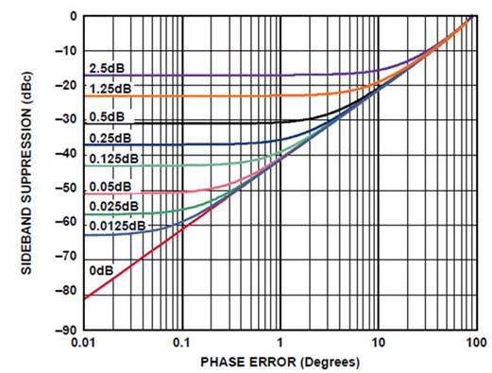



Simulation Assumptions
I/Q imbalance model [1] : Consider Phase and Amplitude mismatch only
I/Q imbalance (IQI) Parameters[2]:
  -30dBc:
  -40dBc
$$y_{a}=y_{a,r}+jy_{a,i}= \left[{10}^{0.5\frac{I_{a}}{20}}∗x_{r}\right]+j\left[{10}^{−0.5\frac{I_{a}}{20}}∗x_{i}\right]$$
$$y_{a\&p}= e^{−j0.5π\frac{I_{p}}{180}}{∗y_{a,r}}+e^{j\left(\frac{π}{2}+0.5π\frac{I_{p}}{180}\right)}{y_{a,i}}$$
$I_{a}=0.5dB$ and $I_{p}=1 Deg$
$I_{a}=0.1875dB$ and $I_{p}=0.3 Deg$

Slide 6
Simulation Assumptions (cont’d)
TGax OFDMA UL
Channel bandwidth: 20 MHz
RU definition: 9 RUs with numerology defined in [3]
RU allocation: RU2 → STA2, RU8 → STA1
The same transmit power from two STAs
dP (dB): Received power difference at AP (0 – 25dB)
    For SS1 and SS4, the power difference (in dB) between the near and far STAs from AP could be more than 20dB (see the Received Power Analysis in Appendix).
Received power difference at AP
STA1
STA2
dP
RU
8
RU
1
RU
2
RU
3
RU
4
RU5
RU5
RU
6
RU
7
RU
9
AP
STA2
STA1

Slide 7
Simulation Configurations
Channel: AWGN, B-NLOS, D-NLOS
Modulation:
  MCS2/4/6/8 (QPSK/16QAM/64QAM/256QAM)
Encoder: BCC
Packet length per RU: 100Byte/Packet
Simulation length: 10,000 packets
Rx I/Q imbalance compensation:
  Disable – Use the same imbalance parameters as the transmitter,
  Enable – No I/Q imbalance at receiver (AP).
Ideal channel and noise power estimations
Performance metric: PER of the signal from STA2

Slide 8
Simulation Results
(IQI = -30dBc vs. -40dBc, 64QAM, AWGN)
Legend: “dP = xdB” : The same I/Q imbalance applied to Tx and Rx sides; “dP = xdB, Rx0”: I/Q imbalance applied to Tx side only
The performance is highly sensitive to the IQI level
The performance depends on the received power difference
Perfect Rx IQI compensation can improve the performance

Slide 9
Simulation Results
(IQI = -30dBc vs. -40dBc, 64QAM, D-NLOS)
Legend: “dP = xdB” : The same I/Q imbalance applied to Tx and Rx sides; “dP = xdB, Rx0”: I/Q imbalance applied to Tx side only
The performance is highly sensitive to the IQI level
The performance depends on the received power difference
Perfect Rx IQI compensation can improve the performance

Slide 10
Simulation Results
(64QAM vs. 256QAM, AWGN)
Legend: “dP = xdB” : The same I/Q imbalance applied to Tx and Rx sides; “dP = xdB, Rx0”: I/Q imbalance applied to Tx side only
The performance is highly sensitive to the modulation type

Slide 11
Simulation Results
(64QAM vs. 256QAM, B-NLOS)
Legend: “dP = xdB” : The same I/Q imbalance applied to Tx and Rx sides; “dP = xdB, Rx0”: I/Q imbalance applied to Tx side only
The performance is highly sensitive to the modulation type

Slide 12
Performance Degradation [dB] (IQI = -40dB)
Rx IQI Compensation Disable
Rx IQI Compensation Enable
dP (dB) | QPSK | 16QMA | 64QAM | 256QAM
0 | <0.5 | <0.5 | <0.5 | 0.5
5 | <0.5 | <0.5 | 0.5 | 1.6
10 | <0.5 | <0.5 | 1.5 | >3
15 | <0.5 | 1.1 | >3 | >3
20 | 1 | >3 | >3 | >3
 | QPSK | 16QMA | 64QAM | 256QAM
 | <0.5 | <0.5 | 0.5 | <0.5
 | <0.5 | <0.5 | <0.5 | <0.5
 | <0.5 | <0.5 | <0.5 | 1
 | <0.5 | <0.5 | 1 | >3
 | <0.5 | 0.8 | >3 | >3
AWGN @ PER=1e-2
dP (dB) | QPSK | 16QMA | 64QAM | 256QAM
0 | <0.5 | <0.5 | <0.5 | 0.9
5 | <0.5 | <0.5 | 1.1 | >3
10 | <0.5 | 0.9 | >3 | >3
15 | 1 | 2.5 | >3 | >3
20 | 2.3 | >3 | >3 | >3
 | QPSK | 16QMA | 64QAM | 256QAM
 | <0.5 | <0.5 | 0.5 | <0.5
 | <0.5 | <0.5 | <0.5 | <0.5
 | <0.5 | <0.5 | 0.5 | 1
 | <0.5 | <0.5 | 1 | >3
 | <0.5 | 0.8 | >3 | >3
D-NLOS @ PER=1e-1

Slide 13
Observations
I/Q imbalance at the transmitter of a STA allocated on a RUx could cause significant performance degradation to another STA’s signal allocated on the image of RUx, especially for signals with higher order modulation
The larger the received power difference between the two STAs’ signals, the more degradation can be observed at weaker received signals.
Assuming the same Tx power from STAs, a large received power difference at AP can occur with certain probability (Appendix).
The results with dP = 0dB can be used for downlink performance evaluation.
In the OBSS scenario, the image interference could also cause performance degradation in both UL and DL directions.

Slide 14
Conclusion
To mitigate the image interference due to I/Q impairments, accurate power control in uplink may be necessary.
Other solutions may also be feasible, for example,
  Properly allocating resources among different users [5]
  Setting a maximum I/Q imbalance requirement
To understand other potential impacts, it may be beneficial to include I/Q imbalance settings in evaluation methodology document

Slide 15
References
[1] Marcus Windisch and Gerhard Fettweis, “Performance Degradation due to I/Q Imbalance in Multi-Carrier Direct Conversion Receivers: A Theoretical Analysis,” ICC '06. IEEE International Conference on Communications, 2006.
[2] Eamon Nash, “Correcting Imperfections in IQ Modulators to Improve RF Signal Fidelity,” Analog Devices, Application Note AN-1039 (http://www.analog.com/media/en/technical-documentation/application-notes/AN-1039.pdf)
[3] IEEE 802.11-15/330r5, OFDMA Numerology and Structure, Intel
[4] IEEE 802.11-15/980r10, Simulation Scenarios, Qualcomm
[5] Yuki Yoshida, et al, “Analysis and Compensation of Transmitter IQ
Imbalances in OFDMA and SC-FDMA Systems”, IEEE Transactions on Signal Processing, Vol. 57, No. 8, Aug. 2009

Slide 16
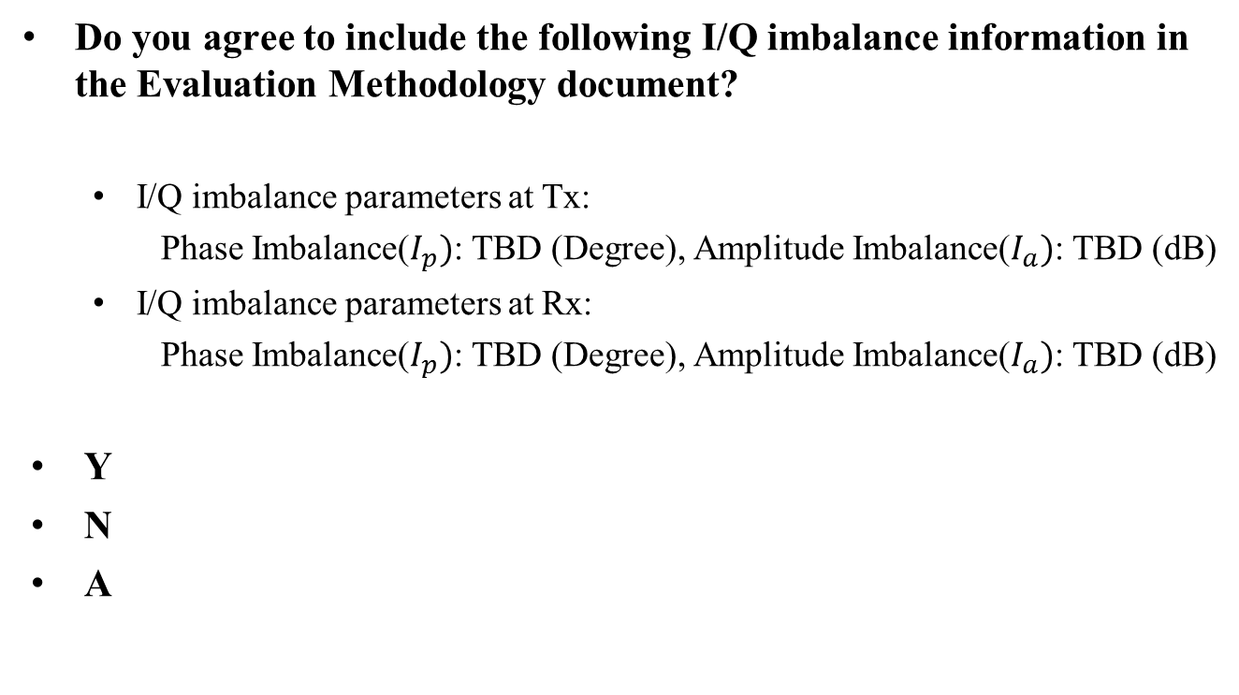
Straw Poll #1
Do you agree to include the following I/Q imbalance information in the Evaluation Methodology document?
  I/Q imbalance parameters at Tx:
  Phase Imbalance($I_{p})$: TBD (Degree), Amplitude Imbalance($I_{a})$: TBD (dB)
  I/Q imbalance parameters at Rx:
  Phase Imbalance($I_{p})$: TBD (Degree), Amplitude Imbalance($I_{a})$: TBD (dB)
Y
N
A

Slide 17

Straw Poll #2
Do you agree to use the following I/Q imbalance model in the Evaluation Methodology document?
where $x=x_{r}+jx_{i}$ is the input.
Y
N
A
$$y_{a}=y_{a,r}+jy_{a,i}= \left[{10}^{0.5\frac{I_{a}}{20}}∗x_{r}\right]+j\left[{10}^{−0.5\frac{I_{a}}{20}}∗x_{i}\right]$$
$$y_{a\&p}= e^{−j0.5π\frac{I_{p}}{180}}{∗y_{a,r}}+e^{j\left(\frac{π}{2}+0.5π\frac{I_{p}}{180}\right)}{y_{a,i}}$$

Slide 18
Appendix

Slide 19
OFDMA UL Received Power Analysis
Randomly drop both STAs
(> min distance to AP)
The distance of the 1st STA to AP
SS1: 1m - SS3: 1.5m
SS2: 1.5m - SS4: 8.5m
The distance of the 2nd STA to AP: Random
(Shadowing: 5dB for all cases)

Slide 20
Simulation Results (AWGN)

Slide 21
Simulation Results (B-NLOS)

Slide 22
Simulation Results (D-NLOS)

