Slide 1
Use Case for LRLP and Full Function in STA.
Date: 2015-11-06
Authors:

Slide 2
Possible AP / STA pairings
When 802.11ax and LRLP are approved and deployed:
All APs support LRLP
STA devices may be:
LRLP only, with no capability for 20 MHz modes
Wideband STA – full capability
AP
ax + L
L
AP
ax + L
20
Tim Godfrey (EPRI)

Slide 3
Function of the mobile embedded STA
Does the standard “ax” generation client implementation include LRLP?
Example full function high performance STA in mobile phones, tablets, etc.
Yes – because these devices are dual mode
Most common mode of operation is as STA
However, capable of operating as AP (Tethering use case)
Given the AP capability, LRPP support should also be supported
Tim Godfrey (EPRI)

Slide 4
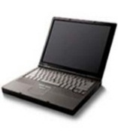
LRLP typical home use case
PV Inverter
Customers mobile devices and energy-related devices are all connected to customer’s Wi-Fi network.
Internet
IEEE 802.11
Wi-Fi Router
LRLP Connection
802.11ax Connection
Customer Residence
Tim Godfrey (EPRI)
Notes:
Three paths into the customer

Slide 5
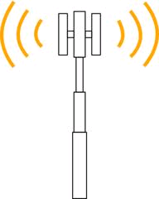
LRLP “cord cutter” use case
PV Inverter
Tethered phone is only connection to Internet
LTE
Internet
LRLP Connection
802.11ax Connection
Customer Residence
Tim Godfrey (EPRI)
Notes:
Three paths into the customer

Slide 6
LRLP Mobile STA use case
PV Inverter
Mobile device user desires to maintain 802.11 connection to home network over greater range:
Lack of cellular coverage
Wi-Fi-only service plan
Use of service/server on local LAN
Internet
IEEE 802.11
Wi-Fi Router
LRLP Connection
802.11ax Connection
Customer Residence
Tim Godfrey (EPRI)
Notes:
Three paths into the customer

Slide 7
Summary
Mobile chipsets are primarily used as STA, but will support AP operation.
General assumption is LRLP is present in AP chipsets, so the mobile device chipset should also support LRLP
The ability of the mobile device to use LRLP as a STA can provide some benefits also
Tim Godfrey (EPRI)

