Slide 1
Effect of Impairments on the Performance of Non-Uniform Constellations
Date: 2015/11/09
Authors:

Slide 2
Abstract
This contribution outlines the performance of non-uniform constellations (NUCs) in single-carrier (SC) modulation under influence of impairments
  NUCs of [1] with 64 signal points are considered
  Considered impairments
    ADC quantization
    Fading channel
  NUCs are shown to
    be robust against quantization
    maintain their gain or even have an additional gain in fading channels

Slide 3
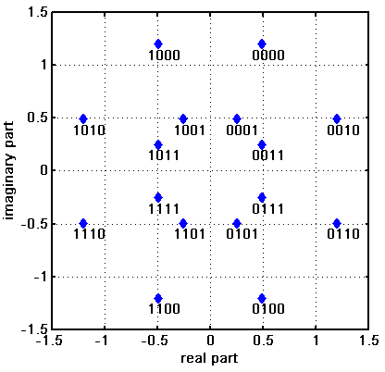
Motivation
Higher order QAMs discussed in e.g. [2]-[5] as potential technology for 802.11ay
  OFDM: 128-QAM, 256-QAM (up to 64-QAM in ad)
  SC: 64-QAM (up to 16-QAM in ad)
Non-uniform constellations (NUCs) provide increased performance compared to uniform constellations (UCs)
NUCs provide
  Shaping gain
    up to 0.7dB for 256-QAM (OFDM) [4]
  Improved robustness against phase noise [5]
  Peak power gain, e.g. [1,6]
  A moderate increase in demapper complexity [4-6]
    2D NUCs feature quadrant symmetry

Slide 4
Introduction
So far, the effect of impairments on the performance of NUCs has been investigated for OFDM only
  Investigations [7] show that NUCs can maintain or even improve their gain in presence of phase noise, quantization, or fading channel.
In this contribution, we investigate the performance of NUCs in SC transmission
  NUCs for SC can be optimized in various ways [1]
  Here we present performance results of NUCs with
    Zero shaping gain but minimum PAPR: Cat. B
    Maximum shaping gain and unconstraint PAPR: Cat. D
  NUCs with other optimization targets (see [1]) are similarly influenced

Slide 5
Introduction (cont.)
Wrap-up of [1]
  The overall gain of SC NUCs has two sources
    Shaping gain
      NUCs require less SNR than UCs for same FER
    Peak power gain
      NUCs can have a lower peak to average power ratio (PAPR) than UCs
  Shaping gain and peak power gain are not independent
  Four different optimization have been considered
NUC Cat. | Shaping gain | PAPR
A | max{shp_gain + pkPwr_gain}
B | ≈ 0 | min
C | max | 2.77dB
D | max | unconstraint
Focus in this presentation

Slide 6
Simulations Parameters
Focus on constellations with 64 signal points
  .11ad LDPC with code rates (CR): ¹/₂, ⁵/₈, ³/₄, ¹³/₁₆
SC modulation
Message length: 1000 bytes
Channel model
  AWGN
  .11ad fading channels, time-varying
MMSE frequency-domain equalizer
Analysis
  Performance compared at FER = 10⁻²
  Benchmark
    Regular uniform 64-QAM

Slide 7
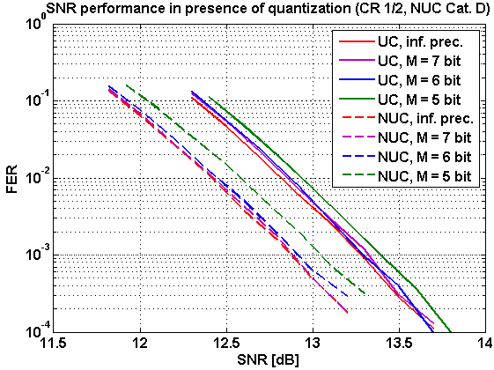
Results: Quantization
Quantization of ADC considered
  ADC has a total of M bits (incl. sign)
    Each component (I and Q) is quantized with M bits
  15% noise margin of ADC range
    i.e. ADC saturation is 15% greater than maximum amplitude in noise free case
sgn
b₁
b₂
…
b_{M-1}
M bits

Slide 8
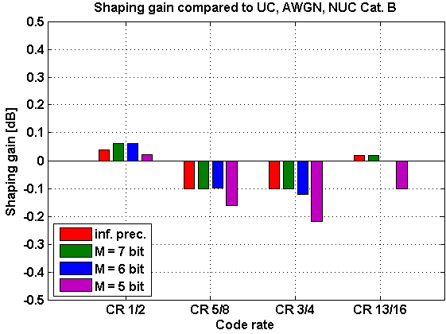
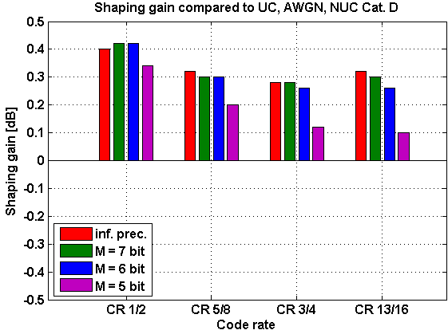
Results: Quantization (shaping gain)
Shaping gain is maintained for (reasonable) quantization
  NUCs of Cat. B stay close to their target shaping gain of ≈ 0dB
  NUCs of Cat. D achieve always a better performance than UCs

Slide 9
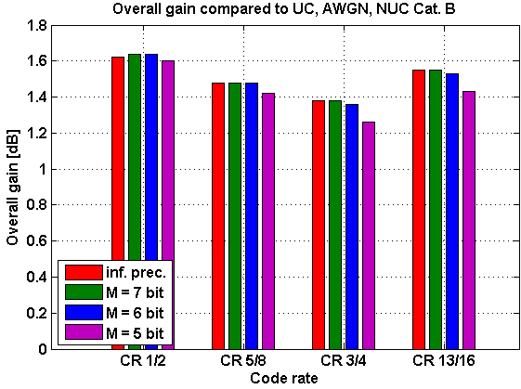
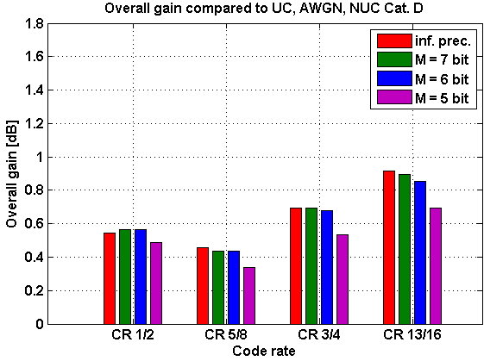
Results: Quantization (overall gain)
Overall gain is maintained for (reasonable) quantization
  Slight performance degradation for M = 5 bit

Slide 10
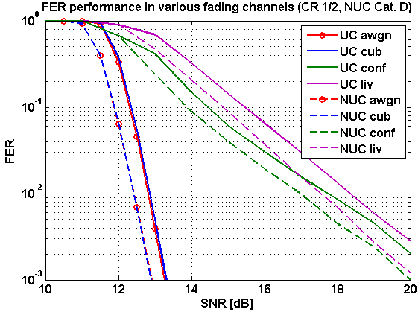
Results: Fading channel
Various .11ad channel models considered
  AWGN, cubical (cub), conference room (conf), living room (liv)
    Cubical: LOS
    Conference, living room: NLOS

Slide 11
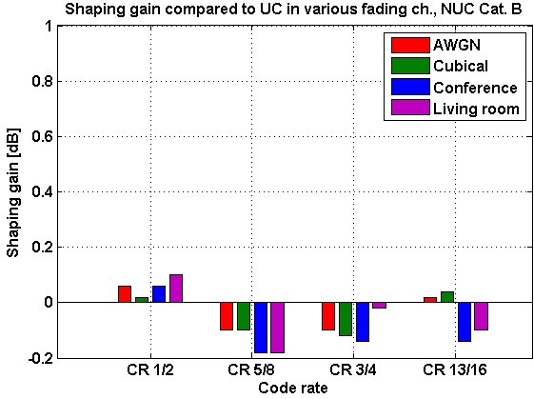
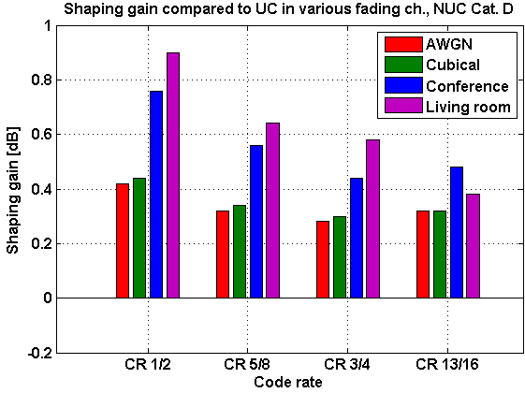
Results: Fading Channel (shaping gain)
Shaping gain is maintained in fading channels
  NUCs of Cat. B: Shaping gain is independent on actual channel
  NUCs of Cat. D: An additional gain can be achieved in NLOS

Slide 12
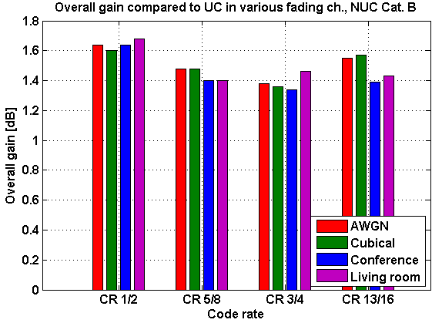
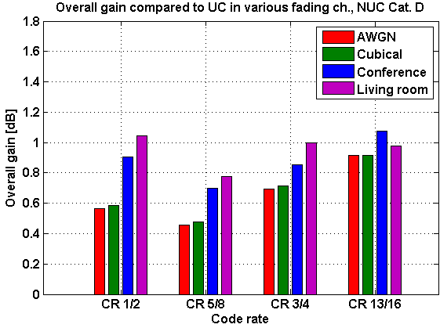
Results: Fading Channel (overall gain)
Overall gain is maintained in fading channels

Slide 13
Conclusion
Investigation of NUC performance in
  Presence of ADC quantization
    NUC gain is maintained for reasonable quantization
  Fading channels
    NUC gain is at least maintained
    NUCs of Cat. D can achieve an additional gain in NLOS channels
NUCs are a promising technology for .11ay
  Significant performance gains (up to 1.6dB)
  Robust against quantization
  Robust in fading channels
  Only a moderate complexity increase
Further aspects under consideration
  E.g. phase noise influence, power amplifier model

Slide 14
References
11-15-0835-01-00ay Potential of Non-Uniform Constellations with Peak Power Constraint
11-14-1378-00-ng60 PHY rate for NG60
11-14-0652-01-0wng-wng Next Generation 802.11ad
11-15-0096-01-ng60 Non-uniform Constellations for higher Order QAMs
11-15-0601-00-00ay Non-uniform Constellations for 64QAM
11-15-0339-00-ng60 SC-64APSK for 11ay
11-15-1289-00-00ax Non-Uniform Constellations for 1024-QAM

