Slide 1
Non-Uniform Constellations for 1024-QAM
Date: 2015/11/08
Authors:

Slide 2
Motivation
1024-QAM has been adopted for 11ax as an optional feature [1]
  “1024-QAM is an optional feature for SU and MU using resource units equal to or larger than 242 tones in 11ax.”
  Advantages
    25% increase in spectral efficiency compared to 256-QAM
    Throughput up to 1.25 Gbps per spatial stream (160MHz, code rate 5/6, short GI)
    ≈10 Gbps aggregate throughput with 8 spatial streams [2]
It has been shown [2, 3] for uniform constellations (UCs) that
  1024-QAM MCS are selected with very high probability in indoor scenarios
  1024-QAM provides an average throughput gain of >20% in most indoor scenarios
However, non-uniform constellations (NUCs) are superior to UCs
  NUCs provide SNR gains compared to UCs
  NUCs are more robust against impairments such as phase noise and quantization
Performance of 1024-QAM in 11ax can be increased by NUCs
  Average throughput gain and selection probability of 1024-QAM MCS will increase

Slide 3
Outline
Details on the proposed NUCs for 1024-QAM
Complexity Analysis
  Comparison of decoding complexity
Performance Results
  AWGN channel
    w/ and w/o phase noise
    w/ and w/o quantization effects
  Performance in fading channels

Slide 4
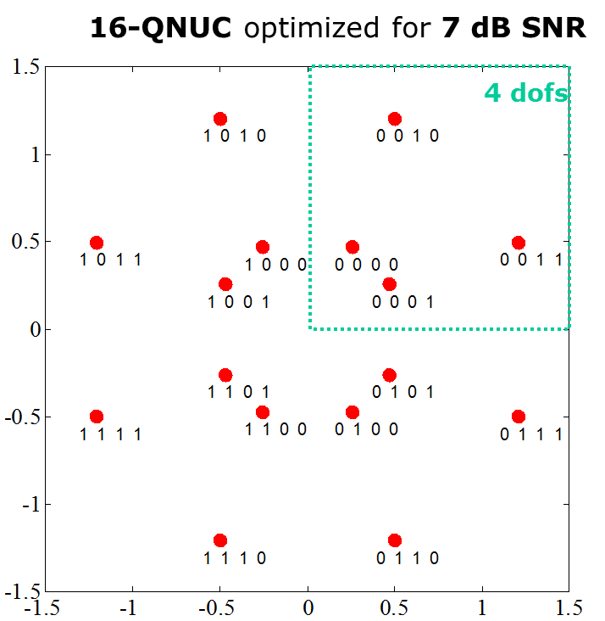
Introduction
Different types of NUCs can be distinguished
  1D NUC
    High level of symmetry
    Amplitude levels of real and imaginary part are the same
    Bit labels of real and imaginary part can be separated
  2D NUC
    Quadrant symmetry
    Amplitude levels of real and imaginary part are independent
    Bit labels can not be separated between real and imaginary part
Comparison of NUC types
  1D NUC
    performance gain over UC
    same complexity as UC
  2D NUC
    even larger performance gain over UCs [4]
    higher complexity than 1D NUCs or UCs
1D NUC: 16-QAM
2D NUC: 16-QAM

Slide 5
Proposed NUCs for 1024-QAM
1D NUCs
  Performance gain at negligible additional decoding complexity
  (see slide 7, [4])
Different NUCs for each code rate
  Optimized for FEC operating point with specific code rate (CR)
Optimized bit labeling
  Matches optimally to existing .11 WLAN system
    No changes at FEC or other blocks required
    No need for a dedicated bit interleaver

Slide 6








Proposed NUCs for 1024-QAM (cont.)
$${−u}_{15}$$
$$u_{15}$$
Figure shows an example
NUC is defined by
amplitudes $u_{1},…,u_{15}$
($u_{0}=1$ assumed)
Details on amplitudes
and bit labeling see
Appendix
$$u_{15}$$
$$u_{0}=1$$
$${−u}_{0}$$
$${−u}_{1}$$
$${−u}_{15}$$

Slide 7
Decoding Complexity of 1D NUCs
1D NUC correspond to a UC with non-uniform amplitude levels
  Real and imaginary part can be independently demodulated
    In case of 1024-QAM, 2x32 metrics are sufficient for the demapping process which is the same for UCs
      No additional complexity
  Metric computation requires the consideration of the non-uniform shape
    Requires only a modification of the amplitude levels of the signal points within the demapper look-up tables
      No additional complexity
1D NUCs yield no additional decoding complexity

Slide 8
Simulation Parameters
1024-QAM: Regular UC and NUC
LDPC, approx. LLR
Message length: 1000 bytes
AWGN, channel model D
Considered impairments:
  w/ and w/o phase noise (PN)
    PN model according to evaluation methodology [5]
  w/ and w/o quantization
    Fixed point quantization between FFT and demapper
Performance compared at FER = 10⁻²
MCS | Coderate | bit/symbol
10 | 3/4 | 10
11 | 5/6 | 10

Slide 9
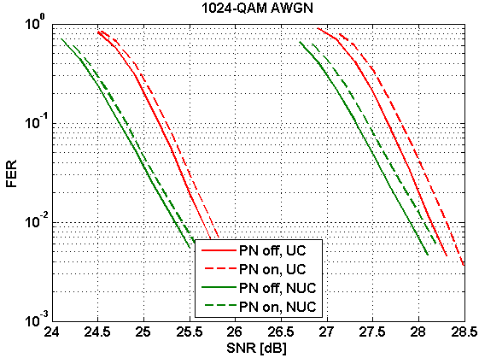
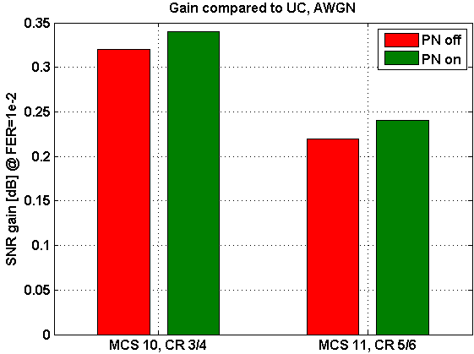
Results: Influence of Phase Noise
NUCs have similar degradation as UCs under PN influence
  NUCs are even more robust against PN than UCs
    Small additional NUC gain
MCS10
CR 3/4
MCS11
CR 5/6

Slide 10
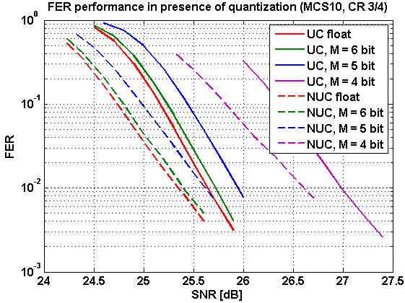
Results: Quantization
Quantization between FFT and Demapper
  Fixed-point implementation
    Number format: sign + 1 bit pre comma + M bits post comma
sgn
a₁
b₁
b₂
…
b_{M}

Slide 11
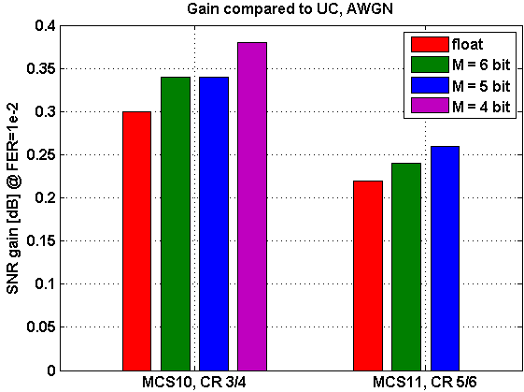
Results: Quantization (cont.)
NUC gain is maintained in presence of quantization
  NUCs even show an additional gain compared to UCs for reasonable quantization
here: SNR gain = 0 dB

Slide 12
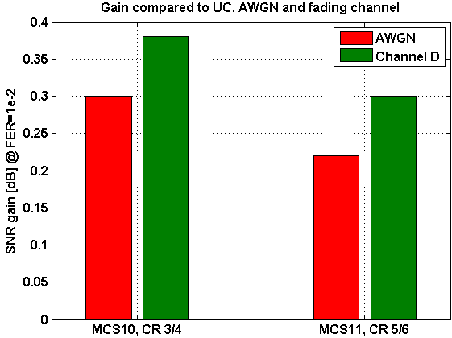
Results: Fading Channel
Channel model D, time-varying
  NUCs show an additional gain compared to UCs in fading channel

Slide 13
Conclusion
Investigation of non-uniform constellations (NUCs) for 1024-QAM
The proposed NUCs
  achieve a gain of 0.3 dB
  have no additional decoding complexity
  maintain / even increase their gain over UCs in presence of
    Phase noise
    Quantization
    Fading channel

Slide 14
References
11-15-0132-09-00ax Specification Framework for TGax
11-15-1070-03-00ax 1024 QAM Proposal
11-14-0624-00-00ax Investigation on 1024 QAM feasibility in 11ax
11-15-0048-00-00ax Non-uniform Constellations for higher Order QAMs
11-09-0451-15-00ac-tgac Functional requirements and evaluation methodology

Slide 15
Tables

Slide 16
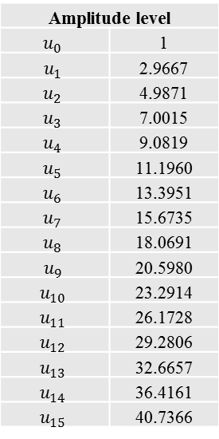
NUC for MCS10 (CR 3/4)
b3 b4 b5 b8 b9 | 0 0 0 0 0 | 1 0 0 0 0 | 1 0 1 0 0 | 0 0 1 0 0 | 0 1 1 0 0 | 1 1 1 0 0 | 1 1 0 0 0 | 0 1 0 0 0 | 0 1 0 0 1 | 1 1 0 0 1 | 1 1 1 0 1 | 0 1 1 0 1 | 0 0 1 0 1 | 1 0 1 0 1 | 1 0 0 0 1 | 0 0 0 0 1
Re(zq) | -31 | -29 | -27 | -25 | -23 | -21 | -19 | -17 | -15 | -13 | -11 | -9 | -7 | -5 | -3 | -1 | Uniform
 | ‑u₁₅ | ‑u₁₄ | ‑u₁₃ | ‑u₁₂ | ‑u₁₁ | ‑u₁₀ | ‑u₉ | ‑u₈ | ‑u₇ | ‑u₆ | ‑u₅ | ‑u₄ | ‑u₃ | ‑u₂ | ‑u₁ | -1 | NUC
b3 b4 b5 b8 b9 | 0 0 0 1 1 | 1 0 0 1 1 | 1 0 1 1 1 | 0 0 1 1 1 | 0 1 1 1 1 | 1 1 1 1 1 | 1 1 0 1 1 | 0 1 0 1 1 | 0 1 0 1 0 | 1 1 0 1 0 | 1 1 1 1 0 | 0 1 1 1 0 | 0 0 1 1 0 | 1 0 1 1 0 | 1 0 0 1 0 | 0 0 0 1 0
Re(zq) | 1 | 3 | 5 | 7 | 9 | 11 | 13 | 15 | 17 | 19 | 21 | 23 | 25 | 27 | 29 | 31 | Uniform
 | 1 | u₁ | u₂ | u₃ | u₄ | u₅ | u₆ | u₇ | u₈ | u₉ | u₁₀ | u₁₁ | u₁₂ | u₁₃ | u₁₄ | u₁₅ | NUC
Amplitude level
$$u_{0}$$ | 1
$$u_{1}$$ | 2.9667
$$u_{2}$$ | 4.9871
$$u_{3}$$ | 7.0015
$$u_{4}$$ | 9.0819
$$u_{5}$$ | 11.1960
$$u_{6}$$ | 13.3951
$$u_{7}$$ | 15.6735
$$u_{8}$$ | 18.0691
$$u_{9}$$ | 20.5980
$$u_{10}$$ | 23.2914
$$u_{11}$$ | 26.1728
$$u_{12}$$ | 29.2806
$$u_{13}$$ | 32.6657
$$u_{14}$$ | 36.4161
$$u_{15}$$ | 40.7366
real part
b0 b1 b2 b6 b7 | 0 0 0 0 0 | 1 0 0 0 0 | 1 0 1 0 0 | 0 0 1 0 0 | 0 1 1 0 0 | 1 1 1 0 0 | 1 1 0 0 0 | 0 1 0 0 0 | 0 1 0 1 0 | 1 1 0 1 0 | 1 1 1 1 0 | 0 1 1 1 0 | 0 0 1 1 0 | 1 0 1 1 0 | 1 0 0 1 0 | 0 0 0 1 0
Im(zq) | -31 | -29 | -27 | -25 | -23 | -21 | -19 | -17 | -15 | -13 | -11 | -9 | -7 | -5 | -3 | -1 | Uniform
 | ‑u₁₅ | ‑u₁₄ | ‑u₁₃ | ‑u₁₂ | ‑u₁₁ | ‑u₁₀ | ‑u₉ | ‑u₈ | ‑u₇ | ‑u₆ | ‑u₅ | ‑u₄ | ‑u₃ | ‑u₂ | ‑u₁ | -1 | NUC
b0 b1 b2 b6 b7 | 0 0 0 1 1 | 1 0 0 1 1 | 1 0 1 1 1 | 0 0 1 1 1 | 0 1 1 1 1 | 1 1 1 1 1 | 1 1 0 1 1 | 0 1 0 1 1 | 0 1 0 0 1 | 1 1 0 0 1 | 1 1 1 0 1 | 0 1 1 0 1 | 0 0 1 0 1 | 1 0 1 0 1 | 1 0 0 0 1 | 0 0 0 0 1
Im(zq) | 1 | 3 | 5 | 7 | 9 | 11 | 13 | 15 | 17 | 19 | 21 | 23 | 25 | 27 | 29 | 31 | Uniform
 | 1 | u₁ | u₂ | u₃ | u₄ | u₅ | u₆ | u₇ | u₈ | u₉ | u₁₀ | u₁₁ | u₁₂ | u₁₃ | u₁₄ | u₁₅ | NUC
imaginary part

Slide 17
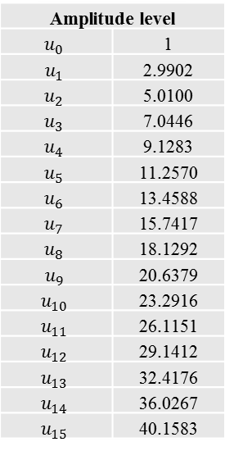
NUC for MCS11 (CR 5/6)
b0 b3 b5 b7 b8 | 0 0 0 0 0 | 1 0 0 0 0 | 1 0 1 0 0 | 0 0 1 0 0 | 0 0 1 0 1 | 1 0 1 0 1 | 1 0 0 0 1 | 0 0 0 0 1 | 0 1 0 0 1 | 1 1 0 0 1 | 1 1 1 0 1 | 0 1 1 0 1 | 0 1 1 0 0 | 1 1 1 0 0 | 1 1 0 0 0 | 0 1 0 0 0
Re(zq) | -31 | -29 | -27 | -25 | -23 | -21 | -19 | -17 | -15 | -13 | -11 | -9 | -7 | -5 | -3 | -1 | Uniform
 | ‑u₁₅ | ‑u₁₄ | ‑u₁₃ | ‑u₁₂ | ‑u₁₁ | ‑u₁₀ | ‑u₉ | ‑u₈ | ‑u₇ | ‑u₆ | ‑u₅ | ‑u₄ | ‑u₃ | ‑u₂ | ‑u₁ | -1 | NUC
b0 b3 b5 b7 b8 | 0 1 0 1 0 | 1 1 0 1 0 | 1 1 1 1 0 | 0 1 1 1 0 | 0 1 1 1 1 | 1 1 1 1 1 | 1 1 0 1 1 | 0 1 0 1 1 | 0 0 0 1 1 | 1 0 0 1 1 | 1 0 1 1 1 | 0 0 1 1 1 | 0 0 1 1 0 | 1 0 1 1 0 | 1 0 0 1 0 | 0 0 0 1 0
Re(zq) | 1 | 3 | 5 | 7 | 9 | 11 | 13 | 15 | 17 | 19 | 21 | 23 | 25 | 27 | 29 | 31 | Uniform
 | 1 | u₁ | u₂ | u₃ | u₄ | u₅ | u₆ | u₇ | u₈ | u₉ | u₁₀ | u₁₁ | u₁₂ | u₁₃ | u₁₄ | u₁₅ | NUC
Amplitude level
$$u_{0}$$ | 1
$$u_{1}$$ | 2.9902
$$u_{2}$$ | 5.0100
$$u_{3}$$ | 7.0446
$$u_{4}$$ | 9.1283
$$u_{5}$$ | 11.2570
$$u_{6}$$ | 13.4588
$$u_{7}$$ | 15.7417
$$u_{8}$$ | 18.1292
$$u_{9}$$ | 20.6379
$$u_{10}$$ | 23.2916
$$u_{11}$$ | 26.1151
$$u_{12}$$ | 29.1412
$$u_{13}$$ | 32.4176
$$u_{14}$$ | 36.0267
$$u_{15}$$ | 40.1583
real part
b1 b2 b4 b6 b9 | 0 0 0 0 0 | 0 0 0 0 1 | 0 0 0 1 1 | 0 0 0 1 0 | 0 1 0 1 0 | 0 1 0 1 1 | 0 1 0 0 1 | 0 1 0 0 0 | 1 1 0 0 0 | 1 1 0 0 1 | 1 1 0 1 1 | 1 1 0 1 0 | 1 0 0 1 0 | 1 0 0 1 1 | 1 0 0 0 1 | 1 0 0 0 0
Im(zq) | -31 | -29 | -27 | -25 | -23 | -21 | -19 | -17 | -15 | -13 | -11 | -9 | -7 | -5 | -3 | -1 | Uniform
 | ‑u₁₅ | ‑u₁₄ | ‑u₁₃ | ‑u₁₂ | ‑u₁₁ | ‑u₁₀ | ‑u₉ | ‑u₈ | ‑u₇ | ‑u₆ | ‑u₅ | ‑u₄ | ‑u₃ | ‑u₂ | ‑u₁ | -1 | NUC
b1 b2 b4 b6 b9 | 1 0 1 0 0 | 1 0 1 0 1 | 1 0 1 1 1 | 1 0 1 1 0 | 1 1 1 1 0 | 1 1 1 1 1 | 1 1 1 0 1 | 1 1 1 0 0 | 0 1 1 0 0 | 0 1 1 0 1 | 0 1 1 1 1 | 0 1 1 1 0 | 0 0 1 1 0 | 0 0 1 1 1 | 0 0 1 0 1 | 0 0 1 0 0
Im(zq) | 1 | 3 | 5 | 7 | 9 | 11 | 13 | 15 | 17 | 19 | 21 | 23 | 25 | 27 | 29 | 31 | Uniform
 | 1 | u₁ | u₂ | u₃ | u₄ | u₅ | u₆ | u₇ | u₈ | u₉ | u₁₀ | u₁₁ | u₁₂ | u₁₃ | u₁₄ | u₁₅ | NUC
imaginary part

Slide 18
Straw Poll #1
Do you agree to add to the TG Specification Frame work document?
  3.3.4 Modulation
  “Non-uniform constellations shall be used for 1024-QAM”

Slide 19
Straw Poll #2
Do you agree to add to the TG Specification Frame work document?
  3.3.4 Modulation
  “1024-QAM shall use non-uniform constellations for code rates 3/4 and 5/6 with amplitude levels and bit labels defined in slide 16 and 17, respectively?”

Slide 20
APPENDIX

Slide 21
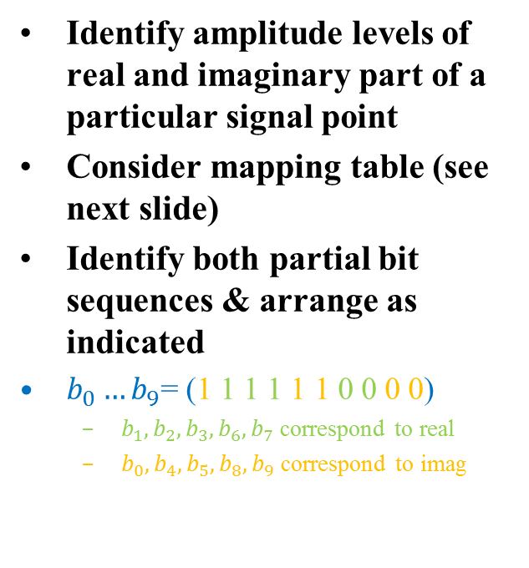



Example: How to get the bit labeling
$b_{0}…b_{9}$= (1 1 1 1 1 1 0 0 0 0)
Real part: ${−u}_{2}$
Identify amplitude levels of real and imaginary part of a particular signal point
Consider mapping table (see next slide)
Identify both partial bit sequences & arrange as indicated
$b_{0}…b_{9}$= (1 1 1 1 1 1 0 0 0 0)
  $b_{1},b_{2},b_{3},b_{6},b_{7}$ correspond to real
  $b_{0},b_{4},b_{5},b_{8},b_{9}$ correspond to imag
Imag.
part: $u_{13}$

Slide 22
Example: How to get the bit labeling (cont.)
b1 b2 b3 b6 b7 | 0 0 0 0 0 | 1 0 0 0 0 | 1 0 1 0 0 | 0 0 1 0 0 | 0 0 1 0 1 | 1 0 1 0 1 | 1 0 0 0 1 | 0 0 0 0 1 | 0 1 0 0 1 | 1 1 0 0 1 | 1 1 1 0 1 | 0 1 1 0 1 | 0 1 1 0 0 | 1 1 1 0 0 | 1 1 0 0 0 | 0 1 0 0 0
Re(zq) | -31 | -29 | -27 | -25 | -23 | -21 | -19 | -17 | -15 | -13 | -11 | -9 | -7 | -5 | -3 | -1 | Uniform
 | ‑u₁₅ | ‑u₁₄ | ‑u₁₃ | ‑u₁₂ | ‑u₁₁ | ‑u₁₀ | ‑u₉ | ‑u₈ | ‑u₇ | ‑u₆ | ‑u₅ | ‑u₄ | ‑u₃ | ‑u₂ | ‑u₁ | -1 | NUC
b1 b2 b3 b6 b7 | 0 1 0 1 0 | 1 1 0 1 0 | 1 1 1 1 0 | 0 1 1 1 0 | 0 1 1 1 1 | 1 1 1 1 1 | 1 1 0 1 1 | 0 1 0 1 1 | 0 0 0 1 1 | 1 0 0 1 1 | 1 0 1 1 1 | 0 0 1 1 1 | 0 0 1 1 0 | 1 0 1 1 0 | 1 0 0 1 0 | 0 0 0 1 0
Re(zq) | 1 | 3 | 5 | 7 | 9 | 11 | 13 | 15 | 17 | 19 | 21 | 23 | 25 | 27 | 29 | 31 | Uniform
 | 1 | u₁ | u₂ | u₃ | u₄ | u₅ | u₆ | u₇ | u₈ | u₉ | u₁₀ | u₁₁ | u₁₂ | u₁₃ | u₁₄ | u₁₅ | NUC
real part
b0 b4 b5 b8 b9 | 0 0 0 0 0 | 1 0 0 0 0 | 1 1 0 0 0 | 0 1 0 0 0 | 0 1 0 1 0 | 1 1 0 1 0 | 1 0 0 1 0 | 0 0 0 1 0 | 0 0 0 1 1 | 1 0 0 1 1 | 1 1 0 1 1 | 0 1 0 1 1 | 0 1 0 0 1 | 1 1 0 0 1 | 1 0 0 0 1 | 0 0 0 0 1
Im(zq) | -31 | -29 | -27 | -25 | -23 | -21 | -19 | -17 | -15 | -13 | -11 | -9 | -7 | -5 | -3 | -1 | Uniform
 | ‑u₁₅ | ‑u₁₄ | ‑u₁₃ | ‑u₁₂ | ‑u₁₁ | ‑u₁₀ | ‑u₉ | ‑u₈ | ‑u₇ | ‑u₆ | ‑u₅ | ‑u₄ | ‑u₃ | ‑u₂ | ‑u₁ | -1 | NUC
b0 b4 b5 b8 b9 | 0 0 1 0 1 | 1 0 1 0 1 | 1 1 1 0 1 | 0 1 1 0 1 | 0 1 1 1 1 | 1 1 1 1 1 | 1 0 1 1 1 | 0 0 1 1 1 | 0 0 1 1 0 | 1 0 1 1 0 | 1 1 1 1 0 | 0 1 1 1 0 | 0 1 1 0 0 | 1 1 1 0 0 | 1 0 1 0 0 | 0 0 1 0 0
Im(zq) | 1 | 3 | 5 | 7 | 9 | 11 | 13 | 15 | 17 | 19 | 21 | 23 | 25 | 27 | 29 | 31 | Uniform
 | 1 | u₁ | u₂ | u₃ | u₄ | u₅ | u₆ | u₇ | u₈ | u₉ | u₁₀ | u₁₁ | u₁₂ | u₁₃ | u₁₄ | u₁₅ | NUC
imaginary part

