Slide 1
Preliminary Q-D Model for Lab Environment at 83 GHz
Date: 2015-11
Authors:

Slide 2
Abstract
This document presents preliminary results for the Quasi-Deterministic (Q-D) Channel Model* developed using measurements taken in a lab environment at 83 GHz.
*“Quasi-deterministic Approach to mmWave Channel Modeling in a Non-stationary Environment,” Maltsev, Pudeyev, Karls,
Bolotin, Morozov, Weiler, Peter, Keusgen, Globecom 2014.

Slide 3
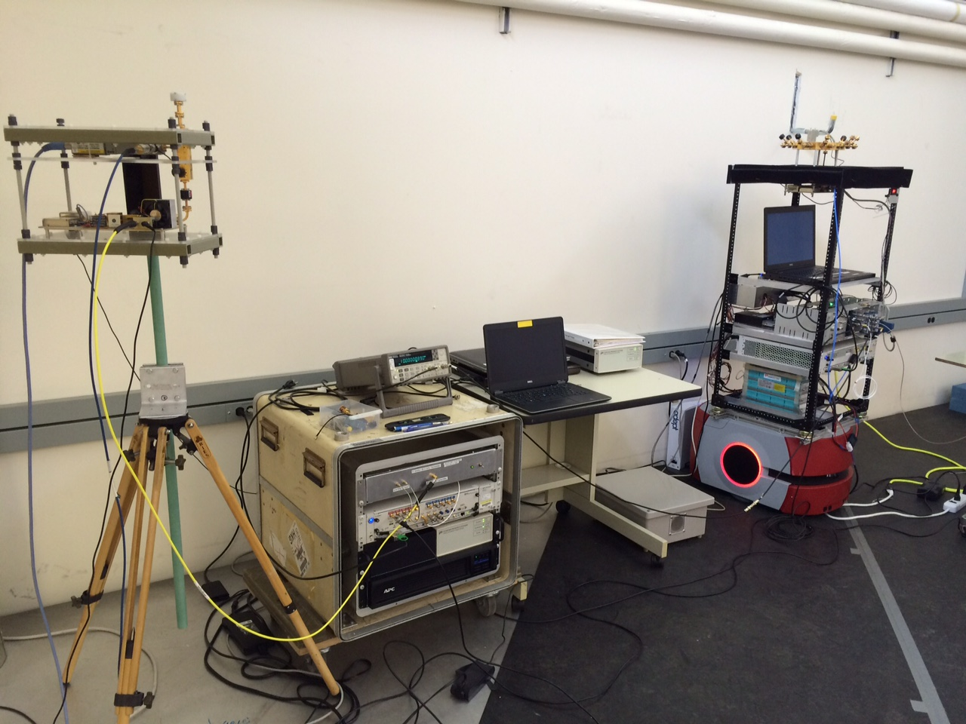
83 GHz Channel Sounder
1 TX antenna
Omni-directional in azimuth
45º beamwidth in elevation
16-antenna RX array
8 elements every 45º in azimuth at 0º elevation
8 elements every 45º in azimuth at 45º elevation
Can extract double-directional AoA
Each horn antenna has 45º beamwidth
2 GHz null-to-null bandwidth
Robot-guided navigational system
Can collect hundreds of GB of data in just minutes
Can support use cases with high mobility
Complete channel measurement sweep in 65 μs
Untethered synchronization through rubidium clocks

Slide 4
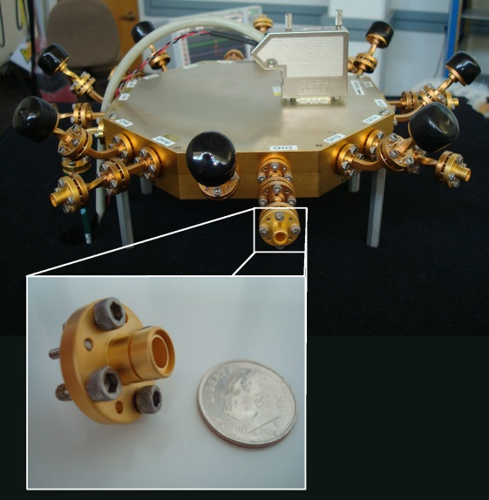
Multipath Extraction
SAGE algorithm:
Superresolution technique which can also deembed the antennas from the measured response
Paths indexed in complex amplitude, delay, azimuth AoA, and elevation AoA
Average AoA error for LOS path over different measurements:
azimuth: 1.6º
elevation: 4.3º
RX array

Slide 5
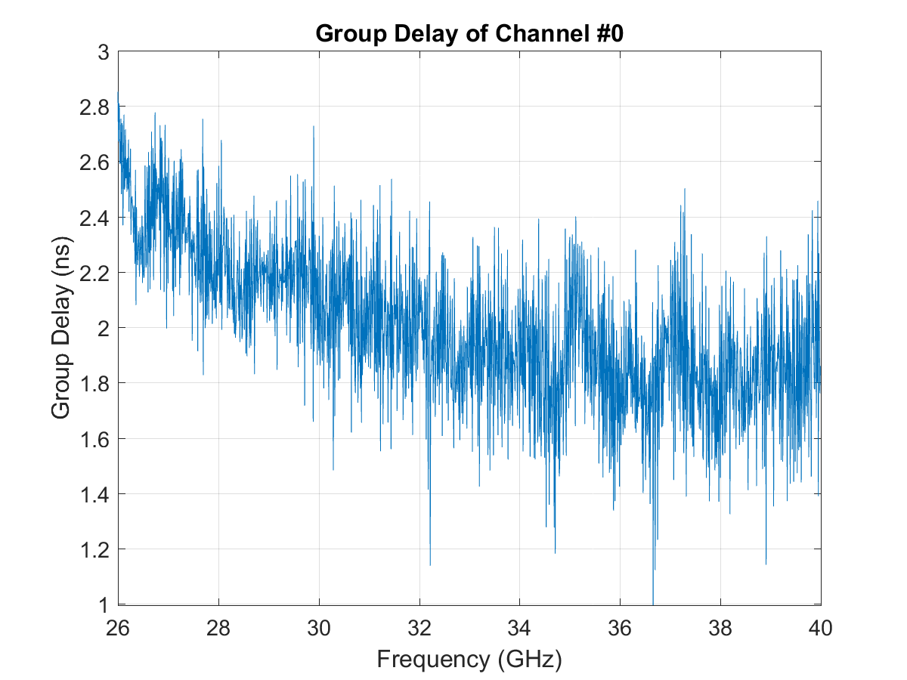
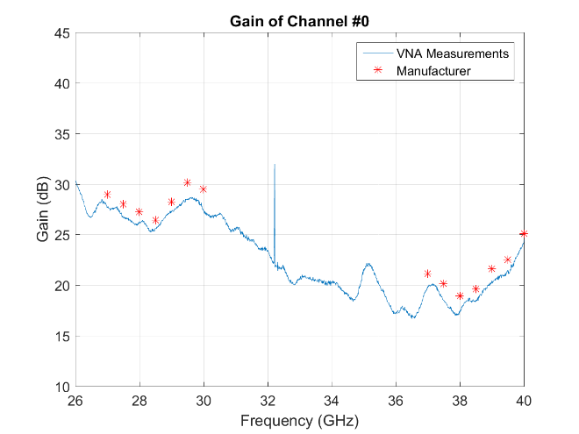
System Calibration
Use the S₂₁ frequency response measured through back-to-back calibration with VNA to account for delay / gain offset between 16 RX antennas (shown for 28 GHz system)
IDEAL
For now, antennas deembedded according to pattern provided by manufacturer specs
Double-directional antenna calibration in anechoic chamber forthcoming
Beam pattern vertical antennas

Slide 6
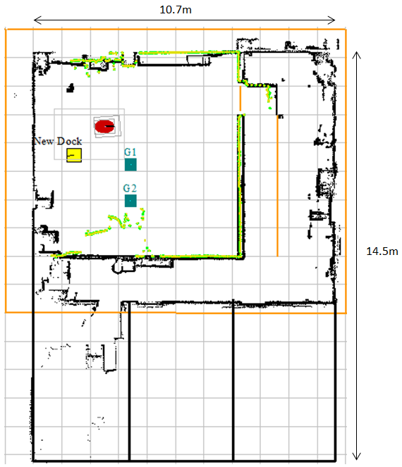
Lab
Picture of lab
Floor plan of lab
Measurements presented for lab environment
Have access to floor plan of lab
Actual measurements taken in 10 x 8 x 10 m³ room (orange)

Slide 7
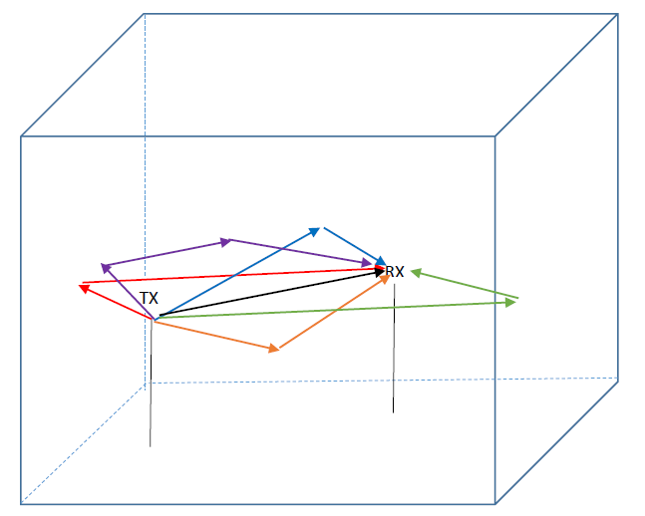
Simplified Raytracing Model
10 m
8 m
10 m
At higher frequencies (e.g. 83 GHz), dominant propagation mechanism is reflection (and resultant diffuse scattering)
Q-D-Model approach is to use simplified raytracing to determine reflected paths
LOS and 1st- and 2nd-order wall, ceiling, and floor reflections predicted given the locations of the TX-RX and the simplified geometry of the room

Slide 8
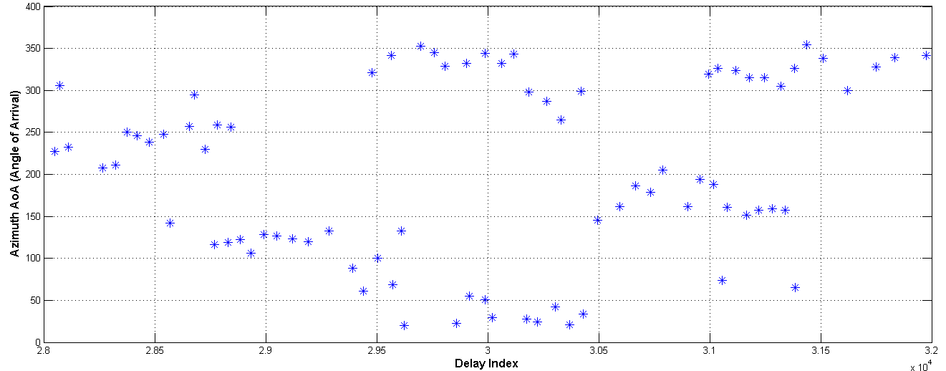
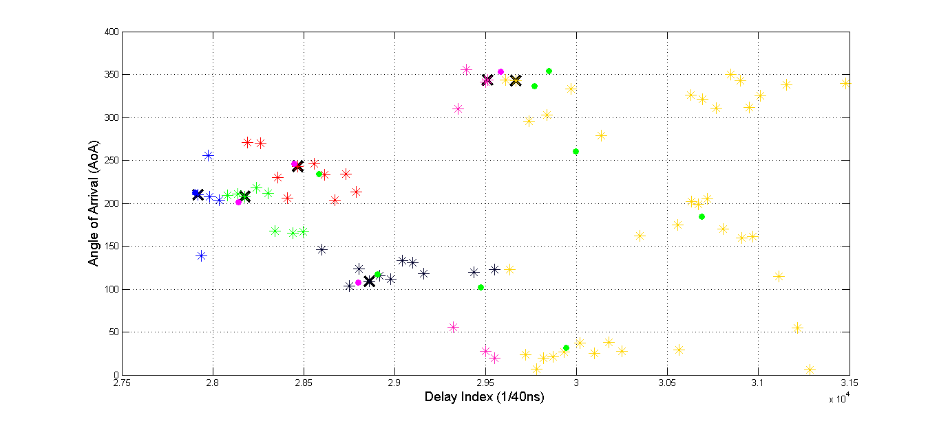
Model-Predicted Clusters
Extracted multipath shown in azimuth AoA vs. delay plot (*)
LOS, 1st- and 2nd-order reflections projected on plot
Clustered multipath correspond to Q-D-model-predicted reflections
The “cursor” is set as the strongest/closest multipath to the predicted reflection (X)
All other multipath considered diffuse scattering clustered around the cursor using K-means

Slide 9
Cluster Parameters
CURSOR
PRE-CURSOR
POST-CURSOR
PL
K
CDF
λ_{f}
1/γ_{f}
Delay index (1/40 ns x 10⁴)
Azimuth AoA (deg.)
Parameter | Notation | LOS | 1st Order Clusters | 802.11 ad*
Pre-cursor rays K-factor (dB) | K_{f} |  | 3.9 – 6.5 | 10
Pre-cursor rays Power decay time (ns) | γ_{f} |  | 0.2 – 1.3 | 3.7
Pre-cursor arrival rate (${ns}^{−1}$) | λ_{f} |  | 0.5 – 0.64 | 0.37
Post-cursor rays K-factor (dB) | K_{b} | 22.7 | 10.9 – 13.7 | 14.2
Post-cursor rays power decay time (ns) | γ_{b} | 0.15 | 0.58 – 3.64 | 4.5
Post-cursor arrival rate (${ns}^{−1}$) | λ_{b} | 1.19 | 0.51 – 0.71 | 0.31
Ray DOA azimuth std. (deg.) | σ_{ᶱ} | 32.5 | 19.3 – 67.7 | 40
Once the extracted multipath have been clustered, the parameters for each cluster can be reduced
Multipath of each cluster can be partitioned into pre- and post-cursor segments according to delay index
Good agreement witnessed in comparison with 802.11ad conference room model
*IEEE 802.11-10/0112r1, Sawada (Tohoku University), Kato (NICT/ Tohoku University), Sato, Harada (NICT), Maltsev, Lomayev, Sevastyanov, Khoryaev (Intel)

Slide 10
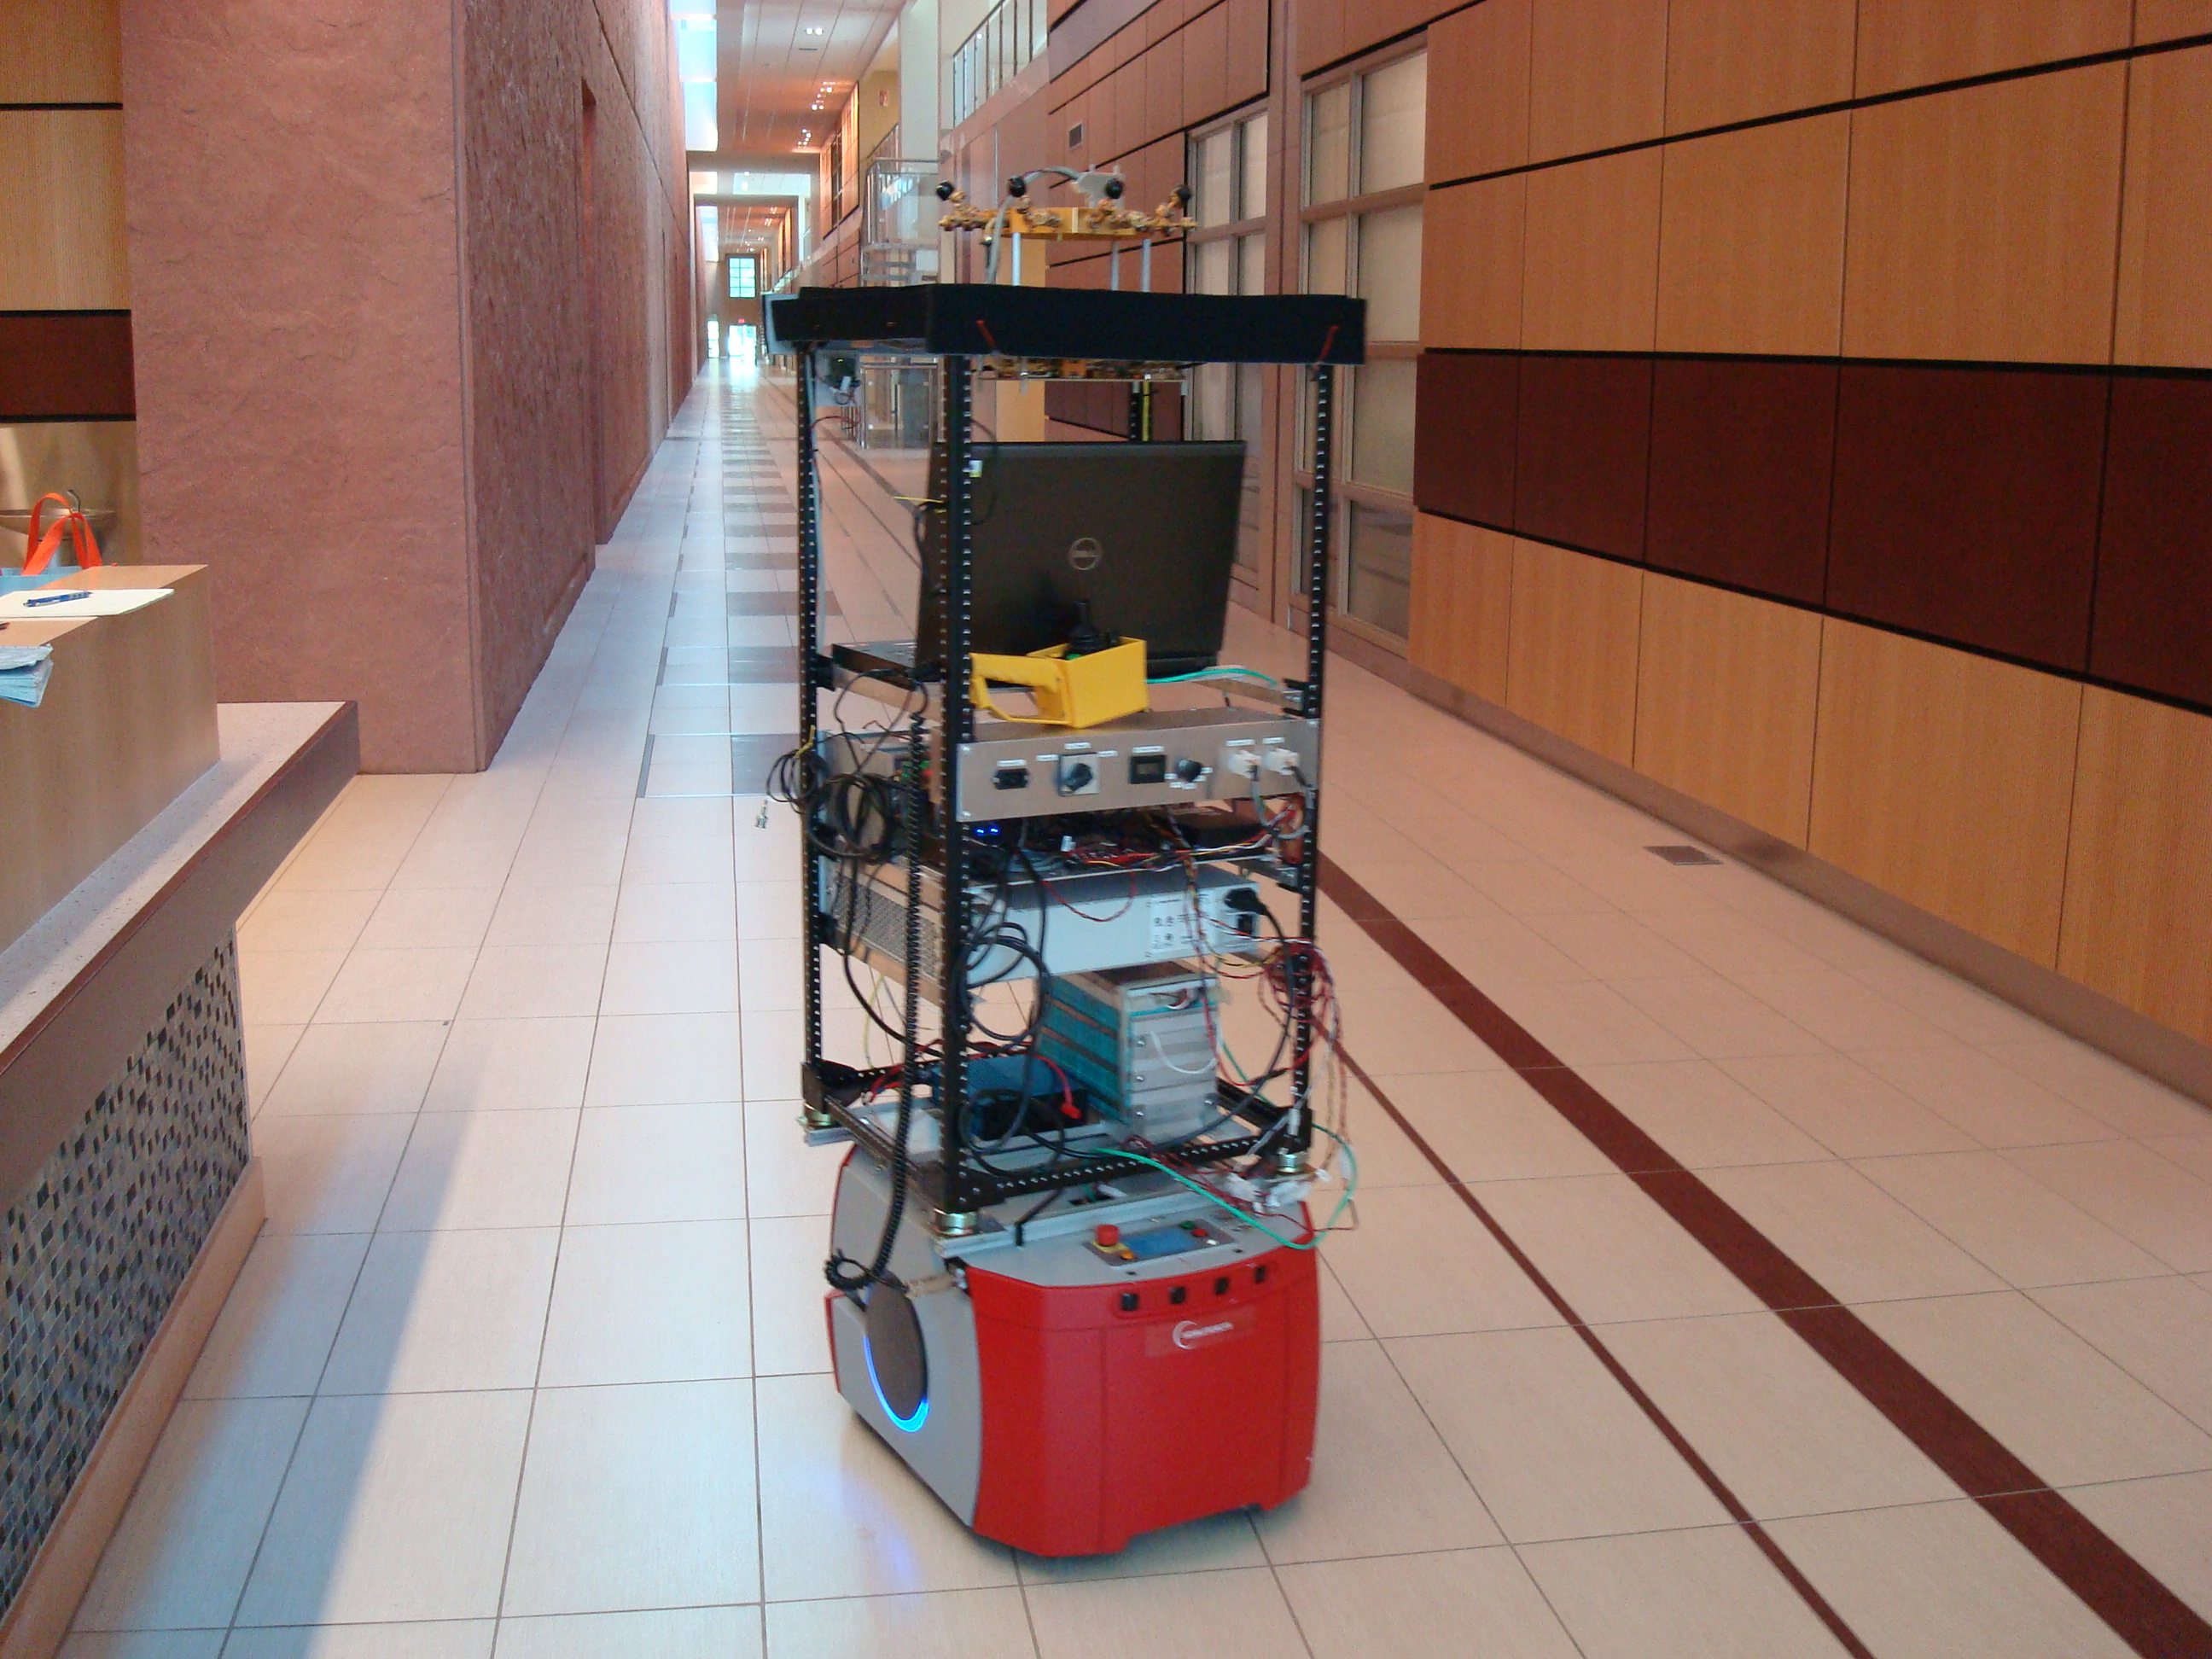
Other Environments
Picture of hallway
Floor plan of hallway
Collected measurements in the presence of human movement: hallway and conference room
In hallway, getting strong reception beyond 150 m
Forthcoming, Q-D model for these two environments as well
Plan to do server room and residential living room

Slide 11
60 GHz Channel Sounder
8-antenna TX array
16-antenna RX array
4 GHz 3dB bandwidth
To be delivered at NIST mid-January

