Slide 1
Traffic priority for random Multi User Uplink OFDMA
Date: 2015-11
Authors:
Name | Affiliation | Address | Email
Stéphane BARON | Canon | Cesson-Sevigné, France | stephane.baron@crf.canon.fr
Patrice NEZOU |  |  | patrice.nezou@crf.canon.fr
Romain GUIGNARD |  |  | romain.guignard@crf.canon.fr
Pascal VIGER |  |  | pascal.viger@crf.canon.fr

Slide 2
Abstract
802.11ax SFD specifies OFDMA to be supported. [2]
A trigger frame (TF-R) enables random access mechanism for MU UL-OFDMA transmissions:
  Resource Units (RU) can be randomly accessed by more than one STA [1]
  The selection method of the Random RU is based on an OFDMA Backoff (called OBO). [3]
  AP may broadcast a Randomization Parameter in trigger frame to help the STAs in their procedure to randomly access an RU. [4]
In this contribution, we propose to introduce traffic priority in the Multi user uplink procedure for any 11ax STA receiving a TF-R frame, based on its EDCA traffic prioritization and the AP Randomization parameter.

Slide 3
Background 1/2
CSMA/CA
  802.11 is contention based access technology - CSMA/CA, which is originally designated for single STA to occupy the medium in a fairness way.
  The random backoff procedure is a fully distributed method and ensures the fairness (allocates the channel to stations with roughly the same probability).
EDCA / IEEE 802.11e std
  Enhanced Distributed Channel Access (EDCA), for differentiated QoS
  Each Access Category (AC) has its own set of channel access parameters (including backoffs), in order to manage local traffic priorities
Priority | Access Catagory | CWmin | CWmax | AIFSN
lowest | Background (AC_BK) | aCWmin | aCWmax | 7
 | Best Effort (AC_BE) | aCWmin | aCWmax | 3
 | Video (AC_VO) | aCWmin/2 | aCWmin | 2
highest | Voice (AC_VI) | aCWmin/4 | aCWmin/2 | 2
EDCA default parameters

Slide 4
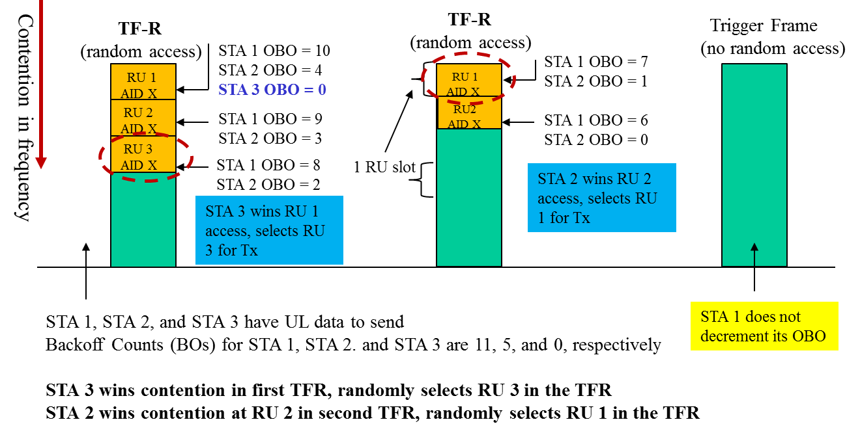
Background 2/2
Terminology (as referred in [3] :15/1105r1) :
  CWO: Contention Window for UL-OFDMA
  CWOmin, CWOmax : Min and max values for CWO
  UL-OFDMA Backoff (OBO) Count : A counter maintained by the STA that determines the random access RU the STA utilizes.
RU selection process:

Slide 5
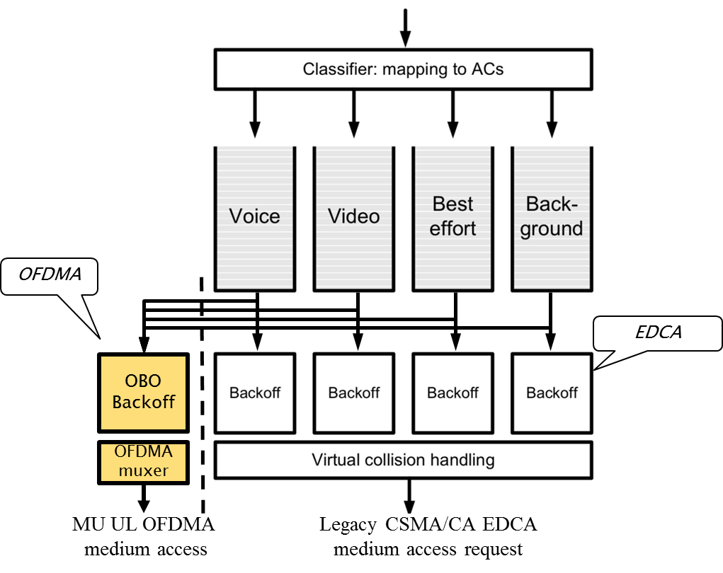
Data selection process for MU UL
Principle :
  OBO runs in parallel of EDCA backoff(s), and manages the medium access onto UL-OFDMA. [3]
  Data stored in the AC queues can be sent through EDCA CSMA/CA medium access or through the OFDMA MU_UL .
  OFDMA muxer manages traffic priorities
  by reusing Access Category priorities to select
  data to be transmitted.
Advantages
  EDCA still runs in parallel,
  Reuse of the existing AC queues
  STA locally ensures its EDCA data priority for both CSMA/CA and MU_UL schemes.

Slide 6
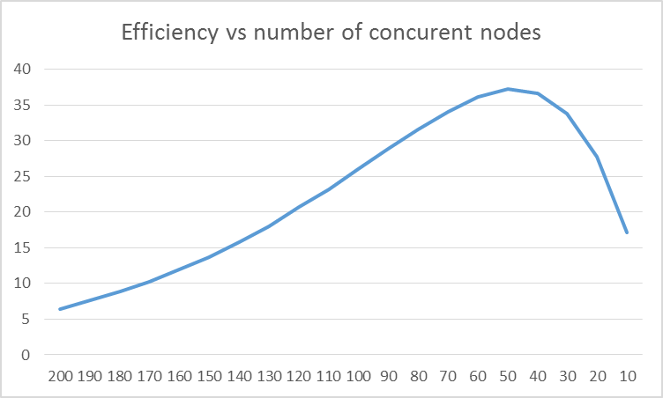
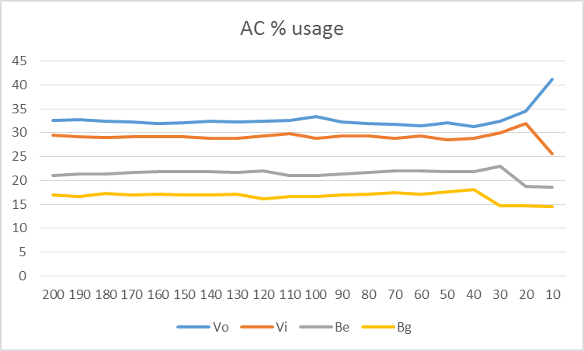
Data selection process for MU UL
Random selection
Selection using AC priorities
CWO=64, 64 RU
CWO=64, 64 RU
Same efficiency
Simulation scenario:
  Full buffer for the 4 AC queues
  AC backoffs evolve between 2 consecutive TF-R.
Local data priority is respected

Slide 7
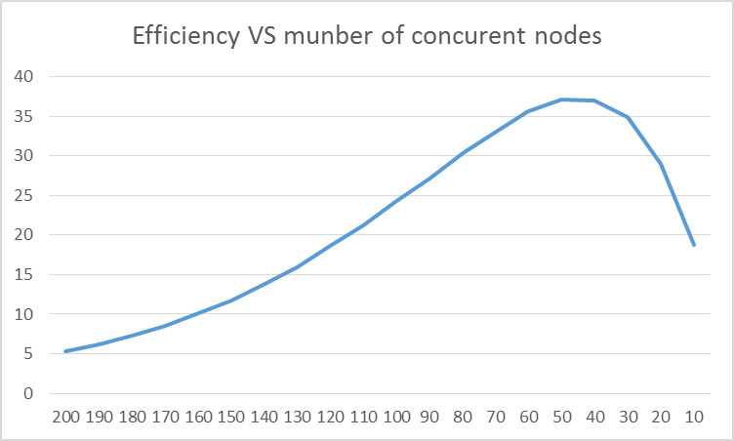
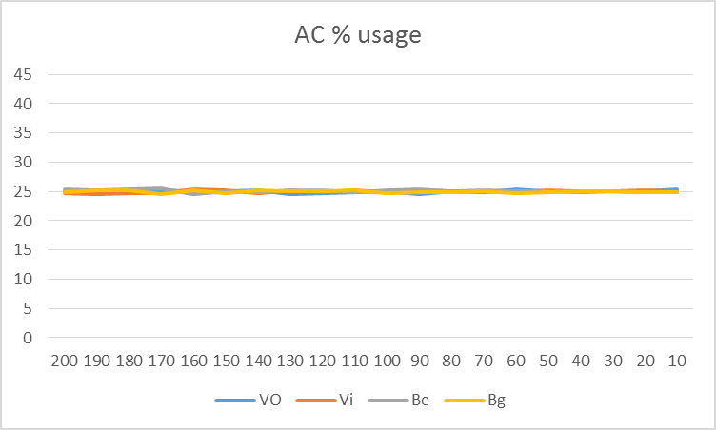
Data selection process for MU UL
Selection using AC priorities only
Simulation scenario:
  Each STA only send one type of data (full buffer for only one AC queue per STA).
CWO=64, 64 RU, no Offset
Same efficiency
Data priority is respected locally, but not between STAs. Additional mechanism required.

Slide 8
OBO determination
ST#4
  EDCA introduced the AIFSN concept to apply the AC priorities among the STAs.
  Similarly, The OBO computing shall take into account the AC priorities using an AC_Offset value (depending of the Current AC).
  AC_Offset[] values shall be adapted to the number of RUs.
  Each STA computes its OBO according the formula : OBO=rand[0,CWO]+AC_Offset[Current AC]
  AC_Offset[] (TBD).
Advantages
  OBO can be adapted to the data priority ready to be sent at the moment of the TF-R reception.

Slide 9
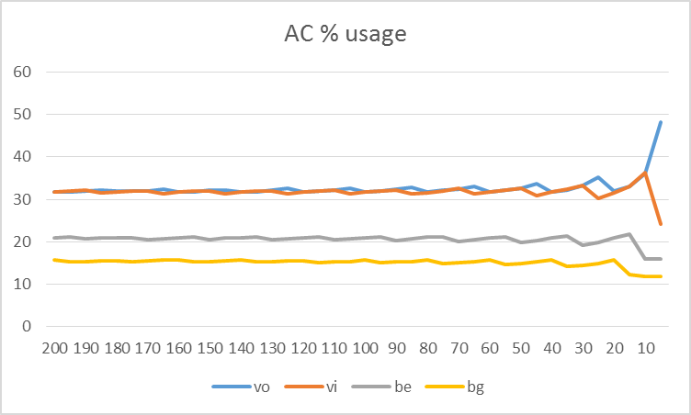
Data selection process for MU UL
With Offset usage
Simulation scenario:
  Each STA only send one type of data (full buffer for only one AC queue per STA).
  CWO=64, 64 RU,
  Offset : vo=0,vi=0,be=32,bg=64
Same efficiency
Data priority between STAs is OK.

Slide 10
CWO computation 1/2
ST#2
  AP may broadcast a Randomization Parameter in trigger frame to help the STAs in their procedure to randomly access an RU. [4]
  CWO computation : CWO=CWOmin x 2^{CRF}
  A Collision Risk Factor (CRF) is a multiplication factor reflecting the probability of transmission error to be taken into account in the congestion window computation.
  The CRF can be provided by the AP (optional Randomization Parameter [4]) or computed locally by each STA based on its previous MU UL transmission status.
  Randomization Parameter received from AP is priority compared to locally computed CRF value.
Advantages :
  2^{CRF} factor reflects the successive “doubling” of the CWO.
  Use of AP randomization parameter for CWO computation enhances the RU usage efficiency, since AP has a global view of the MU UL session efficiency.
  Locally computed CRF allows CWO adaptation when optional Randomization Parameter is not provided by the AP.

Slide 11
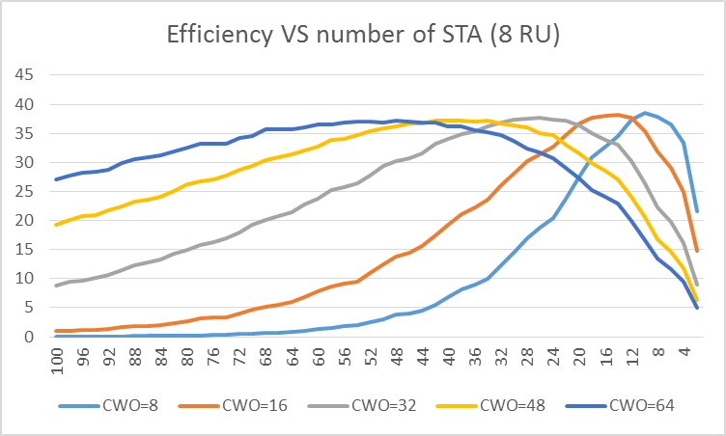
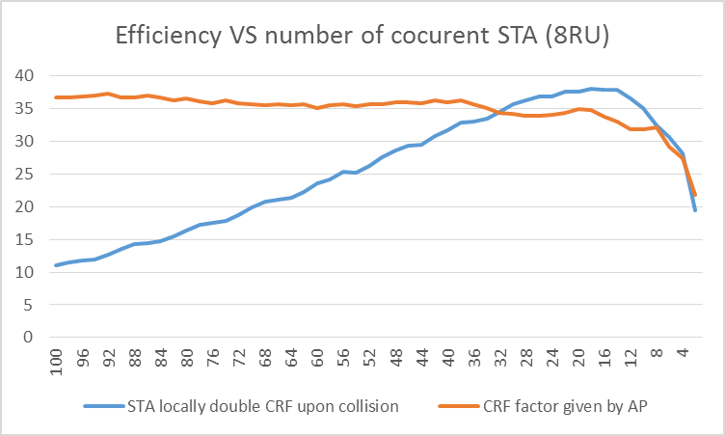
CWO computation 1/2
Simulation scenario:
  Each STA only send one type of data (full buffer for only one AC queue per STA).
  CWO = constant
No CWO evolution mechanism
Simulation scenario:
  Each STA only send one type of data (full buffer for only one AC queue per STA).
  CWO=CWOmin x 2 ^{CRF}
  CWOmin = Number of RU
With CWO evolution mechanism

Slide 12
CWO computation 2/2
ST#3
CWO is in the range [CWOmin, CWOmax]. [3]
CWOmin = number of random RU.
    CWOmin shall be adapted according to the number of RU defined by a TF-R. [3]
    CWOmin shall be determined upon each TF-R reception.
CWOmax= fct( AC_Priority_Factor[Current AC] )
    CWOmax shall be adapted according to the current highest priority of the data contained in AC queues :
      Fct() is TBD.
      AC_Priority_Factor[] (TBD) shall reflects the ratio between AC priorities as defined in EDCA.
        possible TBD values may follow EDCA ratio : (Vo=7, Vi=15, Be=1023, Bg=1023).
      Current AC is the AC of the highest priority among active AC queues (AC queues priority determined based on AC backoff values).
Advantages
  CWO can be adapted dynamically if Nb of RUs changes between two successive TF-R.
  MU_UL medium access scheme follows the AC priority under high collision rate.

Slide 13
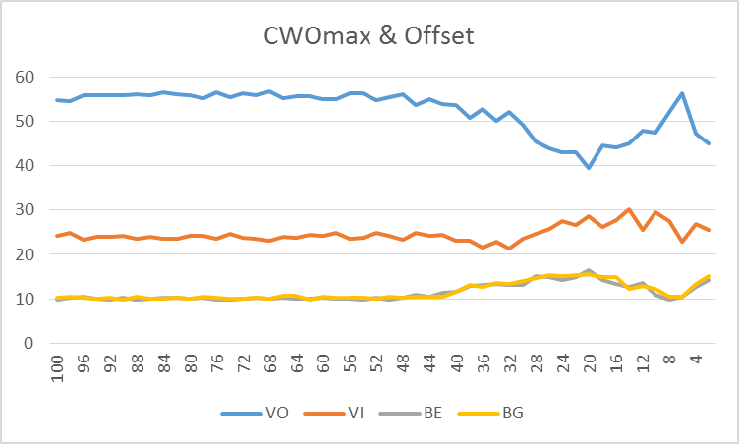
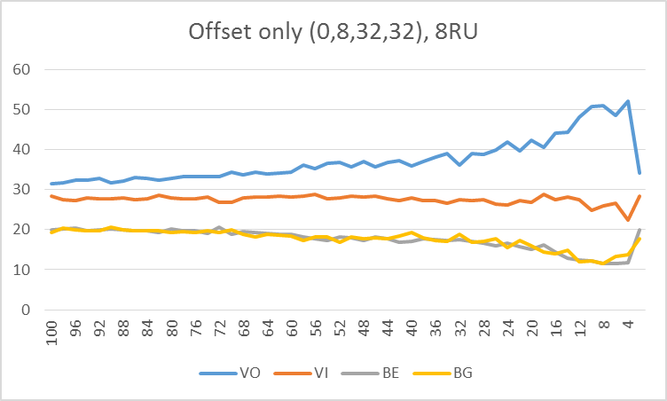
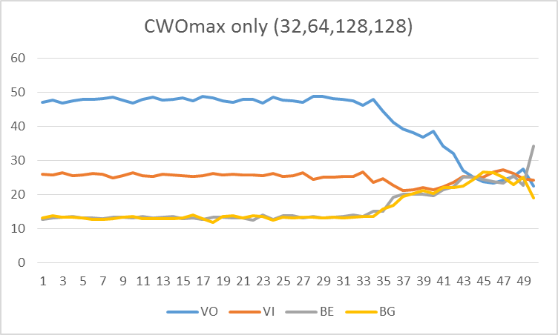
CWO computation 2/2
Simulation scenario:
  Each STA only send one type of data (full buffer for only one AC queue per STA).
  8 RU
  CWO = CWOmin*2 ^{CRF}

Slide 14
Data priority handling for Random procedure
Principle : Upon TF-R reception
  If No active OBO
    STA compute the CWO based on NbRu, Collision Probability, and data priority.
    Collision Probability received from AP is priority compared to locally computed value.
    STA computes a new OBO from CWO + an offset based on data AC.
  STA selects an RU [3].
  STA transmits data
    Select the data with the highest priority
    Transmit the data on the selected RU.
  STA updates locally the collision probability:
Advantages
  The proposal is respectful of the data priority defined in EDCA.
  Use of AP randomization parameter for OBO computation reduces the probability of RU collision.
ST#3
ST#2
ST#4
ST#1

Slide 15
Data priority handling : example of application
Principle : Upon TF-R reception
  If No active OBO
    STA compute the CWO:
      CWO = CWOmin * 2^{CRF}
        Collision Risk Factor computed locally (TBD), and/or received from the AP (e.g. Transmission probability control) provided by AP in the trigger frame
        CWO is in the range [CWOmin, CWOmax]
      Typically:
          CWOmin = number of random RUs of TF-R (theoretical optimal value [3])
          CWOmax = CWmax_{ac} , wherein ac is the current highest priority AC queue
        (this limit may evolve if data is stored in another queue with higher/lower priority)
    STA computes a new OBO from CWO
      OBO = rand [0 , CWO] + AC_Offset : Offset values based on NbRu and the Current_AC (TBD)
        (e.g VO=0, VI=0, BE=max(1,NbRU/4), BG=max(2,NbRU/2))
  STA selects an RU.
  STA transmit data
    Select the data with the highest priority (e.g : data in the AC[] queue having the lowest backoff)
    Transmit the data on the selected RU.
  STA update locally the CRF :
    Upon successful transmission CRF=0.
    Upon transmission failure : CRF=CRF+1.

Slide 16
Summary
In this presentation, we proposed to introduce traffic priority in the Multi user uplink procedure for any 11ax STA receiving a TF-R frame, based on its EDCA traffic prioritization and the AP Randomization parameter :
  A data selection process for MU UL reusing the AC queues.
  A CWO computation mechanism, including the CWOmin, and CWOmax initialization based on the AC priorities, and on a Collision Risk Factor (CRF) reflecting the probability of transmission error.
  An OBO determination mechanism including an AC_Offset value reflecting the data priority ready to be sent at the moment of the TF-R reception.

Slide 17
References
[1] IEEE 802.11-15/0875r1 “Random Access with Trigger Frames using OFDMA”
[2] IEEE 802.11-15/0132r2 “Specification Framework for Tax”
[3] IEEE 802.11-15/1105r0 “UL OFDMA-based Random Access Procedure”
[4] IEEE 802.11-15/1137r1 “Triggered OFDMA Random Access Observations”

Slide 18
Straw-poll 1
Do you agree to add to the TG specification framework document?
The spec shall define a procedure for the data selection upon random trigger frame reception, respectful of AC priorities:
  OFDMA MU_UL muxer picks data from AC queues.
  OFDMA MU_UL muxer follows traffic priorities of Access Categories to select data to be transmitted.
Yes:
No:
Abstain:

Slide 19
Straw-poll 2
Do you agree to add to the TG specification framework document?
    The spec shall define a Collision Risk Factor (CRF) reflecting the probability of transmission error to be taken into account in the CWO computation according to the formula: CWO = CWOmin x 2^{CRF}
    The CRF can be provided by the AP (optional Randomization Parameter [4]) or computed locally by each STA based on its previous MU UL transmission status.
    Randomization Parameter received from AP is priority compared to locally computed CRF value.
Yes:
No:
Abstain:

Slide 20
Straw-poll 3
Do you agree to add to the TG specification framework document?
A STA shall compute the CWOmin and CWOmax values upon TF-R reception. The CWOmin value shall be adapted according to the number of RU (NbRu) defined by the received TF-R, and the CWOmax shall be adapted (AC_Priority_Factor[] is TBD) according to the current highest priority (CurrentAC) of the data contained in AC queues.
The resulting formulas for the CWOmin and CWOmax shall be:
CWOmin=NbRu
CWOmax=fct (AC_Priority_Factor[Current AC] )
Yes:
No:
Abstain:

Slide 21
Straw-poll 4
Do you agree to add to the TG specification framework document?
The STA shall compute the OBO from CWO + an offset based on data AC according to the formula :
OBO=rand[0,CWO]+AC_Offset[Current_AC](TBD)
Yes:
No:
Abstain:

Slide 22
Backup slides

Slide 23
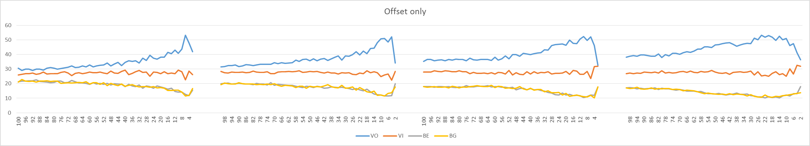
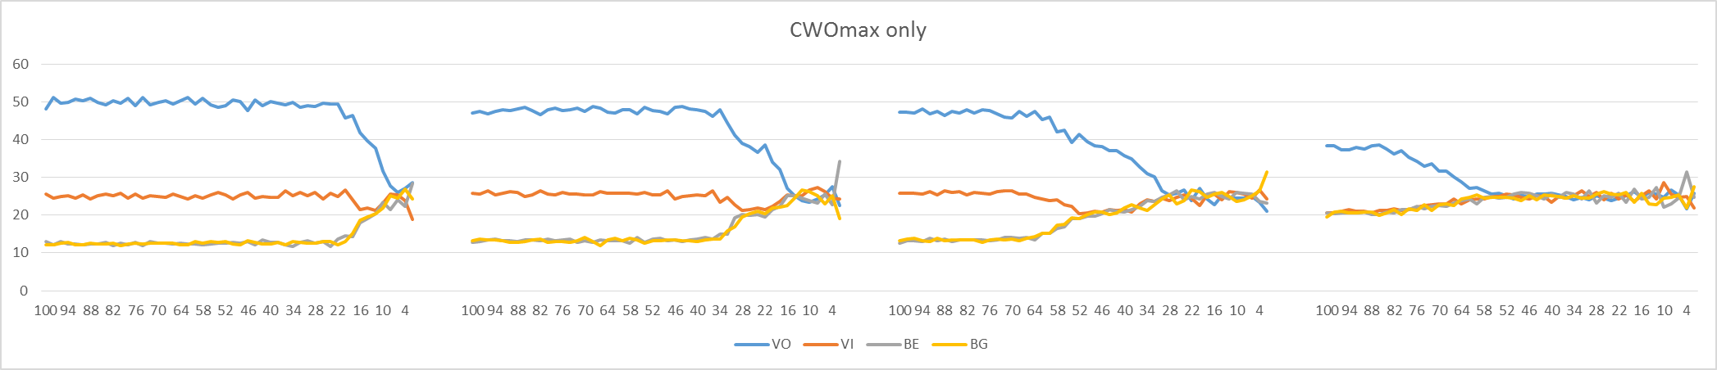
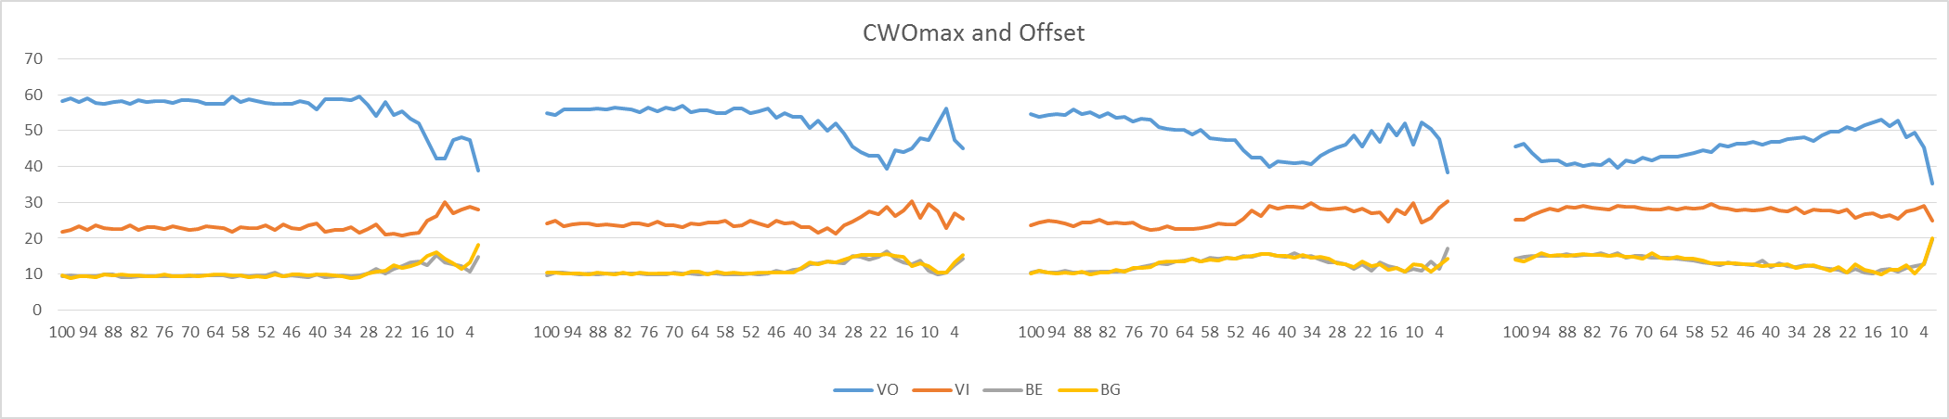
AC usage %
4RU
8RU
16RU
32RU
4RU
8RU
16RU
32RU
Offset : (0,8,32,32), CWOmax : (32,64,128,128)
4RU
8RU
16RU
32RU

Slide 24
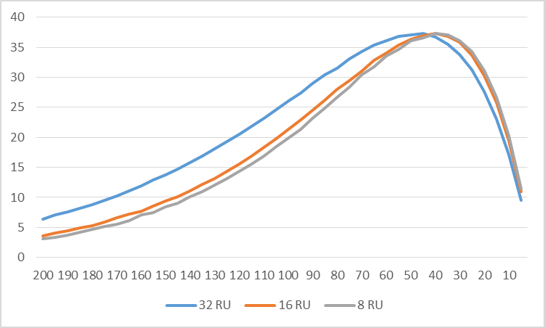
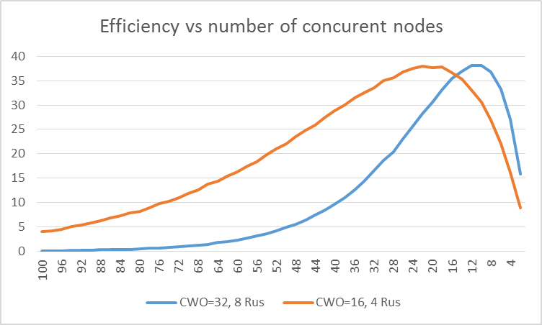
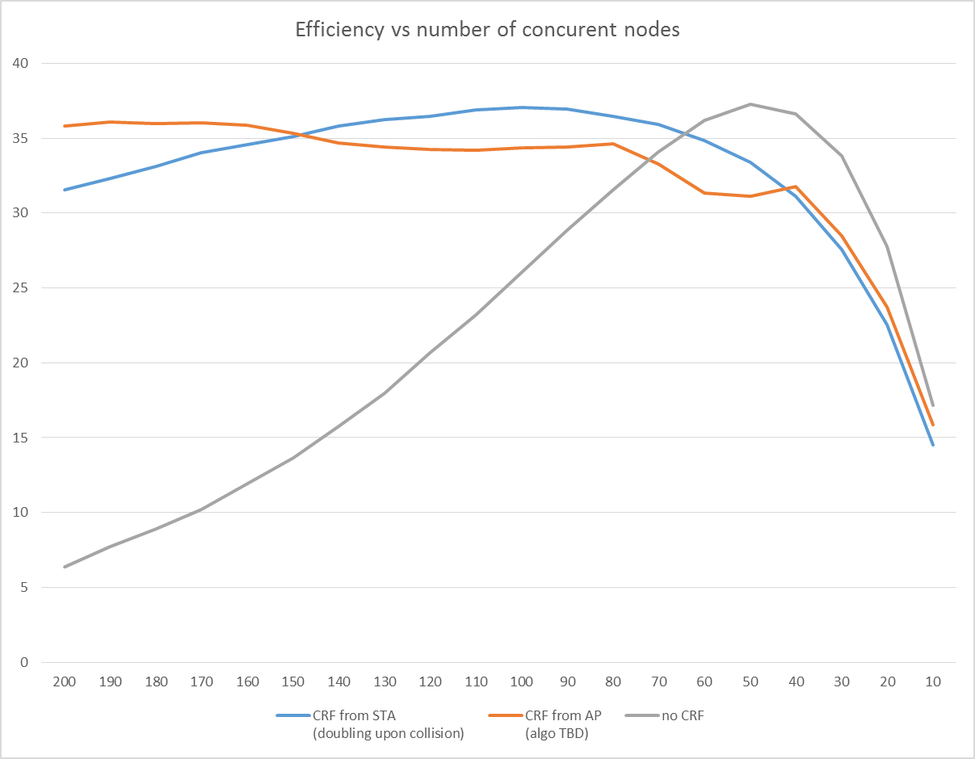
Random selection Efficiency
Cwo= 64

