Slide 1
Should IEEE 802.11 be proposed as an IMT-2020 technology?
10 Nov 2015
Authors:
Name | Company | Phone | email
Andrew Myles | Cisco | +61 2 84461010 +61 418 656587 | amyles@cisco.com

Slide 2
Does 802.11 want to join the 5G bandwagon currently being defined as IMT-2020? Discuss!
5G( IMT-2020) is progressing
IMT-2020 will extend IMT-Advanced
IMT-2020 covers many use cases
Should 802.11 be part of IMT-2020?
Industry is in the early stages of defining 5G …
… but the definition of 5G (IMT-2020) is progressing quickly under stewardship of ITU-R WP5D
IMT-2020 will cover macro cells, small cell and device to device communications
… with key parameters for IMT-2020 likely to significantly extend IMT-Advanced (4G)
Different IMT-2020 capabilities will be applied to a diversity of use cases …
… and there are a developing set of expectations for IMT-2020 capabilities for each use case
The question for today is does IEEE 802 want to submit IEEE 802.11 as part of IMT-2020?
There is no explicit proposal today, just the start of a conversation …

Slide 3
Industry is in the early stages of defining 5G (aka IMT-2020) …
A new communications “generation” has been
defined each decade since the mid 1980s
Each generation has applied new
technology to new use cases
The new capabilities
have driven market
demand
1G - 1980s
2G - 1990s
3G - 2000s
Analog
IMT-2000
4G - 2010s
IMT-Advanced
AMPS
GSM, IS-95,
IS-136
WCDMA, CDMA2000
LTE/LTE-A, 802.16m
Voice
Voice Capacity
Voice & Data
Broadband data & Video
Digital
5G - 2020s
  IMT-2020
  Technology?
  Use cases?
“5G” not yet been defined by any recognized standards body
It is likely to be more than just than greater data capacity and coverage

Slide 4
… but the definition of 5G is progressing quickly under stewardship of ITU-R WP5D

Slide 5

IMT-2020 will cover macro cells, small cell and device to device communications …
5G Radio
> 6 GHz
5G Radio
< 6 GHz
5G Radio
< 6 GHz
4G Radio
< 6 GHz
4G Radio
< 6 GHz
Small Cells
Macro Cells
Unlicensed
D2D

Slide 6
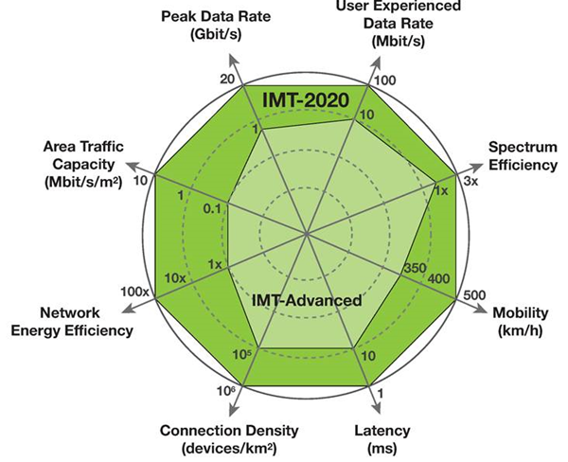
… with key parameters for IMT-2020 likely to significantly extend IMT-Advanced (4G)

Slide 7
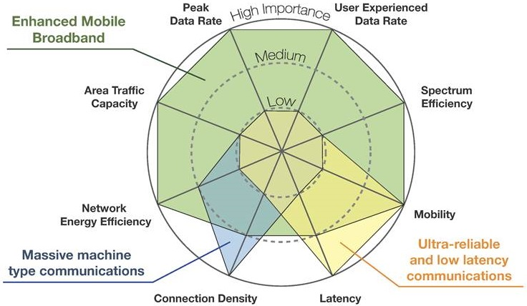
Different IMT-2020 capabilities will be applied to a diversity of use cases …

Slide 8
… and there is a developing set of expectations for IMT-2020 capabilities for each use case
Data rates
1-10Gb/s
Capacity
36TB/month/user
Spectrum
Higher frequencies with flexibility
Ultra-dense
networks
Energy
~10% of today’s consumption
Latency
~1ms
D2D capabilities
NSPS, ITS, resilience, …
Ultra-reliable networks
Reliabiity
99.999% within time budget
Coverage
Coverage
Coverage
>20dB of LTE
Battery
~10 years
Massive machines
Density
300k devices per access node
Source : ITU-R 2020 Vision Workshop Feb-12 2014 @ Vietnam, by METIS project

Slide 9
The question for today is does IEEE 802 want to submit IEEE 802.11 as part of IMT-2020?
Possible benefits of recognition as an IMT-2020 technology
  IEEE 802.11 would be internationally recognized of as part of IMT-2020
    Note: many developing countries rely on ITU Recommendations
    Counter: maybe ISO standardization is sufficient?
  IEEE 802.11 would be included in the 5G marketing hype
    Counter: maybe Wi-Fi does not need any more hype!
  IEEE 802.11 might be able to access licensed & share-licensed channels
    NOTE: May see increased use of shared-licensing as industry moves to higher frequency bands, and certain countries may require IMT-2020 compliance to deploy in these bands
    Counter: is this something that is needed or valuable?
  IEEE 802.11 could be better positioned for IoT space
    Counter: IoT positioning requires features and not more PR!

Slide 10
The question for today is does IEEE 802 want to submit IEEE 802.11 as part of IMT-2020?
Possible negatives of recognition as an IMT-2020 technology
  It will take lots of work
    Note: recognition as part of IMT-Advanced did not help IEEE 802.16, but 802.16 was a new technology, whereas IEEE 802.11 has a massive and established ecosystem
    Counter: the benefits make the effort worthwhile

Slide 11
ITU-R WP 5D already considers IEEE to be an important stakeholder, but maybe not Wi-Fi/802.11
IEEE but no Wi-Fi Alliance
But other parties are invited

Slide 12
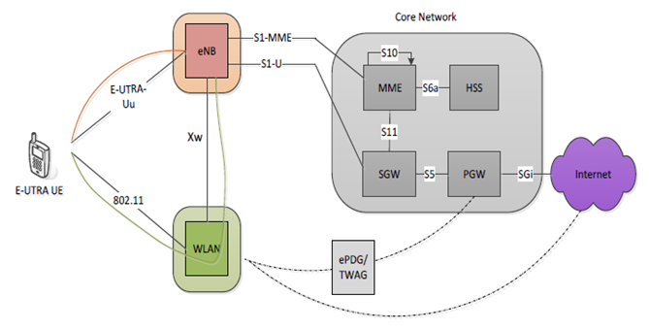
Maybe we can leverage 3GPP LWA to ensure IEEE 802.11 meets IMT-2020 requirements
  LTE-WLAN Aggregation (LWA)
  in 3GPP Rel-13 supports
  aggregation between 3GPP
  LTE & IEEE 802.11 at or
  just above the PDCP layer
  If certain “macro-type”
  IMT-2020 requirements
  cannot be met by IEEE 802.11
  then we could include LWA as an
  option in any proposal for inclusion
  of IEEE 802.11 as part of IMT-2020
  This would allow the proposal to meet the “macro type” IMT-2020 requirements through the licensed band LTE component carrier

Slide 13
There is no explicit proposal today, just the start of a conversation …
  Does anyone have more information?
  Is there any interest?
  What are the next steps?
  …

