Slide 1
Underground Location Use Cases
Date: 2015-09-14
Authors:

Slide 2
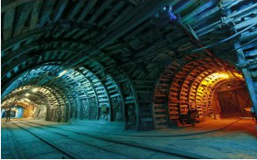
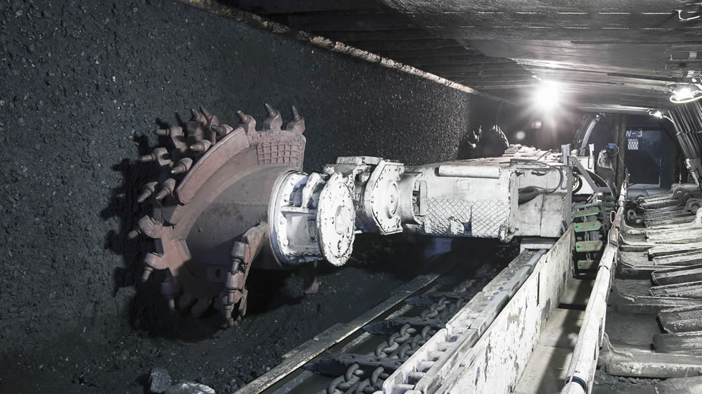
Use case 1: Location services of underground mining
User:
The mining administrator tracks the personnel and valuable assets underground.
The miners locate other personnel or equipment in the pits.
Automated vehicles are navigated to the specified position.
Mining machines use accurate under ground position information to make decision, for example, heading positioning of bucket-wheel excavator machines.
Environment: Underground mines use WiFi networks for data transmission and personnel, vehicle and asset tracking.
1 AP could cover 100~200 meters range
APs support 11n, ac, ax, ay, az
1 AP could support <50 STAs
Use case:
Mining administrator is alarmed that an underground machine is working abnormally.
Administrator locates the specific machine on the central control station
Administrator locates the engineer who is close to the machine and let him go to check.
The engineer locates the machine on the display of his handset and is guided to the position.
P2P cooperative positioning should be enabled to facilitate accurate positioning.

Slide 3
Key Performance and Attributes
Horizontal accuracy:
For personnel: <1 m@90%,
For digging/drilling heads: <0.1 m@90%
Vertical accuracy: correct layer@99% in the pits
Latency: <500ms
Refresh Rate: > 2-5 location/sec
Number of simultaneous users: < 15 depending on the size of the mine
Impact on Network Bandwidth: < 3 additional frames per device/location

Slide 4
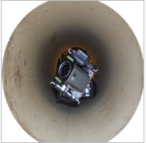
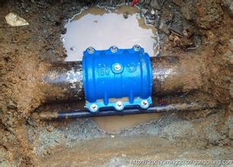
Use case 2: Pipe/Vault Robot Positioning
In China, the length of water supply pipes in cities have reached 500,000 kilometers. If we consider the pipe length of all municipal facilities, it will reach 1,800,000 kilometers.
It is challenging to periodically, manually check the status of these pipes.
Pipe/vault robot could be used to detect leakage/breakage/damages of pipes. The positioning technology is one of the key technologies in the design of pipe robot.
Notes:
极低频管内机器人
http://wenku.baidu.com/link?url=NDDXZ4b7mSFuEBqn1YFzOIYaY1NNG0jk23V2Vb2Bf_5swmAI4DHHsvfI2KwNMRWaudpFcSx4Lo_JsIzpQ_p7_eui69Lw1M8JbpLMjwchKLy
Dead reckoning – accumulated error is unneglectable
Ultra-low-frequency – rely on sensitive receiver on the ground

Slide 5
Pipe/Vault Robot Positioning
User: companies which maintain the pipes
Environment: Pipe/vault is equipped with WiFi enabled sensors or APs. Pipe robots work in the pipes.
1 AP per < 10 users
Use case:
Pipe /vault robots go through the pipe to detect leakage or breakage. It may carry cameras and sensors to record the status of pipes and the environmental conditions.
When the robot detects a leakage or breakage point, it needs to locate the position and report the location to the AP directly or through wifi enabled sensors.
The robots may need to exchange location information to facilitate positioning when APs or sensors are out of range.
Positioning requirements:
Horizontal accuracy: < 0.1m @ 90%
Vertical accuracy: NA
Latency: < 500ms
Refresh rate: > 1 location/sec
Expected number of simultaneous users: < 10 (within AP coverage area)
Impact on Network Bandwidth: very low

Slide 6
Straw Poll
Do you agree to add the following use cases to the 802.11az working draft?
Use case “Location services for underground mining ” and “pipe/vault robot positioning”
Y: N: A:

Slide 7
Motion
To instruct the use case document editor to add use cases depicted by slides 2, 5 of submission 1159r1 to the use case working draft document.
Move:
2nd:
Y: N: A:

